Slide 1



KONGU ENGINEERING COLLEGE
DEPARTMENT OF AI&DS
HCL PROJECT
AGRICULTURE ADVISORY CHATBOT USING
LARGE LANGUAGE MODEL (LLaMA)
Project Members:
ALMAS J(24ADR008)
BARATHVAJ D(24ADR014)
BHARANI K(24ADR016)
Notes:
8 September 2023
1-59
1

Slide 2


PROBLEM STATEMENT
Farmers often lack instant agricultural guidance.
Expert support is not always easily available.
Crop-related doubts remain unresolved for long periods.
Traditional advisory methods are time-consuming.
A simple text-based AI solution is needed.
Notes:
2

Slide 3
LITERATURE SURVEY
JOURNEL | YEAR | DESCRIPTION | METHODOLOGY | LIMITATIONS
Traditional Advisory Systems | 2015 | Provides fixed agricultural guidelines based on predefined rules | Rule-Based Systems | Not interactive, lacks flexibility
NLP Chatbots | 2018 | Enables basic text interaction with users | Natural Language Processing | Limited understandings of complex queries
Plant Disease Detection | 2020 | Detects plant diseases using images | CNN(Deep Learning) | Works only for images, no text support
AI Chatbots | 2022 | Provides improved responses using trained models | Machine Learning | Limited contextual understanding
LLM-Based Systems | 2023 | Understands user queries and generates intelligent responses | Large Language Models(LLM) | Requires high computational resources
Notes:
2

Slide 4
RESEARCH GAP
Most systems are not interactive enough for farmers.
Many platforms do not provide conversational support.
Existing chatbots lack contextual understanding.
Real-time text-based agricultural advice is limited.
Low-cost AI advisory tools are still insufficient.

Slide 5
OBJECTIVE
To develop a text-based agricultural chatbot.
To provide instant advisory support for farmers.
To answer farming queries using AI.
To improve access to agricultural knowledge.
To create a simple and user-friendly system.
Notes:
2

Slide 6
PROPOSED WORK
Build a chatbot using LLaMA through Ollama.
Accept farmer queries in text format.
Process user input using the language model.
Generate meaningful agricultural suggestions.
Display responses through a chat interface.
Notes:
2

Slide 7
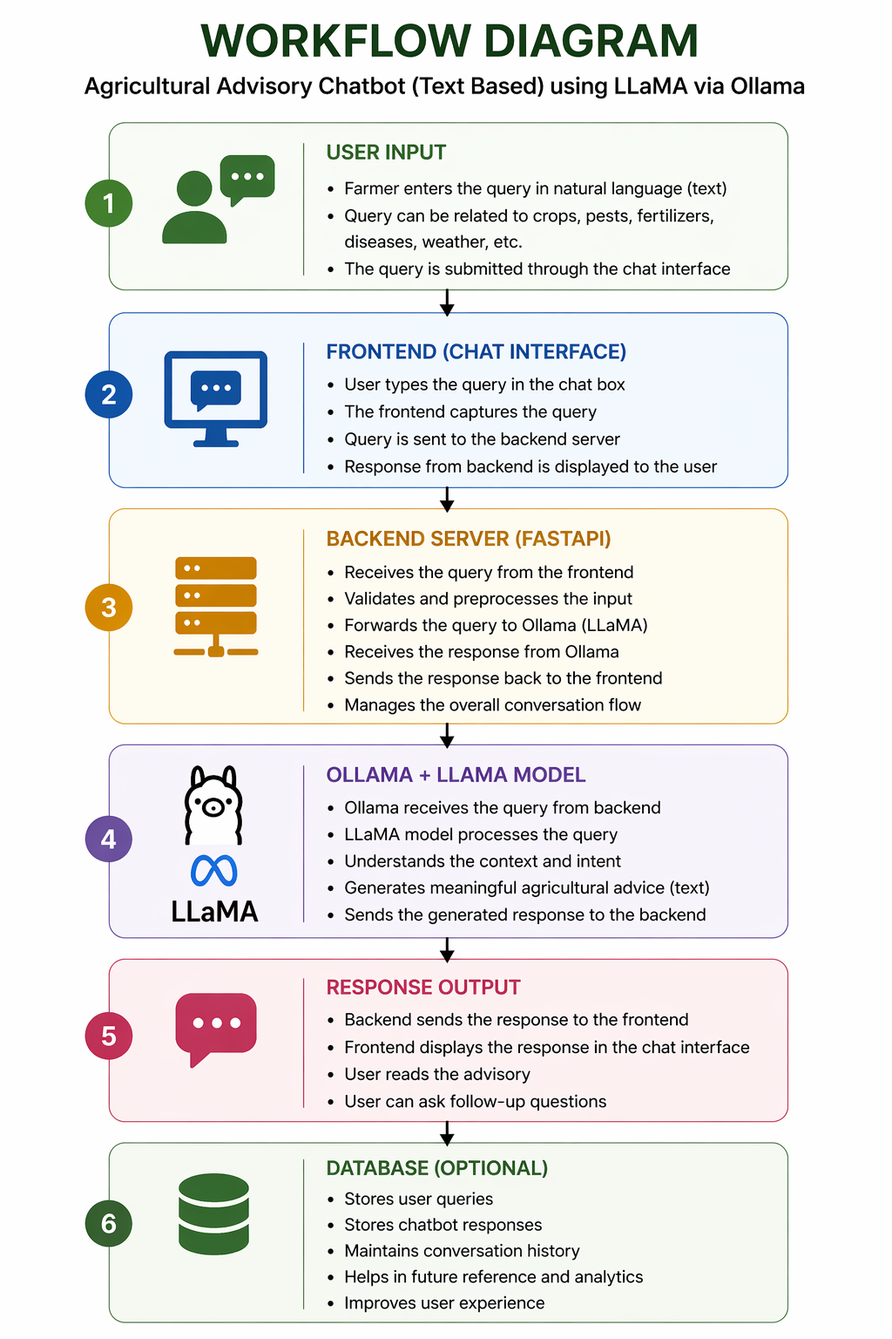
WORKFLOW DIAGRAM
Notes:
2

Slide 8
HARDWARE/SOTWARE
REQUIREMENTS
Minimum 8 GB RAM system.
Python for backend development.
FastAPI for API integration.
React.js for frontend interface.
Ollama to run the LLaMA model locally.
Notes:
2

Slide 9
MODULES
User interface module for text input and output.
Backend module for handling requests.
AI module for processing queries using LLaMA.
Response module for generating advisory replies.
Database module for storing chat history if needed.
Notes:
2

Slide 10
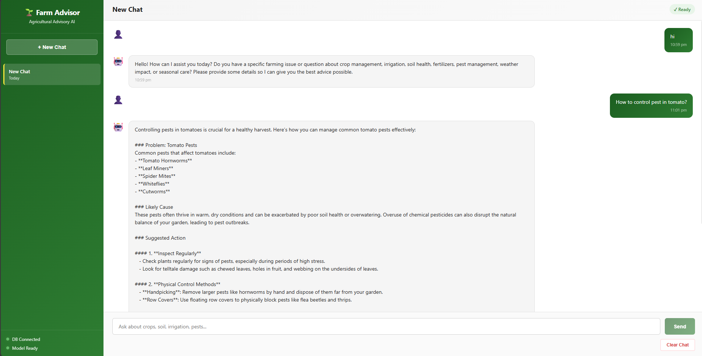
SCREENSHOTS
Notes:
2

Slide 11
.
RESULT ACHIEVED
Developed an AI-based agricultural chatbot using LLaMA.
Provides instant farming guidance to farmers.
Integrated Ollama, FastAPI, and React.js successfully.
Created a simple and user-friendly system.
Notes:
2

Slide 12
CONCLUSION
The Agriculture Advisory Chatbot using LLaMA provides instant and intelligent agricultural guidance for farmers through real-time AI-based conversations. By integrating Ollama, FastAPI, and React.js, the system delivers simple, fast, and user-friendly farming support. Overall, it is a cost-effective and scalable solution for improving digital agricultural assistance.
Notes:
2

Slide 13
REFERENCE
MetaAI(2023) LLaMA: Open and Efficient Foundation Language Models Available: https://ai.meta.com/llama/
Ollama Documentation Running Large Language Models Locally Available: https://ollama.com/
FastAPI Documentation FastAPI Framework for Building APIs Available: https://fastapi.tiangolo.com/
React.js Documentation Frontend Library for Building User Interfaces Available: https://react.dev/
Agricultural Knowledge Source Food and Agriculture Organization (FAO) Available: https://www.fao.org/
Notes:
2

Slide 14
Thank You
Notes:
2

