Slide 1
Spring Boot & WebSocket
Present by MingIn Wu

Slide 2
Outline
Spring Boot
Introduction
Spring Boot Quick Start
Spring Boot External Tomcat plugin
Spring Boot JSP plugin
Spring Boot MySQL & JDBC plugin
Spring Boot Builder Profile
Spring Boot Log4j Plugin
Spring Boot Security
Spring Boot WebSocket
Introduction
WebSocket
Server Side (Spring )
Client Side (javascript & java)
WebSocket + SockJS
Server Side (Spring)
Client Side (SockJS)
STOMP + WebSocket + SockJS
Server Side (Spring)
Client Side (STOMP)
Use Case Sequence Diagrams

Slide 3
Spring Boot Introduction
Primary Goal :
Provide a faster and accessible getting started experience for all Spring development.
Be opinionated out of the box, but get out of the way quickly as requirements start to diverge from the defaults.
Provide a range of non-functional features that are common to large classes of projects.
(e.g. embedded servers, security, scalability ).
Absolutely no code generation and no requirement for XML configuration.
System Requirements:
Java 7+
Tomcat 7+ or glassfish 4+
Spring Framework 4.1.5+
Notes:
1. 提供更快和方便入門體驗所有的Spring開發。
2. 希望能跳開種種限制，卻走不出的方式達到迅速開始的要求。
3. 提供一系列的非功能特性的常用大類的項目。（例如嵌入式服務器，安全性，可擴展性）。
4. 沒有代碼產生和XML配置要求。

Slide 4
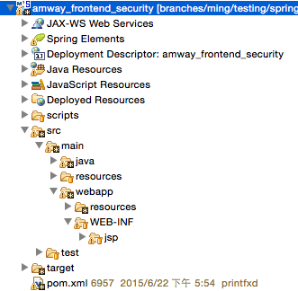
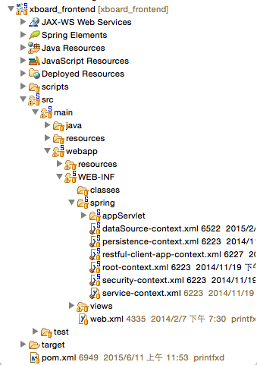
Different between Spring Boot and Spring 3
No requirement for XML configuration:
Spring Boot
Spring 3.x

Slide 5
Spring Boot Quick Start

Slide 6
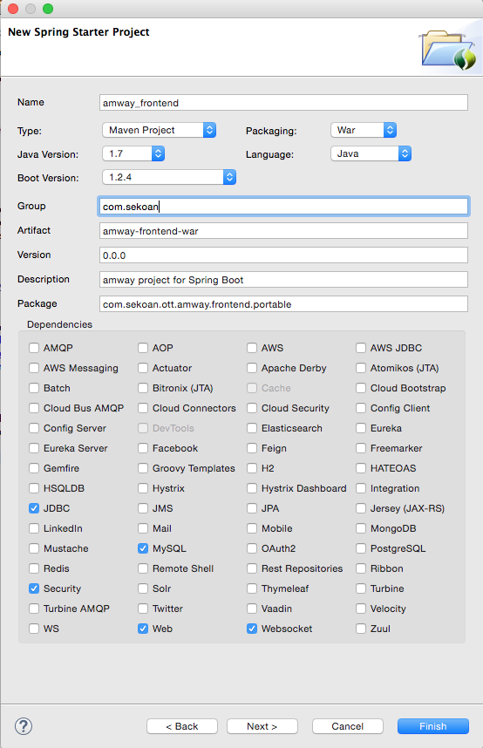
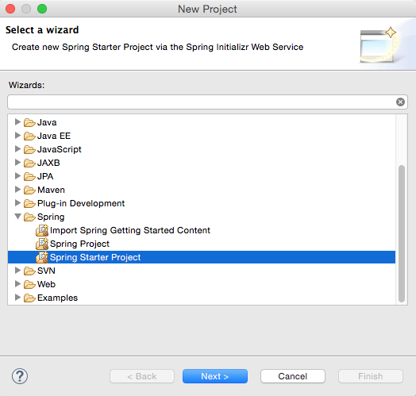
Spring Boot Quick Start (1/3)
1. Create Spring Starter Project guide :

Slide 7
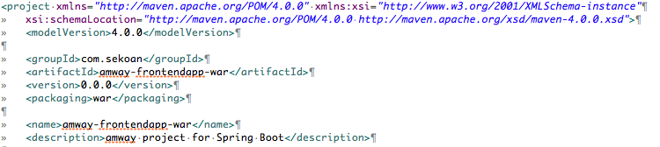
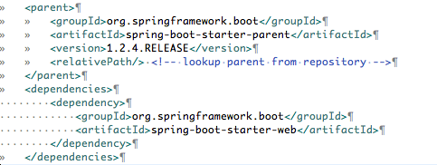
Spring Boot Quick Start (2/3)
2. pom.xml setting :
2-1. Packaging executable jar and war files :
2-2. Use Spring-boot-starter-parent to manage dependencies setting.

Slide 8
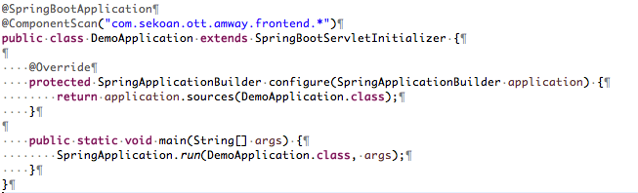
Spring Boot Quick Start (3/3)
3. Project Configuration :
Spring Boot applications need very little Spring configuration.
1. @SpringBootApplication
2. @ComponentScan
3. extends SpringBootServletInitializer

Slide 9
Spring Boot External Tomcat plugin

Slide 10
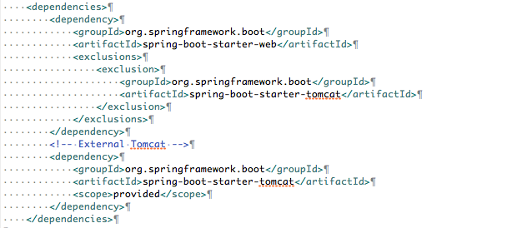
Spring Boot External Tomcat plugin
pom.xml setting :
To build a war file that is both executable and deployable into an external container you need to mark the embedded container dependencies as “provided”.

Slide 11
Spring Boot JSP plugin

Slide 12
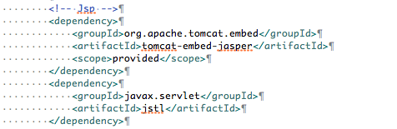
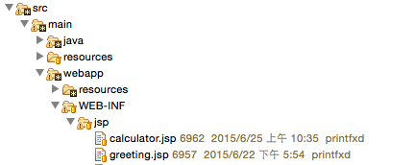

Spring Boot JSP plugin
pom.xml setting :
JSP files path :
Set property in the ‘application.properties’

Slide 13
Spring Boot mySQL & JDBC plugin

Slide 14
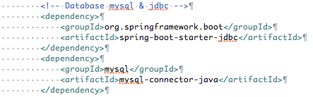
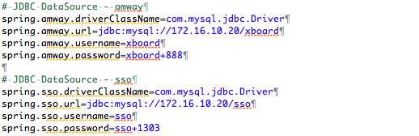
Spring Boot mySQL & JDBC plugin (1/4)
1. pom.xml setting :
2. Set property into the ‘application.properties’

Slide 15
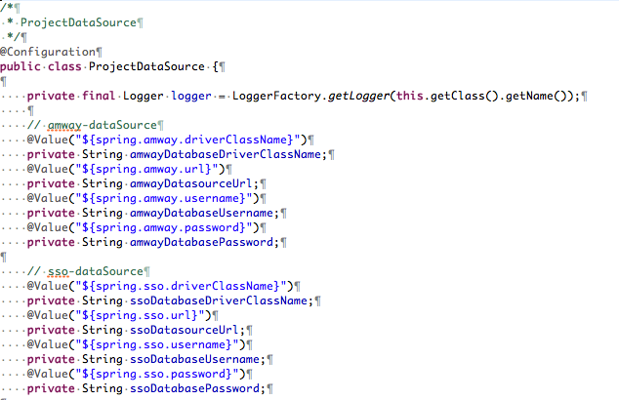
Spring Boot mySQL & JDBC plugin (2/4)
3. Create class ProjectDataSource to replace ‘dataSource-context.xml ‘:
3-1. Set two pair properties to the data source

Slide 16
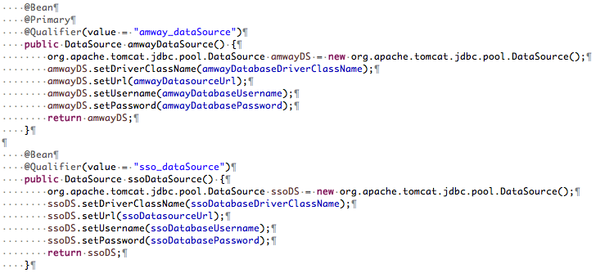

Spring Boot mySQL & JDBC plugin (3/4)
3. Create class ProjectDataSource to replace ‘dataSource-context.xml’ :
3-2. Create two bean classes ‘amway_dataSource’ & ‘sso_dataSource’.
3-3. Create "sqlLoader" class which is load SQL commands from ‘sql.properties’.

Slide 17
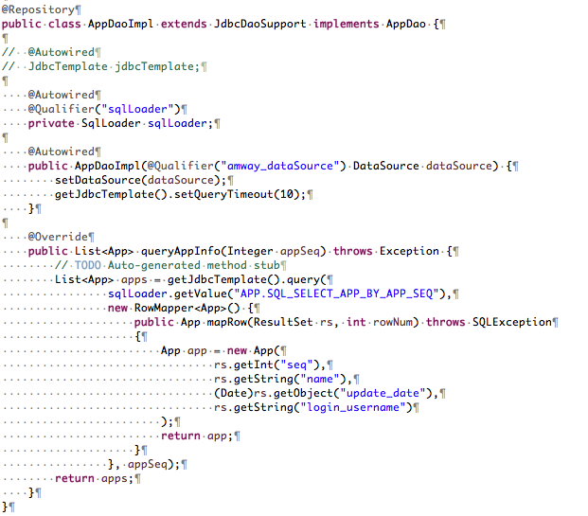
Spring Boot mySQL & JDBC plugin (4/4)
4. Implement interface AppDao and extends by JdbcDaoSupport.

Slide 18
Spring Boot Builder Profile

Slide 19
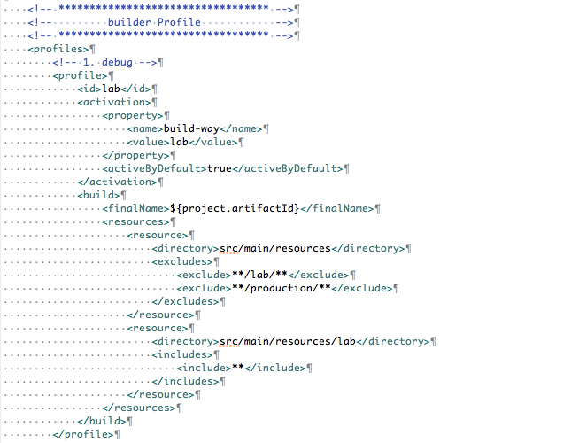
Spring Boot Builder Profile
pom.xml setting :
It's the same configuration as other projects (like xBoard .... etc).

Slide 20
Spring Boot Log4j Plugin

Slide 21
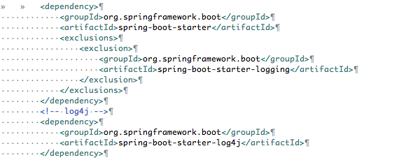
Spring Boot Log4j Plugin (1/2)
pom.xml setting :

Slide 22
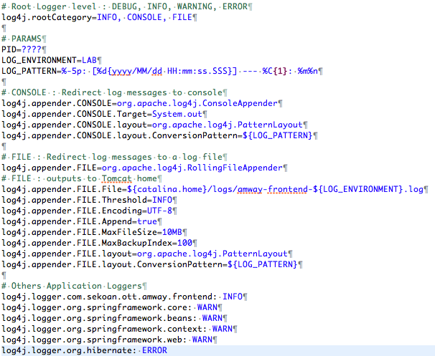
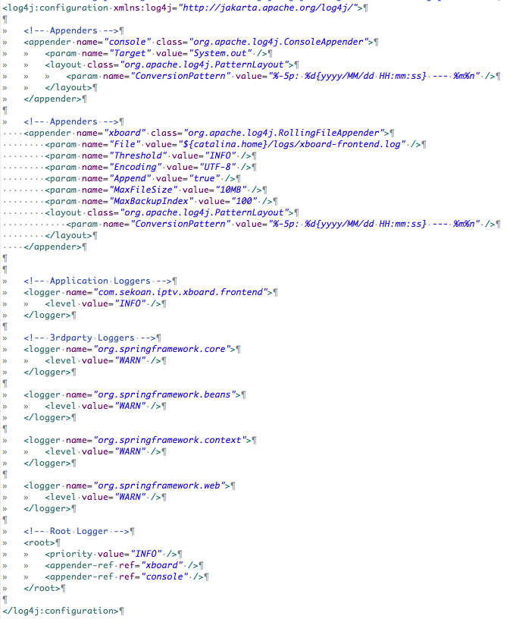
Spring Boot Log4j Plugin (2/2)
comparing log4j.properties with log4j.xml
log4j.properties
log4j.xml

Slide 23
Spring Boot Security

Slide 24

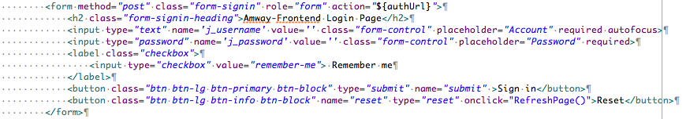
Spring Boot Security (1/5)
pom.xml setting :
System Login form :

Slide 25
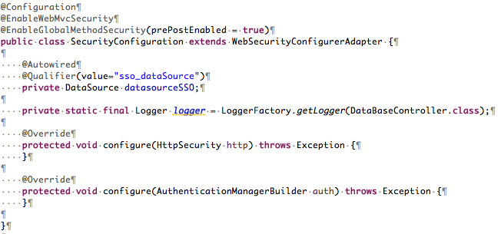
Spring Boot Security (2/5)
Security Configuration :
1. SecurityConfiguration config

Slide 26
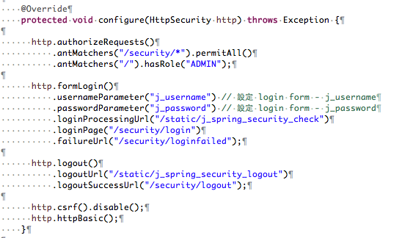
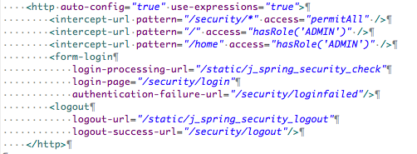
Spring Boot Security (3/5)
Security Configuration :
2. Comparing the HttpSecurity setting:
SecurityConfiguration class
security-context.xml

Slide 27
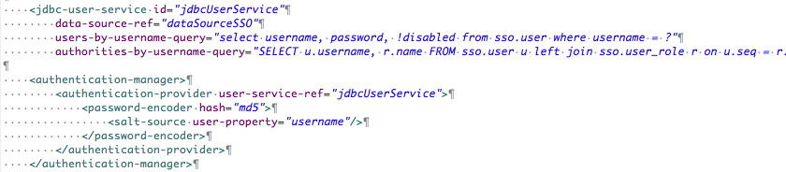
Spring Boot Security (4/5)
Security Configuration :
3-1. Comparing the authentication-manager & jdbc-user-service setting:
security-context.xml
Step1. Setting up JdbcUserDetailsManager.
Step2. Setting up Md5PasswordEncoder & ReflectionSaltSource.
Step3. Md5PasswordEncoder & ReflectionSaltSource put in the DaoAuthenticationProvider.
Step4. DaoAuthenticationProvider put in the AuthenticationManagerBuilder.
Step1
Step3&4
Step2

Slide 28
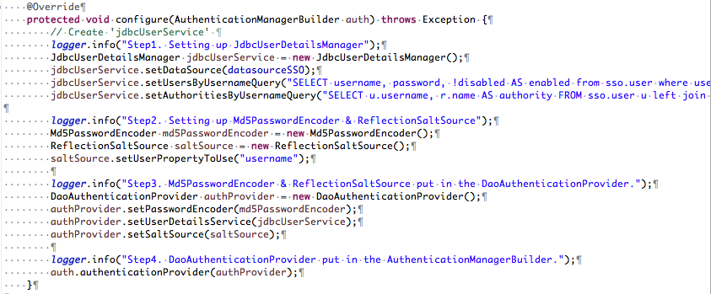
Spring Boot Security (5/5)
Security Configuration :
3-2. Comparing the authentication-manager & jdbc-user-service setting:
SecurityConfiguration class
Step1
Step2
Step3
Step4

Slide 29
Spring Boot WebSocket

Slide 30
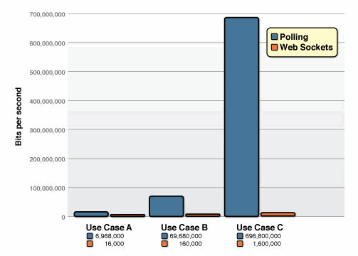
Spring Boot WebSocket Introduction (1/3)
Polling vs WebSocket :
1. Comparison of the unnecessary network throughput overhead between the polling and the WebSocket applications.

Slide 31
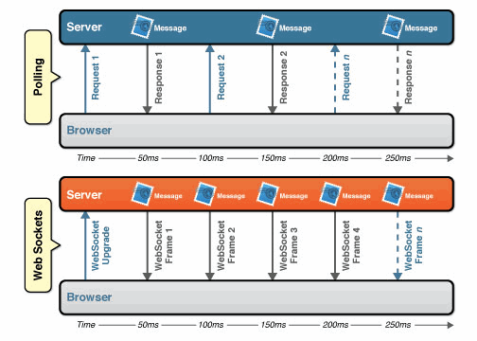
Spring Boot WebSocket Introduction (2/3)
Polling vs WebSocket :
2. Comparison between the polling and WebSocket applications.

Slide 32
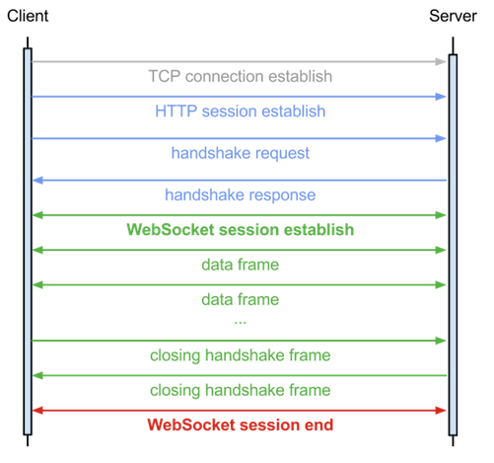
Spring Boot WebSocket Introduction (3/3)
WebSocket Protocol :
WebSocket is an extension to HTTP and enables streaming of data.

Slide 33
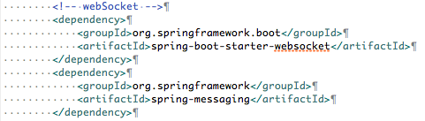
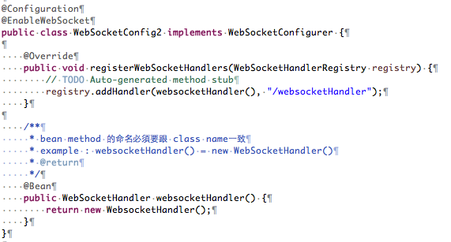
Spring Boot WebSocket Example (1/5)
Server Side (Spring) :
1. pom.xml setting :
2. Configuration (simple) :

Slide 34
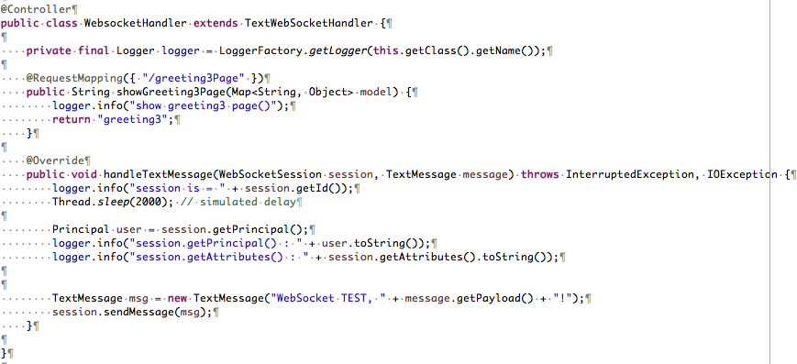
Spring Boot WebSocket Example (2/5)
Server Side (Spring) :
4. GreetingHandler :
extends TextWebSocketHandler class.
Greeting Handler class can mix with @Controller and @RequestMapping.

Slide 35
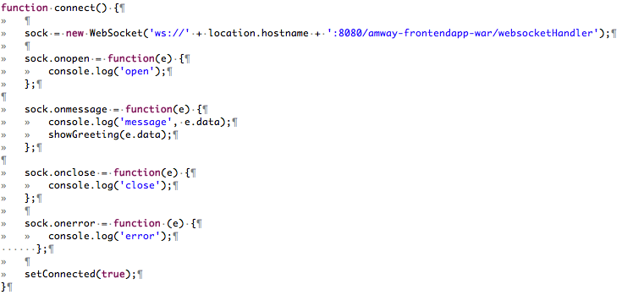
Spring Boot WebSocket Example (3/5)
Client Side (javascript) :
1. connect()

Slide 36
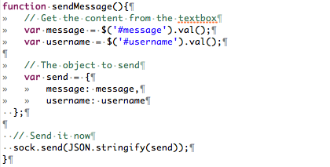
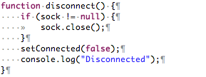
Spring Boot WebSocket Example (4/5)
Client Side (javascript) :
2. sendMessage()
3. disconnect()

Slide 37
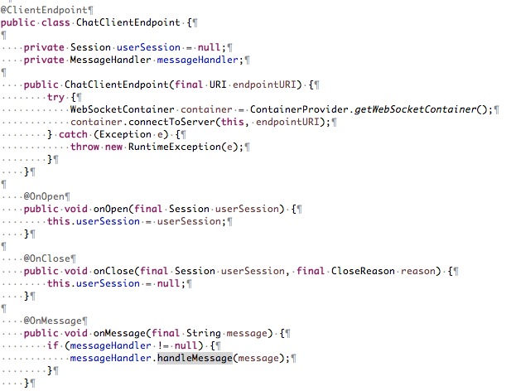
Spring Boot WebSocket Example (5/5)
Client Side (java) :
1. Create ChatClientEndpoint class
2. call

Slide 38
Spring Boot WebSocket & SockJS

Slide 39
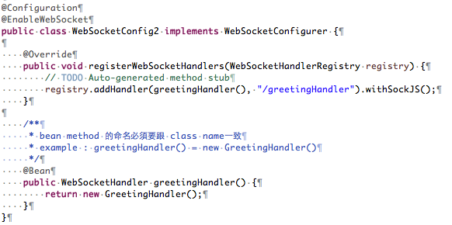
Spring Boot WebSocket & SockJS Example (1/6)
Spring Server Side :
1. pom.xml setting :
2. Configuration (simple) :

Slide 40
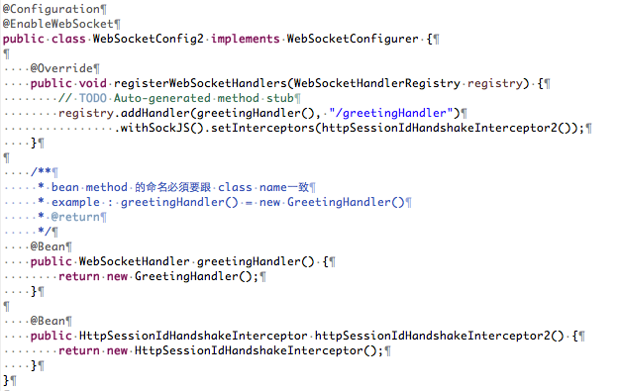
Spring Boot WebSocket & SockJS Example (2/6)
Spring Server Side :
3-1. Configuration (websocket session handshake) :
We can capture the http session for a websocket request.
The reason was to determine the number of websocket sessions utilizing the same underlying http session.

Slide 41
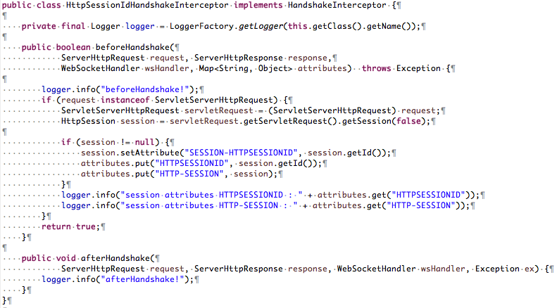
Spring Boot WebSocket & SockJS Example (3/6)
Spring Server Side :
3-2. HttpSession Handshake Interceptor :
beforeHandshake()
afterHandshake()

Slide 42
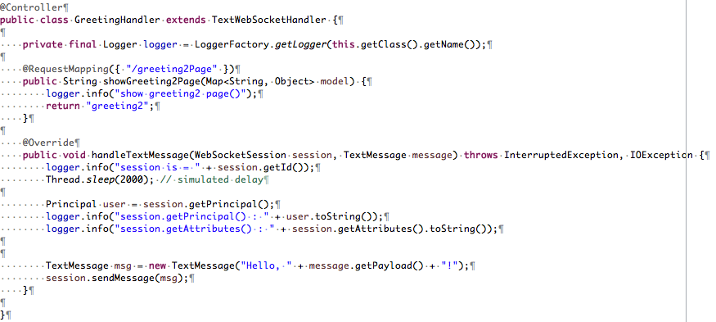
Spring Boot WebSocket & SockJS Example (4/6)
Spring Server Side :
4. GreetingHandler :
extends TextWebSocketHandler class.
Greeting Handler class can mix with @Controller and @RequestMapping.

Slide 43
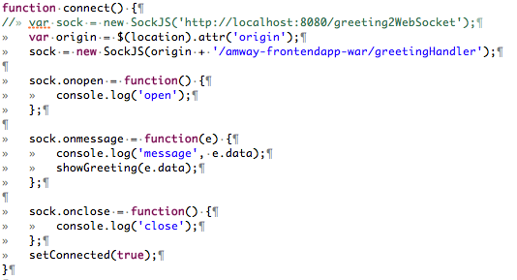
Spring Boot WebSocket & SockJS Example (5/6)
SockJS client side :
1. SockJS – connect()

Slide 44
Spring Boot WebSocket & SockJS Example (6/6)
SockJS client side :
2. SockJS – sendMessage()
3. SockJS – disconnect()

Slide 45
Spring Boot WebSocket & STOMP

Slide 46
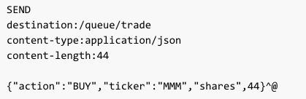
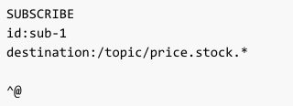
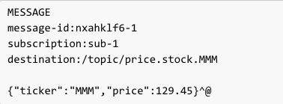
Spring Boot WebSocket & STOMP Example (1/6)
STOMP :
STOMP is a simple text-oriented messaging protocol that was originally created for scripting languages to connect to enterprise message brokers.
STOMP is a frame based protocol with frames modeled on HTTP.
STOMP uses different commands like connect, send, subscribe, disconnect etc to communicate.
Command : SEND format (client) Command : SUBSCRIBE format (client)
Command : MESSAGE format (server) - broadcast messages to all subscribers.
Command
Command
Header
Header
Body
Body
Command
Header
Body
Notes:
1. STOMP是最初創建的腳本語言來連接到企業信息經紀人簡單的文本為導向的消息傳遞協議。
2. STOMP是仿照HTTP幀一幀的基礎協議。
3. STOMP使用不同的命令狀連接，發送，訂閱，斷開等進行溝通。

Slide 47

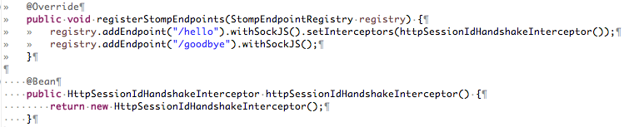
Spring Boot WebSocket & STOMP Example (2/6)
Spring Server Side :
1. Configuration (stomp) :
extends AbstractWebSocketMessageBrokerConfigurer
Configure message broker options.
Configure STOMP over WebSocket end-points.

Slide 48
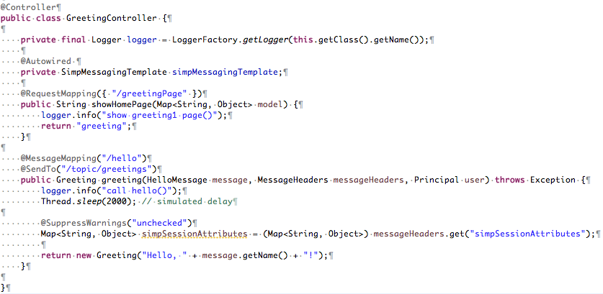
Spring Boot WebSocket & STOMP Example (3/6)
Spring Server Side :
1. Configuration (stomp) :
GreetingController class can mix with @Controller and @RequestMapping.
@MessageMapping
@SendTo

Slide 49
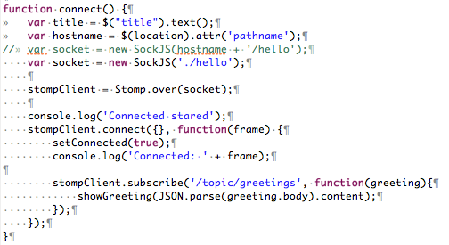
Spring Boot WebSocket & STOMP Example (4/6)
STOMP client side :
1. STOMP + SockJS – connect()
1-1 Create a socket object by SockJS.
1-2 Set StompClient to control the socket.
1-3 Implement stomp client subscribe function.

Slide 50

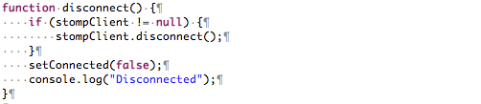
Spring Boot WebSocket & STOMP Example (5/6)
STOMP client side :
2. STOMP + SockJS – sendMessage()
3. STOMP + SockJS – disconnect()

Slide 51


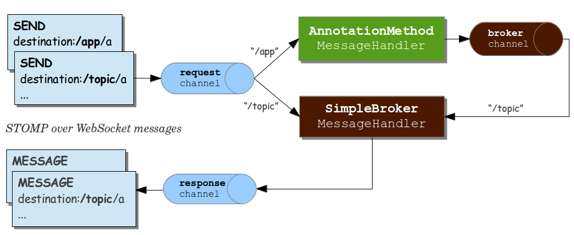
Spring Boot WebSocket & STOMP Example (6/6)
Spring - STOMP Architecture :
AbstractWebSocketMessageBrokerConfigurer setting :
Send request /app/hello
Client send message
Send request /topic/greeting
Send response /topic/greeting
Client subscribe /topic/greeting

Slide 52
Use Case Sequence Diagrams

Slide 53
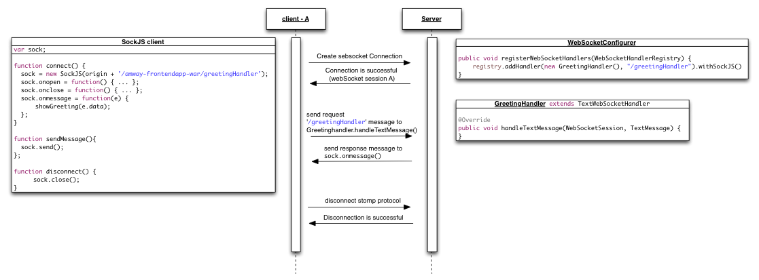
Case1. WebSocket + socJS
Build B2B WebSocket connection between client & server.

Slide 54
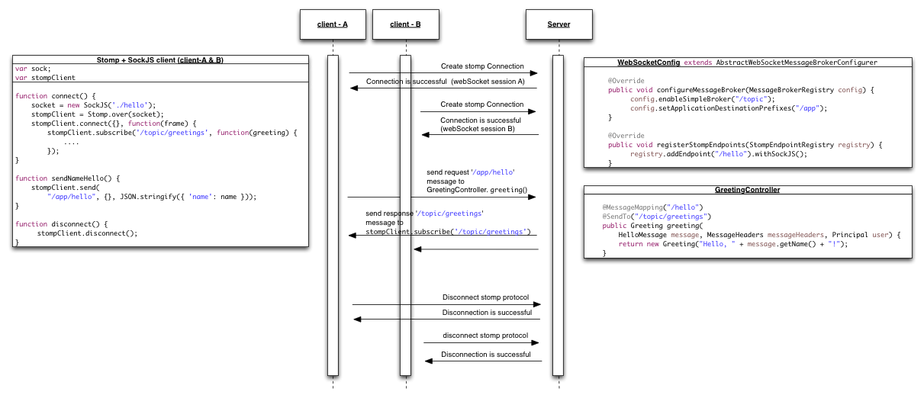
Case2. WebSocket + STOMP - 1
Server Use @SendTo() send message to all of subscriber client.

Slide 55

Case3. WebSocket & STOMP - 2
Server Use @SendToUser() send message to for the specified subscriber client.

Slide 56

Case4. WebSocket & STOMP - 3
Remove enableSimpleBroker() & setApplicationDestinationPrefixes() setting within WebSocketConfig.

Slide 57
End

