Slide 1

NeuroRedTeam: Attack and Repair Testing of a Real Fly Brain
How fragile is a brain's behaviour, and how do you fix it?
Theme: Artificial Intelligence, Neural Networks and Computational Neuroscience
Team: Govind | Bharath | Dhanush A | Shreenidhi Chalmi

Slide 2
Experiential Learning – outline of tentative steps / methodology adopted (or to be adopted)

Slide 3
EL Phase-I
Presentation Outline
Introduction
Literature Review
Problem Definition
Objectives
Methodology
Proposed Outcomes
Timeline of the project
Conclusion
References

Slide 4
Introduction
The starting point: In October 2024 scientists finished mapping every neuron and every connection in a fruit fly's brain: 139,255 neurons, 15 million connections, released free. It is the first complete wiring diagram of an animal that can walk, fly, see and learn. A follow-up paper showed the whole map can be run on a normal laptop and it behaves like a real fly.
What we already have running: we reproduced that simulation on our laptop. Give the simulated fly sugar and its feeding neuron fires; give it random input and nothing happens. Cut 3 specific neurons out of 139,255 and feeding stops; cut 10 random ones and nothing changes (slides 10 and 11).
The question we ask: that 3-neuron result was found by hand, for one behaviour. Nobody knows, for the brain as a whole, how few targeted changes it takes to break a behaviour, or how few it takes to repair it. We treat the brain like a system under security testing: one AI attacks, one AI repairs, and we record the results for every behaviour we can measure.
Why it matters: it tells neuroscientists which circuits are fragile and which are protected, it is a first step toward designing repair stimulation (the logic behind deep brain stimulation) on a complete brain, and every result is a prediction a real fly lab can test.

Slide 5
Literature Review
The map and the simulation:
Dorkenwald et al. (2024, Nature): the complete fly brain connectome (FlyWire).
Shiu et al. (2024, Nature): ran the whole map with simple spiking neurons on a laptop and correctly predicted feeding, grooming and more. We reproduced this.
Perturbing the brain model (the closest prior work):
Shiu et al. (2024) and a bioRxiv preprint (Dec 2025): silenced hand-picked neurons in the same model to test specific ideas; the 2025 work ran combinatorial silencing of two inhibitors and found feeding suppression is redundant. Manual, one circuit, no search for minimal sets, no repair.
Pospisil et al. (2024, Nature, the effectome): a linear model of the whole fly brain that predicts what perturbing one neuron does to others.
Yan et al. (2017, Nature): control theory on the 302-neuron worm to find the minimal driver neurons for movement; one prediction was confirmed by laser ablation in real worms. Worm only, linear maths, no behaviour simulation, no repair.
AI agents that run experiments: exist for chemistry, materials science and quantum physics (2025 to 2026). For the fly brain only single-command tools exist (type "give sugar", get one run). No agent chooses its own experiments on a brain.
Gap (as far as we could find): no automated search of a whole-brain behavioural simulation for the smallest change that breaks a behaviour, no automated design of the smallest stimulation that repairs it, and no table of how fragile each fly behaviour is.

Slide 6
Problem Definition
The problem: we have every wire in a brain, but we do not know how fragile its behaviours are. Prior work silenced a few hand-picked neurons at a time. There is no systematic answer to: how few targeted changes can hijack a behaviour, which neurons are the weak points, and what is the smallest intervention that restores normal function.
Why it matters if left unanswered: neuroscientists cannot tell which circuits are protected by redundancy and which are single points of failure; nobody can design repair stimulation on a complete brain; and the mouse and human brain maps now being built will hit the same gap with far larger networks.
Problem statement: Build a laptop platform that runs the complete fruit-fly connectome as a spiking neural network with measurable behaviours (eat, refuse bitter, groom, escape). On it, build an attacker agent that finds the minimal constrained set of perturbations that forces or blocks a behaviour, and a defender agent that finds the minimal stimulation that restores it. Produce a fragility atlas of fly behaviours and a benchmark comparing random search, greedy search and LLM agents on this task.

Slide 7
Objectives
Main objective: measure, for a complete real brain, how easy each behaviour is to break and how easy it is to repair, using two AI agents that play attacker and defender.
Specific objectives:
Platform: fast simulator of all 139,255 neurons (stimulate, record, cut, weaken, inject), a name table for neurons, and four measurable behaviours reproduced from the 2024 Nature paper.
Attack rules: a written attack surface so the problem is not trivial: no touching motor neurons, only silence, weaken or inject at realistic rates, with a budget.
Attacker agent: finds the smallest set of allowed changes that forces a behaviour (eat with no sugar), blocks it (no eating with sugar) or corrupts it (eat bitter). Three versions: random, greedy, LLM with tools.
Defender agent: given the attacked brain, finds the smallest set of neurons to stimulate that restores the behaviour, and proves it did not simply force it (must work with sugar and stay quiet without).
Fragility atlas and benchmark: for each behaviour: minimal attack size, minimal repair size, key neurons, redundancy; plus how many simulations each method needed.
Virtual fly and dashboard: a 2-D fly driven by the brain and one web page: press Attack, watch neurons turn red and the fly stop eating; press Defend, watch it eat again.
What we believe is new (to the best of our literature search): the automated search for minimal attacks, the repair agent, and the fragility atlas. The simulator and virtual fly are our platform, reproduced from published work, and we do not claim them as new.

Slide 8
Methodology
Design: simulation experiments with controls. Every attack and repair is repeated over several random seeds; results are checked against the neurons named in published papers.
Data: public FlyWire v783 connectome (neurons, synapse counts, excitatory or inhibitory sign, cell-type labels). No data collected from people or animals.
Behaviours as numbers: eat = feeding neuron MN9 above 60 Hz with sugar; refuse = MN9 below 15 Hz with sugar plus bitter; groom and escape read from their descending neurons. Each is a pass or fail test the agents must satisfy.
How an agent works: it is a decision loop with tools: look up who connects to whom, run the brain with chosen changes, read the result, choose the next experiment, stop at the goal. The rules are enforced in code, so the agent cannot cheat. Random and greedy versions use the same tools without an LLM, so we can measure whether the LLM is actually better.
Speed: 300 ms runs on the sub-network reachable from the stimulus, about 1 to 2 s each, with caching. An agent run of 30 experiments takes about a minute; the full atlas runs overnight.
Tools: Python, NumPy and SciPy sparse, NetworkX, Claude or OpenAI API for the agents, pygame for the fly, FastAPI and a web page for the dashboard. Laptop only.
Team: simulator speed-ups and virtual fly (Govind); name table, behaviours and validation (Bharath); attacker agent (Dhanush); attack rules, defender, benchmark scoring and dashboard (Shreenidhi).

Slide 9
Methodology
1. Load the brain
FlyWire data: 139,255 neurons,
15 M connections (done)
2. Simulator
spiking neurons; stimulate,
record, cut, weaken, inject (done)
3. Behaviours + rules
eat, refuse bitter, groom, escape
as pass/fail tests; attack rules
4. Atlas + dashboard
fragility atlas, benchmark,
Attack / Defend buttons, paper
How each agent works (attacker and defender run the same loop with opposite goals):
Choose experiment
look up wiring, pick neurons
to cut, weaken, inject or bias
Run the brain
300 ms simulation with
the chosen changes
Check behaviour
MN9 > 60 Hz with sugar
and < 10 Hz without
Goal met?
if not, use the result to
pick the next one (budget 30)
Record answer
smallest set, neurons,
simulations used
Attacker goal: break the behaviour with the fewest allowed changes (no motor neurons, realistic rates). Defender goal: with the attack still in place, restore the behaviour with the fewest stimulated neurons, and it must stay quiet without sugar. Three versions of each agent share this loop: random choice, greedy ranking, and an LLM that reasons over the wiring. Every result is repeated over several seeds and checked against published circuits.

Slide 10
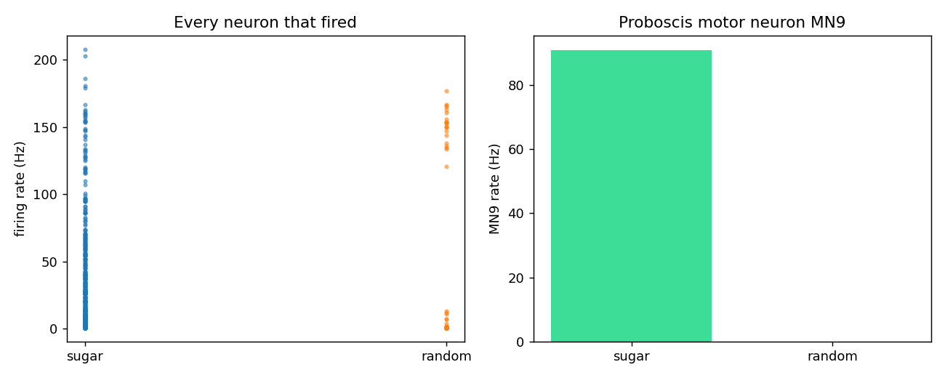
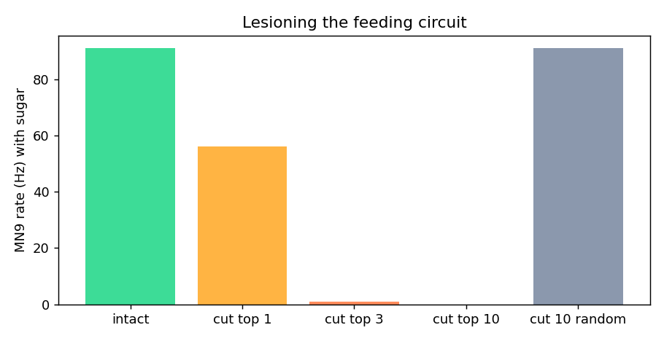
Preliminary Results
Sugar on the tongue: about 380 neurons active, feeding neuron MN9 at 95 to 98 Hz.
Random input: MN9 silent (0 Hz). Same result in 3 of 3 runs.
First attack, done by hand: cut the 3 command neurons and feeding stops (1 Hz).
Cut 10 random neurons and nothing changes (91 Hz).
What this shows: the real brain runs on a laptop and matches Nature 2024. First atlas entry, done by hand: attack = cut 3 neurons, feeding drops from 85 to 1.7 Hz; repair = boost 6 surviving inputs (small bias plus x2 synapse strength), feeding returns to 42 Hz with sugar and stays at 0 Hz without sugar, so it is a real repair, not forcing. Simple repair moves failed; the combination worked, which is why the defender needs a search agent.

Slide 11
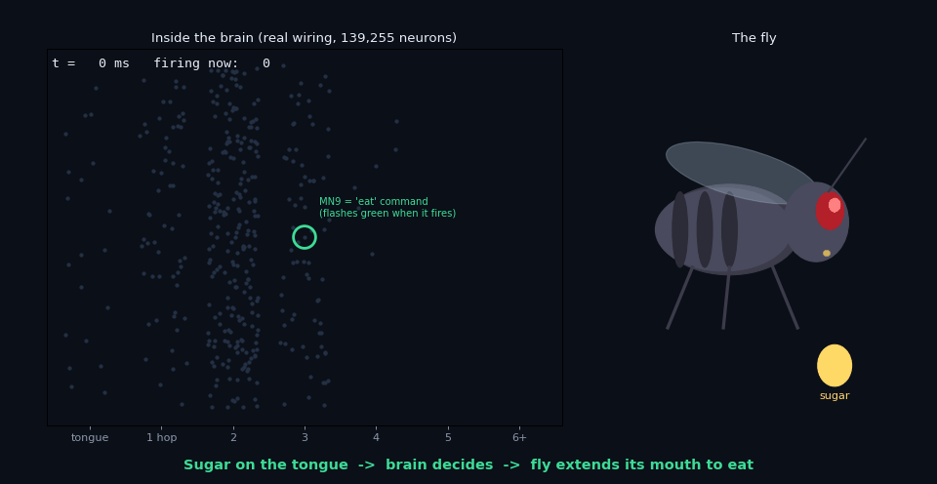
Live Demo
Animation (plays in slideshow): left, the real wiring with neurons flashing as they fire, placed by distance from the tongue. Right, a fly whose mouth is driven live by the MN9 feeding neuron.
0 to 350 ms: sugar arrives, the signal spreads hop by hop, MN9 fires, the mouth extends.
350 ms, the attack: 3 command neurons are cut (red X), MN9 goes silent, the mouth retracts.
Repair, tested by hand: boosting 6 surviving inputs brings feeding back to 42 Hz with sugar, 0 Hz without. Next two slides: the same brain playing Flappy Bird.

Slide 12
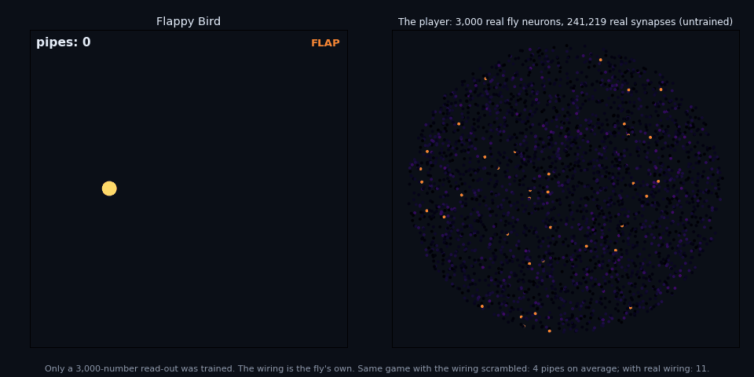
Side Result: Flappy Bird
Why we did it: to check that the fly's wiring works as a neural network before building agents on it.
The brain part: we took 3,000 real neurons and their 241,219 real connections (with the excitatory or inhibitory sign kept) and used them unchanged. Nothing about pipes or jumping is programmed.
What it sees: 34 on/off signals each frame: my height, the gap's height, distance to the pipe. No velocity, so the brain has to remember previous frames.
What we trained: only one output layer of 3,001 numbers that reads the 3,000 neuron activities and says flap or not. We fitted it by watching a simple rule-based coach play, then let the brain play and corrected its own mistakes (a standard method called imitation learning with DAgger).
Then it plays alone. Press a key and the wiring is scrambled, or 300 neurons are cut, while it plays.
Animation (plays in slideshow). Left: the game. Right: 3,000 real fly neurons, brightness = activity.

Slide 13
Flappy Bird: Honest Results
Game version | Fly brain (real wiring) | Same neurons, wiring scrambled | No brain (plain output layer)
Normal game (100 games) | 25 pipes | 20 pipes | 37 pipes
Pipe hidden when close, needs memory (100 games) | 3 pipes | 3 pipes | 1 pipe
Same, with slower neurons (30 games) | 6 pipes | 11 pipes | about 1 pipe
What worked: a real brain's wiring runs as a neural network and plays a game. When the game needs memory, having the recurrent brain beats having none by 3 to 10 times.
What did not work, and we say so: the fly's exact wiring did not beat the same neurons with scrambled wiring. It tied, and with slower neurons it lost. This matches two 2024 to 2026 papers (Suarez et al.; Dhiman) which found no clear advantage for the fly wiring in this kind of simplified network. We do not claim one.
Why this shaped the project: it showed us the platform works, and it showed that "is nature's wiring better?" is a crowded and disputed question. So we moved the project to a question we could not find answered anywhere: how fragile is each behaviour, and how do you repair it.

Slide 14
Proposed Outcomes
Expected results:
A fragility atlas for four fly behaviours: how many targeted changes break each one, how many stimulated neurons repair it, which neurons keep appearing, and how redundant each circuit is.
An attacker and a defender agent, each in three versions (random, greedy, LLM with tools), with a benchmark table: intervention size and simulations used. This answers whether an LLM agent is actually better than a plain search.
Validation: the neurons our attacker finds compared with those named in the published papers (for feeding we can already check: the 3 command neurons).
The platform: whole-brain simulator matching Nature 2024, a 2-D virtual fly, one dashboard with Attack and Defend buttons.
Impact: a map of which brain circuits are protected and which are single points of failure; a first method for designing repair stimulation on a complete brain; testable predictions for fly labs; a testbed that transfers to the mouse and human maps being built now.
Future work: more behaviours, the male brain (released June 2026) for a male vs female fragility comparison, and running attacks on a neuromorphic chip.

Slide 15
Timeline of the project
Phase 1: Foundation (Weeks 1 to 2, 17 Sep to 1 Oct)
Scope agreed with mentor; GitHub repo; simulator sped up (300 ms runs, sub-network mode, caching); neuron name table loaded.
Phase 2: Behaviours and rules (Weeks 3 to 5, 1 Oct to 22 Oct)
Reproduce eat, refuse bitter, groom, escape as pass or fail tests; write the attack rules; greedy attacker as the first baseline.
Phase 3: Attacker and defender agents (Weeks 6 to 9, 22 Oct to 19 Nov)
Simulator exposed as tools; LLM attacker with budget; defender with the two-condition repair test; random and greedy versions of both.
Phase 4: Atlas, virtual fly, dashboard (Weeks 8 to 11, 5 Nov to 3 Dec)
Batch runs over behaviours, goals, methods and seeds; fragility atlas and benchmark table; 2-D fly; web page with Attack and Defend.
Phase 5: Report and paper (Weeks 11 to 13, 3 Dec to 17 Dec)
Final demo, project report, open-source release, IEEE-format paper draft.

Slide 16
Conclusion
Summary: the complete fly brain runs on our laptop and we have already broken one behaviour by hand with 3 neurons. NeuroRedTeam turns that into a method: an attacker agent that finds the smallest change that breaks a behaviour, a defender agent that finds the smallest stimulation that repairs it, and a fragility atlas of the whole brain. Prior work perturbed the model by hand; as far as we found, no one has automated the attack, built the repair, or produced such an atlas.
Final thought: this is where neuroscience, AI and security thinking meet. Treating a brain like a system under test is new, and every answer it gives is a prediction a real lab can check.
Next steps: mentor approval; behaviours and rules in October; agents in November; atlas, dashboard and paper in December.

Slide 17
References (1/2)
Dorkenwald, S., Matsliah, A., Sterling, A. R., Schlegel, P., Yu, S.-C., McKellar, C. E., et al. (2024). Neuronal wiring diagram of an adult brain. Nature, 634, 124-138. https://doi.org/10.1038/s41586-024-07558-y
Shiu, P. K., Sterne, G. R., Spiller, N., Blagburn, D. I., Mosca, T. J., et al. (2024). A Drosophila computational brain model reveals sensorimotor processing. Nature, 634, 210-219. https://doi.org/10.1038/s41586-024-07763-9
Pospisil, D. A., Aragon, M. J., Dorkenwald, S., et al. (2024). The fly connectome reveals a path to the effectome. Nature, 634, 201-209. https://doi.org/10.1038/s41586-024-07982-0
Schlegel, P., Yin, Y., Bates, A. S., et al. (2024). Whole-brain annotation and multi-connectome cell typing of Drosophila. Nature, 634, 139-152. https://doi.org/10.1038/s41586-024-07686-5
Lin, A., Yang, R., Dorkenwald, S., et al. (2024). Network statistics of the whole-brain connectome of Drosophila. Nature, 634, 153-165. https://doi.org/10.1038/s41586-024-07968-y
Yan, G., Vertes, P. E., Towlson, E. K., Chew, Y. L., Walker, D. S., Schafer, W. R., & Barabasi, A.-L. (2017). Network control principles predict neuron function in the Caenorhabditis elegans connectome. Nature, 550, 519-523. https://doi.org/10.1038/nature24056
Whole-brain connectomics of Drosophila reveals a robust, distributed architecture for the suppression of feeding during escape. (2025). bioRxiv preprint. https://doi.org/10.64898/2025.12.14.694122
Bates, A. S., Phelps, J. S., Kim, M., Yang, H. H., et al. (2026). Distributed control circuits across a brain-and-cord connectome. Nature. https://doi.org/10.1038/s41586-026-10735-w

Slide 18
References (2/2)
Lappalainen, J. K., Tschopp, F. D., Prakhya, S., et al. (2024). Connectome-constrained networks predict neural activity across the fly visual system. Nature, 634, 1132-1140. https://doi.org/10.1038/s41586-024-07939-3
Vaxenburg, R., Siwanowicz, I., Merel, J., et al. (2025). Whole-body physics simulation of fruit fly locomotion. Nature, 643, 1312-1320. https://doi.org/10.1038/s41586-025-09029-4
Suarez, L. E., Mihalik, A., Milisav, F., Marshall, K., Li, M., Vertes, P. E., Lajoie, G., & Misic, B. (2024). Connectome-based reservoir computing with the conn2res toolbox. Nature Communications, 15, 656. https://doi.org/10.1038/s41467-024-44900-4
Jin, Z., Zhu, Y., Zhang, C., & Sui, Y. (2026). Whole-brain connectomic graph model enables whole-body locomotion control in fruit fly. arXiv:2602.17997.
Dhiman, N. (2026). Topological sensitivity in connectome-constrained neural networks. arXiv:2604.04033.
Neuromorphic simulation of Drosophila melanogaster brain connectome on Loihi 2. (2025). arXiv:2508.16792.
FlyEM Project Team (HHMI Janelia, University of Cambridge, MRC LMB, Google Research). (2026). Sexual dimorphism in the complete connectome of the Drosophila male central nervous system. Cell. https://www.cell.com/cell/fulltext/S0092-8674(26)00942-6
FlyWire Consortium. (2024). FlyWire Codex, release v783 [Dataset]. https://codex.flywire.ai
Shiu, P. K. (2024). Drosophila_brain_model [Source code]. GitHub. https://github.com/philshiu/Drosophila_brain_model

Slide 19
Expected Outcome by the end of First Year
Our target outcome: a conference publication plus an open-source release.
Conference publication: an IEEE-format paper, "NeuroRedTeam: automated attack and repair testing of a whole-brain connectome model", reporting the fragility atlas and the agent benchmark. Target: IEEE conferences on computational intelligence or neural networks, or a computational neuroscience workshop.
Open-source release: the simulator, the behaviour tests, the attack rules, both agents, the atlas and the dashboard on GitHub, so other students and labs can reproduce and extend it.
Research proposal (stretch): extend the method to the male fly brain and to the mouse connectome, with a budget for a small GPU workstation.
Patent: not planned. The value here is in open science and publication.

Slide 20


