Slide 1
CLIENT SERVER LIVE SESSION

Slide 2
OVERVIEW OF THE PROJECT
This project is mainly developed for the communication of Employees of organization located at different locations. The project entitled session set of platform for the project leaders and administrator to send messages to keep constant interaction with the programmers. In the proposed system, the administrator can communicate with the project leaders and programmers and can also maintain the login time and logout time. He can chat about the project going on with both the programmers and project leaders. This project also maintains offline messages. The project leader gives the instant report about the project to the administrator. Through this Communication System, Whenever user logs-in into the system then login time is recorded in the administrator’s system automatically. The administrator can scan the present online users and send the messages to single programmer ,set of programmers, project leader or Set of project leaders or all the employees wherever he/ she is present.This project makes the most of the tedious and mundane deskwork to minimize. This facilitates the user to concentrate more on the project and less on the managing of these tasks. The software is fully integrated with crm (Customer Relationship Management) as well as cms (Content Management System) solution and developed in a manner that is easily manageable, time saving and relieving one from manual works.

Slide 3
ABSTRACT
This project is mainly developed for the communication of Employees of organization located at different locations. The project entitled live session is a set of platform for the project leaders and administrator to send messages to keep constant interaction with the programmers.

Slide 4
Technologies
Netbeans
Microsoft visual studio
Java server pages
Html
Sql server

Slide 5
MODULES
Online Chat Module.
Member registration Module.
Sending and Receiving mails.
Integrated Security Module[HMAC-MD5 Algorithm]
Admin Module.

Slide 6
System Speciality
The development of the new system contains the specific activities, which try to automate the entire process keeping in view of the database integration approach.
User friendliness is provided in the application with various controls. The system makes the overall project management much easier and flexible. There is no risk of data mismanagement at any level while the project development is under process. It provides high level of security with HMAC-MD5 authentication. Users from any part of the world can make use of the system. New system will process accurate results. New system will be much better in performance as compared to existing one.
The proposed system is having frequent interaction between administrator and the project members by using email and chat modules with automated user-id specific E-MAIL service, which makes user comfortable by not including any personal mail addresses.

Slide 7
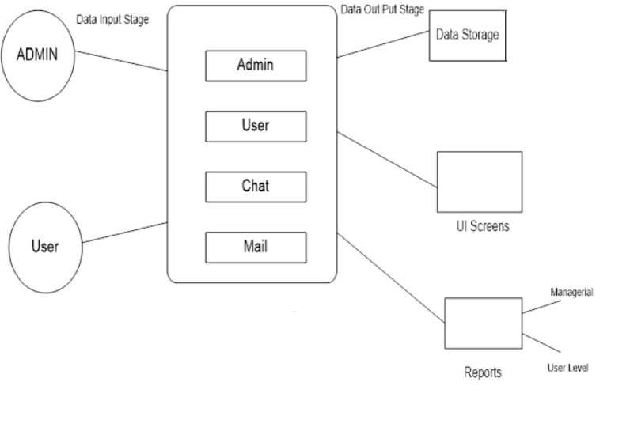
DATA FLOW DIAGRAM

Slide 8
WORKS CARRIED OUT IN THE PROJECT
Took major part in determining the algorithm to be implemented .
Developed the JSTL pages using netbeans .
Successfully tested the code using visual studio server .

Slide 9
Real Time Applications
Organizations like IT companies where frequent interaction between the administrator and the project leaders/programmers is necessary.
Organizations requiring logs of data modification , logins and logouts.
Hospitals where parental control on certain tasks is required.
Companies with a huge Employee Hierarchy.

Slide 10
References
A Distributed Quadtree Index for Peer-to-Peer Settings E. Tanin; A. Harwood; H. Samet 21st International Conference on Data Engineering (ICDE'05), 2005
Providing easier access to remote objects in client-server systems J. Aldrich; J. Dooley; S. Mandelsohn; A. Rifkin Proceedings of the Thirty-First Hawaii International Conference on System Sciences, 1998
The Book of IMAP: Building a Mail Server with Courier and Cyrus By Peer Heinlein, Peer Hartleben

