Slide 1
IRRIGATE
FOR Farmers

Slide 2
SCOPE
Irrigreat currently supports 22 crops. Moreover in the future, fertilizers can also be added accordingly The training was done on 10 pests and with this pesticides are suggested. In future, training can be done on more pests and more pesticides can also be added according to the pests.
In Crop Recommendation, values are manually entered by user of temperature, humidity, rainfall. Admin can also use some weather API to fetch the real time parameters by the city and state.
In Pesticide Recommendation, the uploaded image should be clear for correct results, otherwise with a blur image, the system sometimes gives wrong results so, further filters can be used to obtain better results. Also the system can use better DL models.
In future pesticide code can be integrated with drone code so that it can take live pictures of pests and by email or by mobile the farmers would be notified about the pest along with the pesticides.

Slide 3
LITERATURE SURVEY
Rajak, Rohit Kumar, et al. “Crop Recommendation System to Maximize Crop Yield using Machine Learning Technique.” International Research Journal of Engineering and Technology (IRJET), vol. 04, no. 12, 2017, pp. 951-952. IRJET, https://www.irjet.net/archives/V4/i12/IRJET-V4I12179.pdf.
Dighe, Deepti, et al. “Crop Recommendation System for Precision Agriculture.” IRJET, vol. 05, no. 11, 2018, pp. 476-480. IRJET, https://www.irjet.net/archives/V5/i11/IRJET-V5I1190.pdf.
TÜRKOĞLU, Muammer, and Davut HANBAY. Plant disease and pest detection using deep learning-based features. 2018. Turkish Journal of Electrical Engineering & Computer Sciences, https://journals.tubitak.gov.tr/elektrik/issues/elk-19-27-3/elk-27-3-6-1809-181.pdf.
Wu, Xiaoping, et al. A Large-Scale Benchmark Dataset for Insect Pest Recognition. 2019. IEEE Xplore, https://openaccess.thecvf.com/content_CVPR_2019/papers/Wu_IP102_A_Large-Scale_Benchm ark_Dataset_for_Insect_Pest_Recognition_CVPR_2019_paper.pdf.
Mokarrama, Miftahul Jannat, and Mohammad Shamsul Arefin. “RSF: A RecommendationSystem for Farmers.” Region 10 Humanitarian Technology Conference, vol. 2, no. 17, 2017, https://www.researchgate.net/publication/323203384_RSF_A_recommendation_system_for_far mers.

Slide 4
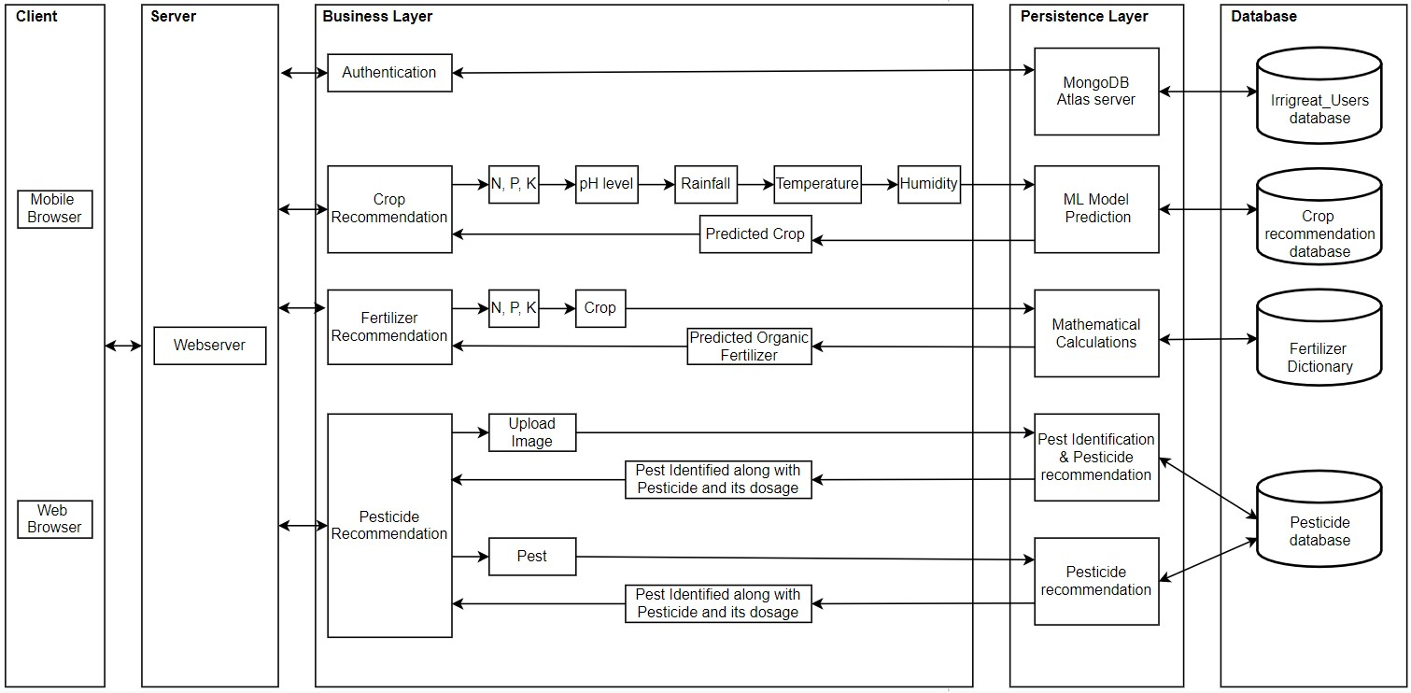
ARCHITECTURAL DESIGN

Slide 5
ALGORITHMS
Crop Recommendation
Fertilizers Recommendation
Pesticide Recommendation
Machine Learning Algorithm:
SVM
Random Forest
Naive Bayes
kNN
Mathematical calculation
Fertilizer dictionary
Machine Learning Algorithm:
CNN

Slide 6
Technology Used
HTML
CSS
Javascript
Flask
Numpy
Pandas
Matplotlib.pyplot
H5
Sklearn
Pickle
Neural networks (keras, tensorflow, CNN)

Slide 7
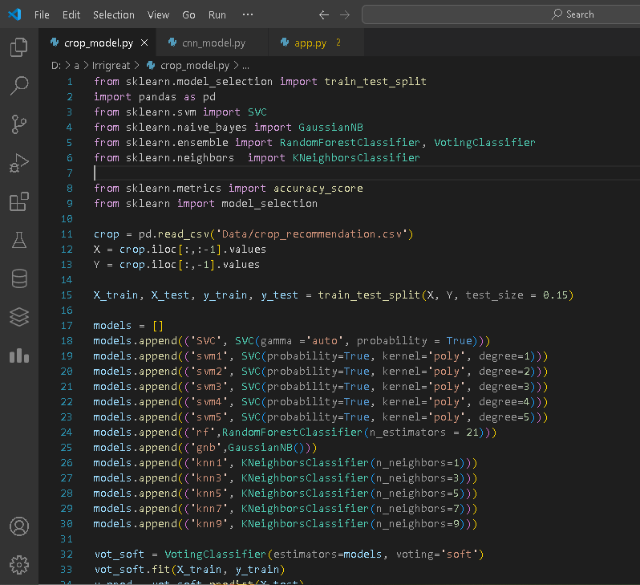
Code IMPLEMENTATION
Crop Recommendation

Slide 8
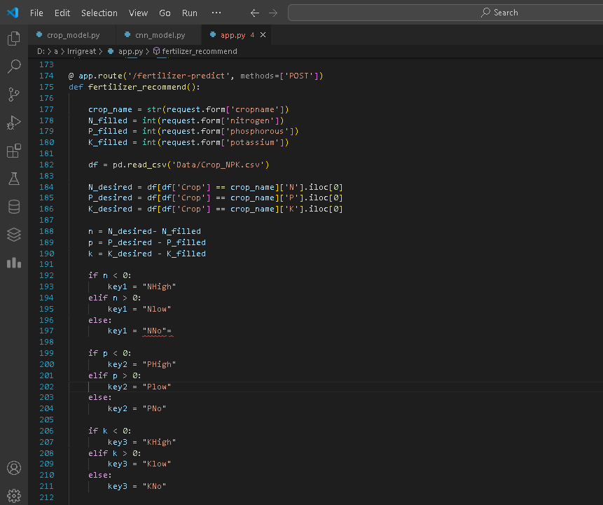
Fertilizers Recommendation

Slide 9
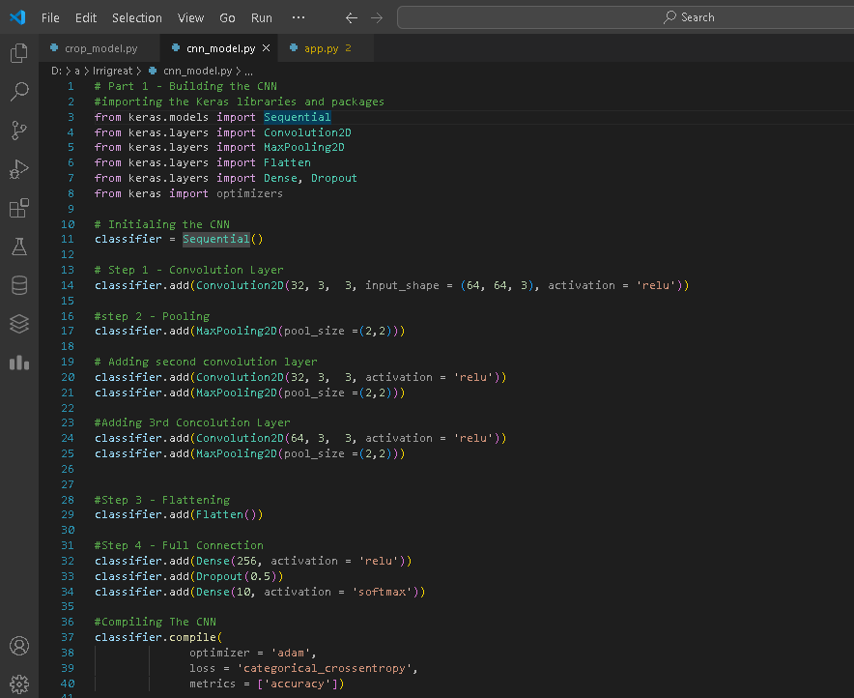
Pesticide Recommendation

