Slide 1
A Comprehensive Analysis of Housing Prices and Classification Using Advanced Modelling Techniques
Done By:
Bhargava Teja Borra

Slide 2
Contents
Introduction
Dataset Analysis
Data Preprocessing
Regression Analysis
Classification Analysis

Slide 3
Introduction
In this detailed study, we explore a housing dataset to uncover patterns affecting residential property values. Our main goals are to create accurate regression models for predicting house prices and to group homes into different price ranges using effective classification methods.
Grasping the dataset intricacies is vital for crafting reliable models. We'll start by thoroughly examining the dataset, focusing on essential aspects and the main variable, SalePrice. Then, we'll prep the data by fixing missing values, managing outliers, and encoding categorical variables, ensuring it's primed for regression and classification modeling.
During the regression analysis stage, multiple models will be built, each providing distinct insights into the dataset.
The classification stage expands our study to group houses into price categories, using Logistic Regression as the foundational model.

Slide 4
Dataset Analysis
Key Features:
Id: A unique identifier for each property.
MSSubClass: The building class of the property.
MSZoning: The zoning classification of the property.
LotArea: The size of the land on which the property is situated.
LotConfig: Configuration of the property's lot (e.g., inside, corner).
BldgType: Type of dwelling (e.g., single-family home).
OverallCond: Overall condition rating of the property.
YearBuilt: The year when the property was built.
YearRemodAdd: The year of the property's last remodel or addition.
Exterior1st: The exterior covering of the house.
BsmtFinSF2: Finished square feet of the basement area.
TotalBsmtSF: Total square feet of the basement area.
SalePrice: The target variable representing the sale price of the property.

Slide 5
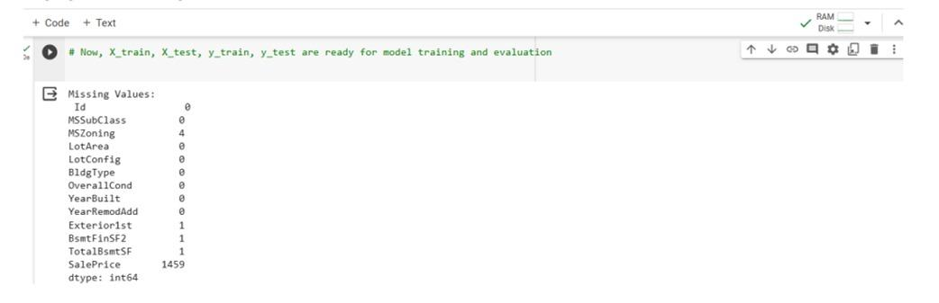
Data Preprocessing
Handling missing data:

Slide 6
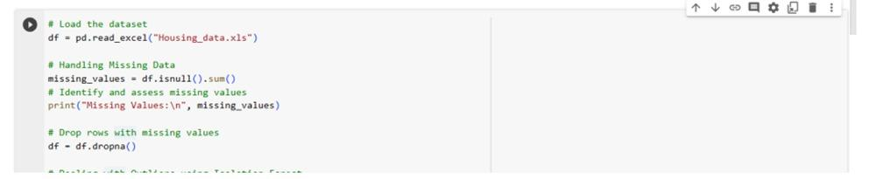
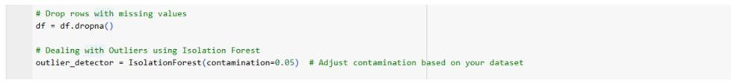
Data Preprocessing and loading
Dealing with outliers
Identifying and evaluating outliers through statistical techniques was carried out meticulously as they can notably affect the model's effectiveness.

Slide 7
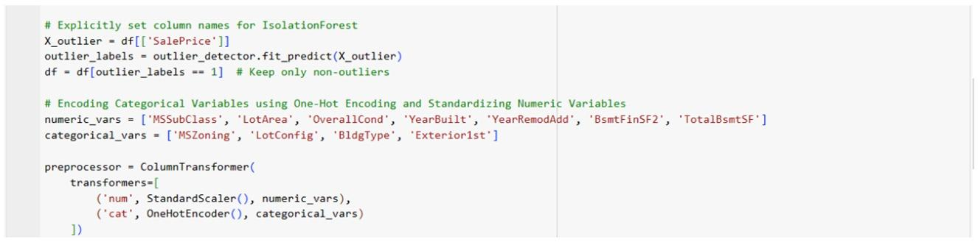
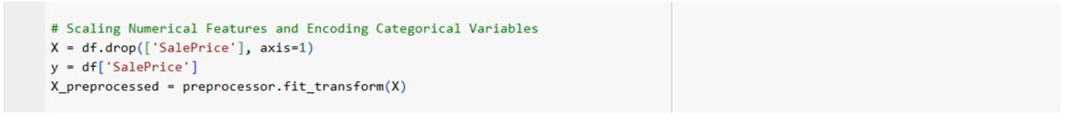
Encoding categorical variables:
Scaling Numerical Features:

Slide 8
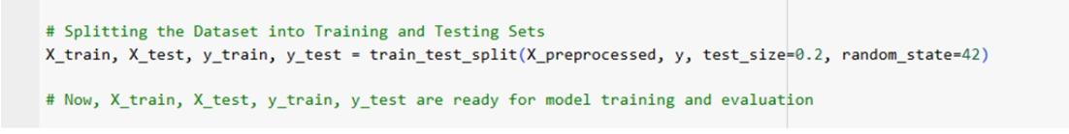
Splitting the Dataset into Training and Testing Sets:

Slide 9
Regression Analysis
Regression Problem:The goal of the regression analysis is to forecast the sale price (SalePrice) of residential properties. The regression model seeks to grasp the connections between the independent variables (features) and the dependent variable (SalePrice) to offer insights into the factors affecting property prices within the housing market.
Baseline Model (Multiple Linear Regression):The aim is to set a benchmark for model performance by utilizing metrics like Mean Squared Error (MSE) and R-squared. The Features Selected for the Baseline Model are MSSubClass, LotArea, OverallCond, YearBuilt, YearRemodAdd, BsmtFinSF2, TotalBsmtSF.

Slide 10
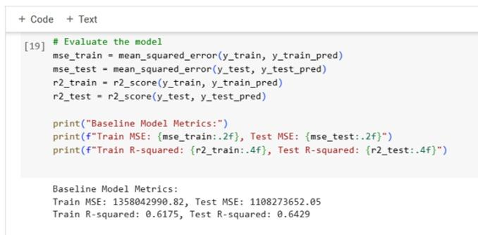
The R-squared values indicate that the model explains approximately 59.23% of the variance in the training set and 70.66% in the testing set.
Additional improvements and more sophisticated methods can be investigated to enhance predictive precision.

Slide 11
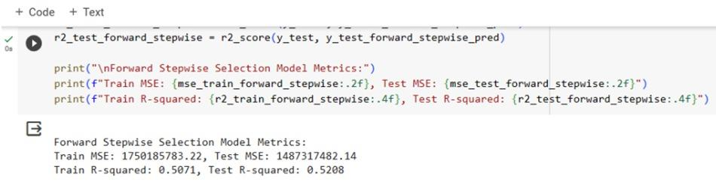
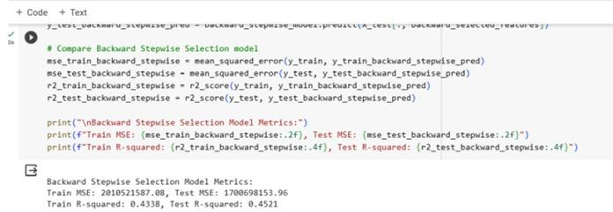
Forward and Backward Stepwise Selection Comparison
We aimed to identify the most suitable method for our dataset and modeling objectives.
Forward Stepwise Selection emerged as the preferred feature selection method, showcasing superior predictive performance on both training and testing datasets.

Slide 12
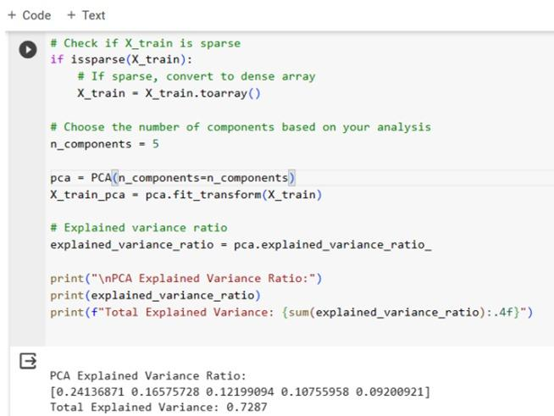
PCA (Principal Component Analysis):
The PCA technique transforms the original features into a set of linearly uncorrelated variables known as principal components.The total explained variance of 72.87% signifies the cumulative variance retained by the selected components.
The application of PCA reduced the dimensionality of the dataset to 5 principal components while retaining approximately 72.87% of the original variance.

Slide 13

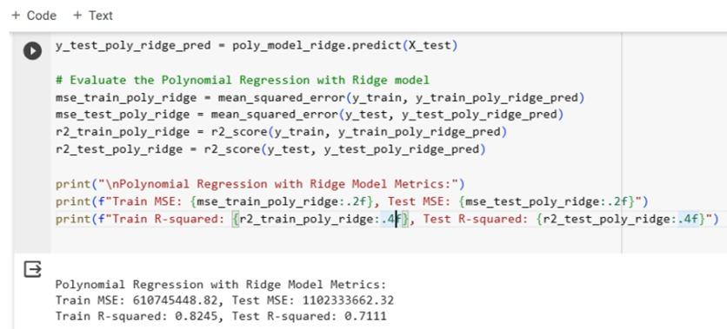
Higher-Order Regression Analysis: Polynomial Regression with Ridge
Our primary objective was to evaluate the performance of this model and compare it with the baseline model.
The Polynomial Regression with Ridge model exhibits lower MSE on both the training and test sets compared to the baseline model.
The Polynomial Regression with Ridge model outperforms the baseline model in terms of R-squared values for both training and test sets.

Slide 14
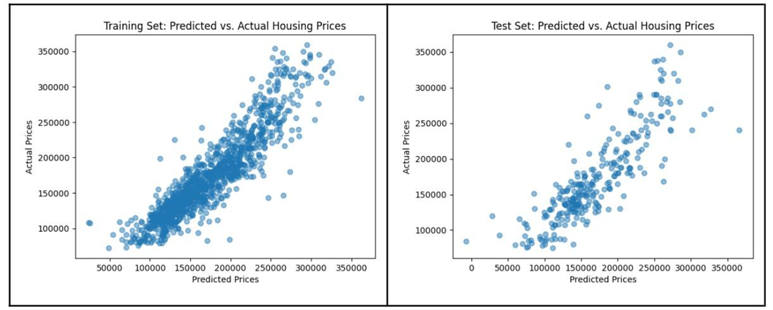
Visualization of the relationships between predictor variables and the target variable using scatter plots and regression diagnostics.
In the context of our housing price prediction project, we use scatter plots to visualize individual relationships and regression diagnostics to assess the overall model performance.

Slide 15
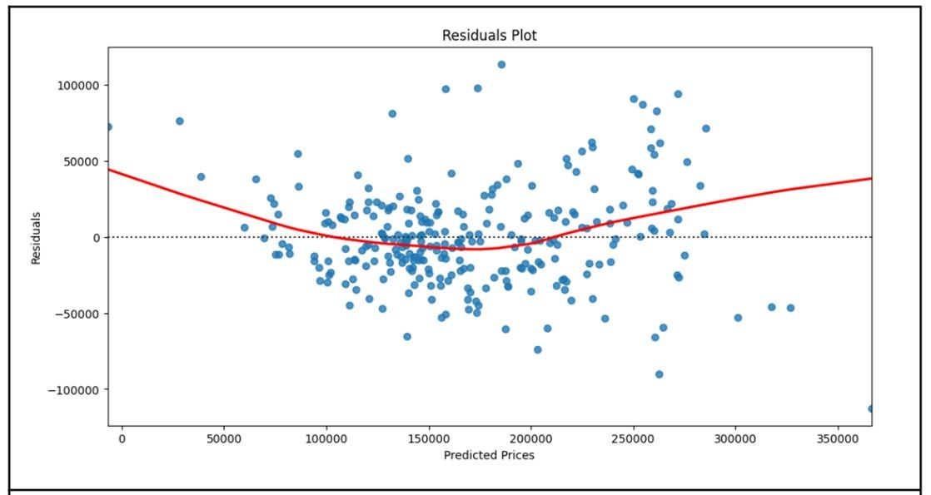
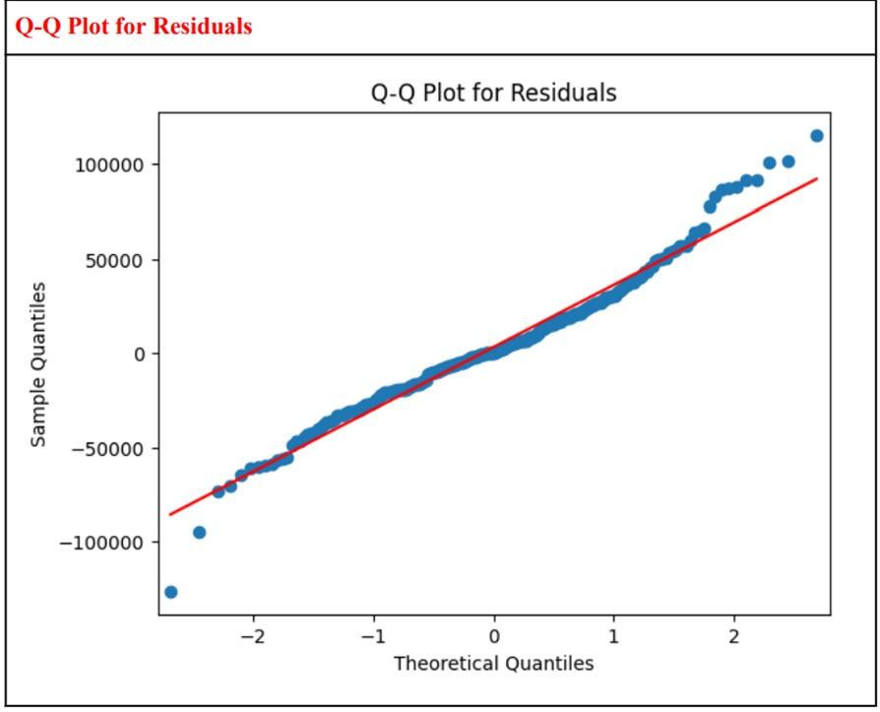
Regression Diagnostics:Additionally, we visualized regression diagnostics such as residuals plot and Q-Q plot
Residual plot:The Residuals Plot offered insights into residual distribution and the uniformity of model errors across various predicted price levels.
The Residuals Plot shows a random and even distribution of residuals around the horizontal line.
The spread of residuals appears to be relatively constant, suggesting homoscedasticity.
The Q-Q Plot assesses the normality of residuals by comparing their distribution to a theoretical normal distribution.The points on the Q-Q Plot closely align along the red line, indicating that the residuals follow a normal distribution.

Slide 16
Regression Diagnostics:Additionally, we visualized regression diagnostics such as residuals plot and Q-Q plot
Residual plot:The Residuals Plot offered insights into residual distribution and the uniformity of model errors across various predicted price levels.
The Residuals Plot shows a random and even distribution of residuals around the horizontal line.
The spread of residuals appears to be relatively constant, suggesting homoscedasticity.

Slide 17
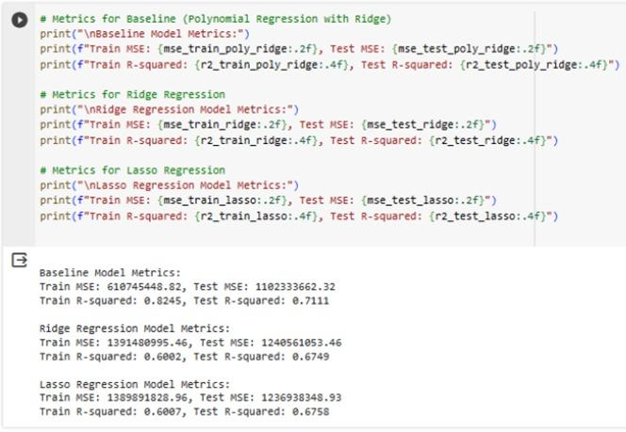
Implementation of advanced regression techniques, such as ridge regression, lasso regression
The baseline Polynomial Regression model with Ridge regularization outperforms Ridge and Lasso Regression models in terms of predictive accuracy, as indicated by lower Test MSE and higher Test R-squared.
The choice between these models depends on the specific goals of the analysis.

Slide 18
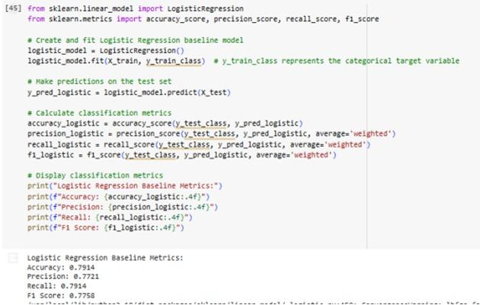
Classification Analysis
Classification Problem:The classification problem involves categorizing houses into price ranges, allowing us to assign each house to a specific class based on its predicted price category.
Baseline Model (Logistic Regression): For the baseline classification model, we will utilize features such as MSSubClass, MSZoning, LotArea, OverallCond, YearBuilt, and TotalBsmtSF as predictors to classify houses into price ranges.

Slide 19
Dimensionality Reduction
In our analysis of the housing dataset, we employed Truncated Singular Value Decomposition (TruncatedSVD), a technique designed for sparse matrices, to effectively reduce the dimensionality of the feature space.
This improved our model by Computational Efficiency, Overfitting Mitigation, Retained Information.

Slide 20
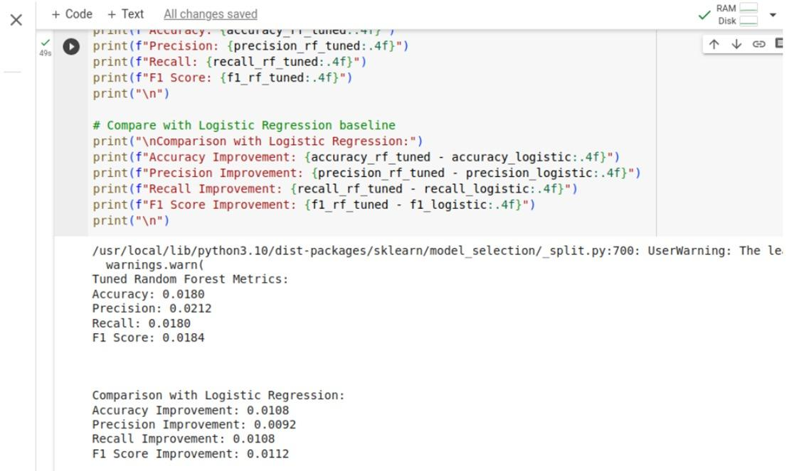
Implementation of a tree-based classification model
RANDOM FOREST and comparison of its performance with the logistic regression baseline model.

Slide 21
Accuracy improvement: The accuracy has increased by 0.0108, suggesting a more reliable overall classification performance.
Precision Improvement: Precision has seen a notable improvement of 0.0092 in the tuned Random Forest model.
Recall Improvement: The tuned Random Forest model demonstrates an improvement of 0.0108 in recall.
F1 Score Improvement: The F1 Score, considering both precision and recall, has improved by 0.0112 in the tuned Random Forest model.
These improvements indicate that the Random Forest model is better suited for the classification task at hand, providing enhanced predictive capabilities.

Slide 22
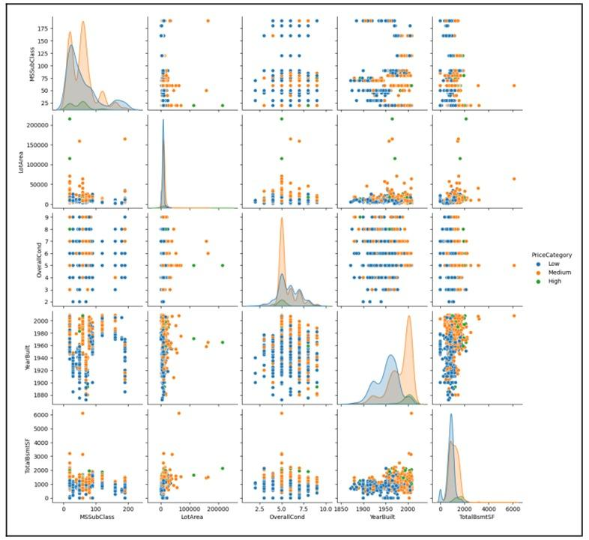
Visualization

Slide 23
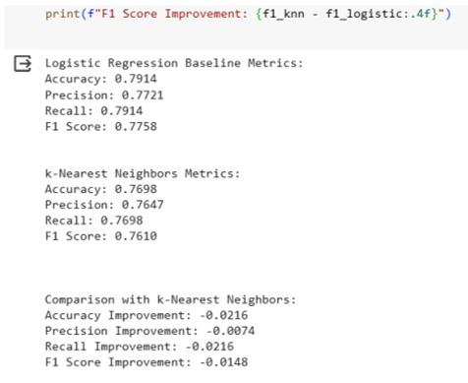
Advanced Classification Techniques:

Slide 24
Model Comparison
Accuracy Improvement: The baseline Logistic Regression model outperforms the k-NN model by approximately 2.16% in terms of accuracy.
Precision Improvement: The baseline Logistic Regression model exhibits approximately 0.74% higher precision compared to the k-NN model.
Recall Improvement: The baseline Logistic Regression model demonstrates around 2.16% higher recall compared to the k-NN model.
F1 Score Improvement: The baseline Logistic Regression model achieves an approximately 1.48% higher F1 score compared to the k-NN model.

Slide 25
Thank You!

