Slide 1


PANIMALAR ENGINEERING COLLEGE
Department of Computer Science and Engineering
Project Review II , DATE
Event Detection System For Covid-19 Pandemic
Members:
Bhargav K R(2114104036)
B L S R K Vishal(211417104039)
CH Pavan Kumar(211417104045)
Project Guide:
Mr. C.THYAGARAJAN.,(Ph.D.), ASSISTANT PROFESSOR
Batch Number: 10

Slide 2
Introduction
The user behavior has been studied to examine the psychological antecedents of actions in various domains like medical, businesses and many other sectors for many years, and by gathering all this information using the data obtained to predict or to make proposal to the client/person and to track the event of the person. In general, the characteristics of a person depends on various factors and one of the most common factor is their health condition and well-being, so that the behavior of the person can also be predicted or analyzed based on their public health status.
Nowadays Social media is been a very popular mode of interaction between the people they share their thoughts, feelings, emotions, behavior and their status etc. in the Social media which is a Online Social Network (ONS), this online social media includes Facebook, Twitter etc. Thus, this Online social media consists of vast amount of data which also analyze the behavior of the person using online social networks.

Slide 3
LITERATURE SURVEY(1/5)
SL.NO | TITLE | ISSUES ADDRESSED | APPROACH | MERITS | CONCLUSION
1 | Social Network and information retrieval | Various techniques to retrieve the information from the online social networks(ONS) and documented. | Social network information retrieval, to find the domain, and categorize the information and analyze the obtain the information | Merits: Information retrieval techniques can effetely retrieved and documented | Various Information based on the domain can be obtained and can be documented for various

Slide 4
LITERATURE SURVEY(2/5)
SL.NO | TITLE, Author | ISSUES ADDRESSED | APPROACH | MERITS | CONCLUSION
2 | Information Retrieval and social Media Mining Author: Maria N Moreno-Garcia | Online Social Networks which contain large amount of data retrieval issues are addressed. | Data mining algorithms which efficiently filter The information for the user based on the necessity like location, domain etc. are taken into notice to retrieve the information. | Merits: Data mining algorithms to efficiently filter the information based on the requirement. | Information of the Locality people or user can be obtained using the data mining algorithms.

Slide 5
LITERATURE SURVEY(3/5)
SL.NO | TITLE, Author | ISSUES ADDRESSED | APPROACH | MERITS | CONCLUSION
3 | Detecting epidemic diseases using sentiment analysis of Arabic tweets Author: Q. B. Baker, F. Shatnawi, S. Rawashdeh, M. Al-Smadi, Y. Jararweh | Influenza is currently one of the world's greatest infectious disease challenges, An Machine learning technique is implemented in order to detect influenzas related using in Arab countries. | Data mining and Machine Learning Techniques like Support Vector Machines, Decision Trees etc. are used in detecting Influenza diseases. | Merits: Tweets in Native language can also be used in this approach in order to detect the influenza related diseases. | Using Data Mining and Machine learning techniques in this approach yield 89.06% accuracy in identifying the accurate information.

Slide 6
LITERATURE SURVEY(4/5)
SL.NO | TITLE, Author | ISSUES ADDRESSED | APPROACH | MERITS | CONCLUSION
4 | A Real-time integration of emotion analysis into homecare platforms Author: A. Menychtas, M. Galliakis, P. Tsanakas, I. Maglogiannis. | A Real Time Integration and operation of emotional analysis service in homecare/mHealth applications. | Developed emotion analysis service follows the IoT paradigm and it is combined with features for connectivity such as bio signal sensors and wearables and integrated in WebRTC video communication functionality offered by homecare flatforms. | Merits: The doctor can check real time patient health and can provide with necessary treatment and can interact with the patient with live video communications. | A real time integration of emotional services with homecare/mHealth application will improve the performance of the application.

Slide 7
LITERATURE SURVEY(5/5)
SL.NO | TITLE, Author | ISSUES ADDRESSED | APPROACH | MERITS | CONCLUSION
5 | Analysis of users' behavior in structured e-commerce websites Author: S. Hernández, Álvarez, J. Fabra, J. Ezpeletay. | Understanding and analyzing users' interests and behavior is essential to adapt e-commerce Web sites to customers' requirements. | Information of the user behavior in the e-commerce website is stored in the weblog an using data mining techniques rather than static characterization to analyze the user behavior and provide the necessary content that the user need. | Merits: The necessary content that the user desired can be displayed on the e-commerce website based the user behaviour on that website. | User behavior can be used in order to improve the user experience on the e-commerce website to provide better results to the user.

Slide 8
Problem Statement
With respect to general wellbeing following status, a few examinations have zeroed in on separating messages in the OSNs for discovering ailment related subjects.
The opinion and emotional examination is another model of methods that have been discovered valuable to identify a few ailments like melancholy or stress.
Other ailments and infections are likewise identified by separating negative remarks of the OSN, being related with misery or anger. In general, the client conduct is affected by close to home encounters, and afterward, by occasions dispersed in OSNs consequently.
The client conduct is a critical boundary to recognize occasions of various natures. In any case, the current investigations do not investigate the connection between the client conduct change furthermore, conceivable future occasions.
2. SOFTWARE REQUIEMENTS

Slide 9
TECHNOLOGY STACK
MINIMUM HARDWARE REQUIREMENTS
Processor | Intel
Hard disk | 260 GB
RAM | 4GB
Speed | 14/15 inches Color
2. SOFTWARE REQUIEMENTS
Tool | Netbeans
Operating System | Windows 7/8/10
Front End | Html, CSS
Scripts | Java

Slide 10
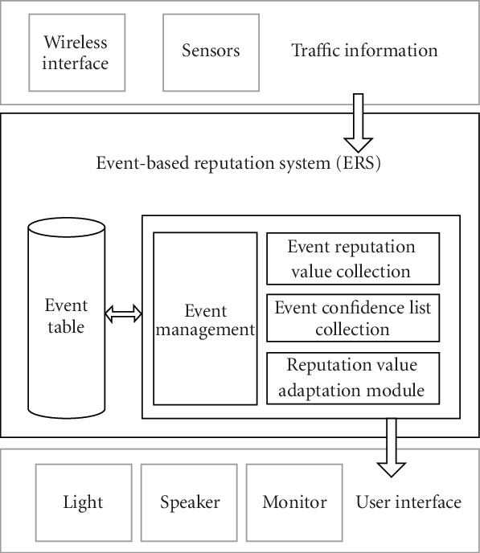
System Architecture

Slide 11
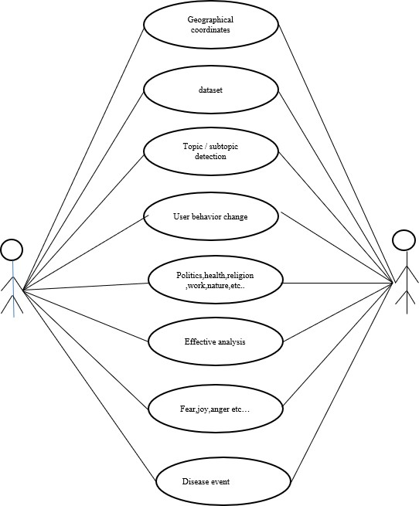
System Design

Slide 12
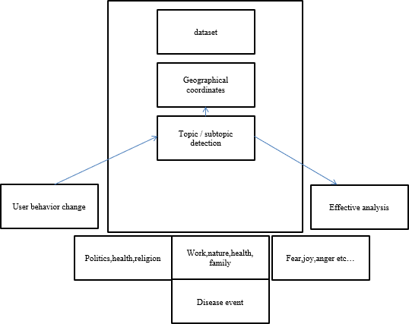
System Design

Slide 13
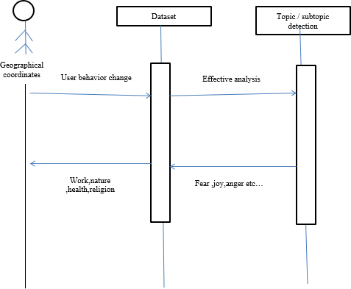
System Design

Slide 14
MODULES
1 User Behavior Analysis In ONS
In the Twitter OSN, the user behavior can also be characterized in relation to the following activities: tweeting, retweeting, and commenting [46]. Other OSNs, such as Sina Weibo, have also been used to extract data and analyze the user behaviors, and then determine the impact of the user popularity on OSN websites. It is important to note that these studies do not explore the changes of topics posted by users.
It is also known that certain events can attract more public attention, which is demonstrated by the number of messages or communication interactions between people interested in such topics .Thus, through the number of messages in OSNs, it is possible to measure the number of members related to potential events, and concerning specific regions. This helps to solve the problem of early event identification. Hence, the messages posted in an OSN represent valuable information to understand and predict the users’ behavior in a specific period of time and geographical location.

Slide 15
MODULES
DETECTION USING DATA FROM AN OSN
Currently, there are diverse solutions to detect different types of events using data from an OSN. However, because the focus of our case study is on disease detection, only works related to this subject are presented.
The authors stated that the virality of a social media content, in the public health context, can depend on the users’ emotions and the disease type. Additionally, the number of followers can affect the propagation scale of the posted messages in OSNs
Thus, the greater the virality of a content, the easier its detection. The virality of a post also depends on the geographical location of the users. An user from a big city can be more influential than users in smaller cities [54]. In the case of accidents or disasters, people usually share information more quickly and mostly with people close to the event .

Slide 16
MODULES
3 TOPIC DETECTION AND AFFECTIVE ANALYSIS
A method of topic detection based on NLP was used for COVID-19 prediction in by applying a hybrid artificial intelligence (AI) model.
The change in the infectious capacity of the virus was analyzed within a few days after the infection, and an improved susceptible-infected (ISI) model was proposed. The NLP module and the LSTM network were embedded in the ISI model to build a hybrid AI model for COVID-19 prediction.
With the NLP and LSTM built into the hybrid AI model, the mean absolute percentage errors of the prediction results, considering the next six days, were 0.52%, 0.38%, 0.05%, 0.86% in Wuhan, Beijing, Shanghai, and nationwide, respectively. In deep learning algorithms were used for NLP using a Contrastive Divergence (CD) algorithm, such as the Deep Belief Network (DBN) , which is composed of restricted Boltzmann machines .

Slide 17
Testing
Test Case Id | Test Cases | Priority | Input Test Data | Test Case Description | Expected Results | Actual Results | Pass/Fail
TU0 1 | User Login | A | Enter Email-id and Password. | Check user with the database | User should be available in database | User present in database | Pass
TU0 2 | Create Event | A | Event Details | Creating an Event | Should be upload Successfull y | Details are stored successfull y | Pass
TU0 3 | Receive Notificatio n | A | - | Event Details are notified. | Notificatio n should be received properly | Alert Message received properly | Pass
TU0 4 | Request Friend informatio n | A | Add Friend Request | Request Friend | Accepted Request | Accepted successful | Pass
Test Case For User Module

Slide 18
Testing
Test Case Id | Test Cases | Priorit y | Inpu t Test Data | Test Case Description | Expected Results | Actual Result s | Pass/Fa il
TE0 1 | Admin Login | A | Enter Email-id and Passwor d. | Check Admin details with the database | Admin should be available in database | Admin present in database | Pass
TE0 2 | View All Events Created | A | Events Created | All Events Description that are Created | Show all the event that are created | Display ed Events | Pass
TC01 | Check Event | A | Event Name | Description of all information regarding the information | Event Description with attendees | Event Informa tion | Pass
TC02 | Receive Notificatio n | A | Event Name | Display information of all the attendees with disease affected percentage | Notificatio n should be received properly | Alert Messag e receive d properl y | Pass
Test Case For Admin Module

Slide 19
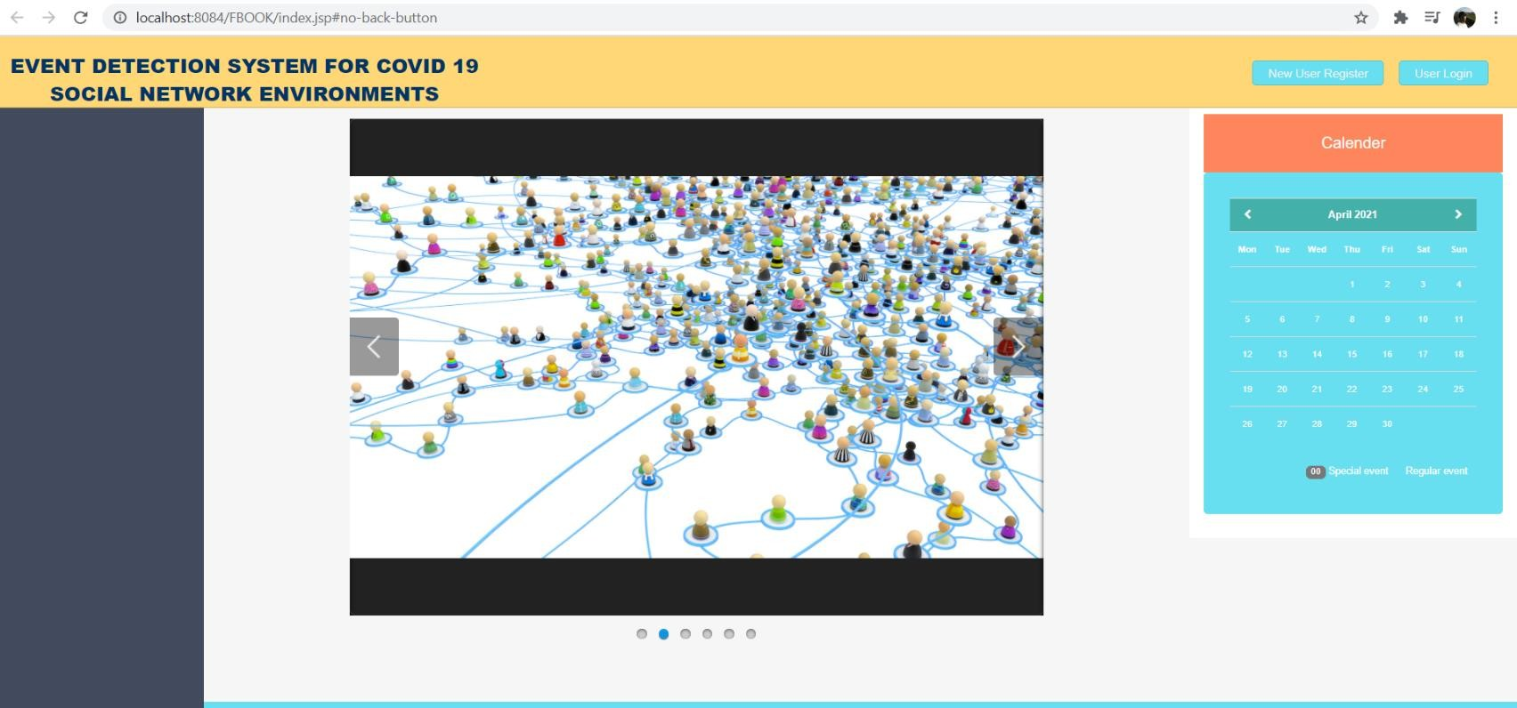
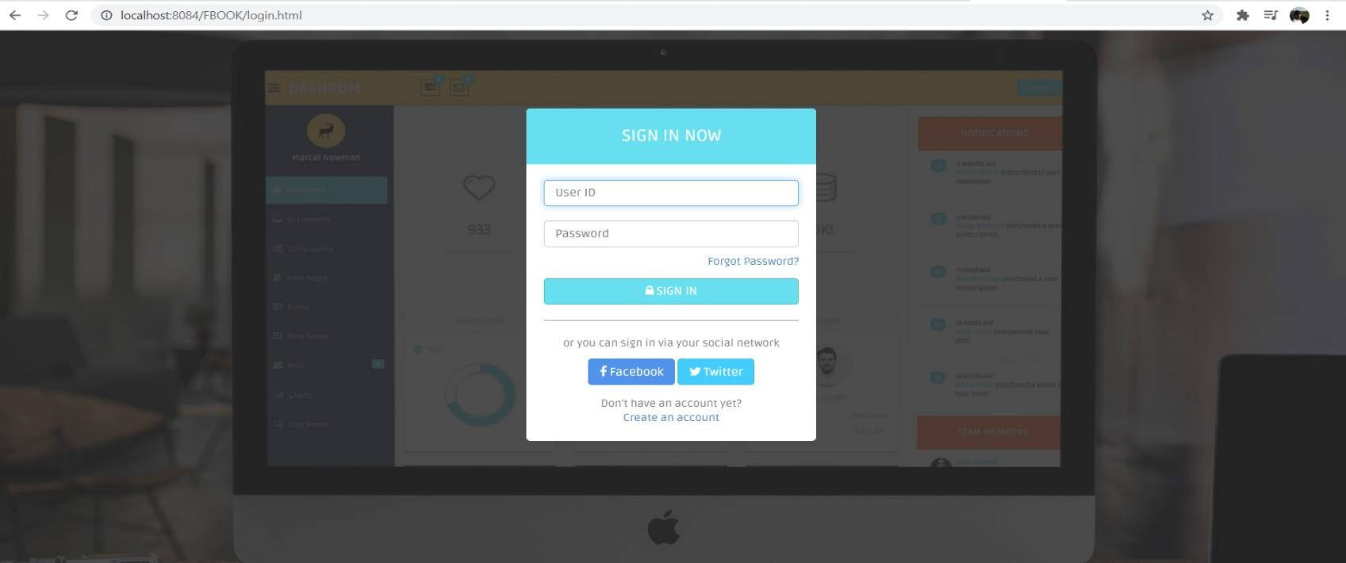
Screen shots

Slide 20
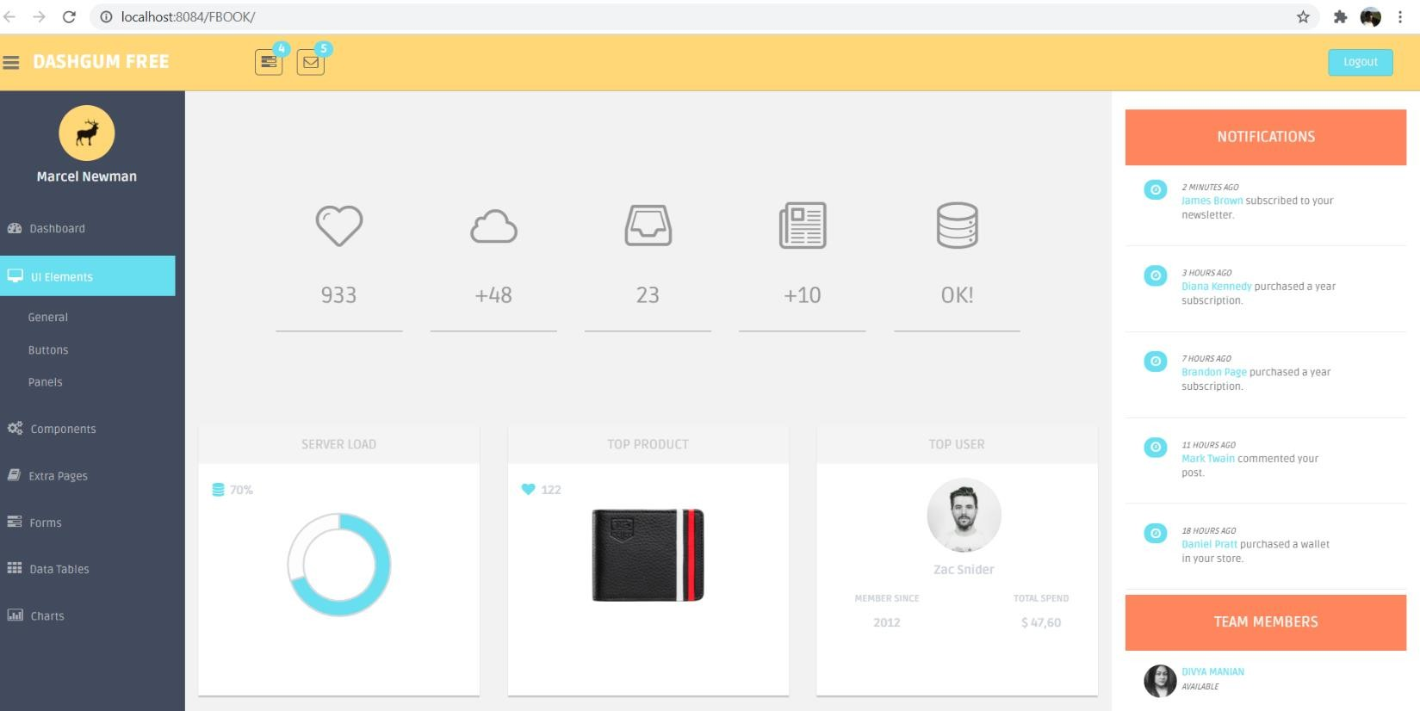
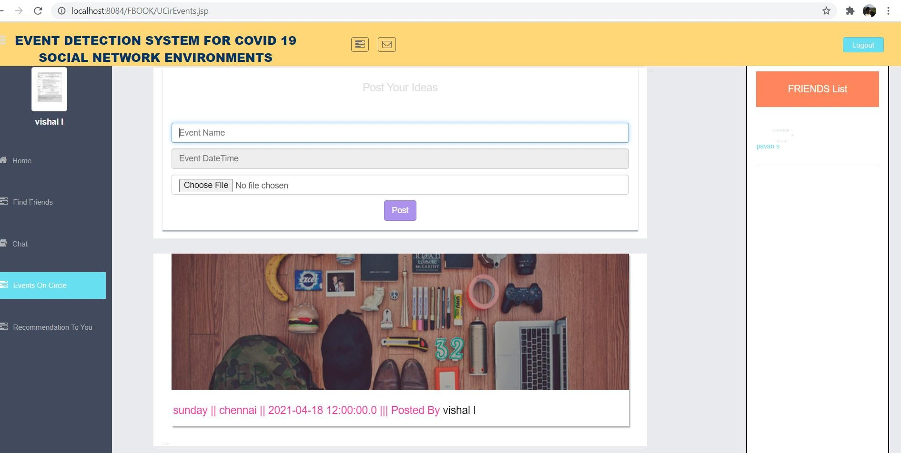
Screen shots

Slide 21
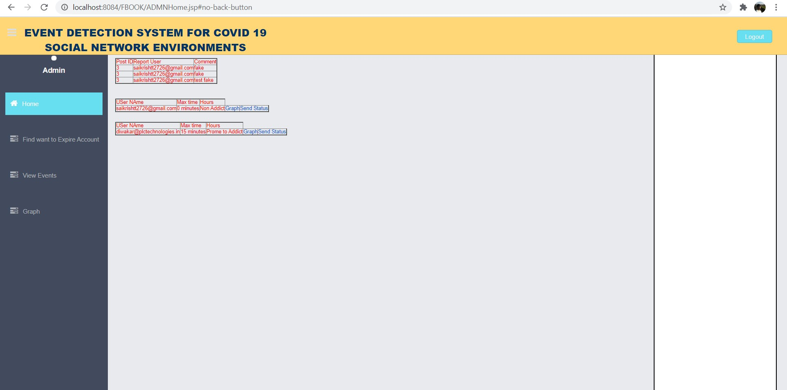
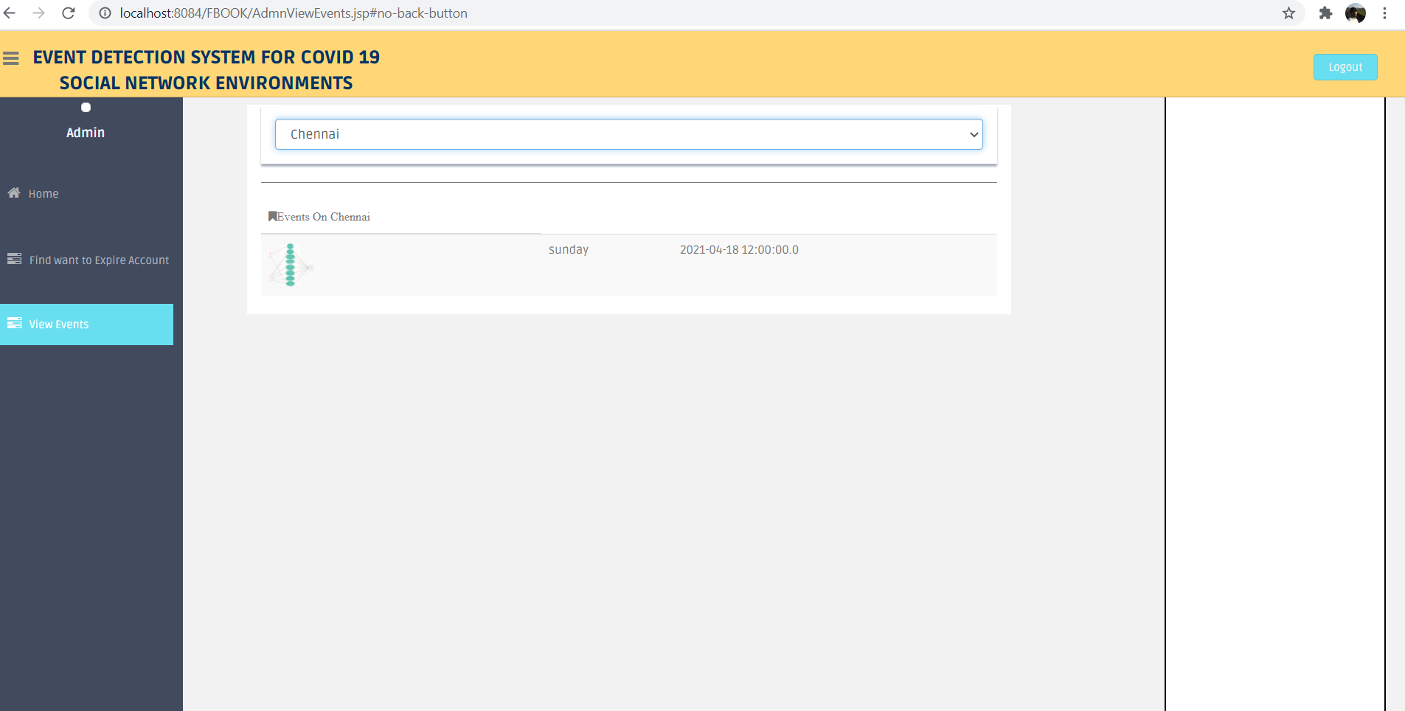
Screen shots

Slide 22
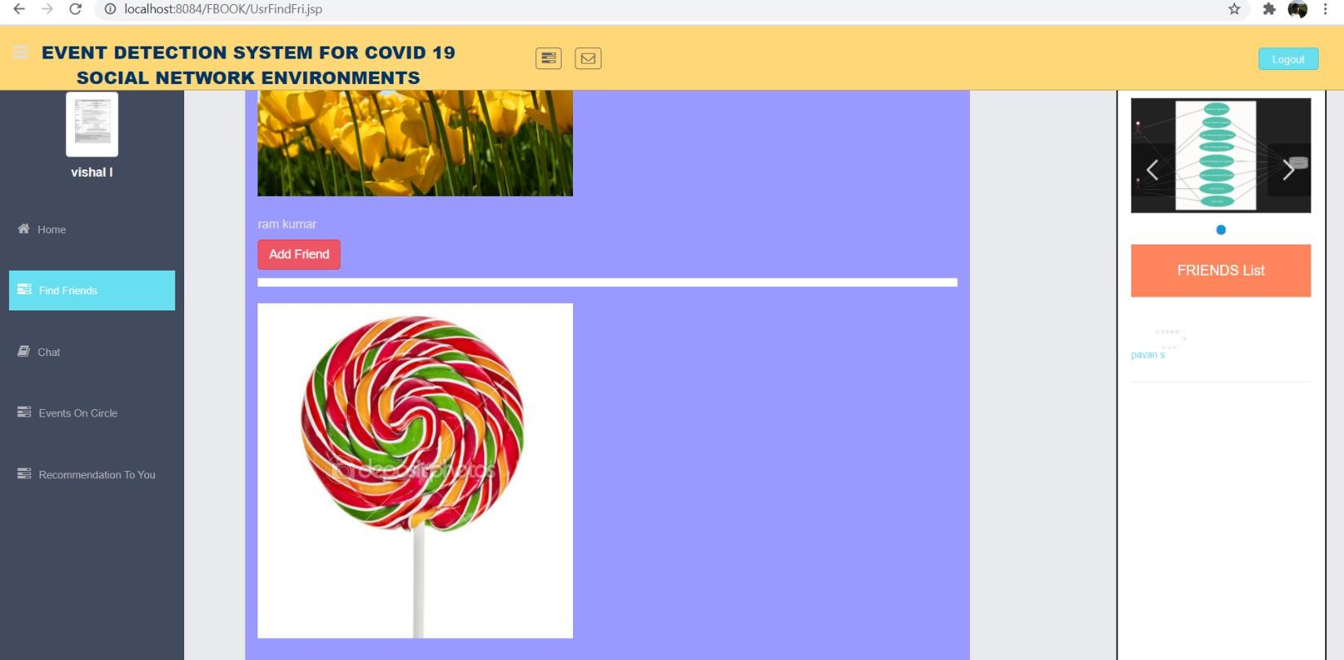
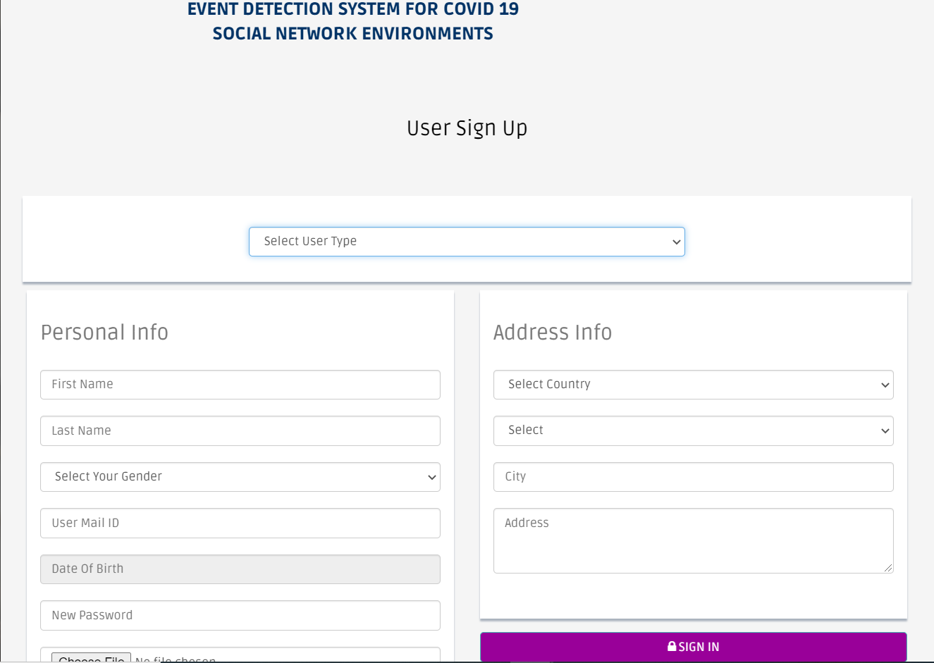
Screen shots

Slide 23
Conclusion
This work presented and approved an occasion discovery framework at a beginning phase dependent on the client conduct data separated from OSNs, featuring the importance of joining the client conduct change examinations into arrangements of this kind. Thus, this work indicated the significance of the subtopic distinguishing proof by the NLP calculation utilizing an unaided AI procedure and the utilization of emotional investigation
The proposed framework presents a superior presentation than two comparative occasion locator arrangements proposed. In spite of the fact that urban communities from various nations were investigated, a comparative conduct was distinguished by the adjustment in themes, yet at various dates.

Slide 24
References
Ajzen and M. Fishbein, Understanding attitudes and predicting social behavior . Englewood Cliffs, New Jersey: Prentice-Hall, 1980.
R. L. Rosa, G. M. Schwartz, W. V. Ruggiero, and D. Z. Rodríguez, “A knowledge-based recommendation system that includes sentiment analysis and deep learning,” IEEE Transactions on Industrial Informatics, vol. 15, pp. 2124– 2135, Apr. 2019.
T. Marcinkowski and A. Reid, “Reviews of research on the attitude–behavior relationship and their implications for future environmental education research,” Environmental Education Research, vol. 25, pp. 459– 471, Jul. 2019. doi: 10.1080/13504622.2019.1634237.

Slide 25
References
4 Y. Su, J. Luo, J. Fang, and Z. Chen, “Research and design of website user behavior data acquisition based on customized event tracking,” in 2019 IEEE 4th Advanced Information Technology, Electronic and Automation Control Conference (IAEAC), vol. 1, (Chengdu, China), pp. 2024–2029, Dec. 2019.
5 H. ˙I ¸S and T. Tuncer, “Confidence index analysis of Twitter users timeline,” in 2018 International Conference on Artificial Intelligence and Data Processing (IDAP), (Malatya, Turkey), pp. 1–8, Sept. 2018. doi: 10.1109/IDAP.2018.8620917.

