Slide 1


Used cars analysis on Area wise and all over India
ON
Cars24
Presented By:
Sainandu Samudrala
Ajay Patel
Bhargav Praveen Chintapalli

Slide 2
INTRODUCTION
This project focuses on analyzing the used car market in India by collecting data from the Cars24 website using Selenium-based web scraping techniques. The objective of the project is to understand pricing patterns, market trends, and consumer preferences in the Indian used car resale market. Data such as car brand, model, price, kilometers driven, fuel type, manufacturing year, and city location was extracted and organized into a structured dataset for analysis.
The project includes both area-wise and brand-wise analysis of used car listings across different cities in India. Area-wise analysis helps identify how car prices, availability, and vehicle usage vary between cities, providing insights into regional demand and pricing differences. By comparing multiple locations, the study highlights which areas have higher listings and different price ranges.
Brand-wise analysis was also performed to understand the popularity and pricing distribution of various car brands in the used car market. This helps identify commonly listed brands and analyze how brand value, vehicle age, and kilometers driven influence resale prices.
After collecting the data, preprocessing and cleaning were performed to ensure accuracy. Exploratory Data Analysis (EDA) and visualizations were used to discover patterns and trends in the dataset. Overall, this project demonstrates how web scraping and data analysis techniques can be used to extract valuable insights from online automobile marketplace data.

Slide 3
BUSINESS PROBLEM
The used car market in India is large and highly dynamic, with prices varying significantly based on factors such as location, brand, vehicle age, fuel type, and kilometers driven. However, buyers, sellers, and automobile platforms often lack clear insights into how these factors influence pricing and demand across different regions. Without proper data analysis, it becomes difficult to understand market trends, identify fair pricing, and determine which brands or cities have higher demand in the resale market.
This project aims to address this problem by collecting used car data from the Cars24 platform through web scraping and performing area-wise and brand-wise analysis. The goal is to uncover patterns in pricing, availability, and vehicle characteristics across different cities and brands. By analyzing this data, the project provides insights that can help businesses, dealers, and consumers make better decisions regarding pricing strategies, inventory planning, and purchasing choices in the used car market.

Slide 4
OBJECTIVES
1. Collect Used Car Data : To extract used car listing data from the Cars24 website using Selenium web scraping, including attributes such as car brand, model, price, kilometers driven, fuel type, manufacturing year, and city.
2. Prepare and Clean the Dataset : To organize the scraped data into a structured format and perform data cleaning and preprocessing to handle missing values, inconsistencies, and outliers.
3. Perform Area-Wise Analysis : To analyze how used car prices, availability, and vehicle usage vary across different cities in India and identify regional trends in the resale market.
4. Conduct Brand-Wise Analysis : To study the distribution and popularity of different car brands in the used car market and examine how brand value affects resale price.
5. Identify Pricing Patterns : To analyze the relationship between factors such as kilometers driven, vehicle age, fuel type, and brand with the price of used cars.
6. Generate Insights Through Visualization : To use exploratory data analysis (EDA) and visualization techniques to identify patterns, trends, and key insights in the dataset.
7. Support Data-Driven Decisions : To provide insights that can help buyers, sellers, and businesses understand market trends and make informed decisions in the used car resale market.

Slide 5
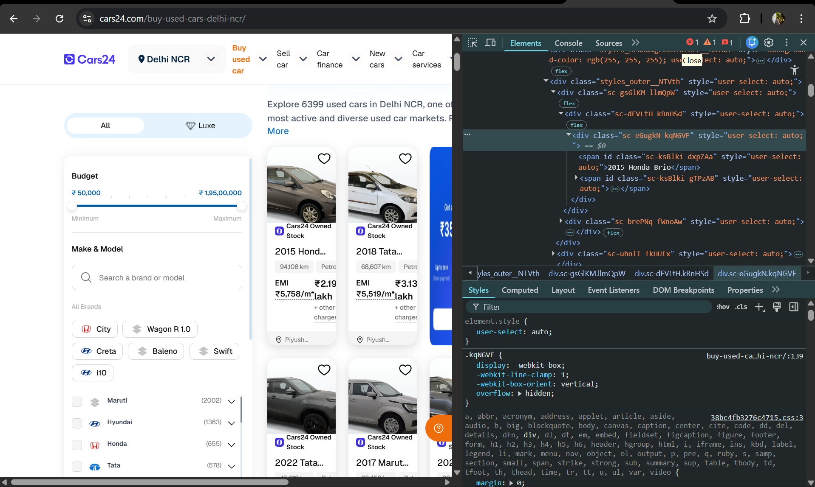
WEB SCRAPING
Tool Used: Selenium WebDriver with Python to automate browser actions and extract dynamic website data.
Target Website: Cars24 used car listings.
Cities Covered: Delhi, Bangalore, Mumbai, Hyderabad, Pune, Gurgaon, Ahmedabad, and Chennai.
Browser Automation: Selenium opened the Chrome browser and navigated to the Cars24 website.
City Selection: The script automatically selected each city to collect location-specific car listings.
Dynamic Content Handling: Explicit waits were used to ensure webpage elements fully loaded before extracting data.
Auto Scrolling: Implemented scrolling to load more car listings that appear dynamically on the page.
Data Extraction: Used XPath/CSS selectors to collect details such as:
Car Brand and Model
Price
Kilometers Driven
Fuel Type
Location/City
Iteration: The process was repeated for multiple listings across all eight cities to build a larger dataset.
Data Storage: Extracted data was stored in a Pandas DataFrame.
Export: Final dataset was saved in CSV/Excel format for further analysis and visualization.
Purpose: The collected data was used to perform area-wise and brand-wise analysis of the used car market in India.

Slide 6
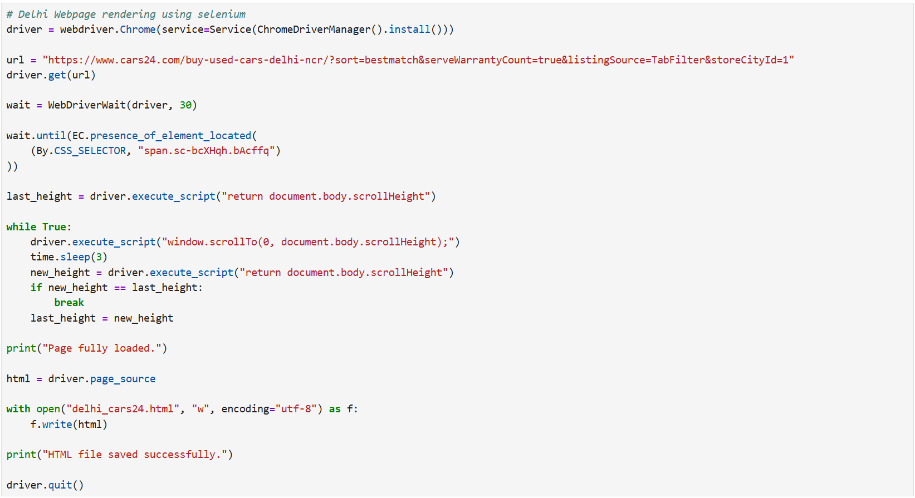
SELENIUM WEBDRIVER WITH PYTHON
Initialize WebDriver: Selenium Chrome WebDriver is launched using ChromeDriverManager() to automate the browser.
Open Target Webpage: The script navigates to the Cars24 Delhi used cars listing page using the URL.
Wait for Page Load: WebDriverWait ensures that the required webpage elements load before extracting data.
Handle Dynamic Content: The script automatically scrolls the webpage to load all car listings that appear during infinite scrolling.
Capture HTML Source: After the page fully loads, the complete HTML page source is extracted.
Save Data: The HTML content is saved as delhi_cars24.html for further data extraction and analysis.
Close Browser: The browser session is closed using driver.quit() after completing the scraping process.

Slide 7
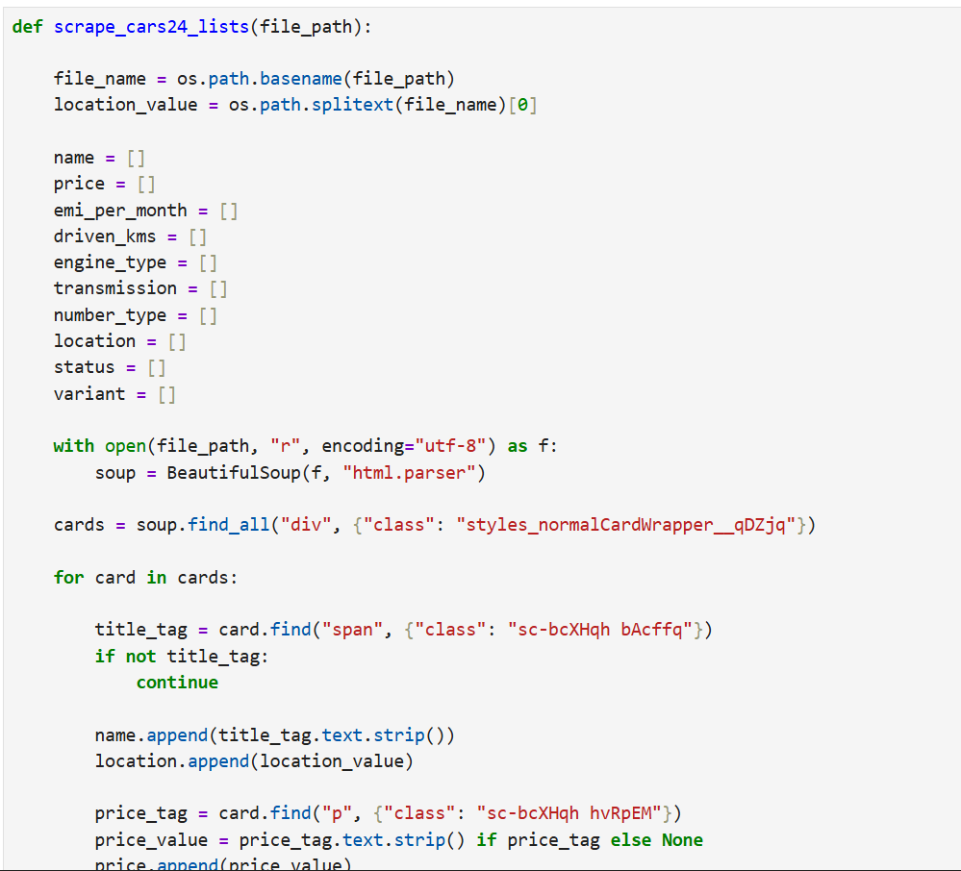
EXTRACTING THE FEATURES FROM SAVED HTML FILES
A function scrape_cars24_lists() is created to extract car details from the saved HTML file.
The file name is used to identify the city/location of the car listings.
Empty lists are created to store data such as car name, price, kilometers driven, fuel type, transmission, and status.
The HTML file is opened and parsed using BeautifulSoup
The script finds all car listing cards using their HTML class.
A loop extracts details like car name and price from each listing.
The extracted values are stored in lists to build a structured dataset for analysis.

Slide 8
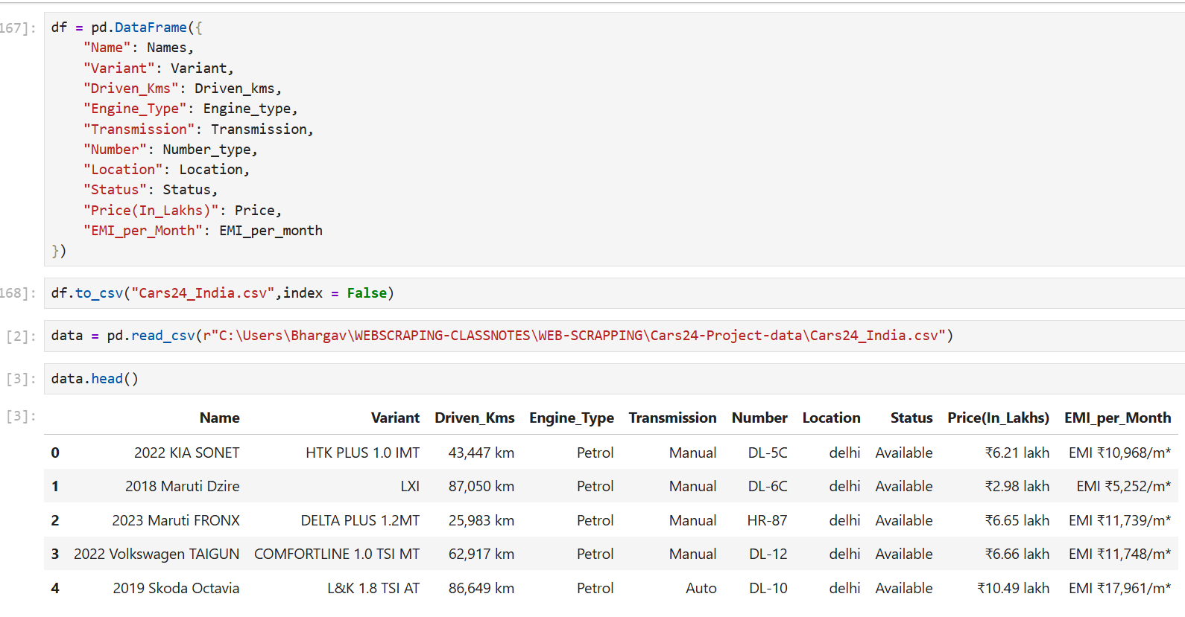
DATA COLLECTED
Extracted car details are organized into a Pandas DataFrame with columns such as Name, Variant, Driven_Kms, Engine_Type, Transmission, Number, Location, Status, Price, and EMI per Month.
Data collected from multiple cities is combined into a single structured dataset.
The structured dataset is then exported to a CSV file (Cars24_India.csv) for storage.
The CSV file is later loaded back into Pandas for further analysis.
The dataset preview is checked using data.head() to verify that the scraped data is correctly stored.
This structured dataset enables easy data cleaning and preprocessing.
The dataset is then used for area-wise and brand-wise analysis of the used car market.

Slide 9
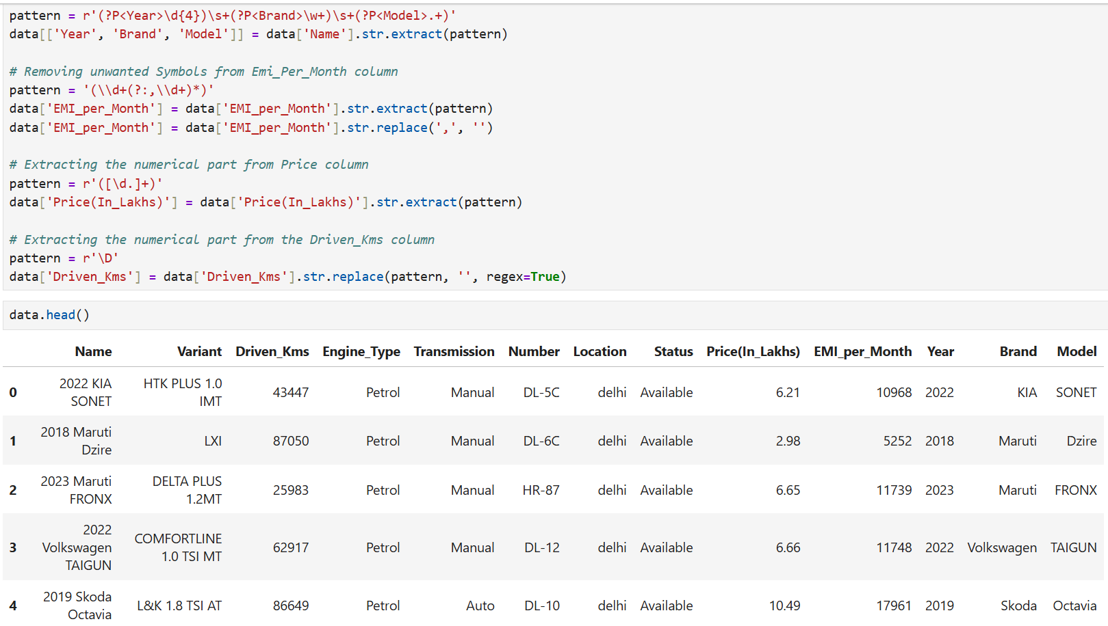
CLEANED UNWANTED DATA USING REGEX
Extract Year, Brand, and Model: Regular expressions were used to split the Name column into separate columns for Year, Brand, and Model.
Clean EMI Column: Unwanted symbols such as ₹, commas, and text were removed from the EMI_per_Month column to keep only numeric values.
Extract Price Values: The numerical part of the Price(In_Lakhs) column was extracted to remove extra text like “lakh”.
Clean Driven_Kms Column: Non-numeric characters such as “km” and commas were removed from the Driven_Kms column.
Convert to Structured Format: These cleaning steps converted raw scraped data into clean numerical values suitable for analysis.
Verify Cleaned Data: The cleaned dataset was checked using data.head() to confirm the transformations.

Slide 10
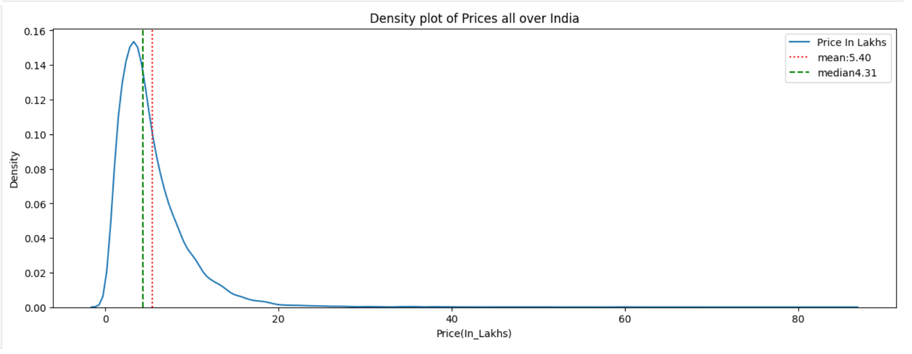
UNIVARIATE ANALYSIS
Price Distribution Analysis (Density Plot)
A density plot was used to visualize the distribution of used car prices across India.
The plot shows how car prices are spread across different price ranges.
The red dotted line represents the mean price (₹5.40 lakhs).
The green dotted line represents the median price (₹4.31 lakhs).
Most used cars are concentrated in the lower price range between ₹2–₹8 lakhs.
The distribution is right-skewed, indicating a small number of high-priced cars.
This analysis helps understand the typical pricing trend in the Indian used car market.

Slide 11
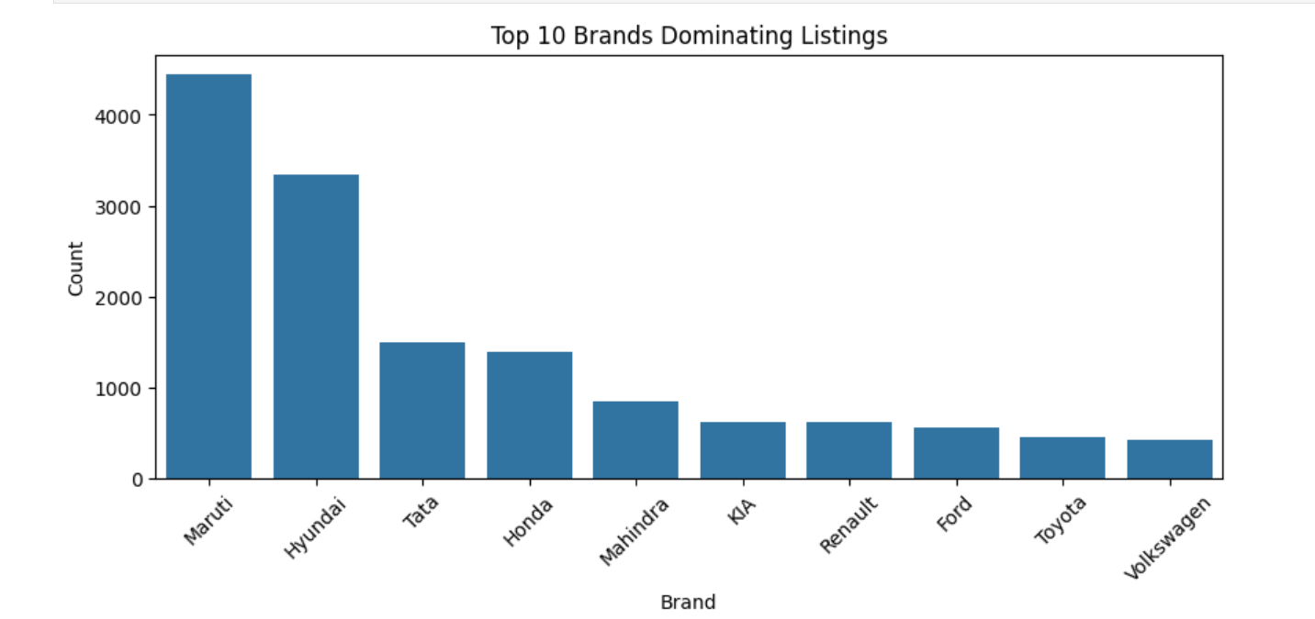
UNIVARIATE ANALYSIS
Top 10 Brands Dominating Used Car Listings
A bar chart was used to identify the top 10 car brands with the highest listings in the dataset.
Maruti has the highest number of used car listings, dominating the market.
Hyundai is the second most listed brand, followed by Tata and Honda.
Other frequently listed brands include Mahindra, KIA, Renault, Ford, Toyota, and Volkswagen.
The results show that Maruti and Hyundai dominate the Indian used car market.
This analysis helps understand brand popularity and market share in used car listings.

Slide 12
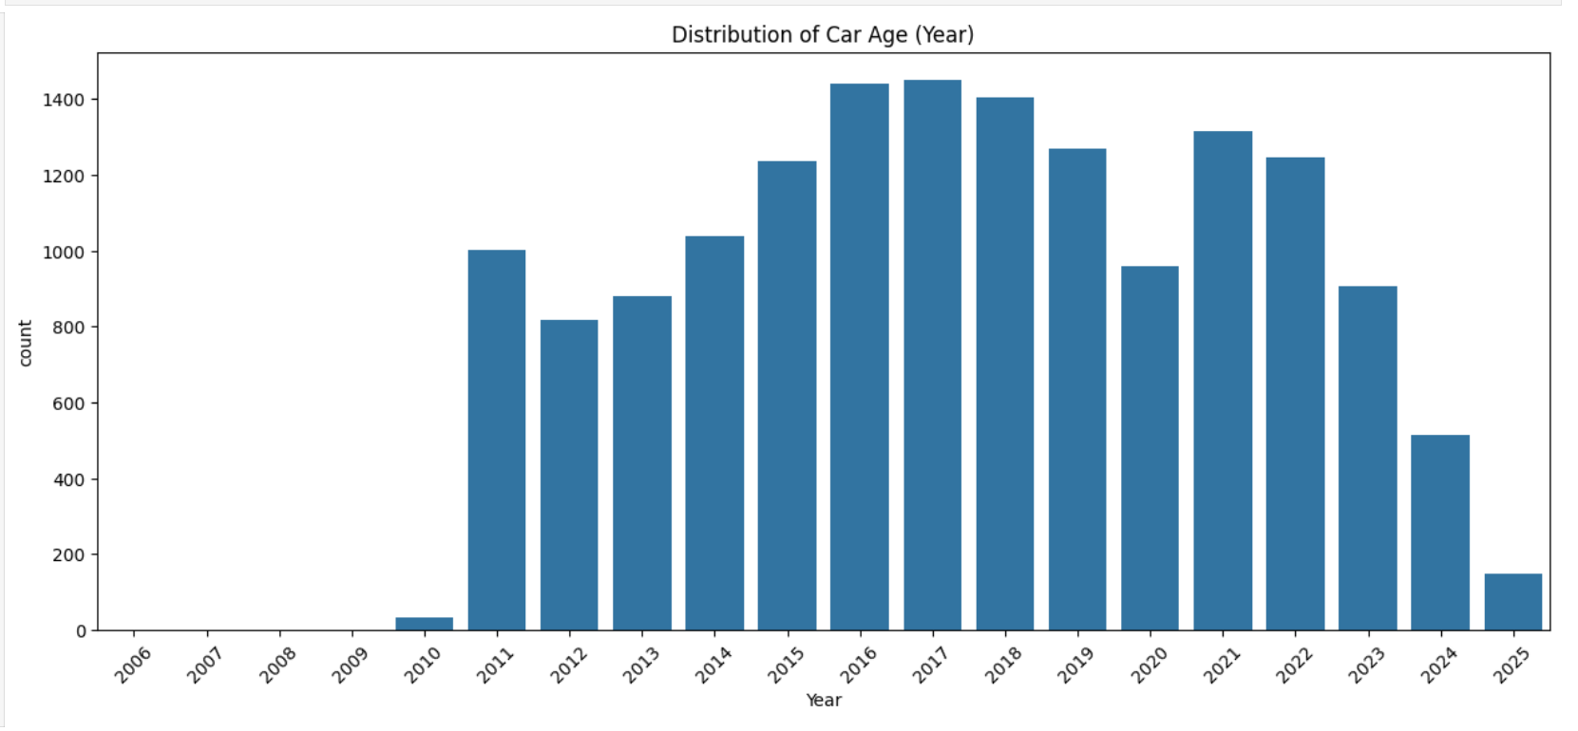
UNIVARIATE ANALYSIS
Distribution of Car Manufacturing Year (Car Age Analysis)
A count plot was used to analyze the distribution of car manufacturing years in the dataset.
Most used car listings fall between 2015 and 2021 model years.
The highest number of listings are around 2016–2018 models.
Very few older cars (before 2010) appear in the dataset.
Newer cars after 2023 have fewer listings, as they are recently purchased.
This analysis helps understand the typical age range of cars sold in the used car market.

Slide 13
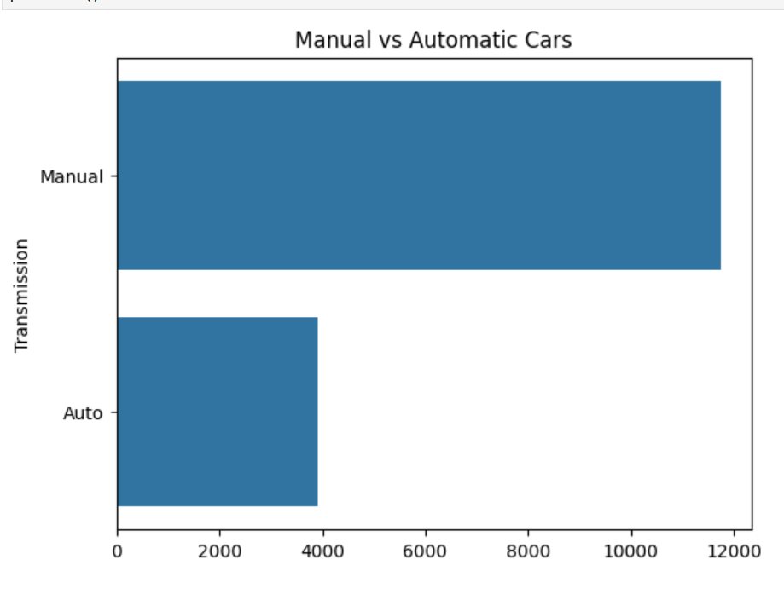
UNIVARIATE ANALYSIS
Manual vs Automatic Transmission Analysis
A bar chart was used to compare the number of manual and automatic cars in the dataset.
Manual transmission cars dominate the used car listings.
Automatic cars are significantly fewer compared to manual vehicles.
This indicates that manual cars are more common in the Indian used car market.
The result reflects consumer preference and higher availability of manual cars.

Slide 14
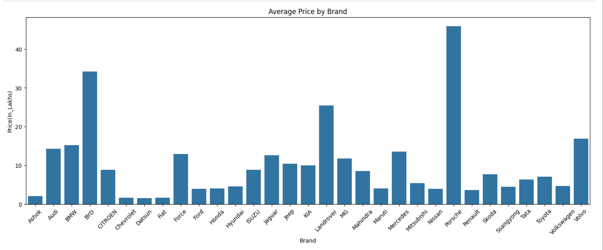
BI-VARIATE ANALYSIS
Average Price by Car Brand
A bar chart was used to analyze the average price of cars for each brand in the dataset.
Luxury brands such as Porsche, BMW, and Audi have significantly higher average prices.
Land Rover and Volvo also show relatively high average price ranges.
Popular brands like Maruti, Hyundai, and Tata have lower average prices compared to luxury brands.
The chart highlights the price differences between premium and budget car brands.
This analysis helps understand how brand value influences the resale price of cars.

Slide 15
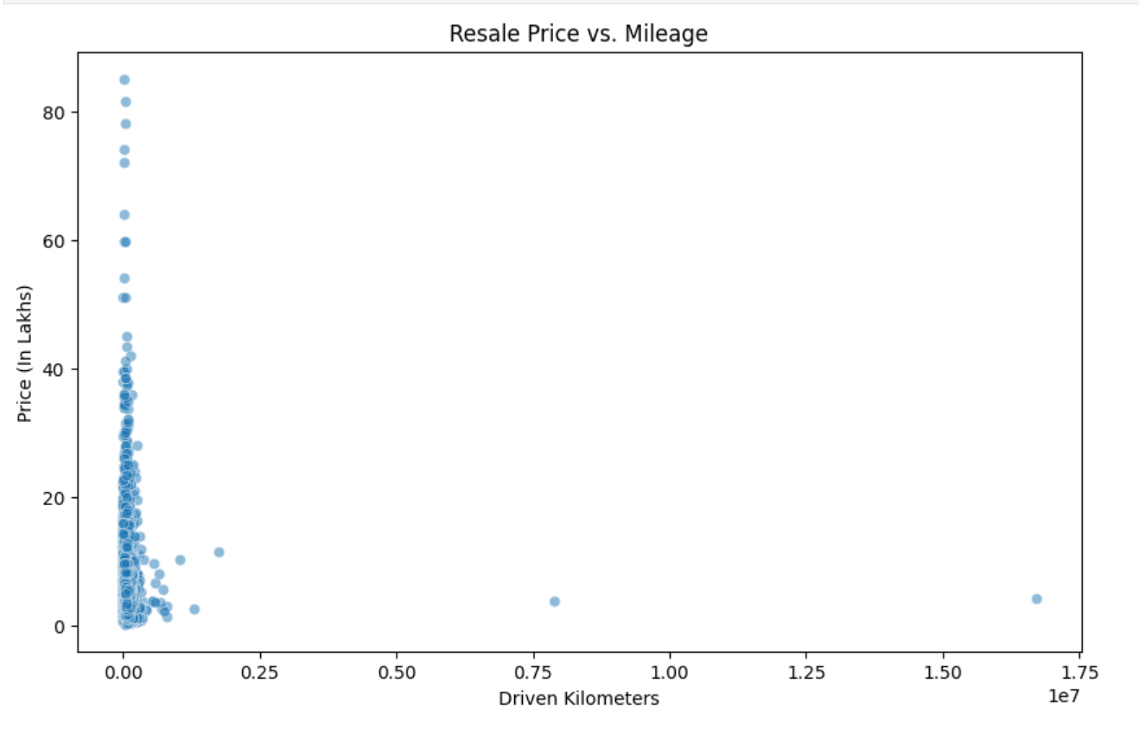
BI-VARIATE ANALYSIS
Resale Price vs Driven Kilometers Analysis
A scatter plot was used to analyze the relationship between resale price and driven kilometers (mileage).
Each point represents a car listing with its price and kilometers driven.
Cars with lower kilometers driven generally have higher resale prices.
As driven kilometers increase, the resale price tends to decrease.
Some outliers exist with very high kilometers but lower prices.
This analysis shows the impact of vehicle usage on resale value in the used car market.

Slide 16
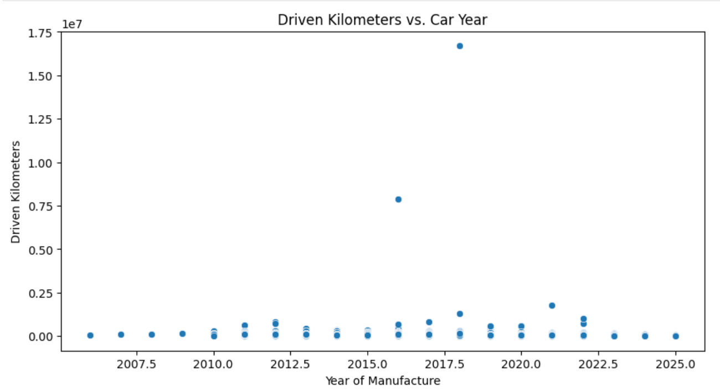
BI-VARIATE ANALYSIS
Driven Kilometers vs Car Manufacturing Year
A scatter plot was used to analyze the relationship between car manufacturing year and kilometers driven.
Older cars generally show higher driven kilometers compared to newer cars.
Newer models tend to have lower mileage, indicating less usage.
Some outliers exist with extremely high kilometers driven.
Most cars fall within a moderate mileage range regardless of year.
This analysis helps understand how vehicle age influences total kilometers driven.

Slide 17
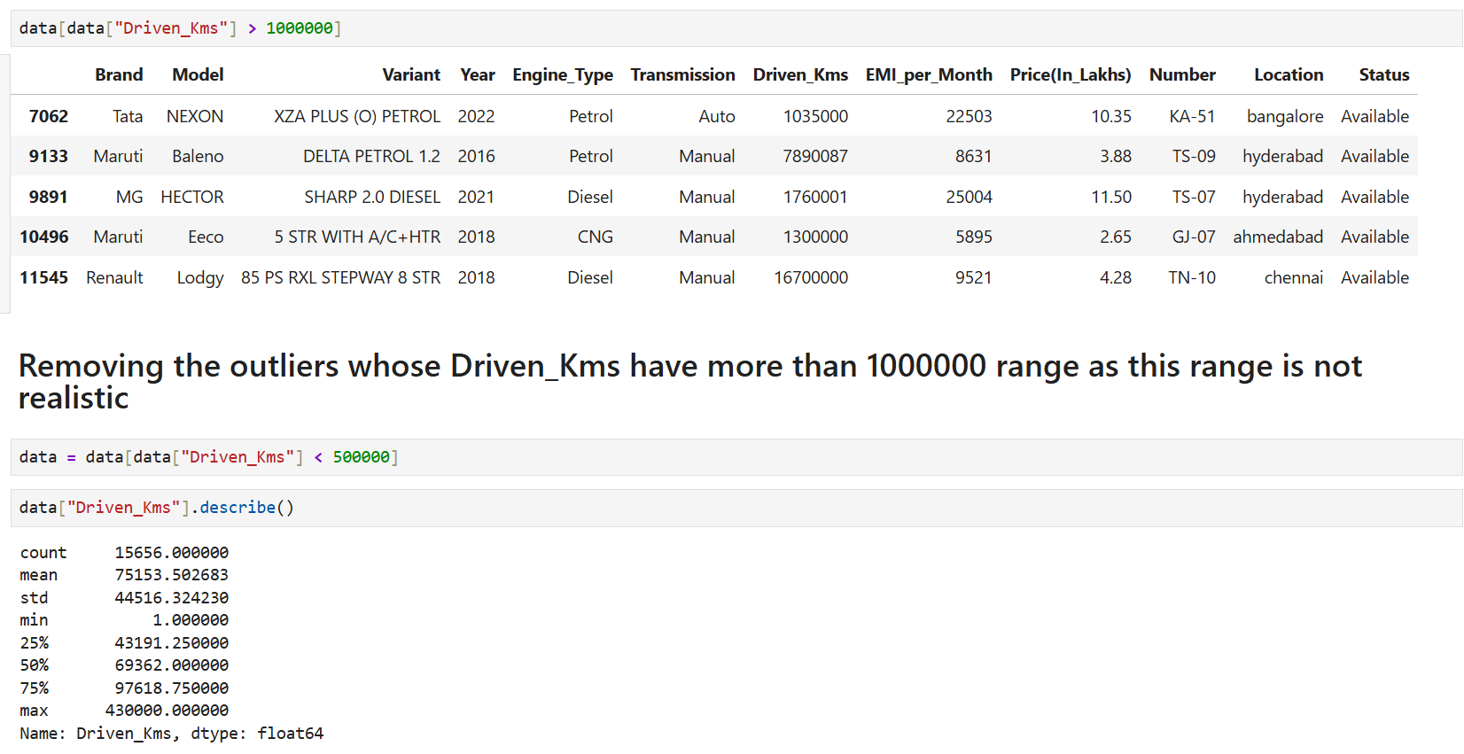
BI-VARIATE ANALYSIS – DETECTING OUTLIERS
Outlier Detection and Removal (Driven Kilometers)
The dataset was checked for outliers in the Driven_Kms column.
Some records showed extremely high values (above 1,000,000 km) which are unrealistic for cars.
These values were identified as data entry or scraping errors.
Outliers were removed by filtering cars with Driven_Kms less than 500,000 km.
After removing outliers, summary statistics (`describe()`) were used to analyze the cleaned data.
This step improved data accuracy and reliability for further analysis.

Slide 18
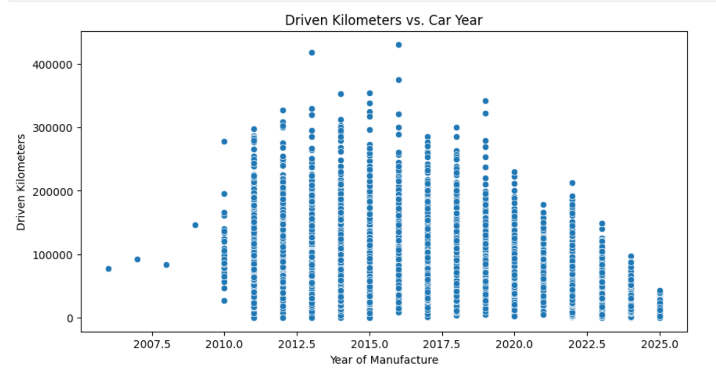
BI-VARIATE ANALYSIS – AFTER REMOVING OUTLIERS
Driven Kilometers vs Car Year (After Removing Outliers)
A scatter plot was used to analyze the relationship between car manufacturing year and driven kilometers after removing outliers.
Unrealistic values were removed to ensure more accurate data representation.
Older cars generally show higher kilometers driven compared to newer models.
Newer cars tend to have lower mileage since they have been used for a shorter period.
The cleaned data provides a clearer and more reliable trend between car age and usage.

Slide 19
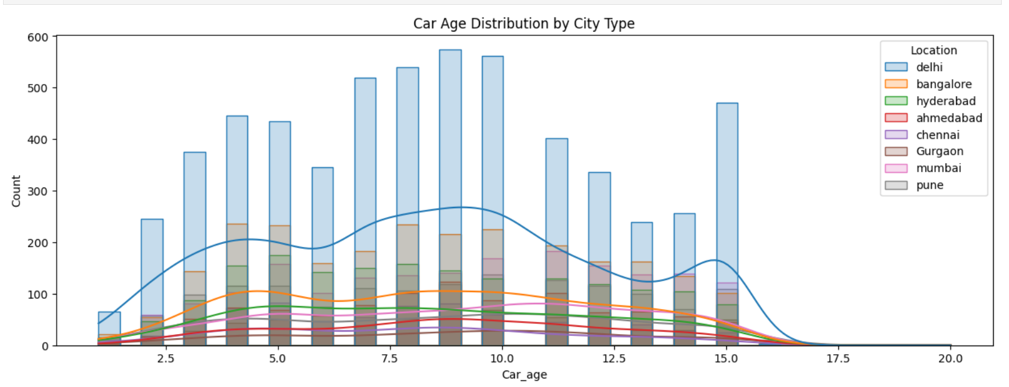
BI-VARIATE ANALYSIS
Car Age Distribution by City
The analysis compares cities such as Delhi, Bangalore, Hyderabad, Ahmedabad, Chennai, Gurgaon, Mumbai, and Pune.
Most used cars fall within the 4–10 years age range across cities.
Delhi shows the highest number of listings compared to other cities.
The distribution pattern is similar across most cities, indicating consistent resale trends.

Slide 20

THANK YOU

