Slide 1
Digital Image Processing
Arithmetical and Logic Operations

Slide 2
Basic Arithmetic Operations
Operation | Definition
ADD | c = a + b
SUB | c = a - b
MUL | c = a * b
DIV | c = a / b
LOG | c = log(a)
EXP | c = exp(a)
SQRT | c = sqrt(a)
TRIG. | c = sin/cos/tan(a)
INVERT | c = (2^{B} - 1) - a

Slide 3
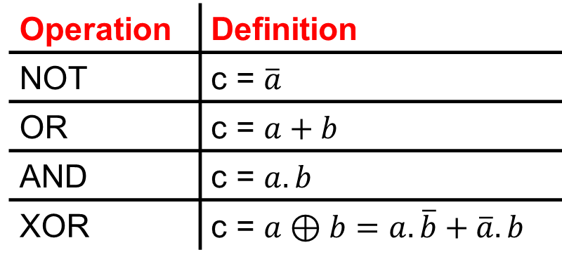
Basic Logic Operations

Slide 4





Arithmetic and Logic Operations
a
b
NOT(a)
a . b
a + b

Slide 5
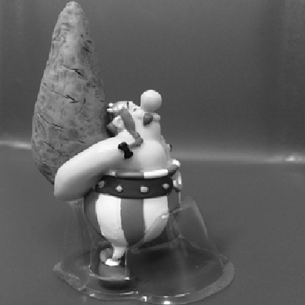

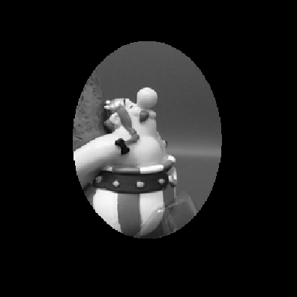

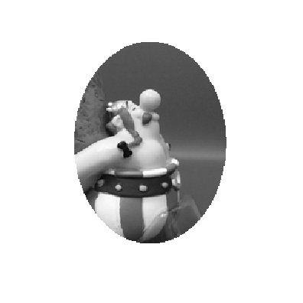
Arithmetic and Logic Operations
.
=
+
=

Slide 6
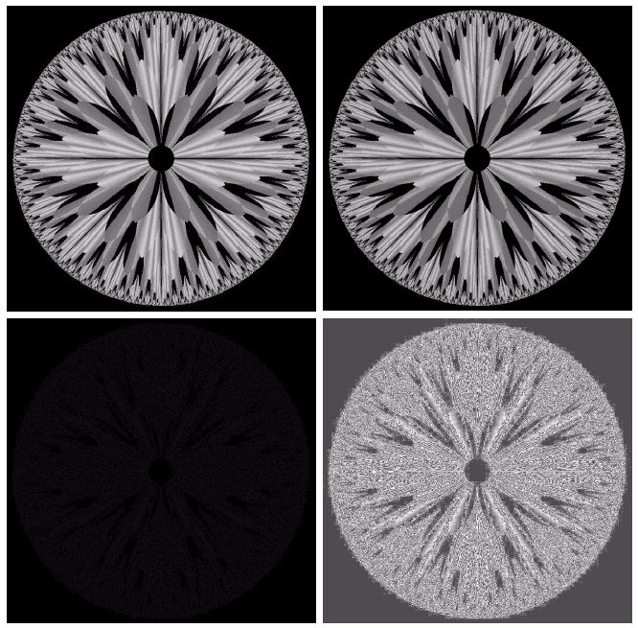
Image Subtraction
a | b
c | d
(a) original fractal image. (b) Result of setting the four lower-order bit planes to zero. (c) Difference between (a) and (b) . (d) Histogram equalized difference image.
© 2002 R. C. Gonzalez & R. E. Woods

Slide 7
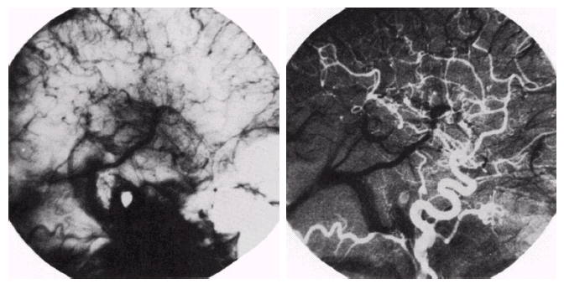
Image Subtraction
a | b
Enhancement by image subtraction. (a) Mask image. (b) An image with mask subtracted out.
© 2002 R. C. Gonzalez & R. E. Woods

Slide 8
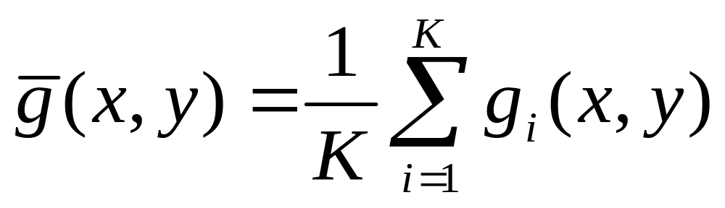
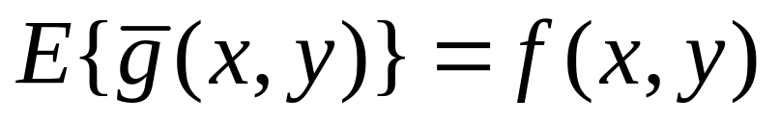
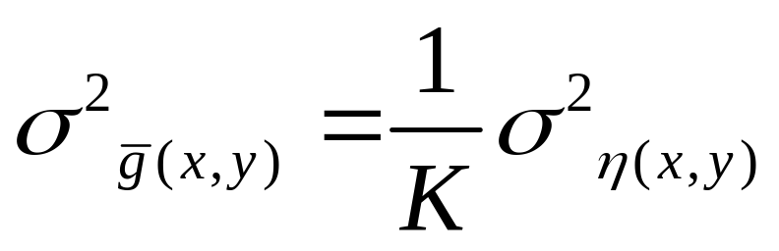
Image Averaging
Image Averaging : consider an uncorrelated noise with zero average value then:

Slide 9
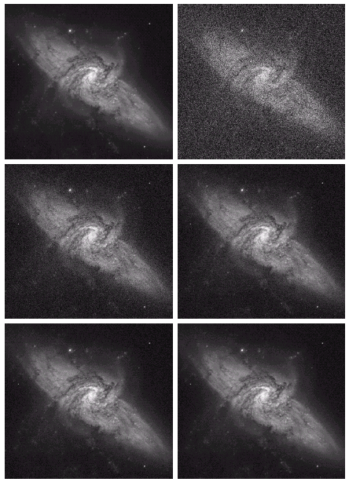
Image Averaging
Original
K=1
K=8
K=16
K=64
K=128
© 2002 R. C. Gonzalez & R. E. Woods

Slide 10
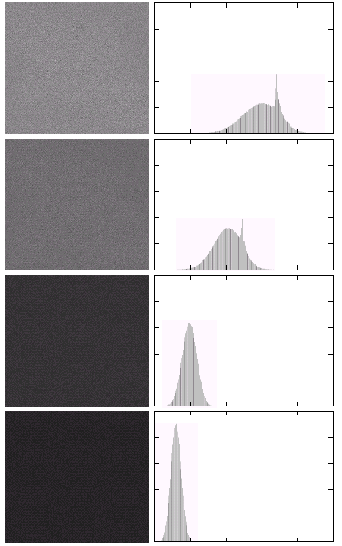
Image Averaging
K=8
K=16
K=64
K=128
© 2002 R. C. Gonzalez & R. E. Woods

Slide 11
Spatial Filtering
Filtering : spatial domain filtering
frequency domain filtering
Spatial domain filtering : linear spatial filtering
nonlinear spatial filtering

Slide 12
Summary
We have looked at:
  What are arithmetic operations.
  What are logic operations.
  Image averaging
Next time we will continue our talk
about image enhancement in spatial
domain by focusing on spatial filtering

