Slide 1
Smartphone based User Authentication Scheme without Verifier Table on Authentication Server
Bhaskar Kalia
Anurag Singh
Sushant Thakur
Premlata Negi
Nisha Kumari

Slide 2
The Proposed Scheme
The proposed scheme also consists of three phases
Registration phase: Used for registration of new user
Authentication phase: Used for every time user want to access resource
Password change phase: Used when user loses his phone to recover the account
<number>
Notes:
<number>

Slide 3
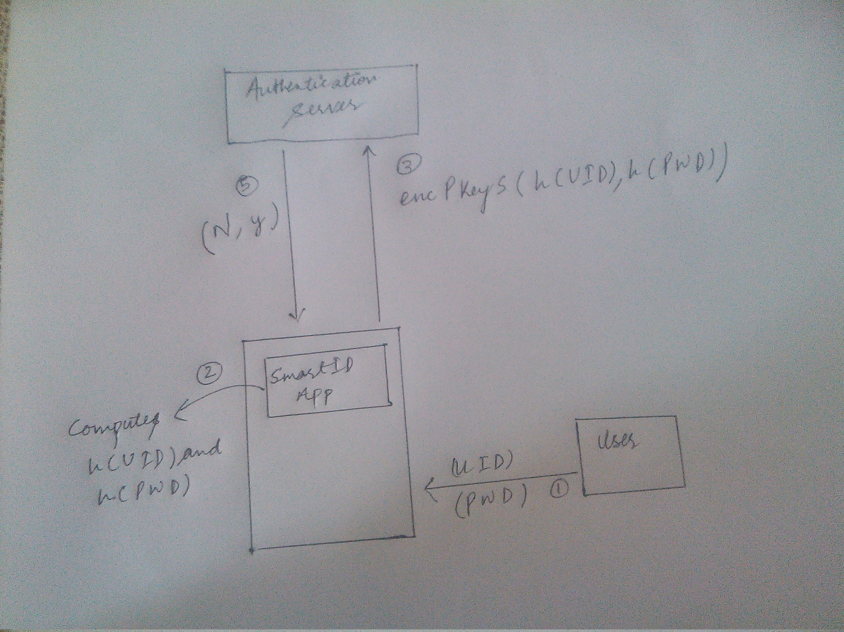
Registration Phase
<number>
Notes:
<number>

Slide 4
User will start the Application on phone and tap on the "Register" option to register himself. A login page will display in which user will enter the UserID (UID), password(PWD).
Application computes h(UID) and h(PWD).
Application encrypts h(UID) and h(PWD) with the Public Key of Authentication server and sends to Authentication server.
<number>

Slide 5
Server computes Nonce, N= h(PWD) ⊕ h(x), where x is server master key.
Server sends back N and y to application where y is a number stored in each user application.
<number>

Slide 6
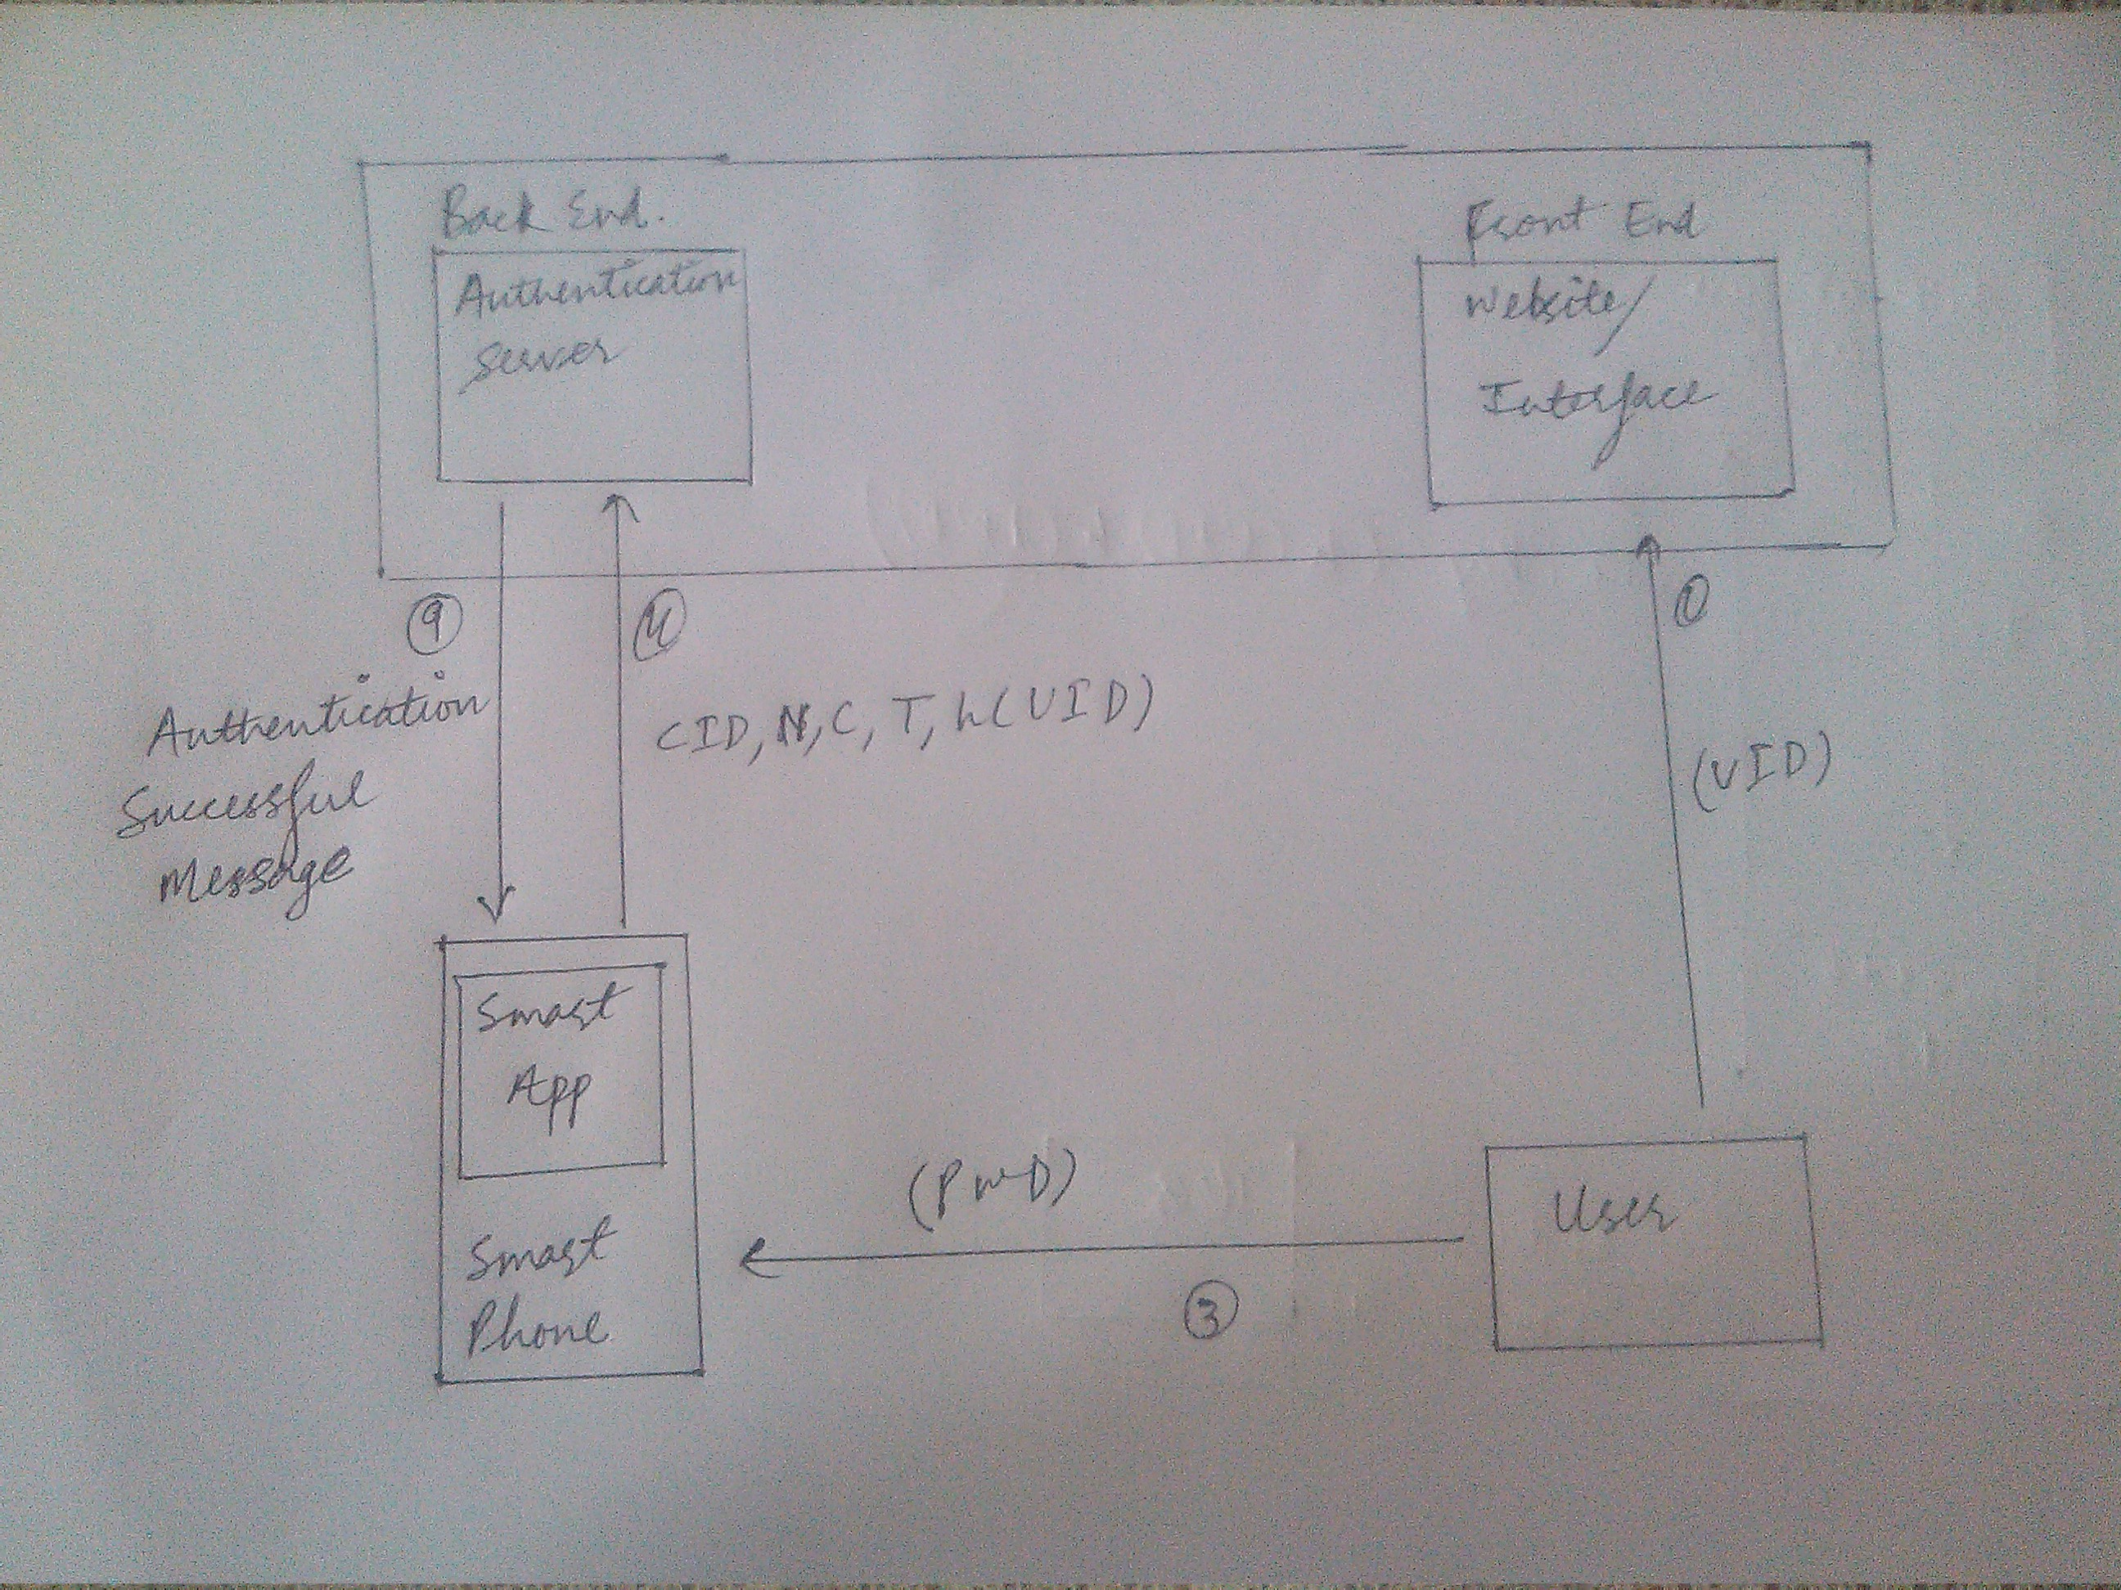
Authentication Phase

Slide 7
User enters UID on website/server .
Website directs user to authenticate via app.
User enters PWD in the application and taps on authenticate button.
Application computes, CID= h(PWD) ⊕ h(N ⊕ y ⊕ T), where T is the curent date and time.
B= h(CID ⊕ h(PWD)). - C= h(T ⊕ N ⊕ B ⊕ y).
App->Server: CID,N,C,T,h(UID).
Notes:
<number>

Slide 8
5. Upon receiving the login message(CID,N,C,T, UID) at the time T* , the remote server authenticates the user with the following steps:
6. Verify the validity of the time interval between T and T* . If (T*-T) >=del T , where del T denotes the expected valid time interval for transmission delay, then the remote server rejects the login request.
7. Computes h(PWD )= CID ⊕ h(N⊕ y⊕ T) .
8. Computes B= h(CID⊕ h(PWD )).
<number>

Slide 9
9. Thereafter, checks whether C= h(T⊕ N⊕ B⊕ y). If it holds,the remote system accepts the login request. Otherwise it terminates the login operation .

Slide 10
Password Change Phase
This phase is invoked whenever the user wants to change his password. He can easily change his password without taking any assistance from the remote system. The phase works as follows:
1. The user opens his application. He submits the password PWD and requests to change the password.
2. Then User chooses new password PWD* .
<number>

Slide 11
3. The smart card computes
N*= N⊕ h(PWD)⊕ h(PWD*) , which yields h(PWD*)⊕ h(x) .
4. The nonce N will be replaced with N*. The password has been changed with the new password PWD* and terminates the operation.
<number>

