Slide 1
Sub Routines - Functions

Slide 2
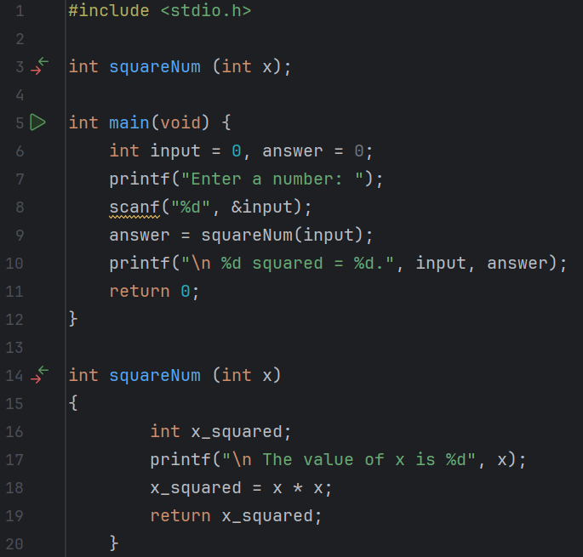
Predict
What do you think this code does?

Slide 3
Run
Download the code from Github and run it!
What does the code do?
Does this match your prediction?

Slide 4
Investigate
Investigation Activities
What are the name of the variables being used? What data types do they hold? What are the names of the functions? What type of data do these return? Annotate lines 4-19 to explain what each line of code does.

Slide 5
Modify
Modification Activities
Modify the program to return the cube of the value entered. Modify the program to return the square root of the value entered.

Slide 6
Make
Make Activities
Write a program that uses shows you can write a function, pass a parameter and return a value. Requirements: The program should allow a user to enter a number It should then pass the number as a parameter to an int function called divEleven() The function should then calculate how many times the input number can be divided by 11 The result of the sum should be returned to the main program and output to screen e.g.

