Slide 1

TEAM NAME : REAL TIME VISIONARIES
TEAM SIZE : 2
Problem statement 2 : Image Sharpening using knowledge distillation
INTERNSHIP 2
TEAM MEMBERS :
1. C . V BHAVADEEP KUMAR – BU22CSEN0300277
2. T . NAVEEN REDDY – BU22CSEN0500017
Dept of Computer Science & Engineering

Slide 2
ABSTRACT
Motion blur is a prevalent problem in images captured during fast motion or low shutter speeds, degrading visual quality and affecting downstream computer vision tasks. While state-of-the-art models like Restormer offer exceptional deblurring performance, their high computational costs make them impractical for deployment in real-time systems or on resource-constrained devices.
In this project, we propose a knowledge distillation framework where a compact student model learns to replicate the deblurring capabilities of the larger teacher model (Restormer). The student is trained using a custom loss function that includes reconstruction loss, perceptual loss, feature distillation loss, and edge-aware loss to ensure both fidelity and perceptual sharpness.
We use the GoPro dataset, which contains paired blurred and sharp images, and enhance it with teacher-generated outputs. The lightweight student model is trained to simultaneously minimize the differences with both the ground truth and the teacher outputs.
Experimental results demonstrate that the student model achieves competitive performance in terms of SSIM and perceptual quality, while significantly reducing computational cost — making it ideal for edge-based and mobile deployment.
Dept of Computer Science & Engineering

Slide 3
DATASET OVERVIEW
Dataset Used: GoPro Motion Deblurring Dataset
This dataset is widely used for benchmarking motion deblurring algorithms.
It consists of paired blurred and sharp images, captured from high-speed video frames.
Each blurred image has a corresponding sharp ground-truth image.
Total Images:
3,214 pairs (blur + sharp)
Resolution: 1280 × 720 pixels
Split:
Training Set: 2,103 pairs
--train/blur/ → 2,103 images
--train/sharp/ → 2,103 images
Testing Set: 1,111 pairs
--test/blur/ → 1,111 images
--test/sharp/ → 1,111 images
GoPro/
├── train/
│ ├── blurry/
│ │ ├── img1.png
│ │ ├── img2.png
│ │ └── ...
│ └── sharp/
│ ├── img1.png
│ ├── img2.png
│ └── ...
├── test/
│ ├── blurry/
│ └── sharp/
Dept of Computer Science & Engineering

Slide 4
TEACHER MODEL - RESTORMER
The Restormer is a state-of-the-art deep learning model designed for high-performance image restoration tasks such as deblurring, deraining, and denoising. It leverages transformer-based architectures with long-range dependency modeling, making it particularly effective in handling complex image degradations like motion blur.
Key Features :
Transformer-Based Backbone:Restormer uses self-attention mechanisms to capture global context, which CNNs often miss.
Multi-Stage Hierarchical Design:It processes images at multiple resolutions, refining details progressively.
Gated DFFN (Depth-wise Fully-connected Feedforward Network):Improves feature transformation and efficiency with fewer parameters than traditional MLPs.
Layer Norm and Residual Connections:Help stabilize training and preserve fine details in restored images.
Pretrained Model for Deblurring:We use the pretrained model released by the authors, trained specifically for motion deblurring using the GoPro dataset.
Dept of Computer Science & Engineering

Slide 5
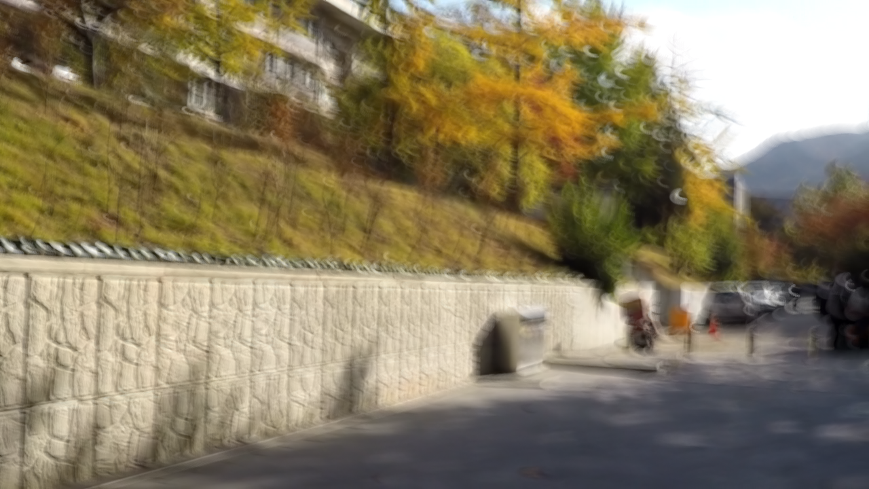

Role in Our Project
The Restormer model acts as the teacher in our knowledge distillation setup.
It takes blurred images as input and produces high-quality deblurred outputs.
These teacher-generated outputs are then used to guide the training of a lightweight student CNN.
This helps the student learn from both :
--Ground truth sharp images (hard labels)
--Teacher’s outputs (soft labels)
INPUT : BLUR IMAGE
OUTPUT : DEBLURRED IMAGE
“INPUT BLUR → RESTORMER → DEBLURRED OUTPUT”
Dept of Computer Science & Engineering

Slide 6
STUDENT MODEL - CNN
To reduce the computational cost of inference while maintaining good deblurring performance, we design a lightweight Convolutional Neural Network (CNN) as the student model.
The student model is trained using knowledge distillation, where it mimics both:
The ground truth sharp images (supervised learning)
The outputs of the Restormer teacher model (distillation)
Architecture :
Encoder:
-- Conv2D (Input: 3 channels → 32 channels), Kernel: 3x3, Padding: 1 → ReLU
-- Conv2D (32 → 64 channels), Kernel: 3x3, Padding: 1 → ReLU
Decoder:
-- Conv2D (64 → 32 channels), Kernel: 3x3, Padding: 1 → ReLU
-- Conv2D (32 → 3 channels), Kernel: 3x3, Padding: 1 (Final output image)
A smaller model ensures fast training and testing, making it suitable for mobile devices and real-time usage.
Dept of Computer Science & Engineering

Slide 7
Design Goals:
Minimize number of parameters
Maintain high structural similarity (SSIM)
Ensure fast inference time
Be compatible with distillation learning from teacher outputs
Training Process:
The student receives the blurred image as input.
It generates a predicted sharp image.
During training, the output is compared against:
-- The ground truth (using L1 loss, edge loss)
-- The Restormer teacher’s output (for knowledge distillation and perceptual loss)
Input (Blur Image)
↓
Conv2D + ReLU (x2) → Encoder
↓
Conv2D + ReLU (x2) → Decoder
↓
Output (Deblurred Image)
Dept of Computer Science & Engineering

Slide 8
KNOWLEDGE DISTILLATION
Knowledge Distillation is a machine learning technique where a smaller, simpler student model learns to imitate the behavior of a larger, more complex teacher model.
It helps transfer the generalization ability of the teacher to the student, even when the student has far fewer parameters.
How It Works in Our Project
Teacher Model: Restormer -- Trained on GoPro dataset to produce high-quality deblurred images.
Student Model: Lightweight CNN -- Trained to mimic both the teacher’s output and the actual ground truth (sharp image).
Dual Supervision: The student is trained with two sources of supervision:
-- Hard Target: Ground truth sharp images
-- Soft Target: Teacher’s deblurred output
Dept of Computer Science & Engineering

Slide 9
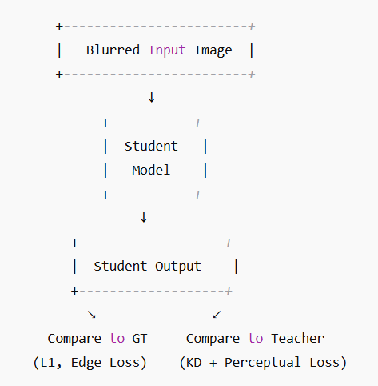
KNOWLEDGE DISTILLATION
Why Use Distillation?
Helps the student model learn:
-- Where to focus (important edges and structures)
-- How to generalize like the teacher
-- Reduces model size,memory footprint,inference time
Simply to say “You get the brains of the teacher in the body of a student.”
Dept of Computer Science & Engineering

Slide 10
LOSS FUNCTIONS
To train the student model effectively, we combine multiple loss functions.
Each loss serves a specific purpose to ensure the deblurred output is:
-- Pixel-accurate
-- Perceptually sharp
-- Structurally similar to the ground truth
-- Guided by the teacher’s predictions
Reconstruction Loss (L1 Loss) :
Measures absolute difference between the student’s output and the ground truth sharp image.
Promotes pixel-level accuracy.
2. Knowledge Distillation Loss
Encourages the student to match the teacher model's output.
Helps in learning soft features and teacher's knowledge.
FORMULA : Lrec =||Student_Output−Sharp_GT||1
FORMULA : Lkd =||Student_Output−Teacher_Output||1
Dept of Computer Science & Engineering

Slide 11
3. Perceptual Loss (VGG-based):
Uses intermediate layers of a pretrained VGG-16 network to measure differences in feature space rather than pixels.
Helps student learn texture, content, and structure.
4. Knowledge Distillation Loss
Ensures sharp edges and transitions.
Uses Sobel filters to calculate gradients in both student and ground truth.
Promotes better edge alignment and local detail preservation.
FORMULA : Lpercep =||ϕ (Student)−ϕ(Teacher)||1
FORMULA : Ledge =||∇ (Student)−∇ (Teacher)||1
Dept of Computer Science & Engineering

Slide 12
TRAINING RESULTS
Loss Decrease Over Epochs :
The average loss dropped from 0.0567 in Epoch 1 to 0.0237 in Epoch 10 — over 58% reduction, indicating effective convergence.
Most of the performance gain occurred in the first 4 epochs, suggesting fast initial learning.
2. Improved Image Quality (SSIM) :
Structural Similarity Index (SSIM) improved from 0.76 to 0.87, showing that the model's output became visually and structurally closer to the ground truth.
Plateau after Epoch 6 indicates the model reached saturation with the current architecture and dataset size.
3. Loss Breakdown Insight:
Reconstruction Loss (L1):
-- Final sample: 0.0425
-- Average: 0.0256
-- Indicates good pixel-level accuracy.
Dept of Computer Science & Engineering

Slide 13
Perceptual Loss (VGG):
-- Final sample: 0.65
-- Average: 0.55
-- Shows that the model retains high-level visual features learned from the teacher.
Feature Distillation Loss:
-- Final: 0.0386
-- Average: 0.0225
-- Confirms the student successfully mimics teacher behavior at feature level.
Edge/Gradient Loss:
-- Final: 0.35
-- Average: 0.18
-- Demonstrates that the model effectively learns to preserve edge details.
4. Performance vs. Complexity
Despite being a lightweight model, the student achieved:
-- High SSIM (up to 0.87)
-- Visually sharp outputs
Dept of Computer Science & Engineering

Slide 14
CONCLUSION
This project presented an efficient and scalable motion deblurring solution using Knowledge Distillation, where a compact CNN-based student model learns to replicate the performance of a complex Restormer transformer model.
-- Input: Blurred image
-- Teacher Output: Generated by Restormer
-- Student Output: From lightweight model
-- Ground Truth: Original sharp image
Successfully trained a lightweight student model with strong deblurring capabilities.
Achieved a peak SSIM of 0.872 on the GoPro dataset.
Combined multiple loss functions (L1, perceptual, edge, distillation) for superior visual results
Significantly reduced training time and model size, enabling real-time
Demonstrated effective feature transfer from Restormer to a simpler CNN.
Dept of Computer Science & Engineering

Slide 15
Thank You
Dept of Computer Science & Engineering

