Slide 1



Major Project Review
MATRUSRI ENGINEERING COLLEGE
Department of CSE
Symmetric-Key Encryption for Cloud Storage Security
Project Batch Number: B15
Project Guide : Mrs B Sonal, Asst professor
Student Names Roll No
1) B. Aishwarya 1608-20-733-069
2) S. Bhavya Sri 1608-20-733-081
3) V. Sai Prakash 1608-20-733-080

Slide 2
Content Page
MATRUSRI ENGINEERING COLLEGE
Department of CSE
Problem Statement
Introduction
Motivation
Objectives
Existing System
Proposed System
Implementation
Technology Stack
UML Diagrams
Screens
Conclusion
Future Scope
References

Slide 3

Problem Statement
MATRUSRI ENGINEERING COLLEGE
Department of CSE
SYMMETRIC-KEY ENCRYPTION FOR CLOUD STORAGE SECURITY
Cloud services are always to prone to account hijacking, malware injection attacks.
Symmetric encryption requires that both the sender and receiver have the same key and each computes a common key that is subsequently used.

Slide 4
Introduction
MATRUSRI ENGINEERING COLLEGE
Department of CSE
Technology has been emerging enormously in the latest 21st century. As a coin has two sides, similarly the threats or vulnerabilities in the system have become even more danger.
To provide an authenticated security to cloud storage, we can make use of various encryption techniques such as symmetric key cryptography or public-key encryption.
Symmetric-key encryption, a type of encryption where only one key (a secret key) is used to both encrypt and decrypt electronic data .The sender encrypts the data before sending it and the receiver decrypts the data after receiving the data.
To be secured, information needs to be hidden from unauthorized access (confidentiality), protected from unauthorized change (integrity), and available to an authorized entity when it is needed (availability).

Slide 5
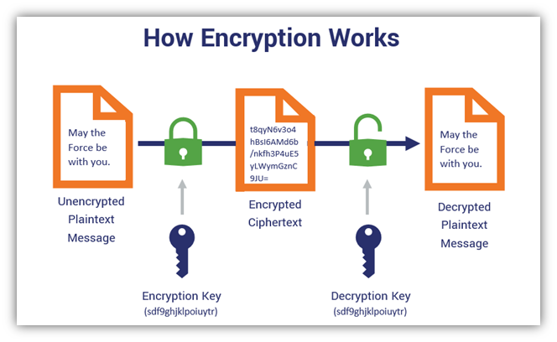

Slide 6
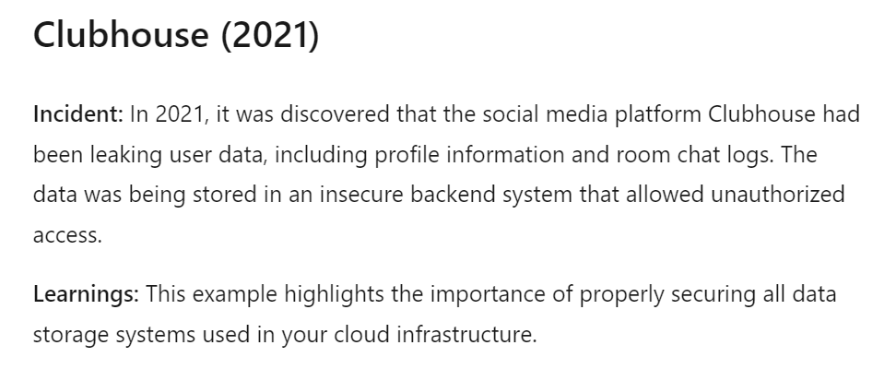
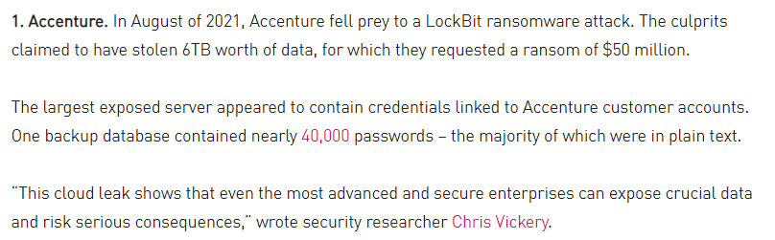
Motivation
MATRUSRI ENGINEERING COLLEGE
Department of CSE
Cloud storages are constantly under cyber attacks. Hackers are honing their methods and techniques to intrude into your cloud storage and steal your data.
As more and more companies move their data to the cloud, it is becoming increasingly important for them to understand the risks and potential consequences of cloud hacks.

Slide 7
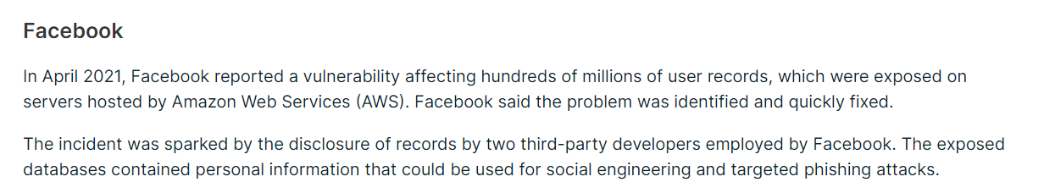

Searching for a document on cloud which consists of millions of files, increases the retrieval rate. By using keyword search, this can be minimized.
Google search engine generates plenty of links or related information according to the keyword specified in the search bar.

Slide 8
Objectives
MATRUSRI ENGINEERING COLLEGE
Department of CSE
The main objective is to generate the encryption which allows the user to retrieve the encrypted documents.
To protect the data that is stored or moving in and out of the cloud from security threats, unauthorized access, theft, and corruption.
The most important concept of security is to provide encryption to the data which is valuable.
To protect the data from chosen ciphertext attack, Key algorithm attack, Brute force attack
To secure the information on the cloud against modification and to maintain user’s data integrity.

Slide 9
Existing System
MATRUSRI ENGINEERING COLLEGE
Department of CSE
Existing cloud security software are Trend micro one, cisco cloudlock, PaloAlto networks prisma cloud and soon. Trend micro one has the agent based security on Desktop/Laptop and error reporting is very difficult to maintain. Support is very slow to respond and resolve issues.
Many organizations implement a defense-in-depth plan that includes: Firewalls Anti-malware Intrusion detection Access control
Cloud environments are vulnerable to network-based attacks, as tactics like distributed denial-of-service (DDoS) can throttle speed, block traffic, and cause unpredictable downtime.
Unauthorized access can take longer to detect on the cloud than on physical, on-premise systems.
If companies hand over ownership to a managed cloud services provider, there can be a significant delay in reporting and addressing the breach.

Slide 10
Proposed System
MATRUSRI ENGINEERING COLLEGE
Department of CSE
The main aim is to develop a Symmetric-key Encryption system(SKES) for the secure cloud storage.
Using one of the efficient symmetric algorithm named AES encryption algorithm, the document is encrypted and secret key is obtained.
The data owner uploads the documents into cloud using a secret Key.
The user who wants to retrieve files enters the key to retrieve, which the user wants to get the documents

Slide 11
Implementation
MATRUSRI ENGINEERING COLLEGE
Department of CSE
AES Algorithm:
Advanced encryption algorithm is a specification for the encryption of electronic data established by the U.S National Institute of Standards and Technology (NIST) in 2001. AES is widely used today as it is a much stronger than DES and triple DES despite being harder to implement.
Why AES?
With the right quantum computer, AES algorithm would take about 2.61*10^12 years to cryptanalyse without knowing keysize.
It takes 128 bits as input and outputs 128 bits of encrypted cipher text as output. AES relies on substitution-permutation network principle which means it is performed using a series of linked operations which involves replacing and shuffling of the input data.

Slide 12
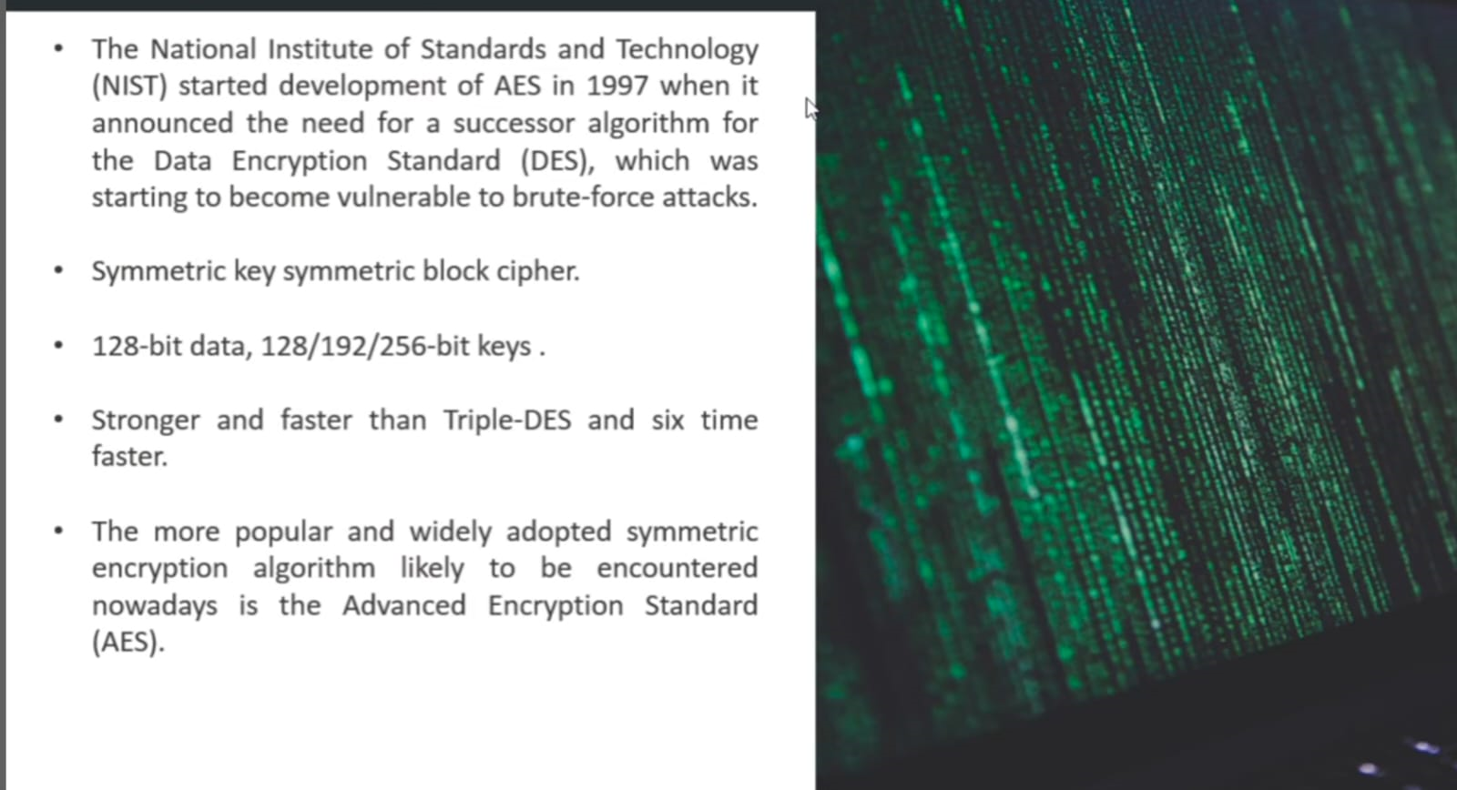

Slide 13
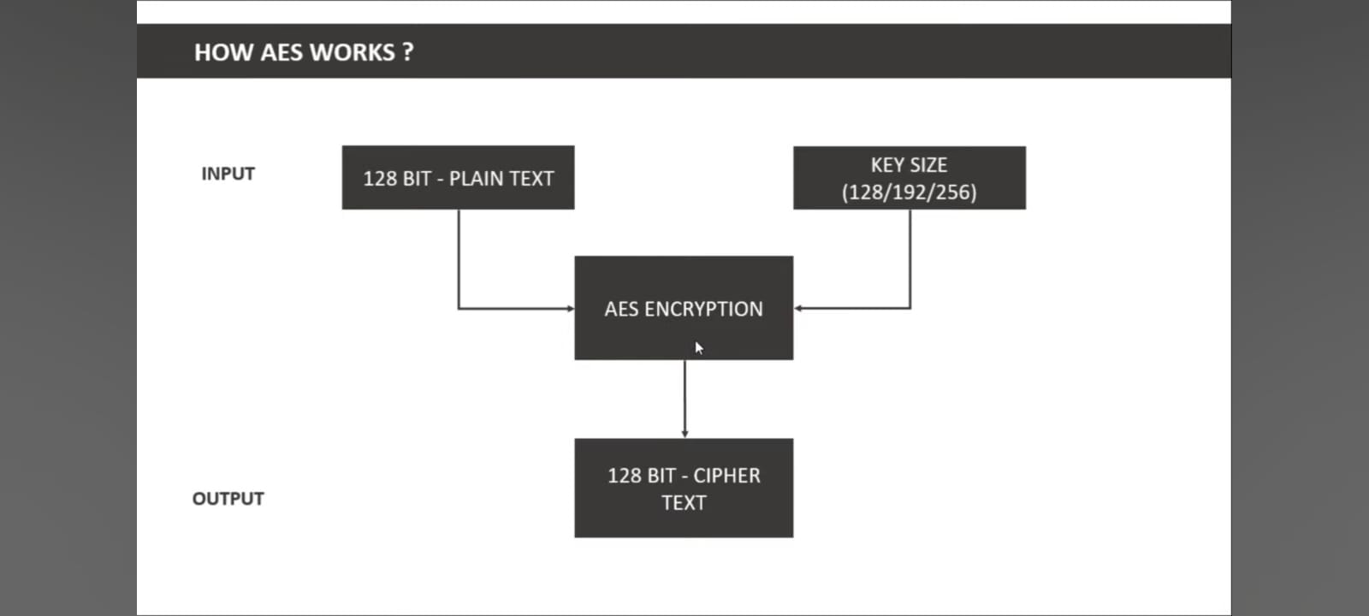

Slide 14
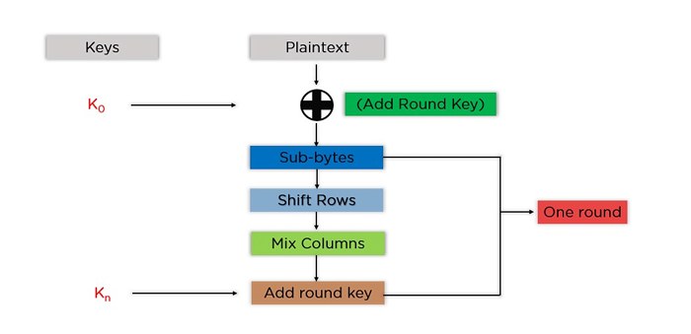

Slide 15
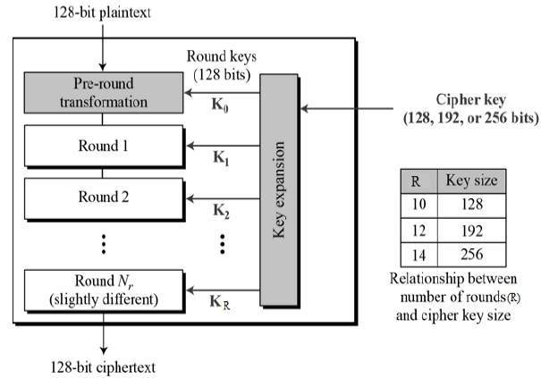

Slide 16
Technology stack
MATRUSRI ENGINEERING COLLEGE
Department of CSE
Software Requirements:
Operating system: Windows 10, Linux
Programming languages: Java, JSP
Server: GlassFish/Apache
Database connector: MySQL connector jar
Database: MySQL Server(SQL yog)
Hardware Requirements:
Processor: Core i3 and above
Hard Disk: 500GB
RAM: 4GB
Data Card

Slide 17
UML DIAGRAMS
MATRUSRI ENGINEERING COLLEGE
Department of CSE
Class diagram
Activity diagram
Use-case diagram
Sequence diagram
Communication diagram
Component diagram
Deployment diagram

Slide 18
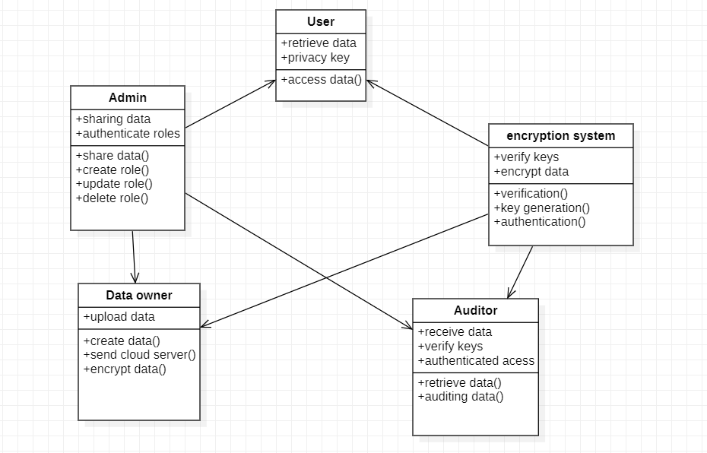
CLASS DIAGRAM

Slide 19
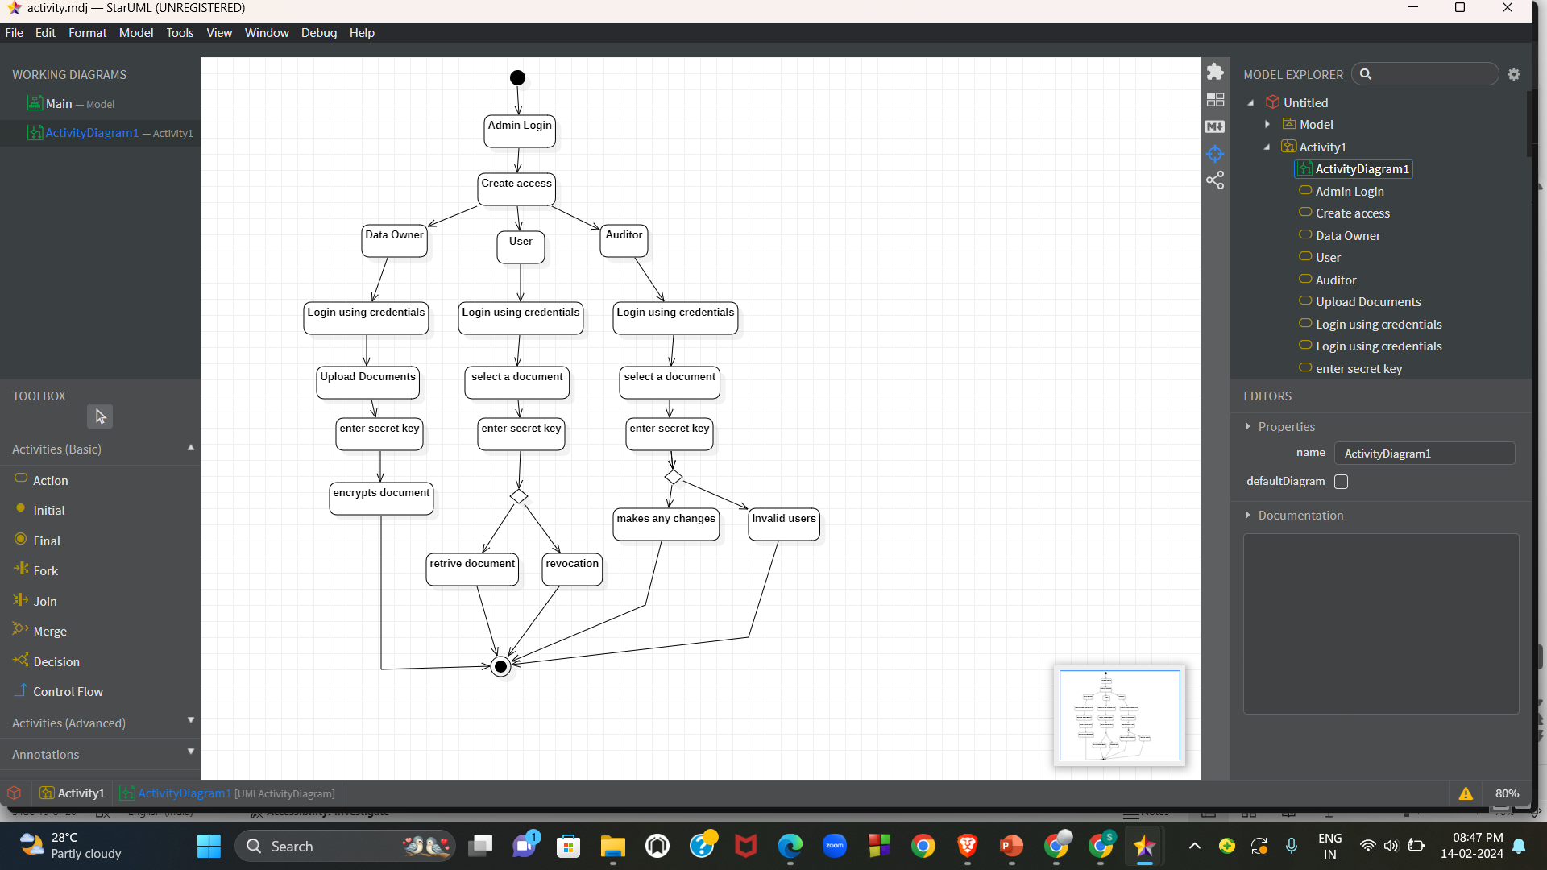
ACTIVITY DIAGRAM

Slide 20
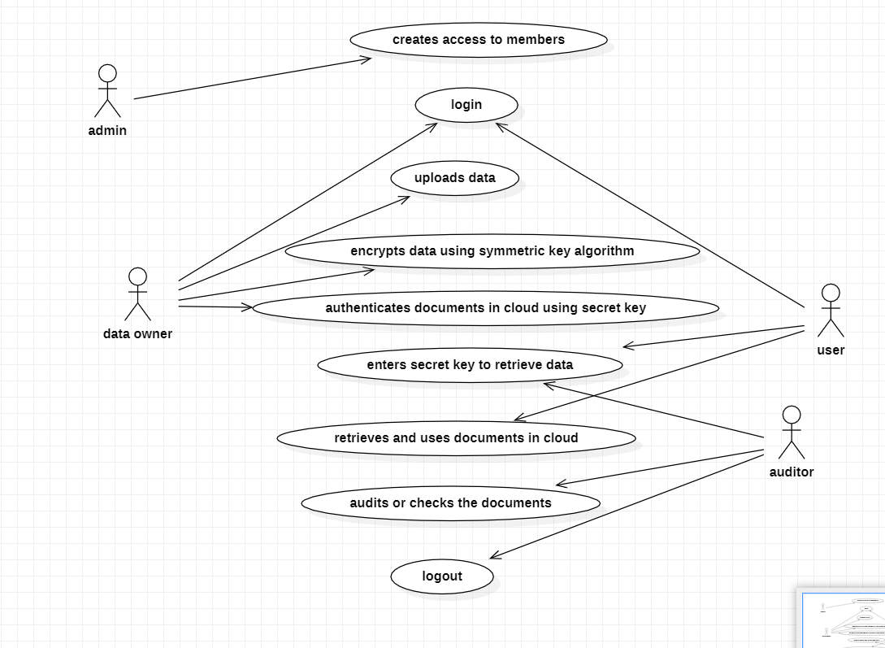
USECASE DIAGRAM

Slide 21
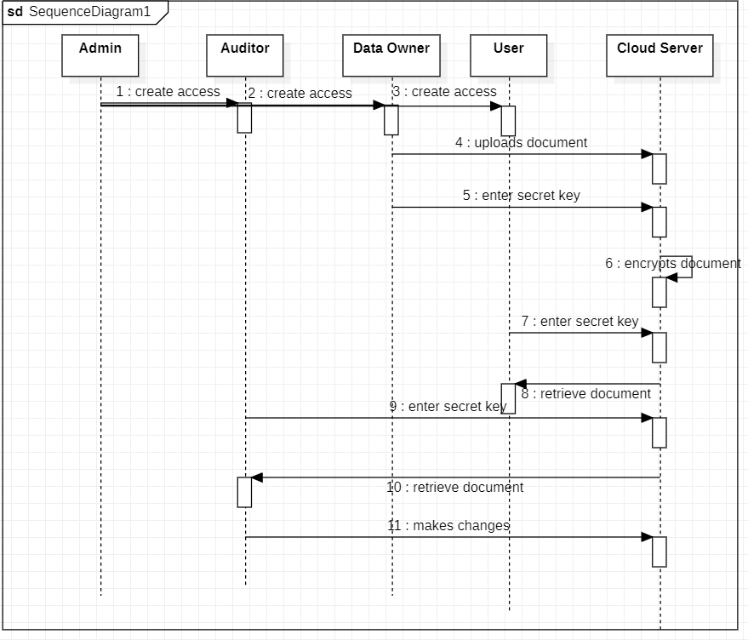
SEQUENCE DIAGRAM

Slide 22
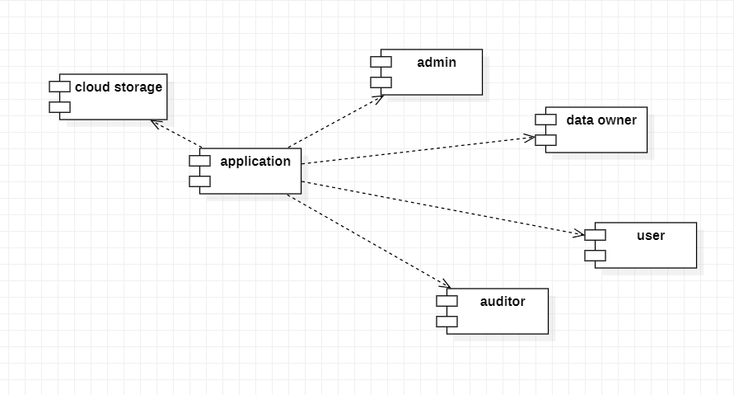
COMPONENT DIAGRAM

Slide 23
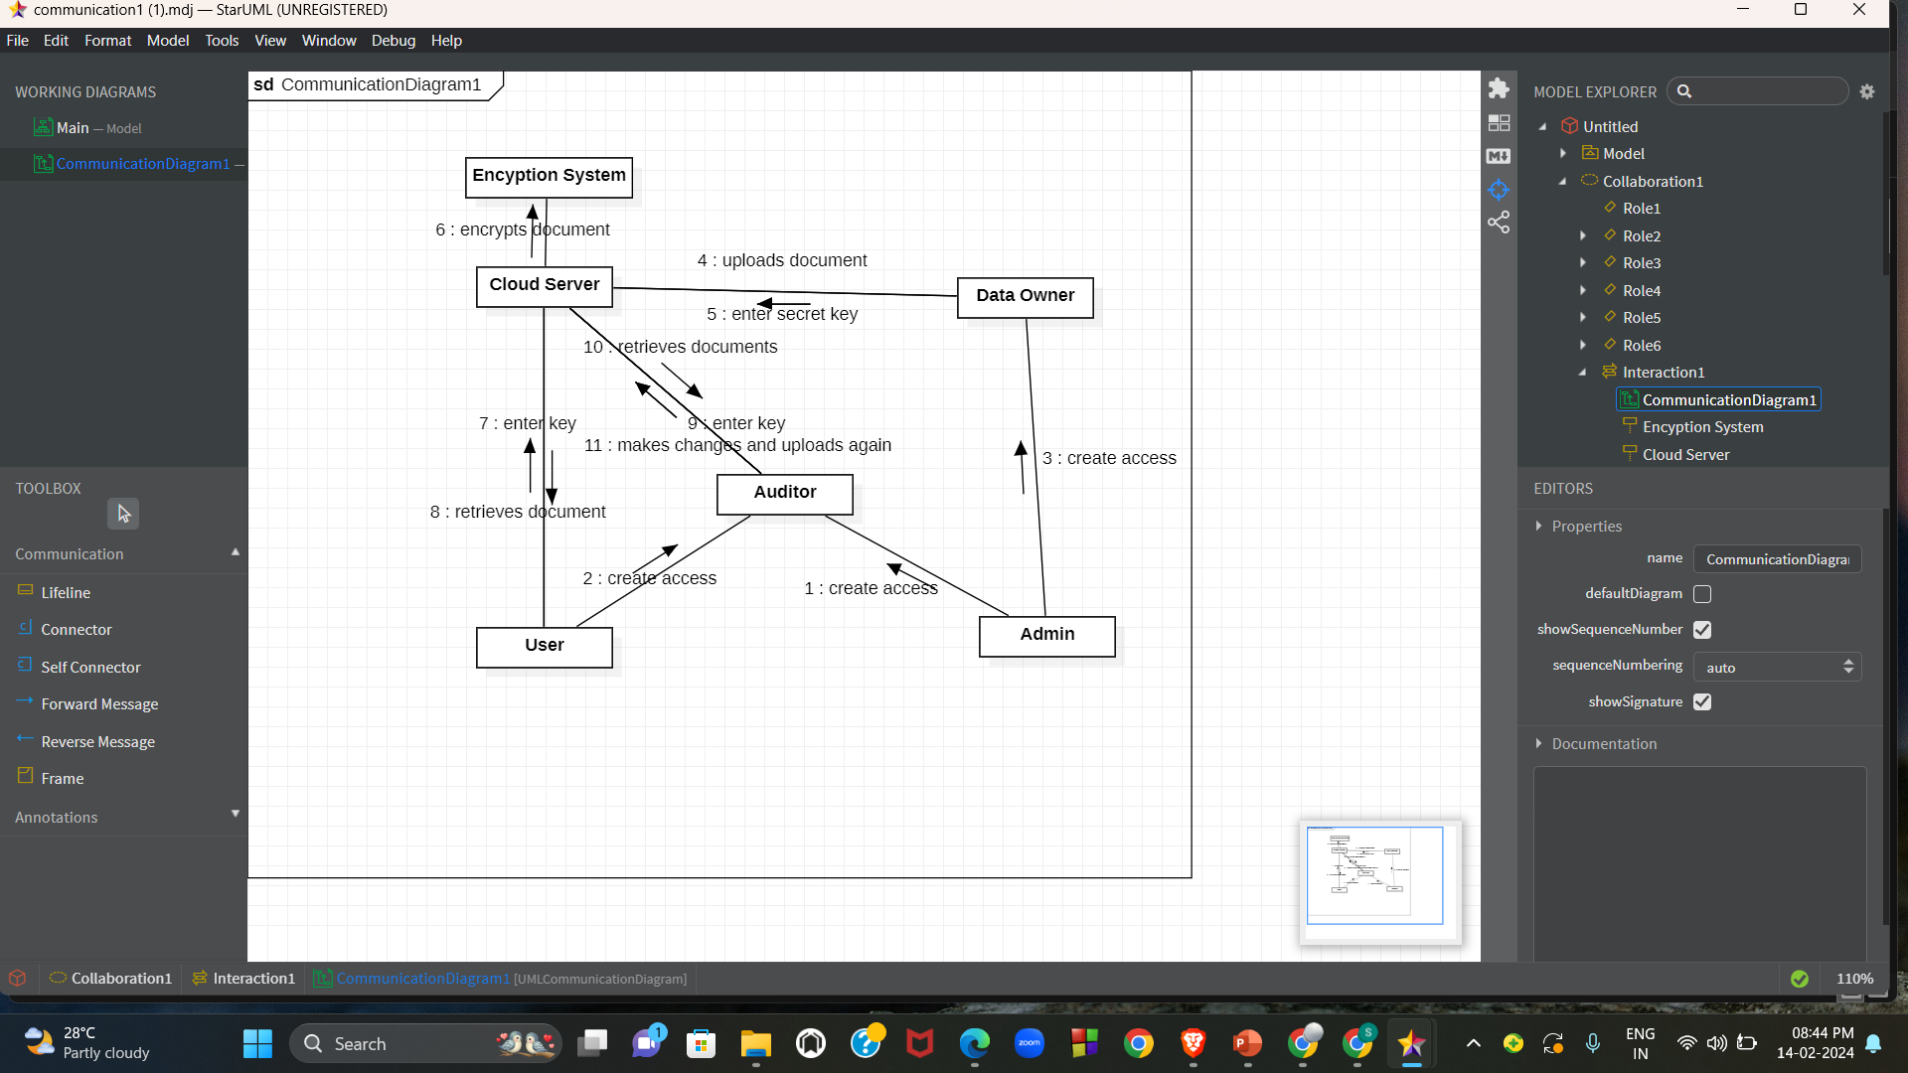
COMMUNICATION DIAGRAM

Slide 24
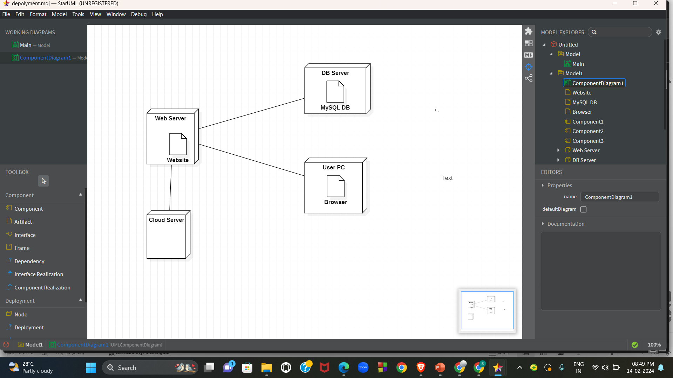
DEPLOYMENT DIAGRAM

Slide 25
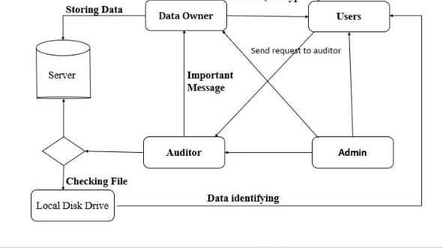
System Architecture

Slide 26
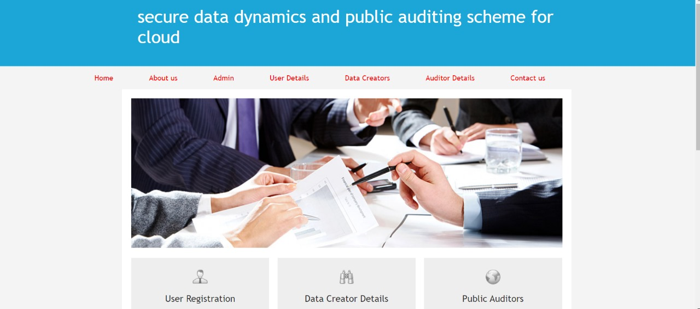

Screens
Main Page
Admin Login Page

Slide 27

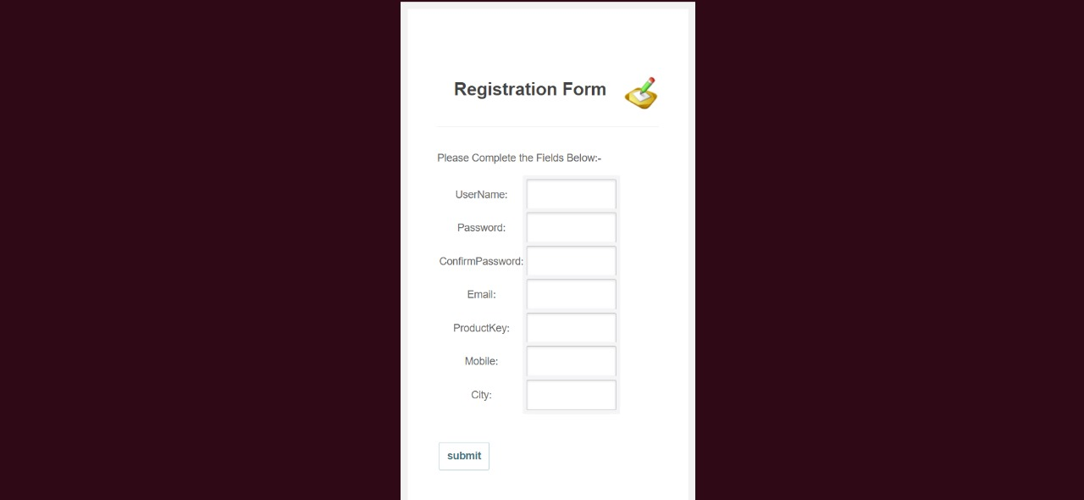
Registration Page
Data Owner Registration Page

Slide 28

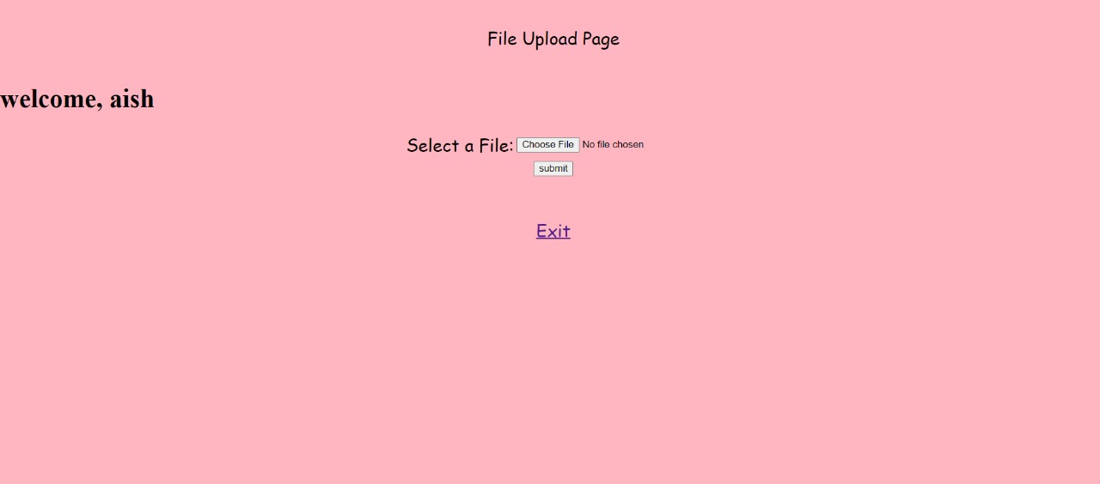
Data Owner Login Page
File Upload Page

Slide 29
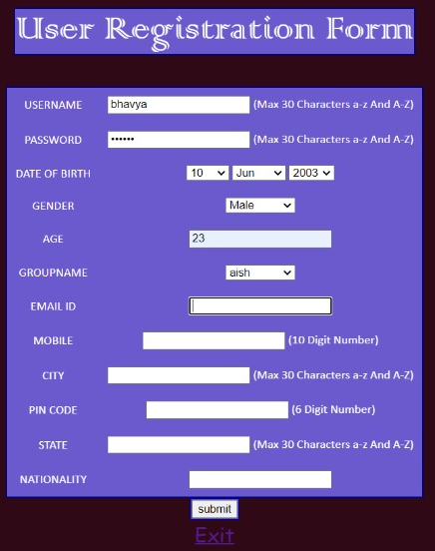

User Registration Page
User Login Page

Slide 30

File Download Page

Slide 31
Conclusion
MATRUSRI ENGINEERING COLLEGE
Department of CSE
In the realm of cloud storage, where vast amounts of sensitive data are stored and transmitted across networks, security is paramount. Symmetric key encryption emerges as a robust solution for safeguarding data integrity, confidentiality, and authenticity in cloud storage environments.
The application of symmetric key encryption in cloud storage begins with data encryption before transmission or storage. When a user uploads data to the cloud, it is encrypted using a symmetric encryption algorithm along with a secret key.
Symmetric encryption algorithms, such as Advanced Encryption Standard (AES), are computationally efficient and can process large volumes of data swiftly.
This efficiency is essential for cloud storage environments where rapid encryption and decryption of data are necessary to meet the demands of users accessing their data from various locations and devices.
In conclusion, symmetric key encryption serves as a fundamental building block for securing data in cloud storage. By encrypting data using a shared secret key, cloud storage providers can ensure confidentiality, integrity, and authenticity of stored data.

Slide 32
Future Scope
MATRUSRI ENGINEERING COLLEGE
Department of CSE
Integration with various standard cloud service platforms like Microsoft Azure, Amazon web services can be done for extensive storage and security.
Mobile application can also be enabled for this system.
Public key infrastructure(PKI) can also be integrated with this application.
Elliptic curve cryptography may also be used.
For better community engagement and collaboration by open-sourcing the project code, sharing in various platforms like GitHub and inviting contributions from various developers. This collaborative approach could accelerate innovation, sharing and facilitate developing new features for the project.

Slide 33
References
MATRUSRI ENGINEERING COLLEGE
Department of CSE
[1] Dr. S. Vasundra et.al, CSE, JNTUACEA, Published a paper” Enabling Secure Data Sharing in the Cloud Storage Groups”, International Research Journal of Engineering and Technology, ISSN: 2395-0056, July 2017.
[2] S. Kamara, C. Papamanthou and T. Roeder, “Dynamic searchable symmetric encryption,” presented at ACM Conference on Computer and Communications Security, pp. 965-976, 2012.
[3] Z. H. Xia, X. H.Wang, X. M. Sun and Q.Wang, “A Secure and Dynamic Multi Keyword Ranked Search Scheme over Encrypted Cloud Data,” in IEEE Transactions on Parallel and Distributed Systems, vol. 27, No. 2, pp. 340-352.
[4] J. B. Yan, Y. Q. Zhang and X. F. Liu, “Secure multikeyword search supporting dynamic update and ranked retrieval,” in China Communication, vol. 13, No. 10, pp.209-221, 2016.
[5] E. Goh, H. Shacham, N. Modadugu, and D. Boneh, “Sirius: Securing remote untrusted storage,” in Proc. of NDSS’03, 2003.
[6] Subashini S, Kavitha V (2011) A survey on security issues in service delivery models of cloud computing. J Netw Comput Appl 34:1–11.
[7] C. Guo, X. Chen, Y. M. Jie, Z. J. Fu, M. C. Li and B. Feng, “Dynamic Multi phrase Ranked Search over Encrypted Data with Symmetric Searchable Encryption,” in IEEE Transations on Services Computing, vol. 99, No. 1939, pp. 1 1, 2017.

