Slide 1


TechE CGC_REBOUNDER

Slide 2


Slide 3
CONTENT
Use-case model
Flowchart
Bluetooth Chipset
Design
Formulae
Algorithm
Working
Testing
Screen shots
Updation in Version

Slide 4
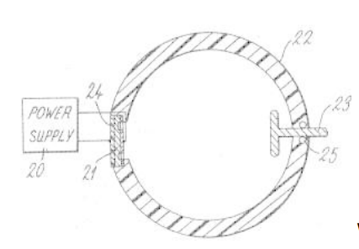
USE-CASE MODEL
A Ring Shaped Embedded Structure
Used to Calculate the Exact Volume
Of Petrol being Poured in the vehicle

Slide 5
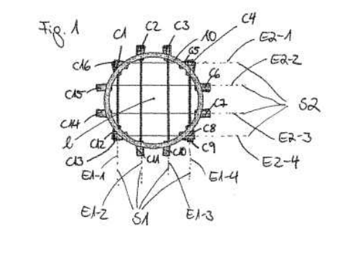
USE-CASE MODEL
This is how the Ring is divided in
Particular Quarter in order to
Get the Exact Volume of Petrol
Being Dropped in the vehicle

Slide 6
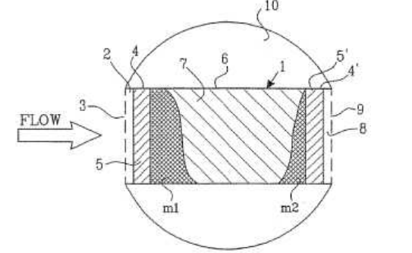
USE-CASE MODEL
avg rate of flow = volume passed
time passed
This is How the flow of Petrol is
Being Calculated at the Time of dropping
How the rings Wires comes in Contact

Slide 7
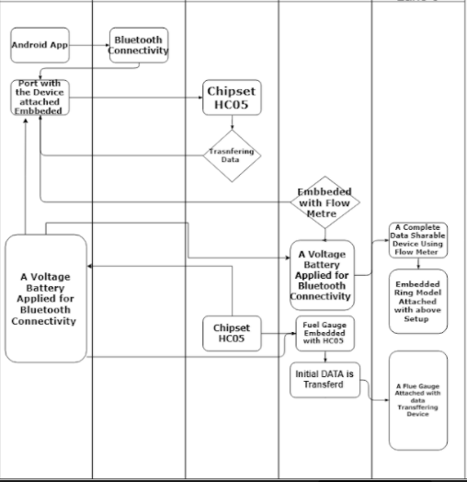
FLOWCHART

Slide 8
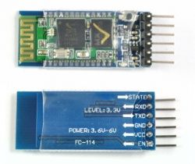
BLUETOOTH CHIPSET
HC‐05 module is an easy to use Bluetooth SPP (Serial Port Protocol) module.
Designed for transparent wireless serial connection setup.
Software Features:
Slave default Baud rate: 9600
Data bits:8
Stop bit:1
Parity : No parity
Auto‐connect to the last device on power as default.
Permit pairing device to connect as default.
Auto‐pairing PINCODE:”1234” as default.

Slide 9
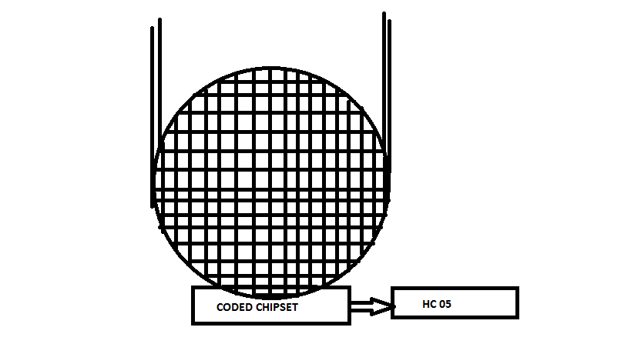
DESIGN
This embedded design will be Get
Attached with the Tank of our Vehicle
And the Procedure will start in action
When Ever the User click on the Start
Button in the Application.

Slide 10
Formulae
average rate of flow = volume passed
time passed
So if our pipe were pouring fluid into a container, then the instantaneous rate of flow would be the derivative with respect to time of the total volume accumulated in our container.
We see that the rate of flow doesn’t particularly depend upon the length of our pipe.
That is, any section of the pipe has the same instantaneous rate of flow as any other section, whether it be located elsewhere or have different length.
So we might as well say we are talking about the rate of flow through a cross section of the GRID, i.e. the rate of flow through a perfectly flat cross-section perpendicular to the pipe’s central axis

Slide 11
ALGORITHM
Basically It works on the Basic Functionality of Flow Meter as well as Fuel Gauge
We just have Club Up their Functionality with HC 05 which shows the Output in our screen
Flow meter Function is embedded on the GRID
As well as Fuel gauge inside the tank is attached with HC 05 to provide the initial amount of Volume in our tank

Slide 12
WORKING
Open The App And Click On Start
Sharing Of Data
Android API
Bluetooth API
HC-05
Embedded system data
Fuel Gauge
Pair The Device
Collecting The Data

Slide 13
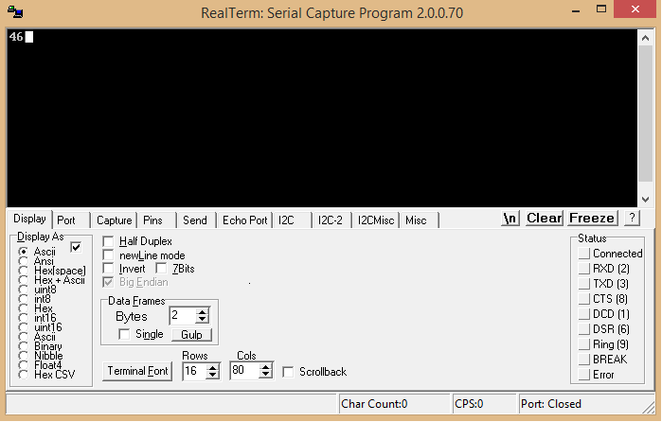
Testing
Input with the Help Of Real Term –For Grid Value
Set Baud to
9600
And Port to
\VCP0

Slide 14

Testing
Input with the Help Of Real Term – For Initial Value

Slide 15

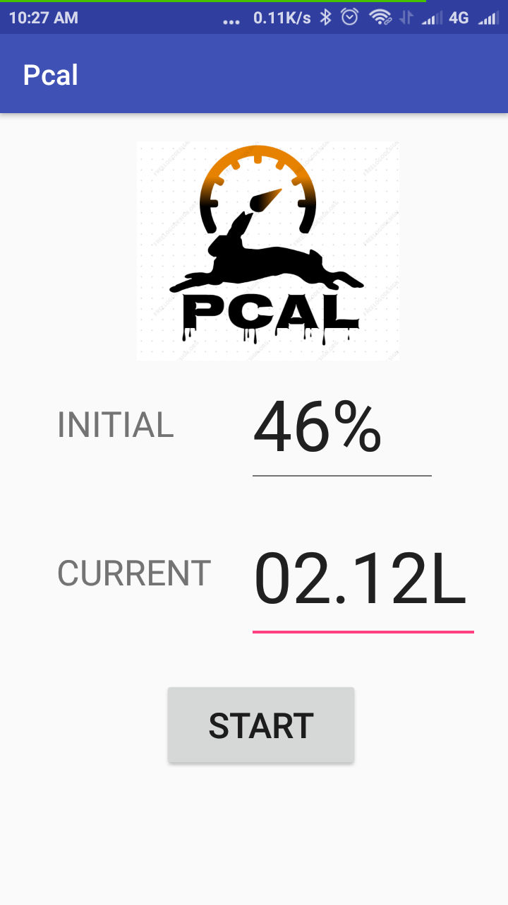
Application Layout and Tested Screen Shot
Splash Screen Tested Value

Slide 16
Update in version
We can check the Purity of the Fuel
The App will Show the Push Notification when ever it’s the time to Refill the Vehicle
A Rough Idea of Time that the Fuel will keep the engine running
One can contact to the Ministry level regarding the Fraud being taken Place

