Slide 1
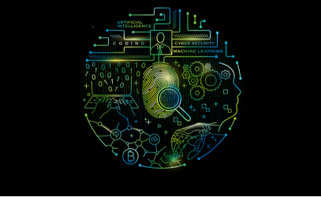
Team CGC_Rebounder
Project Name:-Ttime (Traffic Time )
Team captain:- Bhawna Rajput
Team member:- Himanshu Kumar
Team member:- Surendra Singh Hada

Slide 2
Round 2
Phase 1 – Ideation – Sample
Defined Deliverables | Sample Use Case
Brief Business Problem | Traffic Now days There is Lots Of traffic as we can see in our day life still Traffic Lights are not able to Manage them Lots Of time wastage is consider apart and there are some slots Which are green but there is no one to cross the road
Proposed solution | For this there must be a sensor attached to two pillar of a side it will pass out some rays and in return the signal lights will be changing the First pillar will use to navigate at the origin of the zebra Road to get the estimate of the Rush up in the Locality on the other side the another pillar embedded with the senor will detect the rush up at its end if there is rush up at the lights then the calculations will be put in the code embedded to the machines other wise the signal will be set to the red
Proposed Tech Stack | Python JAVA
Market Place/Positioning | Traffic congestion is a condition on transport networks that occurs as use increases, and is characterized by slower speeds, longer trip times, and increased vehicular queueing. When traffic demand is great enough that the interaction between vehicles slows the speed of the traffic stream, this results in some congestion
Effort (Hours) and Cost (INR) of Implementation | Person Hours - 3 person * 199(7 hours*3 days*5 weeks) = 597 hours Hardware - Rs. 4000-6000
Theme Alignment | Data Science/Machine Learning
Industry Alignment | Government and Public Services

Slide 3
Ttime
Traffic Now days There is Lots Of traffic as we can see in our day life still Traffic Lights are not able to Manage them
Lots Of time wastage is consider apart and there are some slots Which are green but there is no one to cross the road
For this there must be a sensor attached to two pillar of a side it will pass out some rays and in return the signal lights will be changing
the First pillar will use to navigate at the origin of the zebra Road to get the estimate of the Rush up in the Locality on the other side the another pillar embedded with the senor will detect the rush up at its end if there is rush up at the lights then the calculations will be put in the code embedded to the machines other wise the signal will be set to the red

Slide 4
Why Ttimr?
There are many Problems through which Public user are facing now days
Every one wants value to their Time
Everyone get Irritating While standing the Queue and seeing no one on the other side
If yes, then here comes a device to assuage your doubts --Ttime.
The appliance is connected with Pillars to track the details

Slide 5
ADVANTAGE
The main Advantage Expect all the above listed things are
Use of Sensor for auto-detect
Less Man Power
Less Accident as No one will Cross the Road if there is someone on the other side
All the above as everyone now day want the value of their Time

