Slide 1

GameOn (Connect, Play, and Organize Sports Events Nearby)
TEAM MEMBERS
1.Thejashvi Venugopal
2. Shreyas Shekar
3. Bhima Sai Koushik
4.Geetha Pavan Sahasranth Velisetti

Slide 2
Project Description
GameOn is an online platform for sports and gaming enthusiasts. You can use it to find nearby sports and gaming events, create your own events, or join events happening around you. The website also lets you book sports venues like cricket grounds, badminton courts, or basketball courts and organize events that others nearby can join.

Slide 3
Key Features
1)Discover Events:
Find nearby sports and gaming events easily.
2) Create Your Own Events
Organize your own sports or gaming events for others to join.
3) Join Existing Events
Participate in events hosted by others in your area.
4) Book Sports Venues
Reserve sports venues like cricket grounds, badminton courts, or basketball courts and make easy payments with the integrated gateway.

Slide 4
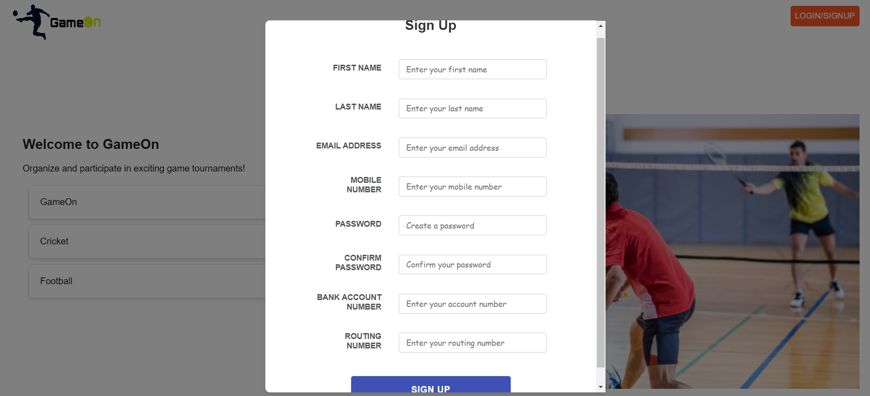
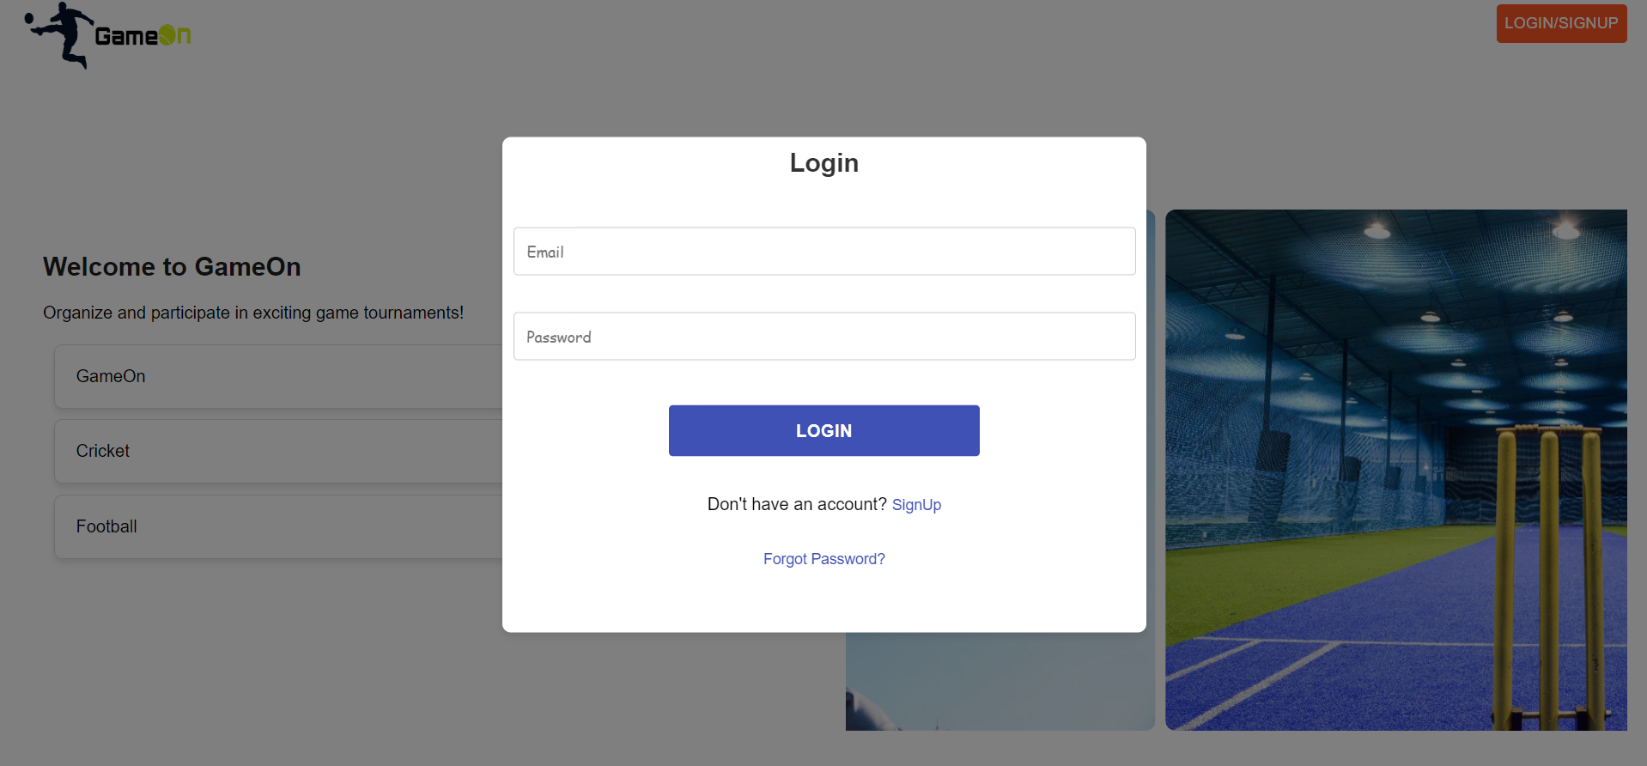
SignUp and Login Page

Slide 5
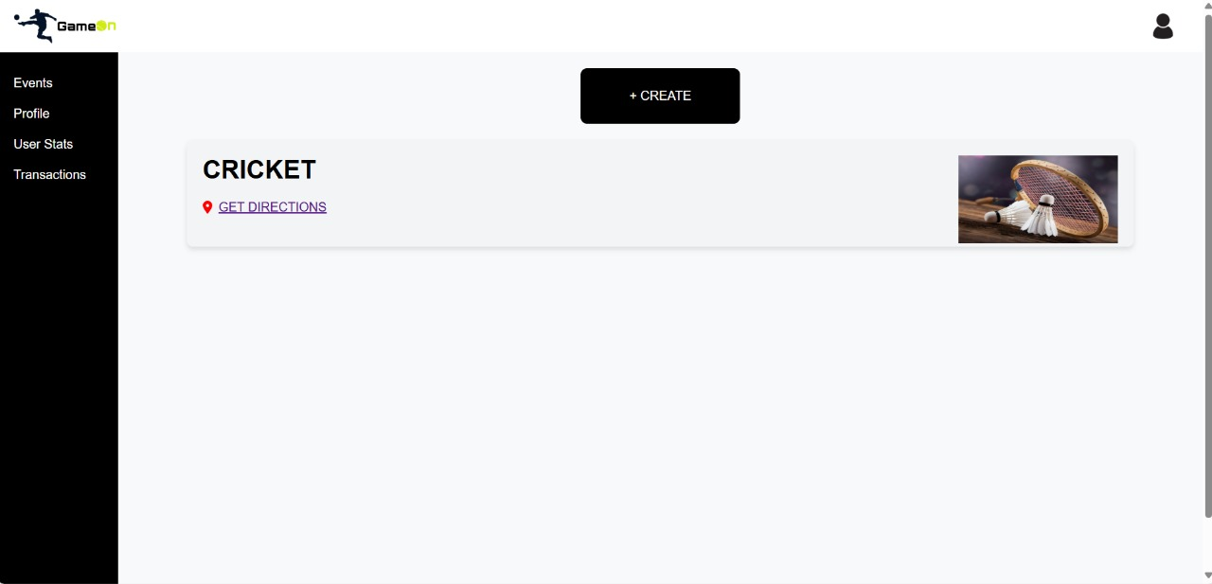
Owner Dashboard

Slide 6
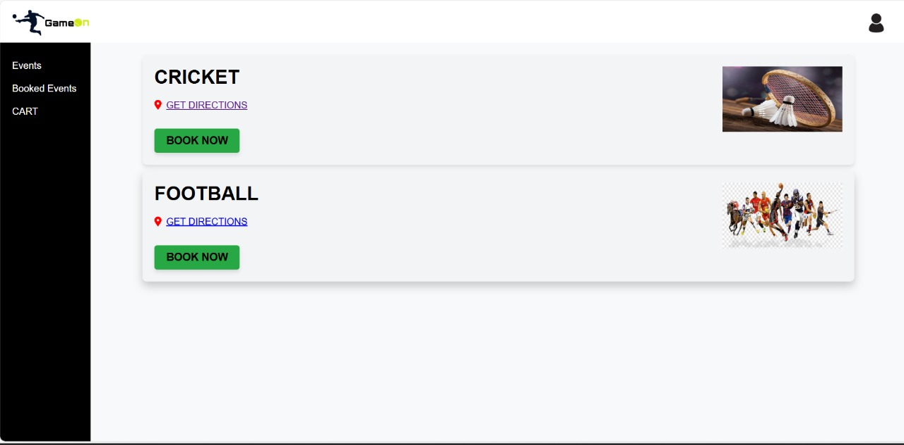
Customer Dashboard

Slide 7
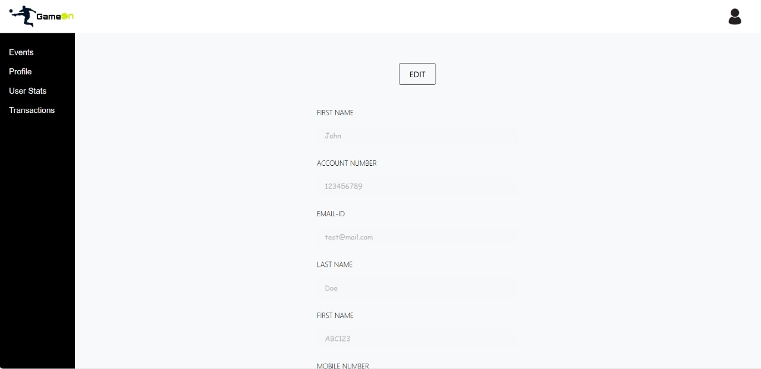
Profile

Slide 8
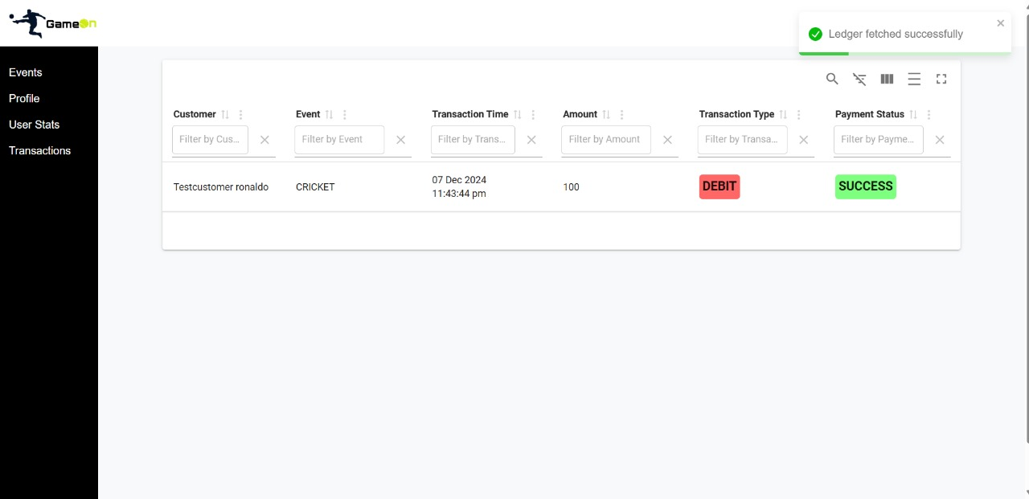
Transactions

Slide 9
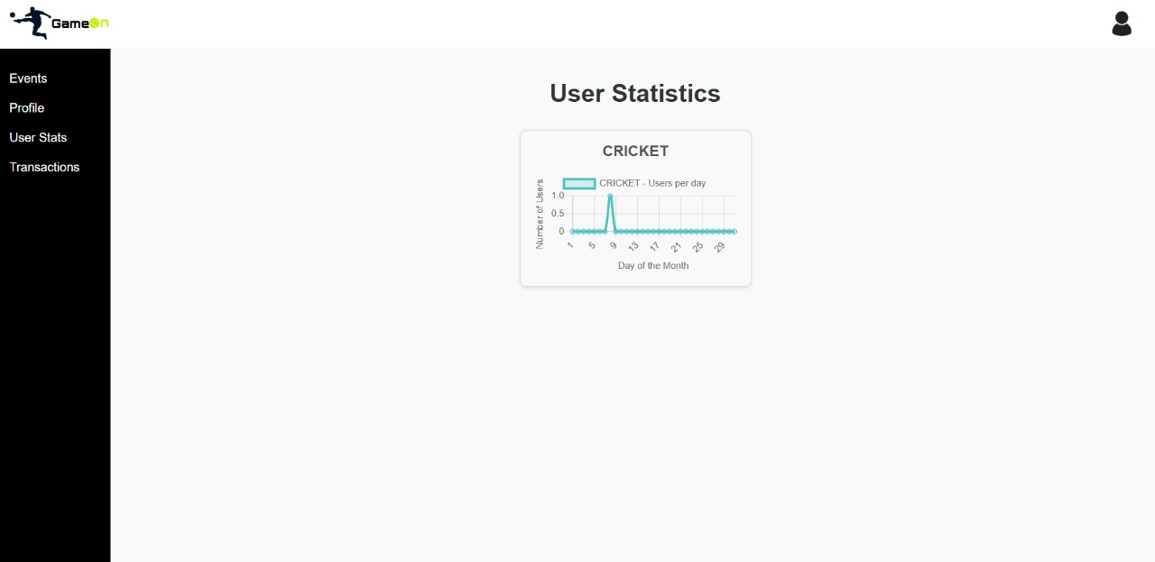
User Statistics

Slide 10
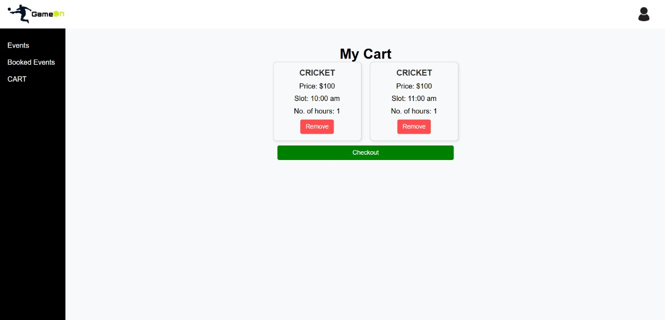
Cart

Slide 11
Summary
GameOn is a platform where sports and gaming fans can easily connect, organize, and join local events. Users can find all events in one place, book venues with simple payments, and connect with others who share similar interests, making everything convenient for everyone.

Slide 12
Thank You

