Slide 1
Project Title:
“WIRELESS WATER MANAGEMENT SYSTEM USING LORA ”
Presented By:
Aditya Dodal
Ajit Ghawghawe
Ayushi Bhiwapurkar
Nandini Bondre
Under the Guidance of
Prof. Y. S. Kale Sir
Sponsored By:
Er. Bhushan Kawale
(Director of S.S.Agro Industry,Navegaon)

Slide 2
Contents
Introduction
Literature Review
Problem Statement
Methodology
References

Slide 3
Introduction
As we know that water plays crucial role in our day-to-day life. Being electronics enthusiastic it is our responsibility to manage and save water efficiently.
Water overflow is a common problem which leads to the wastage of water.
Water management system is a device which can be used in Agriculture, Industries ,Cities and Domestic use.
Water Management system is a simple and Low powered device which will not only indicate water level but will automatically ON/OFF the motor using LoRa technology

Slide 4
Literature Review
An automatic irrigation system has been designed to facilitate the automated provide of adequate water from a reservoir to field or domestic crops[14].
One of the goals of this research is to determine how human control can be removed from irrigation while also optimising water use in the process.
Flow of water should be controlled so that it doesn’t go waste. Traditionally, water flow is managed through locks and controlled manually but it was very lengthy process[11]. Due to recent trends in technology and increased connectivity, a system of IoT devices is best choice for managing water grid[12]. A new technology called Long range (LoRa) is explored in the proposed system which is narrow band low power wide area network (LPWAN) technology.

Slide 5
Problem Statement
In regions like South Africa's Western Cape and parts of India, water shortages endanger food production. This project addresses the challenge by developing a smart water management system utilizing LoRa technology. It aims to monitor water resources in real-time, optimizing their usage for irrigation to mitigate wastage and guarantee adequate water supply for crops, particularly during dry periods. By integrating LoRa technology into water management practices, this initiative seeks to enhance agricultural sustainability and resilience in water-stressed regions, ultimately safeguarding food security in the face of water scarcity.

Slide 6
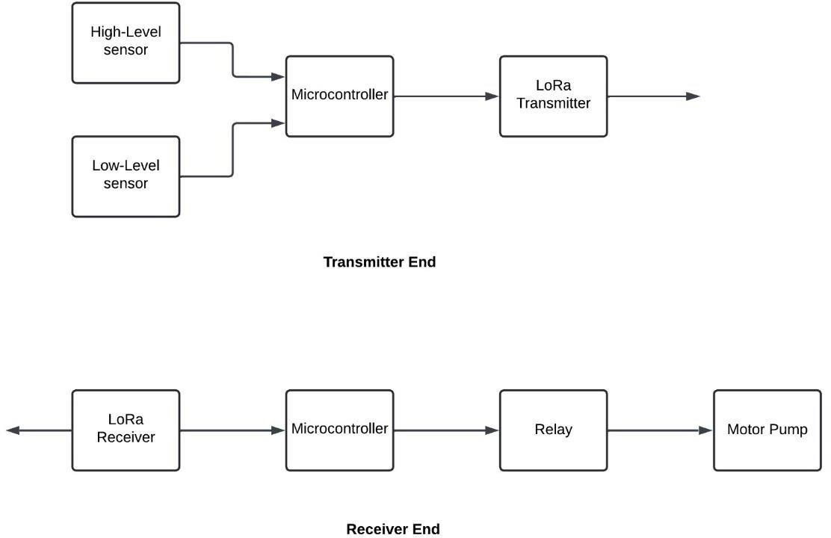
Methodology
Block Diagram:

Slide 7
Methodology
Hardware Components:
Magnetic sensor: Detects the level of the tank (empty or full).
LoRa Transmitter: Transmits the tank level information wirelessly.
LoRa Receiver: Receives the transmitted data.
Microcontroller (Arduino): Processes the received signal.
Octocoupler PC718: Isolates the receiver circuit.
Relay (12V, 10A): Controls the motor operation based on the received signal.
Setup and Wiring:
Connect the magnetic sensor to the LoRa transmitter.
Wire the LoRa receiver to the microcontroller.
Isolate the receiver circuit using the Octocoupler PC718 for safety.
- Connect the relay to the microcontroller to control the motor.

Slide 8
Methodology
Transmitter Side:
The magnetic sensor continuously monitors the tank level.
When the tank level changes (empty to full or vice versa), the sensor sends a signal to the LoRa transmitter.
The transmitter encodes this signal and transmits it wirelessly using LoRa modulation.
Receiver Side:
The LoRa receiver receives the transmitted signal.
The microcontroller interprets the received signal as full or empty tank.
Based on the received signal, the microcontroller sends a control signal to the relay.
Motor Control:
If the received signal indicates the tank is empty, the microcontroller activates the relay to turn ON the motor.
- If the received signal indicates the tank is full, the microcontroller deactivates the relay to turn OFF the motor.

Slide 9
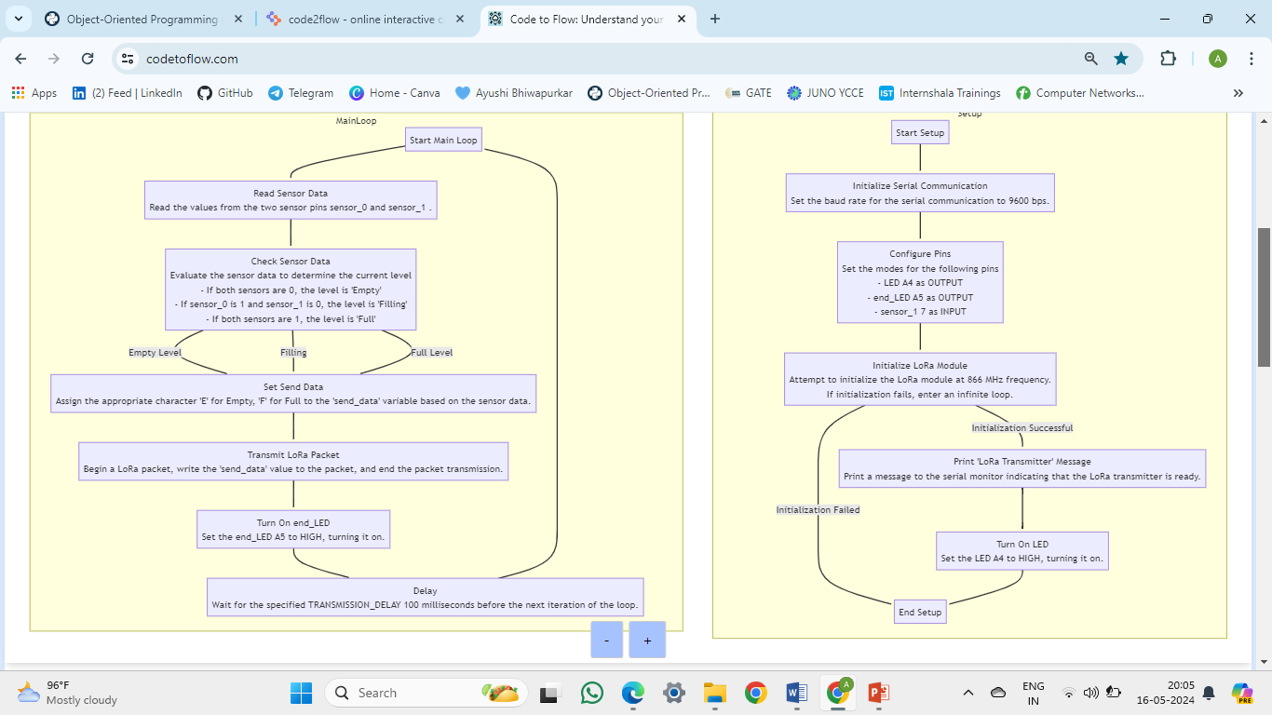
Methodology Transmitter Flowchart

Slide 10
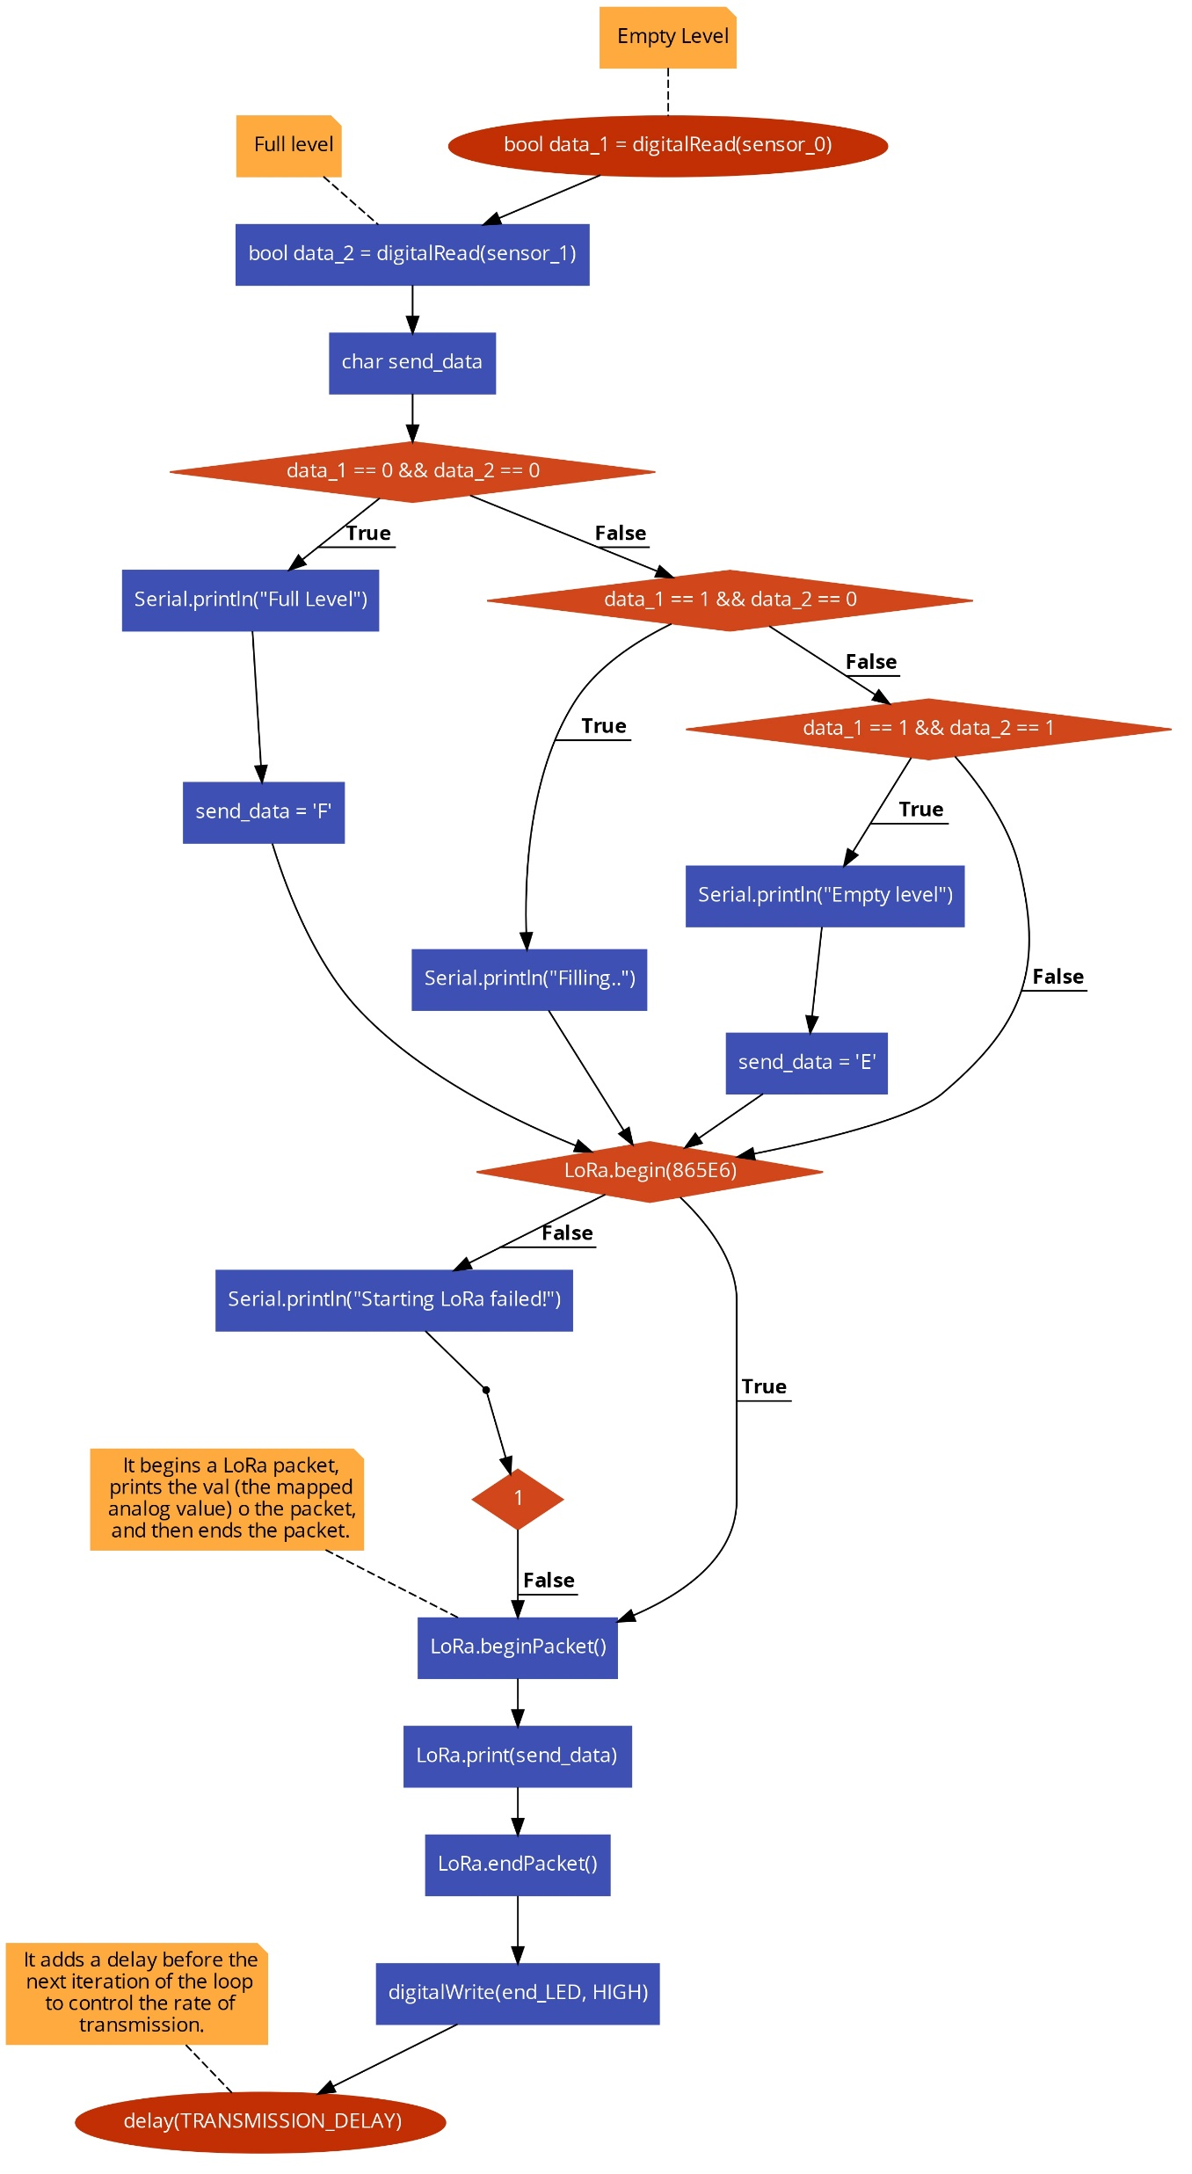
Methodology Transmitter Flowchart

Slide 11
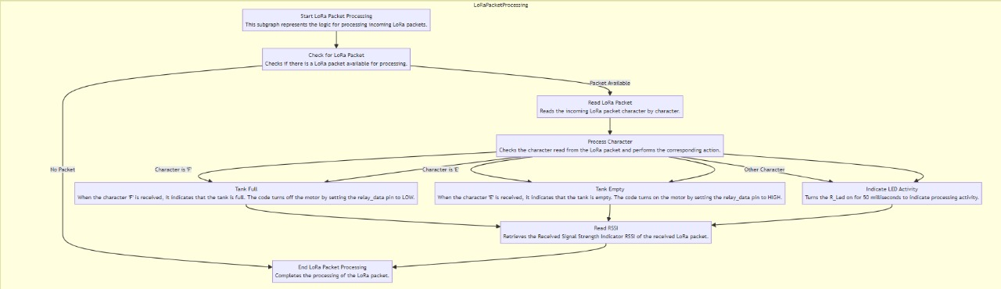
Methodology Receiver Flowchart

Slide 12
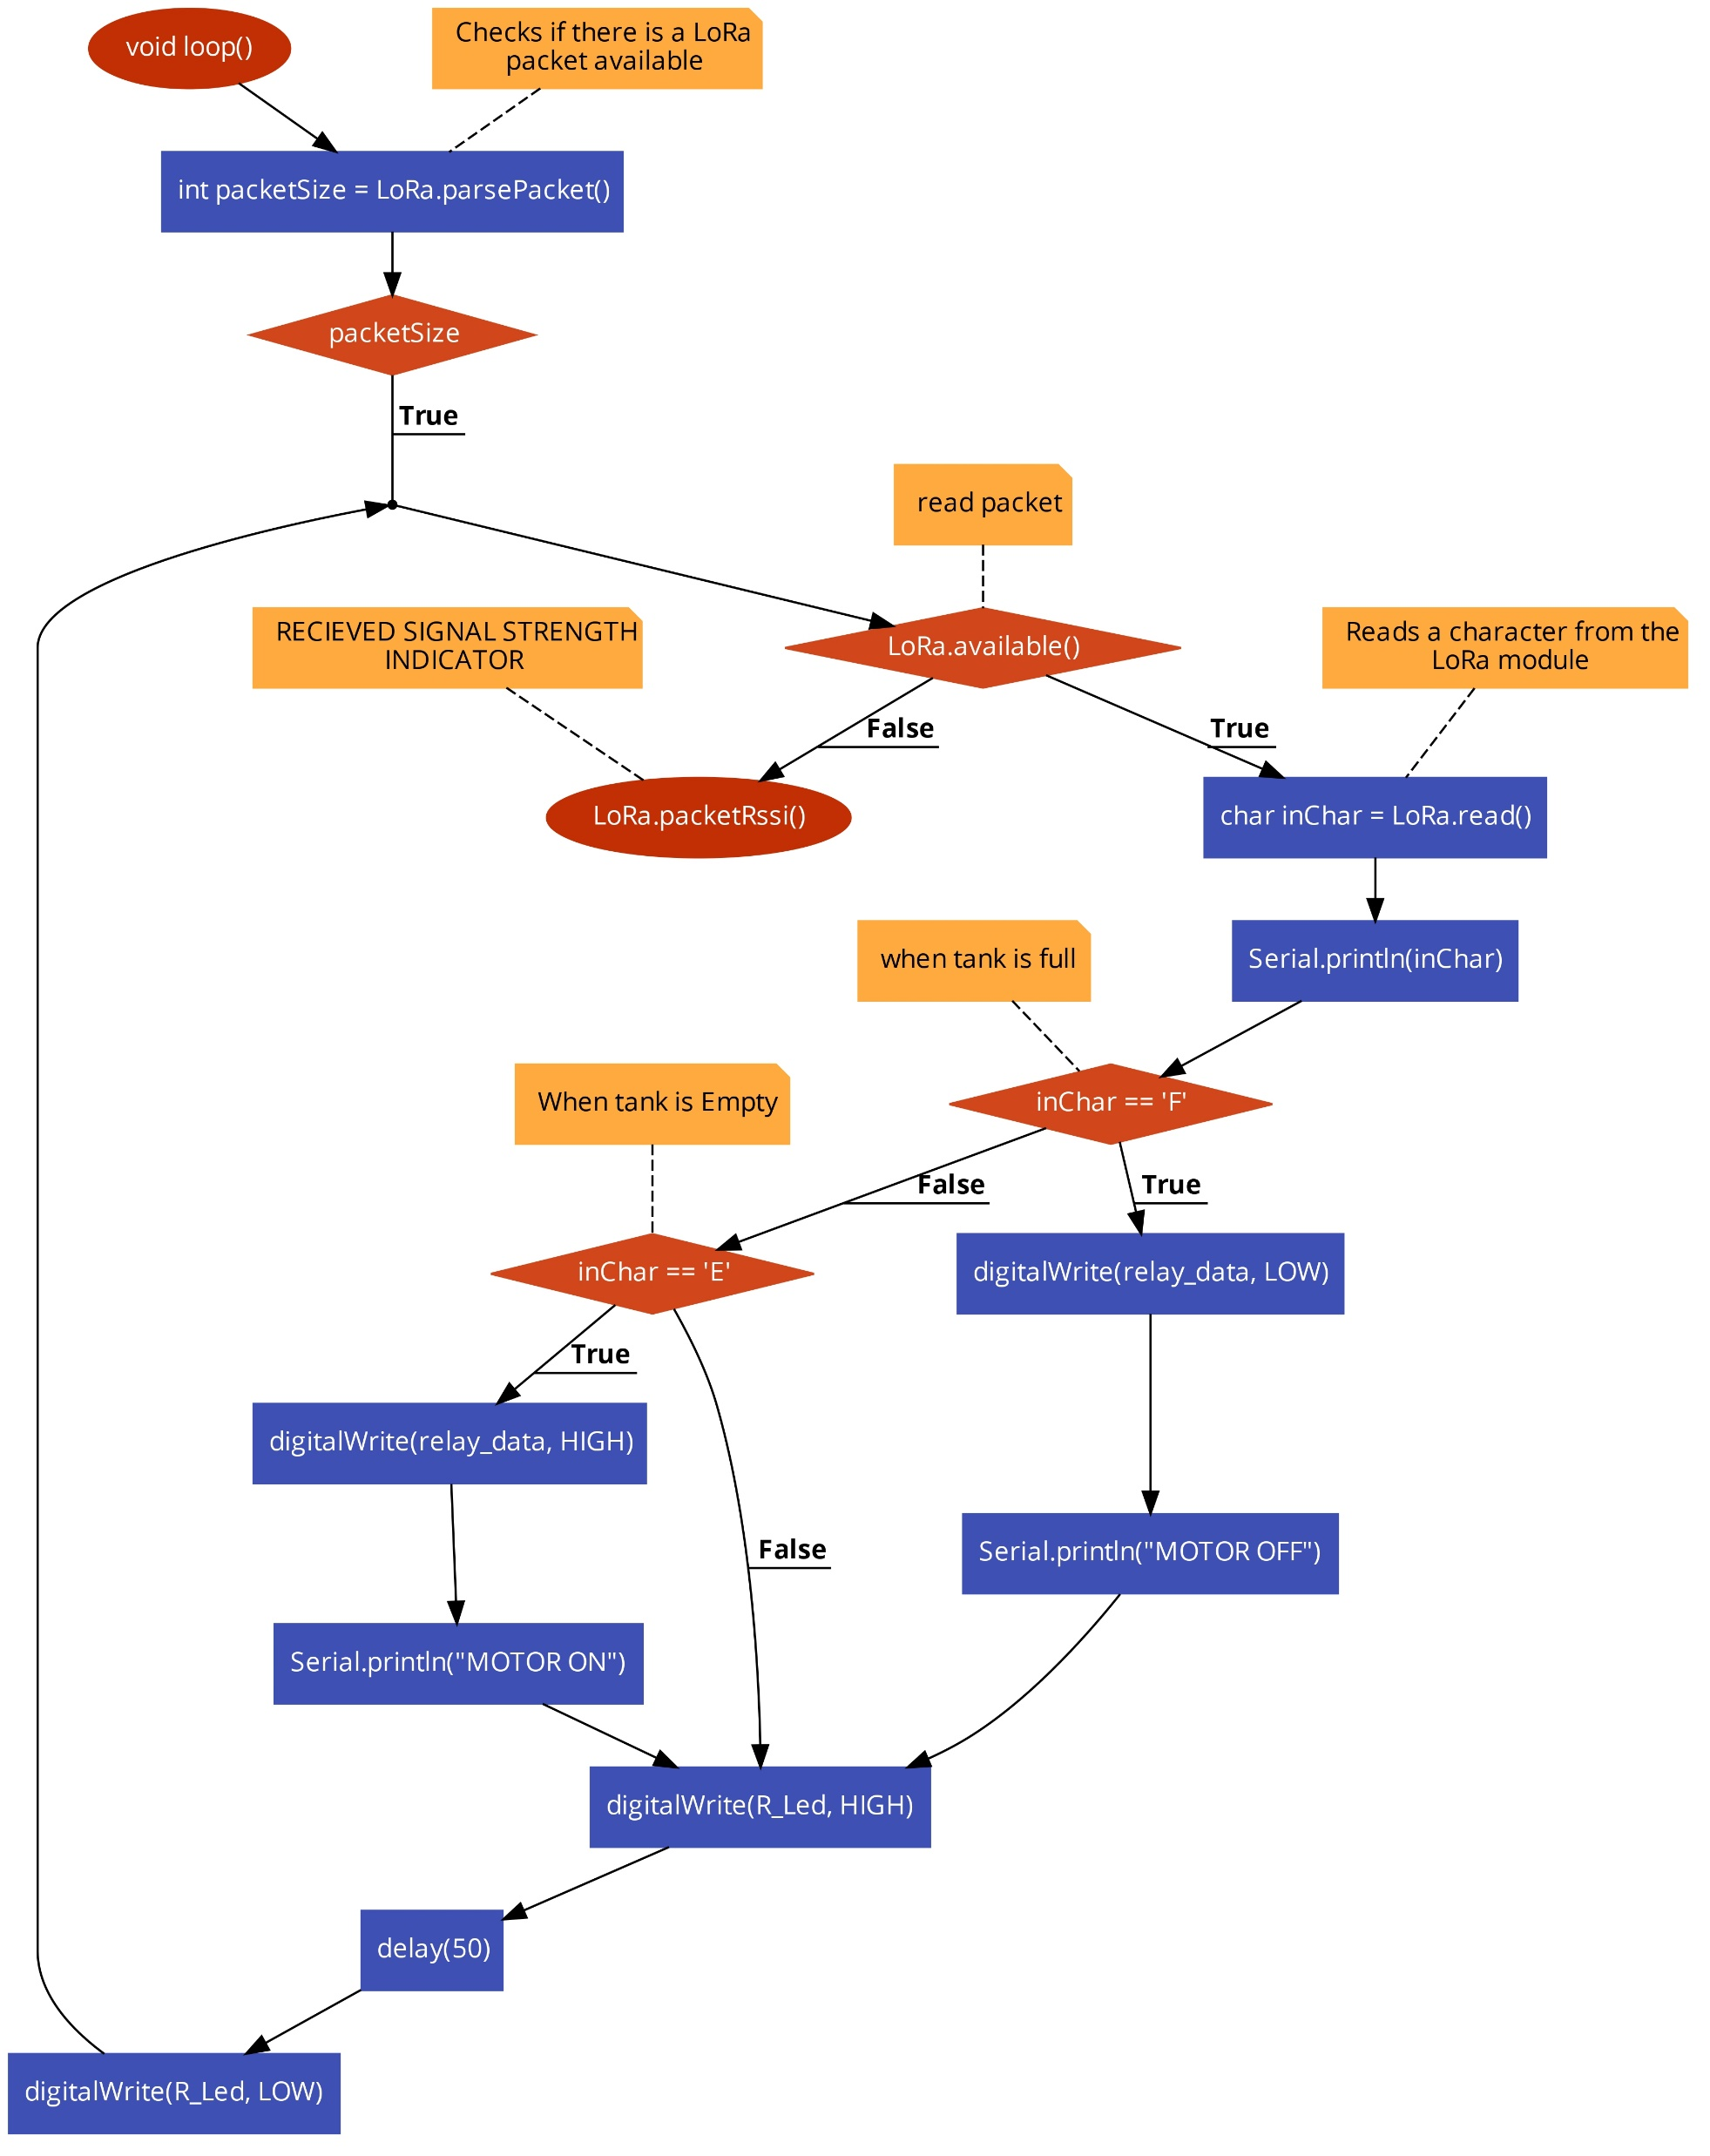
Methodology Receiver Flowchart

Slide 13
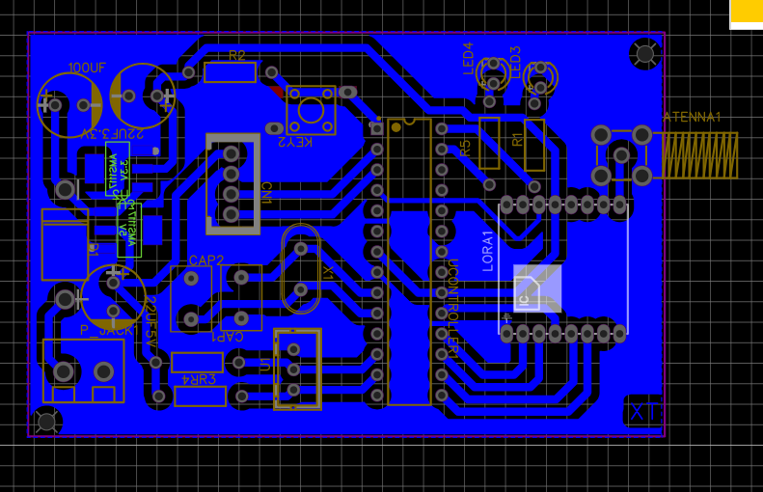
3D Layout of Transmitter Circuit

Slide 14
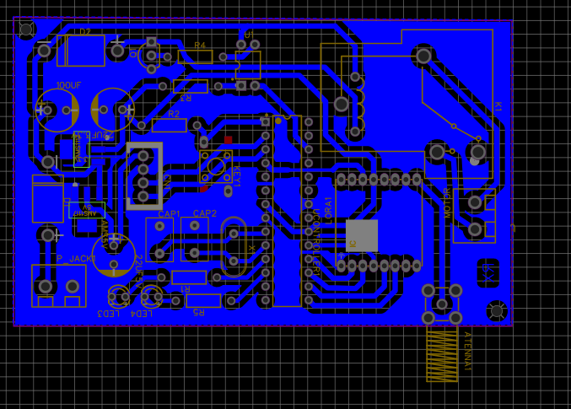
3D Layout of Receiver Circuit

Slide 15
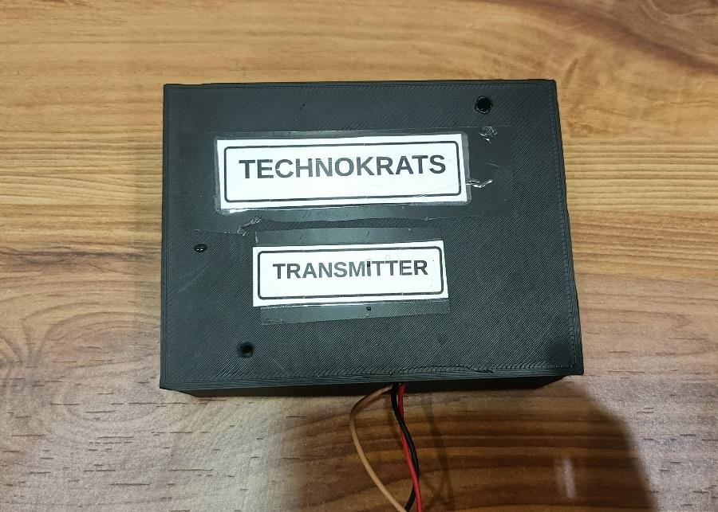
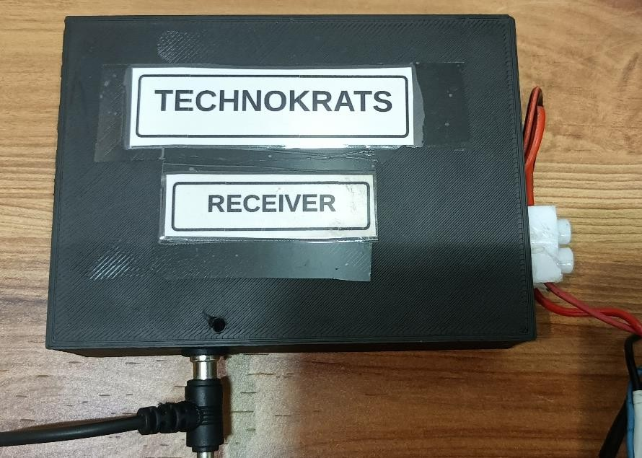
Receiver and Transmitter Module
Transmitter module
Receiver module

Slide 16
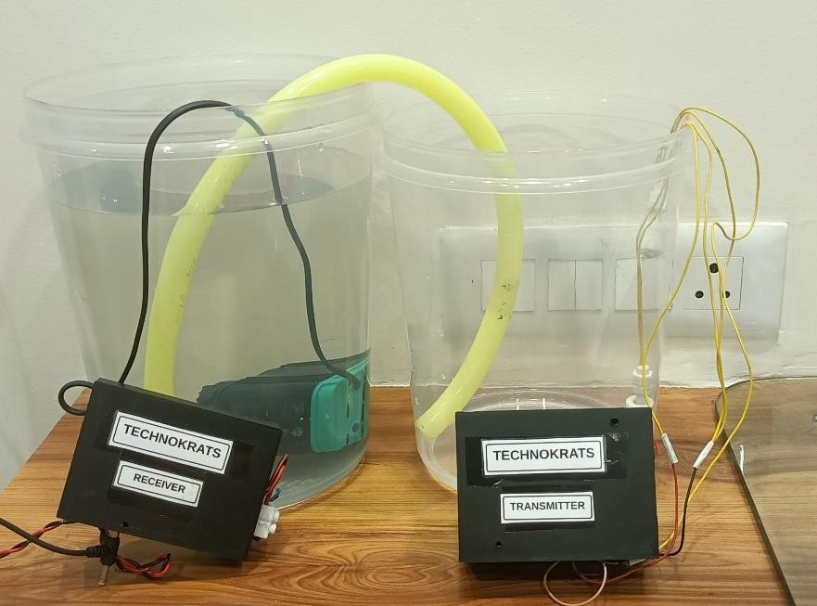
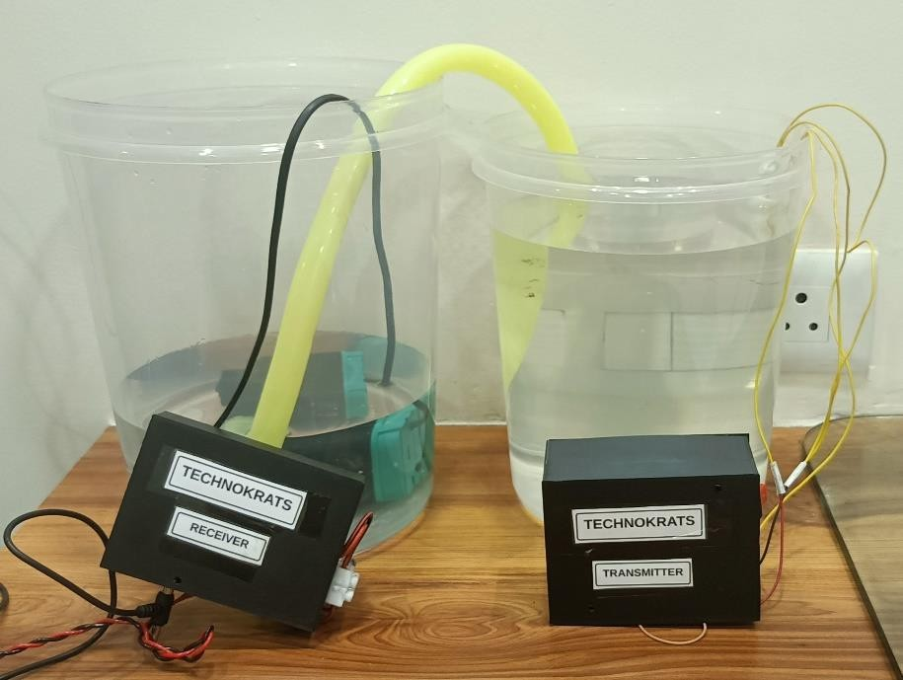
Working Module of Wireless Water Management System using LoRa
When water level is low
When water level is high

Slide 17
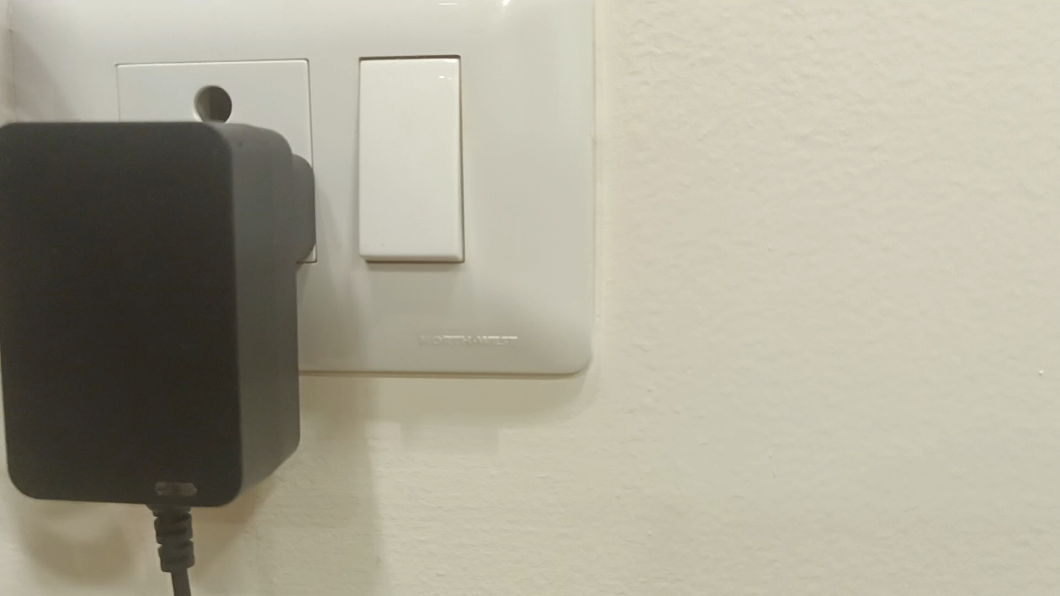
Demonstration Video

Slide 18
Conclusion
The water controller system presents a significant advancement in water management practices, offering precise control and monitoring capabilities. By harnessing LORA technology, the system enhances resource allocation, conserves water, and promotes sustainable irrigation practices. Further refinements and integration with smart sensors promise even greater efficiency and environmental conservation in water distribution systems.

Slide 19
Future Scope
The future scope of LoRa water management systems for sprinkler and drip systems, especially when configured with multiple transmitters and a single receiver, holds significant potential for enhancing water efficiency in various applications beyond agriculture. By leveraging LoRa sensors, these systems enable precise monitoring and control of water usage, leading to optimized irrigation schedules, reduced water wastage, and enhanced environmental sustainability. The scalability and flexibility of LoRa technology facilitate seamless connectivity across diverse infrastructures, while data-driven insights empower efficient resource management and cost savings.
Additionally, the integration of LoRa water management systems with other IoT technologies offers opportunities for smart water management solutions tailored to specific needs, ranging from industrial facilities and commercial properties to municipal water distribution networks.

Slide 20
References
[1] Kamal, Muhammad Ayoub & Alam, Md & Abu Bakar Sajak, Aznida & Mazliham, “Review Article Requirements, Deployments, and Challenges of LoRa Technology: A Survey”, in year 2023.
[2] Gkotsiopoulos, Panagiotis & Zorbas, Dimitrios & Douligeris, Christos, “Performance Determinants in LoRa Networks: A Literature Review”, in year 2021.
[3] Kolobe, Lone Godfrey & Lebekwe, Caspar & Sigweni, Boyce, “Systematic literature survey: applications of LoRa communication”, in year 2020.
[4] Devalal, Shilpa & Karthikeyan, “LoRa Technology - An Overview”, in year 2018.
[5] Saari, Mika & bin Baharudin, Ahmad Muzaffar & Sillberg, P & Hyrynsalmi, Sami & Yan, Wanglin. “LoRa-A Survey of Recent Research Trends”, in year 2018.
[6] Baballe, Muhammad & Muhammad, Abubakar Sadiq, “A Review of an Automatic Water Level Indicator”, in year 2022.
[7] S, Akshay, “Review on IoT based water level sensing and controlling”, in year 2020.
[8] Loizou, Constantinos & Koutroulis, Eftichios, “Water level sensing: State of the art review and performance evaluation of a low-cost measurement system”, in year 2016.

Slide 21
References
[9] Sudhan, R.Hari & Kumar, M.Ganesh & Prakash, A.Udhaya & Devi, S.Anu & P., Sathiya, ”ARDUINO ATMEGA-328 MICROCONTROLLER”, in year 2015.
[10] Supardi, I I & Poniman, S. & Wibawa, I & Adnyana, I & Jaya, I & Sari, Ida & Yudistira, “Development of atmega328 microcontroller based hydroponic plant watering automation tools”, in year 2022.
[11] Janssen, Thomas & BniLam, Noori & Aernouts, Michiel & Berkvens, Raf & Weyn, Maarten, “LoRa 2.4 GHz Communication Link and Range”, in year 2020.
[12] Myagmardulam, Bilguunmaa & Miura, Ryu & Ono, Fumie & Kagawa, Toshinori & Shan, Lin & Nakayama, Tadachika & Kojima, Fumihide & Choijil, Baasandash, “Performance Evaluation of LoRa 920 MHz Frequency Band in a Hilly Forested Area”, in year 2021.
[13] Noreen, Umber & Bounceur, Ahcène & Clavier, Laurent, “A study of LoRa low power and wide area network technology”, in year 2017.
[14] Khan, Mohammed Asadullah & Sun, Jian & Li, Bodong & Przybysz, Alexander & Kosel, “Magnetic sensors – A review and recent technologies”, in year 2021.
[15] Francis, Laurent A. & Poletkin, Kirill & Iniewski, “Magnetic Sensors and Devices: Technologies and Applications”, in year 2017.

Slide 22
THANK YOU

