Slide 1
Music Hunter
Submitted by
MD. Billal Hosain Nirab
BSSE 1020
Session 2017-18
Supervised by
Nadia Nahar
Lecturer
IIT, University of Dhaka

Slide 2

Introduction
Specialized Music player
Import multiple song at a time and make a playlist
Play song from playlist
Manually
Using Gesture
ADD or Remove Music from favorite list
Manually
Automatically
User Account with password encryption using SHA-1
Server to Handle user account
Message Encryption and Decryption

Slide 3
Background study
Specialized Music player
Morphological Image Processing
Erosion
Dilation
Message Encryption and Decryption
WAV file specifications
Cryptographic Hash algorithm
SHA-1

Slide 4
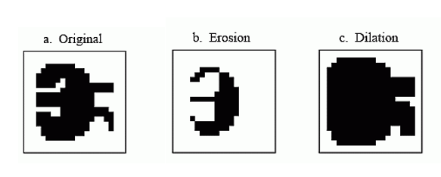
Morphological Image Processing
This is usually more of an art than a science.
Morphology is a broad set of image processing operations that process images based on shapes. Morphological operations apply a structuring element to an input image, creating an output image of the same size.

Slide 5
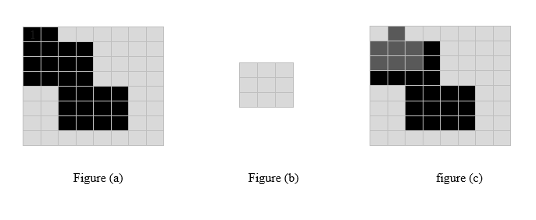
Erosion
This is usually more of an art than a science.
In erosion, every object pixel that is touching a background pixel is changed into a background pixel. Erosion makes the objects smaller, and can break a single object into multiple objects.

Slide 6
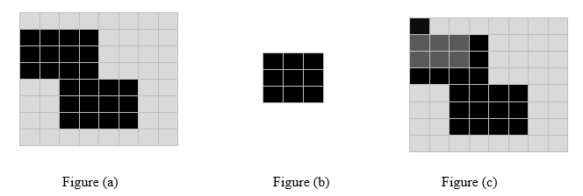
dilation
This is usually more of an art than a science.
In dilation, every background pixel that is touching an object pixel is changed into an object pixel. Dilation makes the objects larger, and can merge multiple objects into one.

Slide 7
WAV (RIFF) File
A WAV (RIFF) file is a multi-format file that contains a header and data. For the purposes of this document, only a simple PCM file will be explored. A WAV file contains a header and the raw data, in time format.
Wav file specifications
What's bit size?
Bit size determines how much information can be stored in a file.
What is Sample Rate?
Sample rate is the number of samples per second. CD-Audio has a sample rate of 44,100. This means that 1 second of audio has 44,100 samples.

Slide 8
What are Channels?
Channels are the number of separate recording elements in the data. For a real quick example, one channel is mono and two channels are stereo.
Wav file specifications
What is the data?
The data is the individual samples. An individual sample is the bit size times the number of channels. For example, a monaural (single channel), eight bit recording has an individual sample size of 8 bits. A monaural sixteen-bit recording has an individual sample size of 16 bits. A stereo sixteen-bit recording has an individual sample size of 32 bits. Samples are placed end-to-end to form the data. So, for example, if you have four samples (s1, s2, s3, s4) then the data would look like: s1s2s3s4.

Slide 9
Wav file specifications

Slide 10
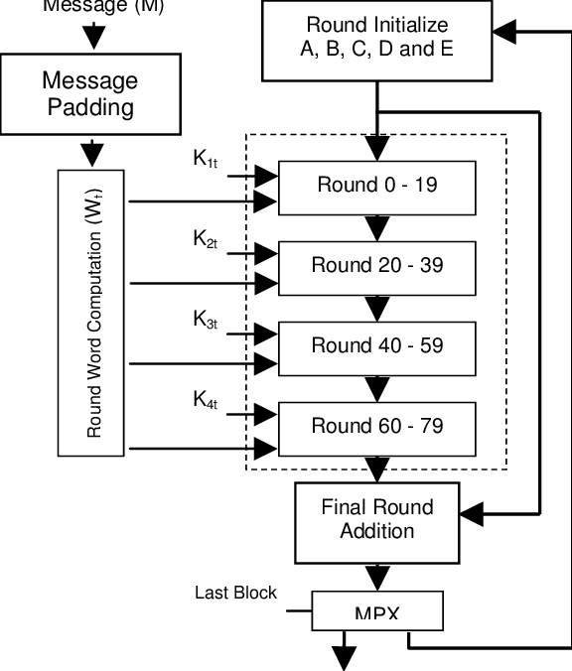
SHA stands for Secure Hash Algorithm.
In cryptography, SHA-1 is a cryptographic hash function designed by the National Security Agency (NSA) and published by the NIST as a U.S. Federal Information Processing Standard. SHA-1 produces a 160-bit message digest.
It use left rotation to each round for manipulating five constant. For left rotation it use this method
w[i] = (w[i-3] xor w[i-8] xor w[i-14] xor w[i-16])
Sha-1

Slide 11
Challenges
Specialized Music player
The challenge I faced while making this project is that how I can detect the movement of gesture and perform a task? I have overcome it.

Slide 12
Challenges
Specialized Music player
The idea behind it
Capture a frame using webcam
Find RED portion of each frame
Apply Threshold effect based on a RED color
Apply morphological operation on that frame
Return the position of the first BLACK pixel from the frame
Store the position of (X,Y)

Slide 13
Challenges
Specialized Music player
Position pos[5] = { (4,5), (7,5), (10,5), (13,5), (17,6) }
In this example, we consider a duration of 5 frames. Where each frame gives a location if any RED color exits on that frame. Now I can make a decision from movement of a gesture and perform a task.

Slide 14
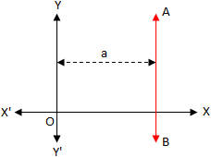
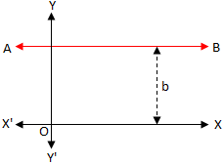
Challenges
Specialized Music player
Tracker track = new Tracker();
track.generateTracker("frame1.jpg", 315, 360, 55, 55);
int pos[] = track.getPos();
public void generateTracker(String path, int lowerBoundHue, int upperBoundHue, int lowerBoundSaturation, int lowerBoundValue);

Slide 15
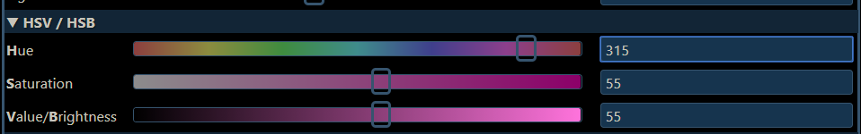
Challenges
Specialized Music player
float[] hsb = Color.RGBtoHSB(r, g, b, null); if ((hsb[0]*360 >= lowerBoundHue && hsb[0]*360 <= upperBoundHue) && (hsb[1]*100 >= lowerBoundSaturation) && (hsb[2]*100 >= lowerBoundValue)) r1 = g1 = b1 = 0; else r1 = g1 = b1 = 255;

Slide 16
Challenges
Specialized Music player
getRGB
public int getRGB()
Returns the RGB value representing the color in the default sRGB ColorModel. (Bits 24-31 are alpha, 16-23 are red, 8-15 are green, 0-7 are blue).
Returns:
The RGB value of the color in the default sRGB ColorModel
Since:
JDK1.0

Slide 17
Project overview
Specialized Music player
Import multiple song at a time and make a playlist
User can import multiple song at a time and make a playlist. And this playlist is safely store in the server so that there is no chance to lose user playlist.
public void addMusictoPlaylist(String userID, File path, int rating);
Here addMusictoPlaylist() method takes three parameters where first one is for userID. So that, SERVER can recognize for whom to store the playlist and second one is for file path of a song and last one is for rating.

Slide 18
Project overview
Specialized Music player
Play song from playlist
Manually
When user click play button an Actionevent occurs and MUSIC HUNTER load that selected music from database and start playing it.
Using gesture
To play a song user need to put RED object in front of camera and make a gesture. MUSIC HUNTER can recognize the movement and try to perform an operation

Slide 19
Project overview
Specialized Music player
ADD song into favorite list
Manually
User can set a rating of a song and song will be added into favorite list. The rating is from 0 to 5. Where 0 is a default rating. In case of default rating a song is not consider as a favorite. Otherwise it is consider as a favorite song and added into favorite list.
Automatically
MUSIC HUNTER are continuously track user state. If an user listen a song frequently then it might be a favorite song for an user. Sometimes user is forget to set a rating of a song. But don’t worry. The algorithm of MUSIC HUNTER has taken the responsibility of it.

Slide 20
Project overview
Specialized Music player
ADD song into favorite list
Automatically
If a user listened a song 70% of total duration without seeking a song and without set a manual rating then MUSIC HUNTER will assume that user listened it and priority of that song will increasing by one
if (current.toSeconds() >= percent.get() && !isSeekingOccurs && !isListened && !isClickRatingSlider && currMusic.priority <= 10)
currMusic.priority++; Playlist.updateCurrentMusicInfo(currMusic.path, currMusic.rating, currMusic.priority, currMusic.dateToAddedFavList); updatetmpMusic(); isListened = true;

Slide 21
Project overview
Specialized Music player
ADD song into favorite list
Automatically
if (currMusic.priority == 0) { String formatedDate = "01-Jan-2000 23:01:01"; currMusic.rating = 0; currMusic.dateToAddedFavList = formatedDate; Playlist.updateCurrentMusicInfo(currMusic.path, 0, currMusic.priority, formatedDate); updatetmpMusic(); } else if (currMusic.priority == 2) { Date dateAddedtoFavlist = new Date(); SimpleDateFormat format = new SimpleDateFormat("dd-MMM-yyyy HH:mm:ss"); String formatedDate = format.format(dateAddedtoFavlist); currMusic.rating = 1; currMusic.dateToAddedFavList = formatedDate; Playlist.updateCurrentMusicInfo(currMusic.path, 1, currMusic.priority, formatedDate); updatetmpMusic(); }// and so on

Slide 22
Project overview
Specialized Music player
ADD song into favorite list
Automatically
Here I am showing that if priority is 0 then rating of a song has to be default value 0 and set the dateToAddedFavList attribute to default value "01-Jan-2000 23:01:01" which represent this song has no rating.
And if the priority is 2 or grater, then my program captured current date and store it to dateToAddedFavList attribute which represent when a song is added into favorite list.

Slide 23
Project overview
Specialized Music player
ADD song into favorite list
Automatically
C:\Users\ASUS\Music\Britney spares.mp3?3?6?27-May-2019 12:19:12
Here I am showing the format of an user playlist. Where ‘?’ is used for delimiter and first portion before the ‘?’ mark represent the path of a music and second one is for rating and third one is for priority of a song and last one is for when a music was added into favorite list.
And this is a mechanism to added music into favorite list automatically by tracking an user state.

Slide 24
Project overview
Specialized Music player
Remove song from favorite list
Manually
By setting the rate of a song ‘0’ it will be removed from favorite list.
Automatically
When an user liked a song he/she will listen it thousand times. After listening it thousand time he/she will start ignoring it. But it will still remain in favorite list. But don’t worry. MUSIC HUNTER has taken the responsibility to remove unwanted song from user favorite list.

Slide 25
Project overview
Specialized Music player
Remove song from favorite list
Automatically
long duration = currDate.getTime() - addedDate.getTime(); if(tmp1.rating>0) { if(TimeUnit.MILLISECONDS.toSeconds(duration)>=10) { tmp1.rating--; tmp1.priority = tmp1.priority-2; } }
To remove music from favorite list automatically, I calculate the duration by subtracting current date and date added into favorite list.
If an user doesn’t listened a song certain period of time then the priority of a song is decreasing by 2 and rating of a song is also decreasing by one and so on. If a rating will be 0 then the song will be automatically removed from user favorite list.

Slide 26
Project overview
Specialized Music player
User Account
Create Account
User can create an account along with a private playlist.
If user doesn’t provide a profile picture then a default profile picture will be set for an user.
It is mentioned that password of an user will be encrypted using SHA-1 algorithm
User will also not be able to create an account if he/she will provide a duplicate userID.
Login
User can login into MUSIC HUNTER using his/her userID and password.

Slide 27
Project overview
Specialized Music player
Sever
ServerSocket server = new ServerSocket(PORT); while(true) { System.out.println("Waiting for connection..."); Socket client = server.accept(); System.out.println("Connected with: " + client.toString() ); Thread eachClient = new Controller(client); eachClient.start(); }
Server is for handle user account and user playlist.
First it take a request from client and run a thread for each client.

Slide 28
Project overview
Specialized Music player
Sever
public class ObjectPacking implements Serializable { public String command; public String from; public String to; public String comment; public Object data; }
To send and receive data, server and client use a class called ObjectPacking.

Slide 29
Project overview
Specialized Music player
Sever
if(object.command.equals("createAccount")) { User user = (User)object.data; Account acc = new Account(); Boolean feedback = acc.createAccount(user); response.command = "createAccount"; response.from = "server"; response.to = user.userID; if(feedback) response.comment = "true"; else response.comment = "false"; }
This is one kind of packet where “command” attribute represent which task have to perform in the server. “from” and “to” attribute represent from and destination and if user have any comment about packet he/she can put that comment in “comment” attribute. It is optional. And finally the “data” attribute hold the actual data.
Client or Server make an object of ObjectPacking class and send it throw the socket.

Slide 30
Project overview
Specialized Music player
Message Encryption and Decryption
Encryption
User can push a message into WAV file audio data and after pushing the message the audio holds some distortion.
But the change of an audio is impossible to recognize.

Slide 31
Project overview
Specialized Music player
Message Encryption and Decryption
Encryption
public Encryption(File path) { orginalFile = path; chunkSize = new byte[4]; subchunkSize = new byte[4]; audioFormat = new byte[2]; numberOfChannels = new byte[2]; sampleRate = new byte[4]; byteRate = new byte[4]; blockAlign = new byte[2]; bitsPerSample = new byte[2]; dataSubchunkSize = new byte[4]; readOrginalFile(); }
To push message into a audio data first we need to declare some attribute to hold the header of WAV file. This code portion shows that how to make a space for each of the header portion.

Slide 32
Project overview
Specialized Music player
Message Encryption and Decryption
Encryption
private void readOrginalFile() { DataInputStream input = null; try{ input = new DataInputStream(new FileInputStream(orginalFile)); chunkIdentifier = "" + (char)input.readByte() + (char)input.readByte() + (char)input.readByte() + (char)input.readByte(); input.read(chunkSize); format = "" + (char)input.readByte() + (char)input.readByte() + (char)input.readByte() + (char)input.readByte(); subchunkIdentifier = "" + (char)input.readByte() + (char)input.readByte() + (char)input.readByte() + (char)input.readByte(); input.read(subchunkSize); input.read(audioFormat); input.read(numberOfChannels); input.read(sampleRate); input.read(byteRate); input.read(blockAlign); input.read(bitsPerSample); dataSubchunkIdentifier = "" + (char)input.readByte() + (char)input.readByte() + (char)input.readByte() + (char)input.readByte(); input.read(dataSubchunkSize); soundData = new byte[dataSubchunkSize]; input.read(soundData); }catch(Exception e){} }

Slide 33
Project overview
Specialized Music player
Message Encryption and Decryption
Encryption
Here readOrginalFile() method initialize those array with appropriate value.

Slide 34
Project overview
Specialized Music player
Message Encryption and Decryption
Encryption
public boolean injectData(String data) { if(data.length() >= soundData.length/5000) return false; for(int i=0,j=0; i<soundData.length && j<data.length(); i++) { if(i%5000==0){ int dataAtj = (int)data.charAt(j); soundData[i] = Byte.valueOf(Integer.toString(dataAtj)); j++; } } writeOrginalFile(); return true; }
Now its time to push message into audio data. This is how I push message into audio data. I push each character of a message after each 5000 sample of audio data.

Slide 35
Project overview
Specialized Music player
Message Encryption and Decryption
Decryption
public String getEncryptData() { skippedHeader(); String encodedData = ""; for(int i=0; i<soundData.length; i++){ if(i%5000==0) { int value = soundData[i]; if(value == 46) break; encodedData = encodedData + (char)value; } } return encodedData; }
To decrypt message I have to read audio which holds the actual message and find the character that I include after each 5000 sample and stop finding when I found (.)

Slide 36
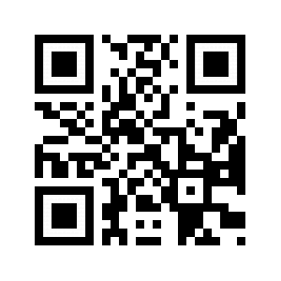
And to make this project I have to write 4,694 lines of code without GUI. With GUI the number of lines are 5,456
Appendix
In future I’ll developed my project and add some interesting features which is eye catching.
Scan the QR Code to watch the video review of MUSIC HUNTER
http://bit.ly/2JJ2vGu

Slide 37
references
https://github.com/BHN-Nirab/MUSIC_HUNTER
https://github.com/BHN-Nirab/MUSIC_HUNTER_SERVER
Scan the QR Code to watch the video review of MUSIC HUNTER
https://github.com/BHN-Nirab/MessageEncryptor

Slide 38
THANK YOU

