Slide 1
A QUEUE THAT WAITS FOR YOU
Apni Bari
(बारी)
Line nahi, Life
घर रहो, बारी आने पर आना
Team: [Team name] · [Hackathon name]
Notes:
Open with the promise in the name: the turn will come, but the family should not have to spend the day proving it in a line.

Slide 2
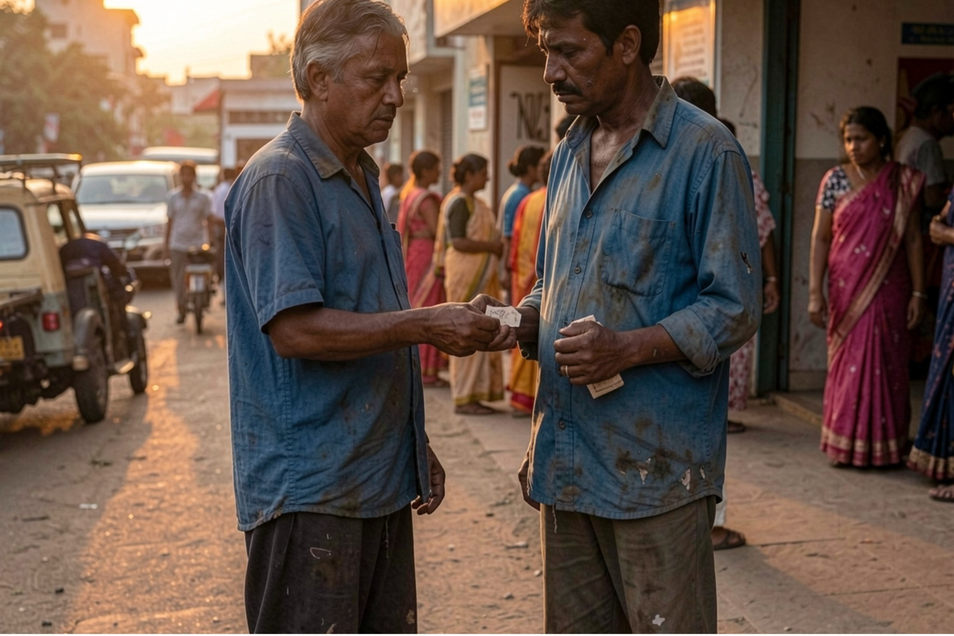
THE HUMAN COST
A day’s wage should not buy a place in line
A daily-wage worker reaches a government hospital before sunrise, waits about 45 minutes for a 5-minute consult, and can still return without treatment.
“घर रहो, बारी आने पर आना”
Before sunrise · one missed day matters
500–2,000
60–70%
Time, dignity, income
The queue takes all three.
OPD patients/day · busy government hospital
walk in without appointments
Queue volumes and walk-in share are pitch assumptions to validate in a pilot, not national averages.
Notes:
Make the story personal before making it technical. The cost is not only the time in the lobby. It is the wage that disappears, the dignity of waiting without information, and the risk of going home untreated.

Slide 3
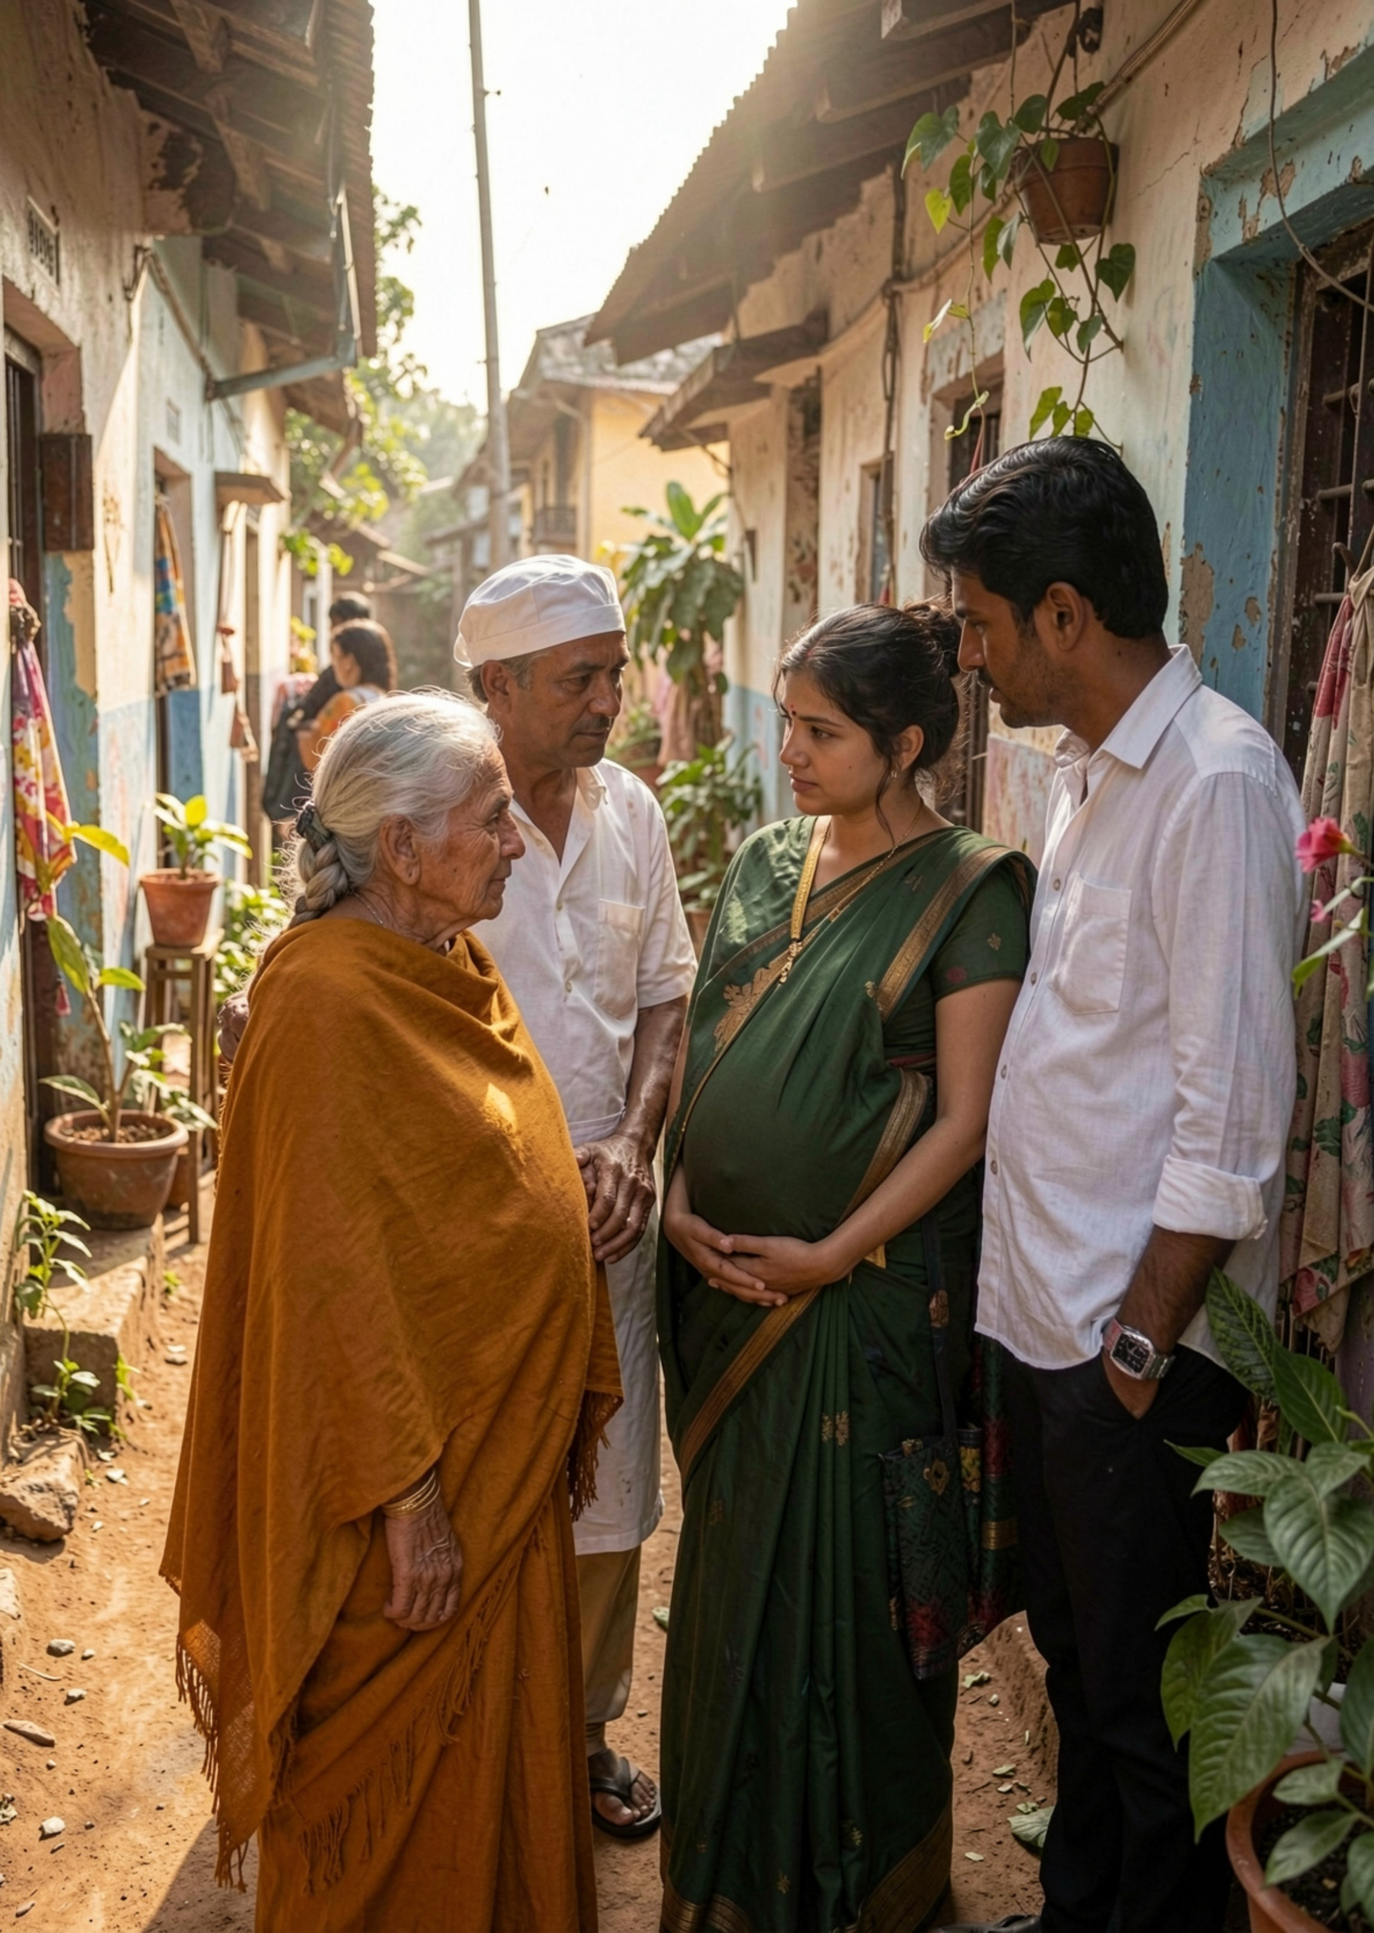



WHO WE DESIGN FOR
Built for families the app economy leaves behind
Healthcare access should not depend on a data plan.
Lower-middle-class and rural families
No smartphone, no English, no budget for private hospitals
Elderly people, pregnant women, and daily-wage workers
Notes:
Apni Bari starts with the people most digital health products assume away. The design constraint is simple: access must still work when the user has a basic phone, limited literacy, and no money for private care.

Slide 4



THE CORE JOURNEY
One missed call turns a queue into a plan
Give a missed call
Wait at home
Get the alert
Book a token without a smartphone or app.
Let the queue move while life continues.
Your phone rings when the turn is near.
Patient page
Doctor dashboard
Hospital TV
Simple status and ETA.
One button to call next.
Token + Hindi voice announcement.
Notes:
The product is a small chain of familiar actions. A missed call creates the token, the queue continues without the patient, and a phone alert brings the patient back at the right moment.

Slide 5
DESIGN PRINCIPLE
Simple by design. Useful at every step.
01
02
03
Find
Book
Track
Nearby government hospitals; distance, timings, queue count.
Missed-call token; no smartphone or app required.
Live queue status and ETA on any phone.
04
05
Keep moving
Hear
No-show auto-skip.
Hindi voice announcements for low-literacy users.
Notes:
Each verb answers a practical question: where should I go, how do I join, when should I leave home, what happens if someone misses their turn, and how do I understand the announcement?

Slide 6



CARE + COVER
Hamdard finds care. PM-JAY removes the fear.
Hamdard agent
Recommends the best nearby hospital using distance, queue length, and free-care availability.
PM-JAY check
Helps families understand whether treatment is free under Ayushman Bharat.
Nearest. Shortest queue. Free when eligible.
PM-JAY offers a ₹5 lakh per family per year cover in empanelled hospitals.
One clear choice
SOURCE: NHA · PM-JAY
Notes:
Hamdard is the human navigation layer. PM-JAY is the confidence layer. Together they answer both questions a family has before leaving home: where should we go, and can we afford the care?

Slide 7
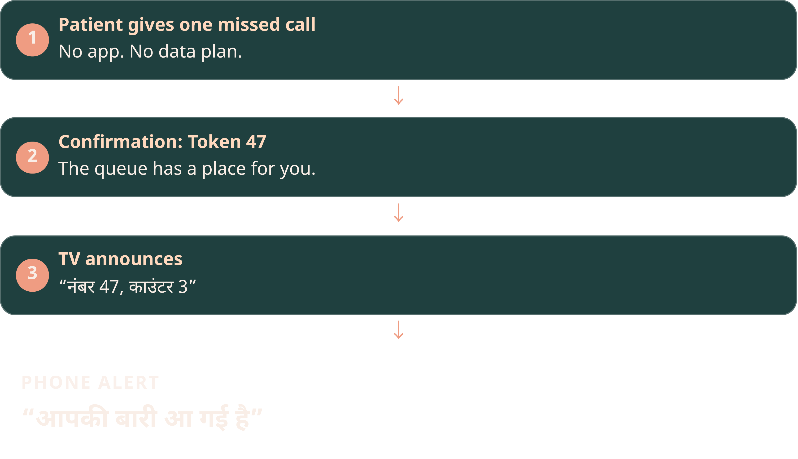
LIVE DEMO
From missed call to “आपकी बारी आ गई है”
One familiar phone call. One less day lost.
Notes:
Run the demo as a story, not a feature tour. Give the missed call, show Token 47, let the hospital TV announce it, and end on the phrase the patient hears on their own phone.

Slide 8
PILOT TARGET
45 minutes becomes 12
TODAY
TARGET
45
12
→
minutes waiting near the hospital
minutes waiting near the hospital
1 day’s wage
0 crowding
1 fair rule
Voice + missed call
saved per visit for a daily-wage worker
fewer people packed into lobbies
transparent first-come-first-served
works for illiterate users too
Impact targets to validate in the first district pilot. Queue time and wage-saved figures are targets, not national averages.
Notes:
The headline is a measurable promise, not a claimed result. In the first district pilot, we will test whether patients can spend 12 minutes near the hospital instead of 45, while preserving a transparent first-come-first-served rule.

Slide 9
DEPLOYMENT PATH
Government-ready, not government-replacing
Apni Bari adds
Built to complement
Missed-call token · live queue status · Hindi voice announcements · consent-first data layer
ABDM: Scan & Share has already generated 3 crore+ OPD tokens
Complements ORS instead of asking hospitals to rip out existing systems
Consent-first, DPDP-ready data handling
Existing systems stay: ABDM · ORS · district hospital
Deployment path: one district hospital pilot → measure → scale
Notes:
Position Apni Bari as an enabling layer. Hospitals keep the systems they already use. We add the missing queue experience, start with one district hospital, measure the result, and scale only when the evidence supports it.

Slide 10
THE ASK
45 minute → 12 minute.
Har din, har hospital.
Apni Bari makes a government-hospital visit fit around a family’s life.
Ask
Pilot with 1 district hospital
Team
Product · Tech · Hospital ops · Community
Demo
[QR / short link]
Apni Bari (बारी) — क्योंकि हर किसी की बारी आती है.
Notes:
Close with the ask, then return to the family. We are asking for one district hospital pilot to prove that a government-hospital visit can fit around a family’s life.

