Slide 1
CYBERCRIME CASE ANALYSIS & RESPONSIBLE TECHNOLOGY SOLUTIONS
Analysis of I4C Cyber Digest Incidents, Digital Laws & Ethical Frameworks
Presenter: Patel Bhargav
Enrollment No: 2304050400040 Course: Ethical and Legal Frameworks for Digital Systems (MDC5011C) Semester: 7th Semester (I.Msc.IT)
SILVER OAK UNIVERSITY
Silver Oak College of Computer Application Academic Year: 2026-2027

Slide 2
Project Objectives
✔ Technical Deconstruction: Detail the step-by-step attack vectors (Modus Operandi) of five critical cybercrime incidents compiled from I4C Cyber Digest reports.
✔ Legal Analysis & Mapping: Align modern incidents with specific punitive provisions under the IT Act 2000, Bharatiya Nyaya Sanhita (BNS) 2023, and the DPDP Act 2023.
✔ Ethical Evaluation: Critique ethical concerns, including the breach of bodily digital privacy, psychological coercion, lack of consent, and exploitation of vulnerable demographics.
✔ Practical Prototyping: Design and build an interactive web-based learning portal featuring a Threat Simulator, Law Mapper, and AI Cyber Advisor to empower public awareness.

Slide 3
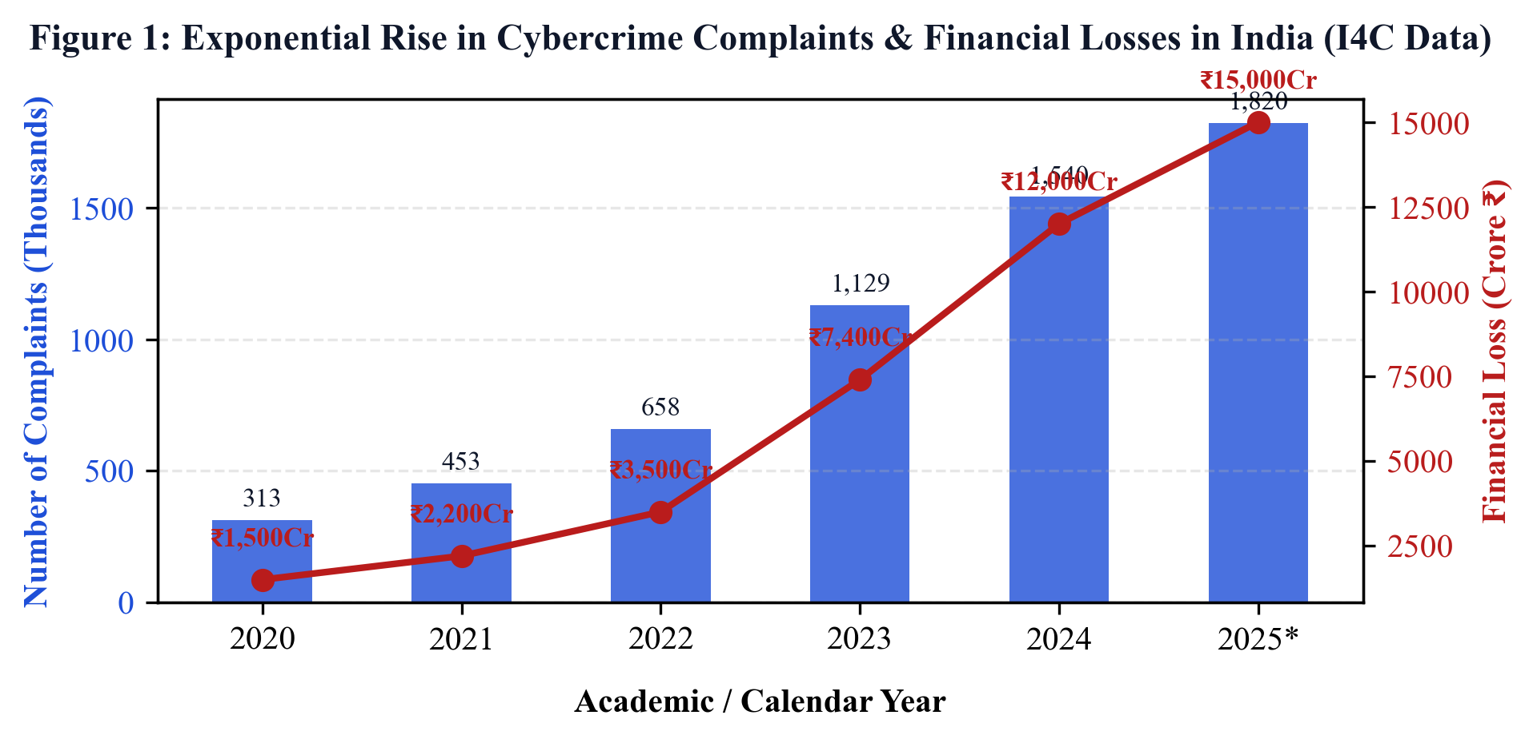
NCRP Statistical Analysis
Exponential Rise in Digital Threat Landscape
• Rapid Adoption vs. Tech Literacy: Financial inclusion services have outpaced consumer threat awareness, leaving gaps for scammers.
• Scale of NCRP Reports: Annual cybercrime complaints logged on the NCRP portal are projected to climb to 18.2 Lakhs in 2025, from 3.1 Lakhs in 2020.
• Economic Cost: Financial losses are estimated to exceed ₹15,000 Crore in 2025, driven by mule account networks.
• I4C & MHA Intervention: Prompts the deployment of Helpline 1930 and coordination platforms to block siphoned transactions.

Slide 4
Case Study 1: AePS Biometric Cloning Fraud
Modus Operandi: Registry Scraping -> Silicone print replica -> Cash withdrawals via retail micro-ATMs (Bypasses OTP validation).
Legal Mapping: IT Act Sec 66C (Identity Theft), Sec 43 (Access); DPDP Act Sec 8 (Registry Data breach liability); BNS Sec 318 (Cheating).
Empirical Evidence / Proof: FIR No. 124/2023 (Gurgaon Cyber Cell): Arrested gang cloned land registry prints, stole ₹18 Lakhs. 350 silicone fingers, scanners seized.
Specific Mitigation: Lock Aadhaar Biometrics via mAadhaar app or UIDAI website. Mask biometric data in public land deeds.

Slide 5
Case Study 2: Digital Arrest & Extortion Scam
Modus Operandi: Intercepted parcel drug warning -> Skype call with fake police -> 24/7 digital containment -> Extorted transfers to 'verification accounts'.
Legal Mapping: IT Act Sec 66D (Cheating by Personation); BNS Sec 308 (Extortion), Sec 204 (Impersonation), Sec 351 (Intimidation).
Empirical Evidence / Proof: MHA Alert (I4C-DA-2024): Retired manager in Noida lost ₹82 Lakhs after being held on Skype for 5 days. Patna suspects arrested.
Specific Mitigation: Disconnect immediately. Indian law enforcement never conducts interrogations or makes arrests via video call.

Slide 6
Case Study 3: Telegram Task & Part-Time Job Scam
Modus Operandi: Unsolicited work-from-home offers -> Paid ₹150 for likes (trust-building) -> VIP Telegram deposits -> Locked funds.
Legal Mapping: IT Act Sec 66D (Personation Cheating); BNS Sec 318 (Cheating) & Sec 61 (Criminal Conspiracy).
Empirical Evidence / Proof: Delhi Cyber Branch (FIR No. 210/2023): Disrupted a syndicate laundering ₹110 Crore. Blocked multiple shell wallets and APK platforms.
Specific Mitigation: Reject job offers requiring deposit fees. Verify recruiter details directly on the company's verified website.

Slide 7
Case Study 4: SEBI-Impersonating Trading App Scam
Modus Operandi: VIP stock tip WhatsApp groups -> Unofficial APK download -> Simulated gains on rigged UI -> Blocked withdrawal & tax demands.
Legal Mapping: IT Act Sec 66C/66D; SEBI Act Sec 12 (Unregistered Advice); BNS Sec 336/340 (Forgery of SEBI certificates).
Empirical Evidence / Proof: SEBI Warning (PR No. 05/2024): Public warnings against WhatsApp trading groups. 120 mule bank accounts frozen.
Specific Mitigation: Verify SEBI registration numbers on sebi.gov.in. Never download financial apps via direct browser links.

Slide 8
Case Study 5: Electricity Bill KYC & Remote Hijack
Modus Operandi: Urgent SMS warning utility cutoff -> Instructed to download AnyDesk/TeamViewer to pay ₹10 fee -> OTP read from screen -> Accounts drained.
Legal Mapping: IT Act Sec 43 (System Intrusion), Sec 66 (Fraud), Sec 66C (Credential Theft), Sec 66D (Personation); BNS Sec 318.
Empirical Evidence / Proof: Advisory No. 42/2023 (Maharashtra Cyber): Over 1,200 complaints, ₹4.8 Crore stolen via AnyDesk meter scams.
Specific Mitigation: Utility boards do not warn disconnections via personal 10-digit mobile numbers or demand screen-sharing apps.

Slide 9
Unprotected vs. Protected Systems
✖ Unprotected System State
• Biometrics are left open in public registry PDF databases, leaving them vulnerable to cloning.
• Users install screen-sharing software (AnyDesk) during phone calls to verify accounts.
• Applications are downloaded from third-party APK links shared on WhatsApp groups.
• Victims delay reporting scams, resulting in the loss of siphoned funds.
✔ Protected System State
• Aadhaar Biometrics locked via mAadhaar; dual-factor (PIN + biometric) authentication active.
• Banking apps restrict screen sharing, preventing credentials from being recorded.
• Financial portals are installed exclusively from verified app stores after checking sebi.gov.in.
• Victims call Helpline 1930 within the Golden Hour to freeze bank transactions.

Slide 10
Proposed Solution: Learning Prototype
An interactive, web-based training dashboard designed in vanilla HTML/CSS/JS:
• Dynamic Case Explorer: Analyzes technical threat vectors, laws, and prevention for all five cases.
• Interactive Law Mapper: Enables users to search and filter key provisions of the IT Act, BNS, and DPDP Act.
• Threat Awareness Simulator: A quiz-based scenario tool that guides users through common social engineering red flags.
• AI Cyber Advisor: A responsive conversational assistant providing instant guidance on cyber safety.

Slide 11
Digital Ethics: Developer Guidelines
Guidelines for designing ethical and compliant digital solutions under DPDP Act 2023:
✔ Privacy by Design: Implement consent options in application forms. Users must be able to manage their preferences easily.
✔ Avoid Dark Patterns: Ensure user interfaces are clear and transparent; do not use deceptive designs to influence user behavior.
✔ Localize Biometrics: Store biometric data in hardware secure enclaves (such as TPMs) rather than public databases.
✔ Security Auditing: Regularly audit databases containing registry documents or customer profiles to prevent scraping.

Slide 12
Conclusion & Helpline 1930
Securing the Digital Citizen
System security requires combining secure development, legal compliance, and user education.
REPORT FINANCIAL FRAUD IMMEDIATELY TO HELPLINE 1930
File a complaint on cybercrime.gov.in within the 'Golden Hour' to freeze transactions.

