Slide 1
CSE302: Computer Networks Project
Title: Virtual Canvas with chat application using TCP Socket Programming in Java
Presented By
124003385: BHUMIREDDY HARINATHREDDY,
Guide Name: Dr. R. Kavitha, CSE/SoC, SASTRA University
Date of Presentation: 14.11.2022
1

Slide 2
Points to be discussed
Aim & Objective
Problem Statement
Literature Survey
Work Flow Diagram
Features and Limitations
Work Done (Implementation code link)
Sample I/O (screen shot)
Proposed Work Flow and Methodology
References

Slide 3
AIM & OBJECTIVES
The aim of the project is implementing the HTTP protocols in wireless Network to simulate the application on Client-Server environment.
Objective 1: understanding TCP,IP protocols
Objective 2: applying Client-Server Application Architecture
Objective 3: Creating java Application
Objective 4: Benefits to the Painting Learners

Slide 4

Problem Statement & Solution : One line story
Sample problem statements are:
In online meeting without a board making all attendees to understand ideas is tough
The Solutions are:
This project can be used as an alternative to the traditional board used in meetings and classes.

Slide 5
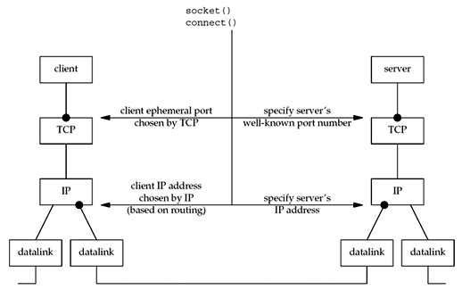
Network Architecture

Slide 6
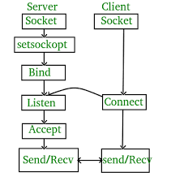
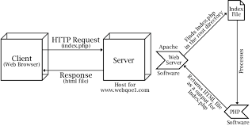
Working Flowchart

Slide 7
FEATURES OF TCP PROTOCOL
TCP is reliable protocol.
CP provides error-checking and recovery mechanism.
TCP provides end-to-end communication.
TCP provides flow control and quality of service.
TCP operates in Client/Server point-to-point mode.
TCP provides full duplex server, i.e. it can perform roles of both receiver and sender

Slide 8
LIMITATIONS OF TCP PROTOCOL
LIMITATION OF TCP PROTOCOL
It does not clearly separate the concepts of services, interfaces, and protocols. So, it is not suitable to describe new technologies in new networks.
It does not distinguish between the data link and the physical layers, which has very different functionalities.
It does not clearly separate the concepts of services, interfaces, and protocols. So, it is not suitable to describe new technologies in new networks.
It does not distinguish between the data link and the physical layers, which has very different functionalities.

Slide 9
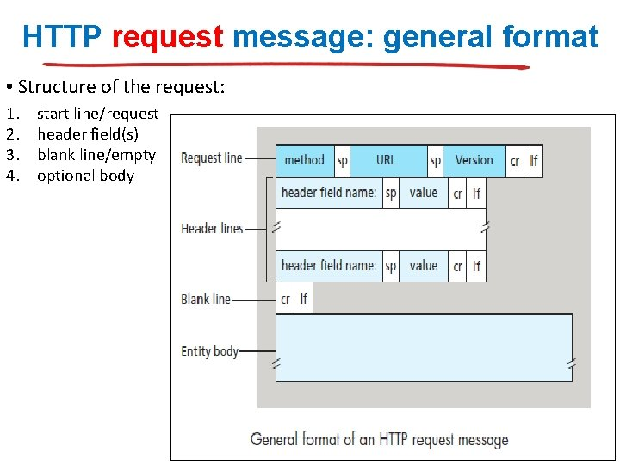
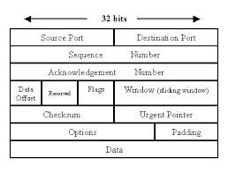
Proposed Protocol Description
RFC number: 9293 Protocol Message format

Slide 10
Work done so far
Link of the implementation code: https://docs.google.com/document/d/161FHHm_Hv7CSxy333bXS_dFjlu2ztSsI-i1R8OviZp4/edit?usp=sharing

Slide 11
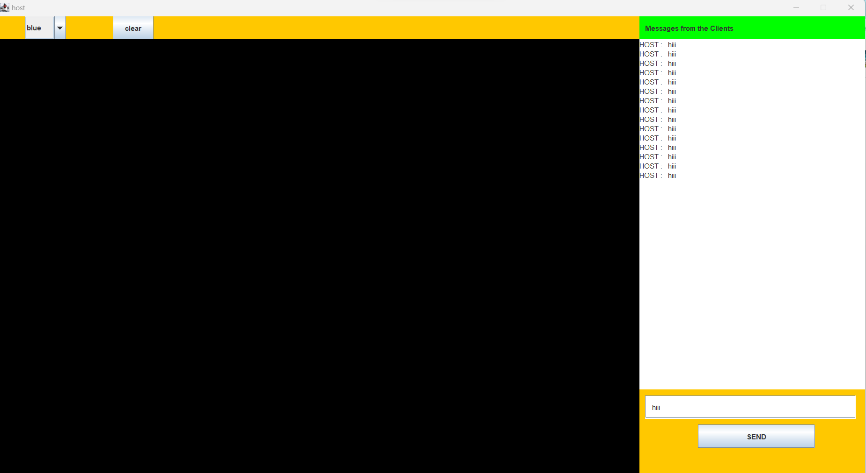
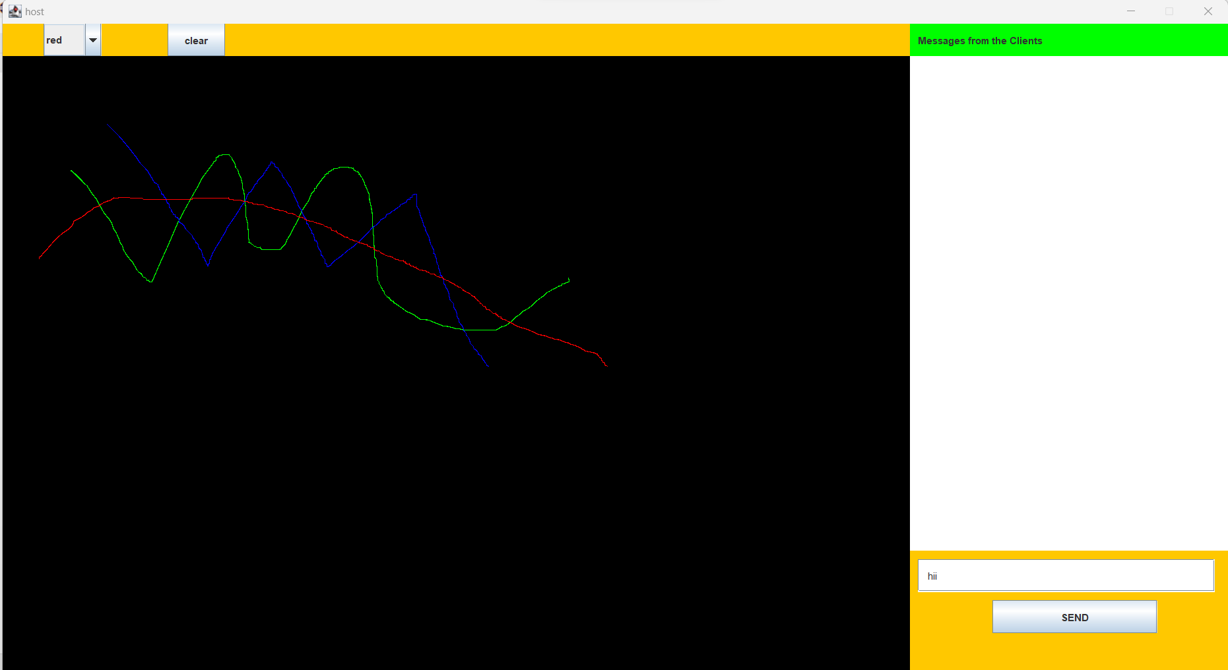
Sample I/O screen shots
HOST

Slide 12
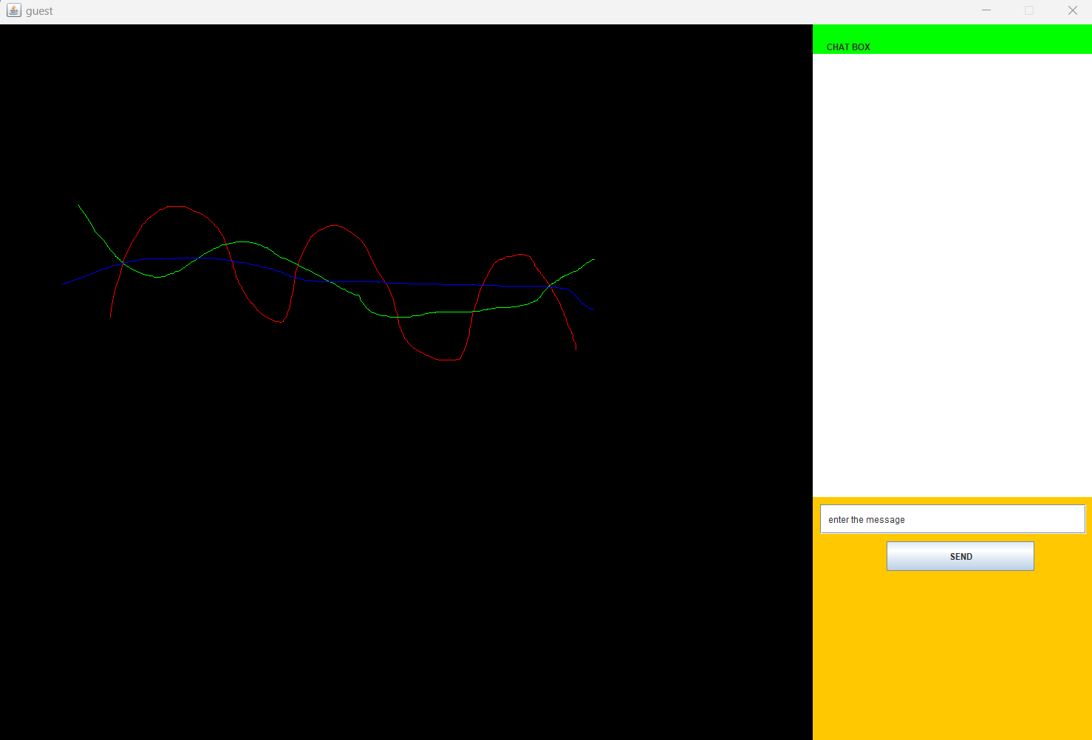

Sample output
CLIENT

Slide 13
References
15
Java Swings :oracle.java.docs

Slide 14
17
Thank You

