Slide 1
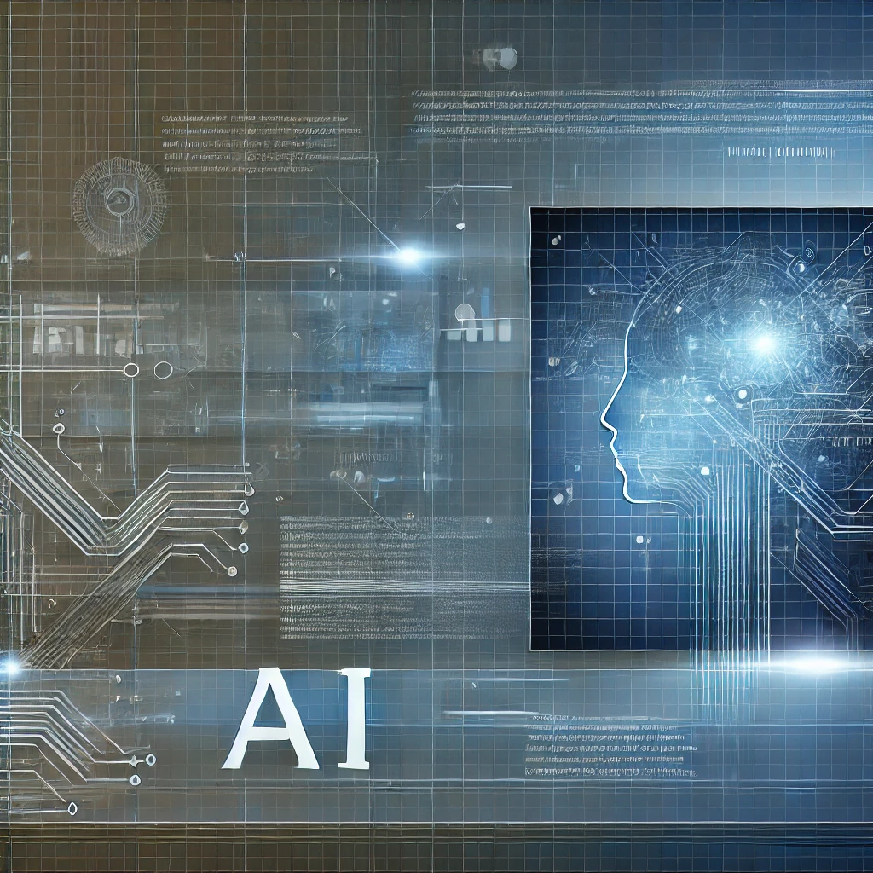
DRIVER UNDER INFLUENCE
(DUI)
Preventing DUI & Unauthorized Vehicle Use with AI and Biosensors

Slide 2
Problem Statement
Driving under the influence (DUI) is a leading cause of road accidents. Existing vehicle security systems fail to prevent impaired driving before the engine starts.

Slide 3
Introduction
Driving under the influence (DUI) is a leading cause of road accidents.
This project proposes an AI-powered smart steering system that prevents DUI-related accidents by integrating biosensors, AI-based monitoring, and real-time alerts.
The system utilizes touch-based alcohol detection, heart rate sensors, and AI-driven facial recognition to ensure the driver is sober before allowing the vehicle to start.
If impairment is detected, the system locks the engine and sends alerts to emergency contacts.

Slide 4
Our Solution
An AI-powered smart steering system that integrates biosensors, AI-based camera and real-time alerts to prevent DUI.

Slide 5

Problem : Accidents due to DUI of alcohol or drugs
DUI-related accidents happen
WHY ?
intoxicated drivers still drive
WHY ?
WHY ?
isn’t there an in-vehicle mechanism
don’t vehicles have this technology
WHY ?
theft prevention
prioritized over driver
safety
WHY ?
ROOT CAUSE

Slide 6
5 Whys Analysis - DUI Problem
1.Why do DUI-related accidents happen?
Drivers operate vehicles while intoxicated.
2. Why do intoxicated drivers still drive?
There is no in-vehicle mechanism stopping them before they start driving.
3. Why isn’t there an in-vehicle mechanism?
Most cars lack real-time alcohol detection and impairment monitoring.
4. Why don’t vehicles have this technology?
Vehicle security focuses on theft prevention rather than driver condition.
5. Why is theft prevention prioritized over driver safety?
AI-driven DUI prevention is not yet widely adopted in the automotive industry.

Slide 7
Sustainability & Impact
• Reduces DUI-related accidents, saving lives.
• Uses energy-efficient biosensors & AI for sustainability.
• Encourages AI-driven smart transportation solutions.

Slide 8
How It Works
Sensors on the steering wheel detect alcohol levels and heart rate.
Drowsiness detection ensures alertness.
If impairment is detected, the system locks the engine and sends alerts.
Mobile app allows remote control and alerts.

Slide 9
Key Features
• Touch-based Alcohol & Heart Rate Sensors
• AI Facial Recognition & Drowsiness Detection
• Engine Lock Mechanism
• Mobile App for Remote Access
• Real-Time Alerts to Emergency Contacts

Slide 10
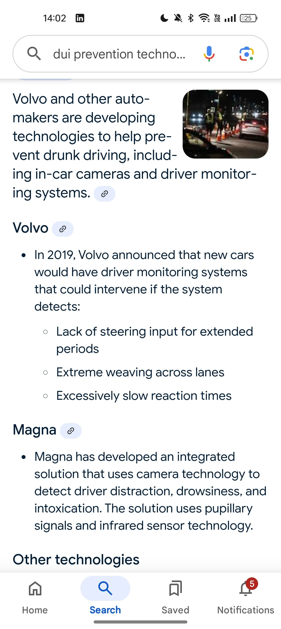
Companies that tried DUI related technologies but failed to avoid DUI related accidents

Slide 11
Overall it contributes to the smart transportation and encourages safer, AI-driven vehicle control.
THANK YOU….

