Slide 1
Menza
Cambridge Canteen App

Slide 2
Introduction
College canteen app- Menza make it easier for students and staff to order food from the canteen without having to wait in line.
From this app, everyone and anyone within the campus can order the food, know the menu, schedule their order, give feedback or reviews, know the cost of the item, etc.

Slide 3

Problem statement:
This Photo by Unknown Author is licensed under CC BY-SA
Food is the very most essential part of the life , from students to teacher’s including non-teaching staff everyone, one or the other time we depend on canteen food .
But there are many challenge faced near the canteen like:
Budget/cost
menu
Out of stock
Taste
And so on

Slide 4
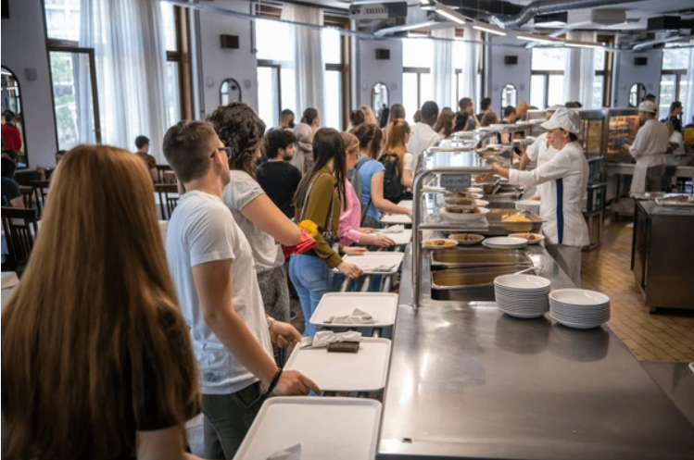
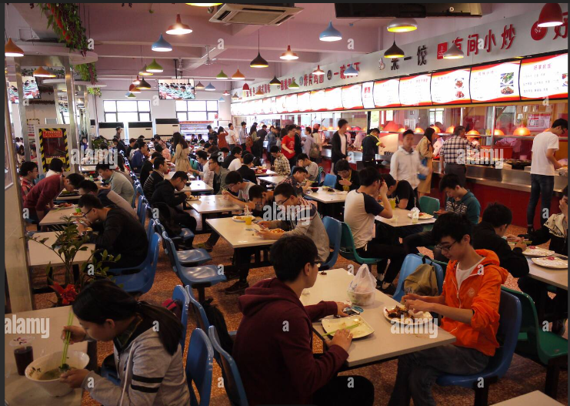
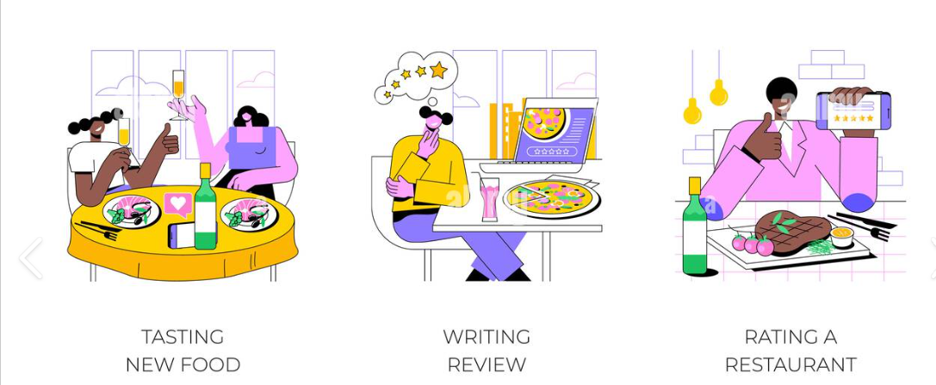
Why Menza
Ease of ordering food
Easy menu access
Ease of cost/budget handling
Real-time updates
Ratings
Easy to provide feedback
Reduce tokens/paper work
Reducing human errors
ITEMS RATING

Slide 5
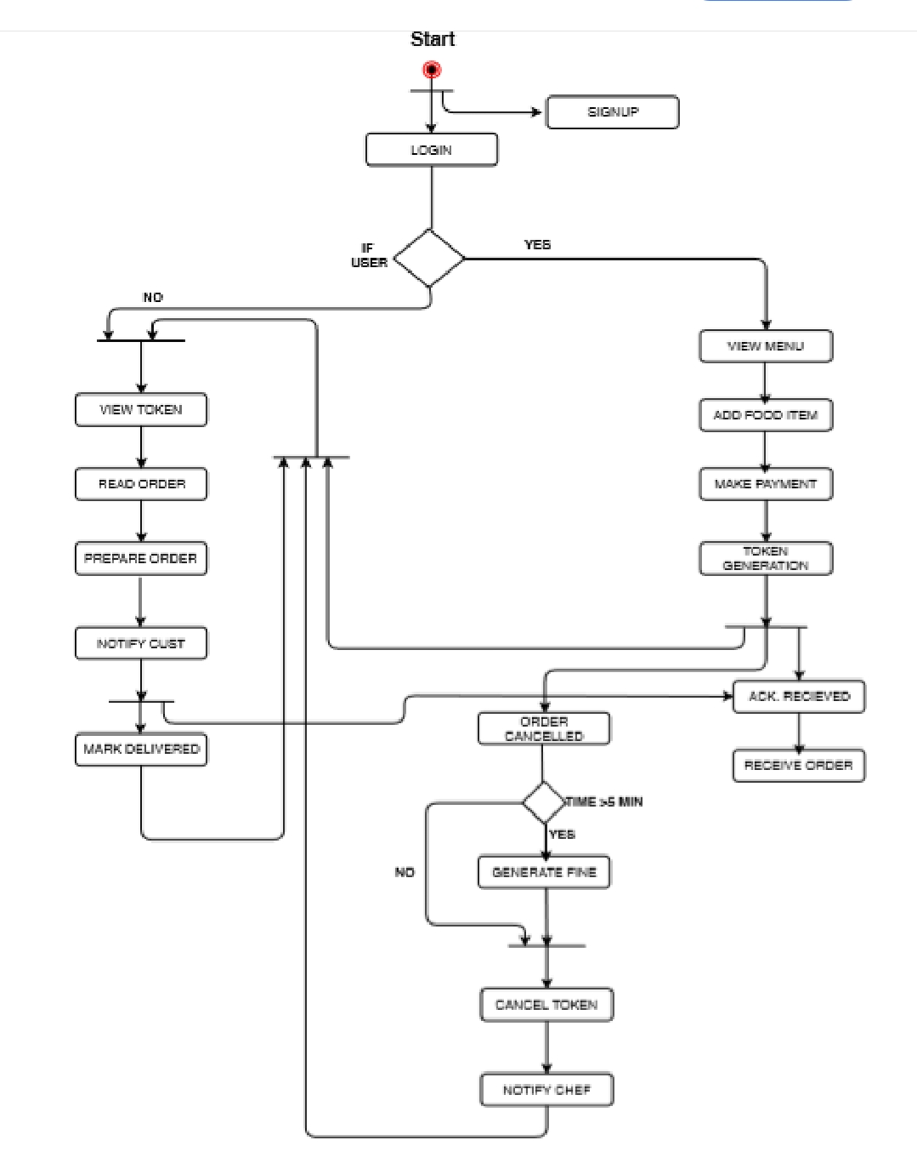
How Menza works:

Slide 6
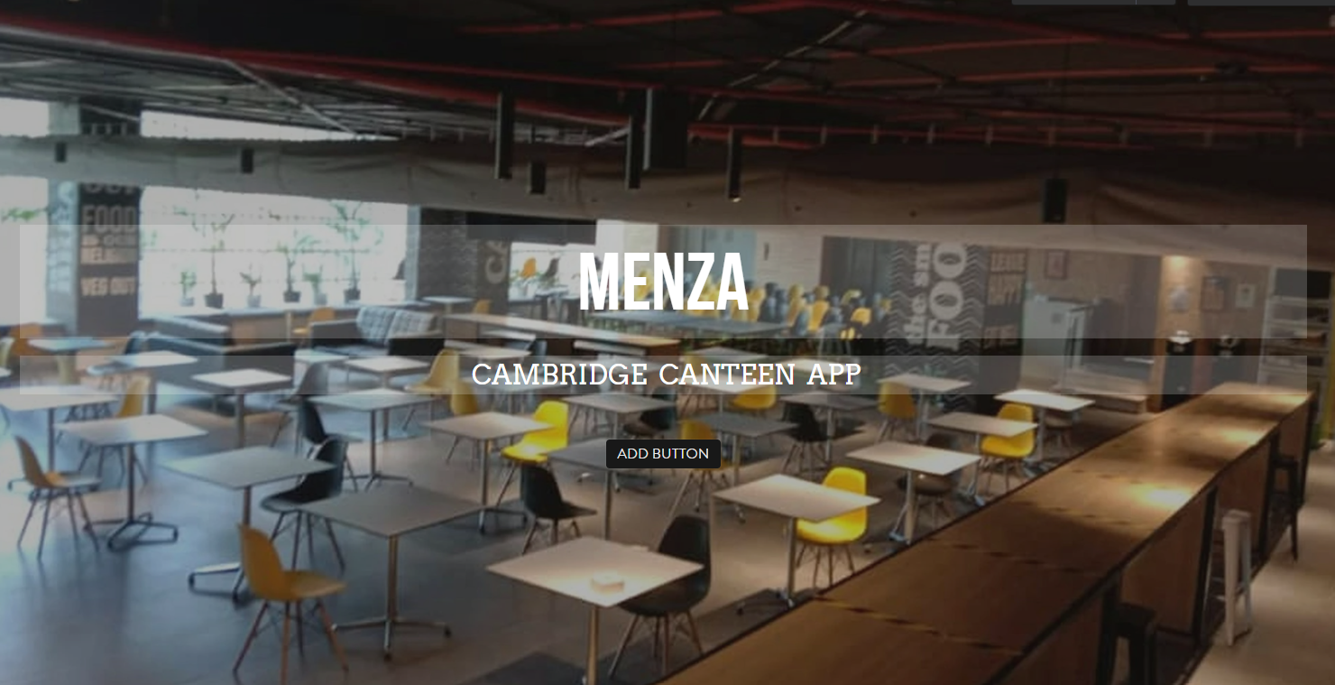
Outline of the Application
Login
LOGIN

Slide 7
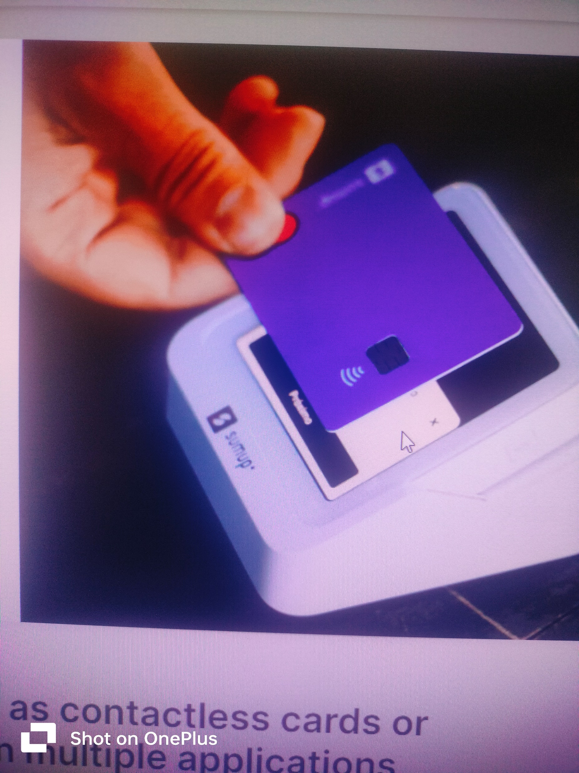
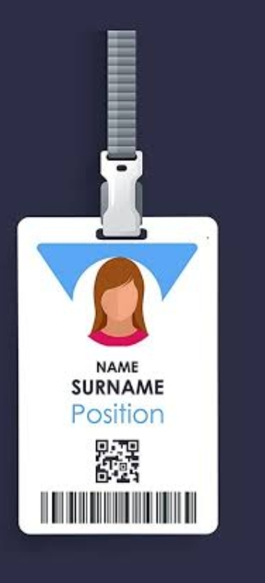
RFID card scanning
Example:
Metro card
Students attendance card
Library card
Etc…….

Slide 8
Thank You..

