Slide 1
FRONT END ENGINEERING-II
ECOMMERCE SHOPPING WEBSITE
ARMAN KALRA-2310990126
ARCHI– 2310990124
AKANKSHA– 2310990100
BHUMI SACHDEVA-2310990145
Class Group: G2 Project Group (PG) No.: PG1
Project Guide Name:
Mr. SACHIN GARG

Slide 2
TABLE OF CONTENT
Introduction
Problem Statement
Technical Details
Key Features
Future Scope
Conclusion
Screenshots
References/Links used

Slide 3
INTRODUCTION
An e-commerce website, specifically one dedicated to clothing, serves as a virtual showroom for fashion enthusiasts. It offers a convenient platform for customers to browse through a wide variety of clothing items, compare styles, and make purchases online. However, creating a successful e-commerce website for clothing comes with unique challenges, including: • Visual appeal: Clothing is highly visual, and a well-designed website is essential to showcase products effectively. High-quality product images, clear descriptions, and a visually appealing layout are crucial. • Product categorization: Organizing a vast clothing catalog into meaningful categories and subcategories is essential for easy navigation and customer satisfaction. • Size and fit: Ensuring accurate sizing information and providing helpful fit guides is crucial to minimize returns and enhance customer satisfaction. • Mobile optimization: Given the increasing use of smartphones for shopping, a mobilefriendly website is essential for reaching a wider audience.
The primary objectives of this e-commerce clothing website project were: • Create a visually appealing and user-friendly interface: Design a website that showcases clothing items effectively and is easy to navigate, providing a positive user experience. • Develop a functional online store: Implement features such as product listings,shopping carts, and a secure checkout process, tailored to the specific needs of a clothing ecommerce website. • Ensure website responsiveness: Optimize the website for various devices (desktop, tablet, mobile) to cater to a wider audience and provide a seamless shopping experience across different platforms. • Integrate essential functionalities: Incorporate featureslike search, filtering, and product recommendationsspecifically designed for clothing e-commerce,such assize filters, color filters, and outfit suggestions. • Provide detailed product information: Include high-quality product images, accurate descriptions, and sizing guides to help customers make informed purchasing decisions. • Offer a personalized shopping experience: Implement features like saved items, wishlists, and personalized recommendations to enhance customer engagement and loyalty.

Slide 4
PROBLEM STATEMENT
In developing this e-commerce clothing website, several key challenges were addressed:
Responsiveness: Designing the website to adapt to different screen sizes and devices (desktop, tablet, mobile) to provide a consistent and optimal experience across various platforms.
Product Information: Providing accurate and comprehensive product information, including high-quality images, detailed descriptions, and sizing guides, to help customers make informed purchasing decisions.
Performance Optimization: Ensuring the website loads quickly and performs efficiently, even with a large number of products and images, to enhance user satisfaction an
While a real-world e-commerce website would typically use a database to store product information, this project utilized sample data for demonstration purposes. The sample data included: • Product Listings: A collection of sample clothing items with descriptions, images, prices, and sizes. • Category Information: A hierarchy of categories and subcategories to organize the product catalog. • User Data: Sample user profiles, including login credentials and shipping informationd minimize bounce rates.

Slide 5



TECHNICAL DETAILS
HTML (Hypertext Markup Language) is used to define the structure and content of a web page. It is a declarative language, meaning that it tells the browser what to display, but not how to display it.
CSS (Cascading Style Sheets) is used to style the content of a web page. It is a presentational language, meaning that it tells the browser how to display the content, such as the font, color, and layout.
BOOTSTRAP simplifies web development by providing these pre-built components and utilities, enabling developers to create functional and stylish websites more efficiently. It is widely used due to its ease of use, responsive design capabilities, and extensive documentation..

Slide 6
KEY FEATURES
Header: The header contains the website's logo, name, and a navigation bar. The logo and name establishes the identity, while the navigation bar allows users to quickly access different sections of the website.
Footer: The footer includes copyright information and links to social media profiles. This section provides essential legal information and additional ways for users to connect with us.
Form: A functional form is included for user input, which could be used for making inquiries. This form is a critical component for user interaction and data collection.
Custom Logos: Designed and implemented unique, visually appealing logos.
Interactive Design: Utilizes CSS hover effects for engaging user interactions.
Small Animations: Subtle animations enhance the user experience.
Modern Aesthetic: Clean and minimal design focused on user experience.

Slide 7
FUTURE SCOPE
Addition of JavaScript :-
Adding JavaScript to make the website more interactive. This could include features like engaging elements such as image sliders and pop-up windows.
Make the Website Responsive :-
Optimize the site for different screen sizes and devices using responsive design techniques, ensuring it looks and functions well on mobile phones, tablets, and desktops.
Adding Animations :-
Use animations to make the website more lively and attractive. This can include smooth page transitions, animated buttons, and effects like fading or sliding elements as we scroll.

Slide 8
CONCLUSION
This provides a comprehensive overview of the development process and outcomes of the e-commerce clothing website project. The project focused on creating a visually appealing, userfriendly, and responsive online store for showcasing and selling clothing products. Key aspects covered in the report include the project's objectives, design approach, development methodology, and results.
The e-commerce clothing website successfully achieved the following key accomplishments:
Visually appealing and user-friendly interface: The website features a modern and intuitive design, showcasing clothing products effectively and providing a positive user experience.
Responsive design: The website is optimized for different screen sizes and devices, ensuring a consistent and seamless experience across various platforms.
Functional online store: The website includes essential features such as product listings, shopping carts, and a secure checkout process, enabling users to browse, select, and purchase clothing items conveniently.
Product information and imagery: High-quality product images and detailed descriptions are provided to help customers make informed purchasing decisions

Slide 9
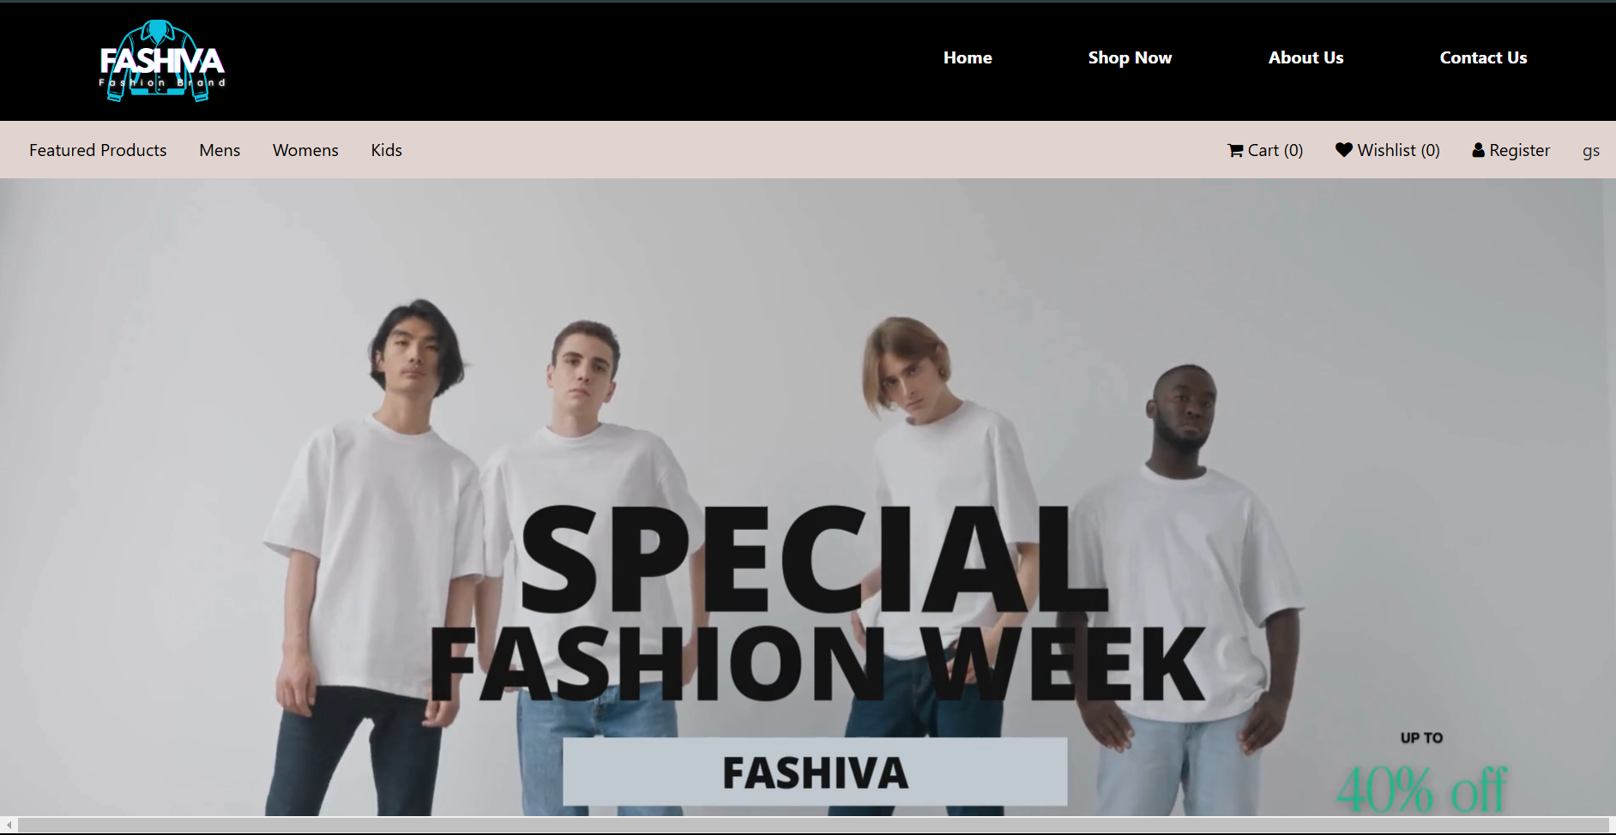
SCREENSHOTS

Slide 10
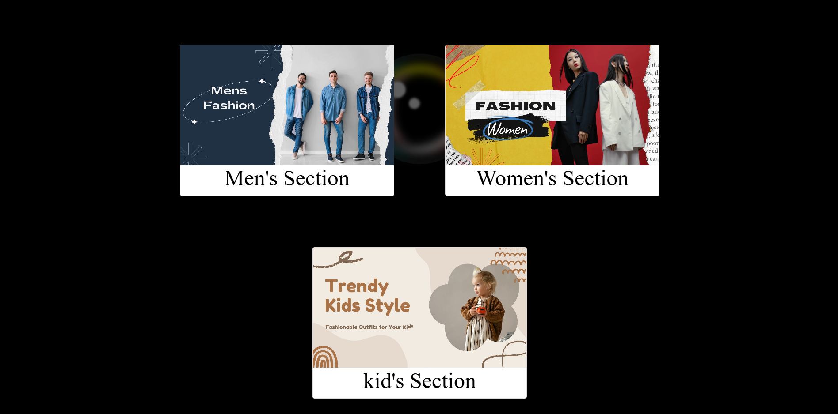


Slide 11
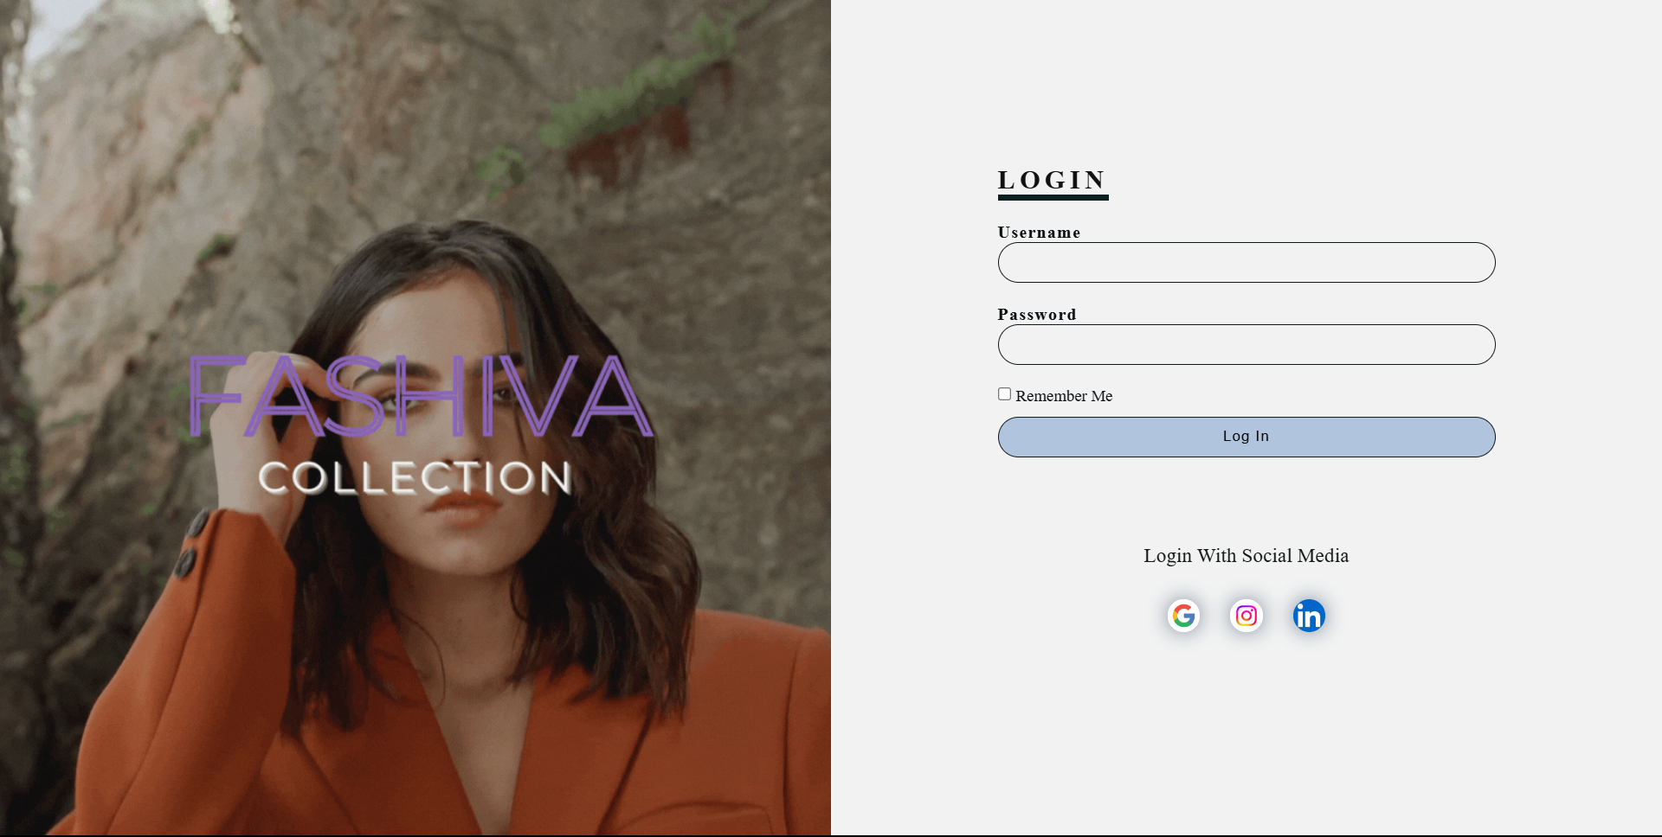

Slide 12
REFERENCE LINKS
In class guidance from our Teacher’s lectures and tutorials
https://www.w3schools.com/css/default.asp

Slide 13


