Slide 1
USER MANUAL FOR:
PLOTDWG
AUTHOR: SUMAN KUMAR (suman.bhutuu@gmail.com)

Slide 2
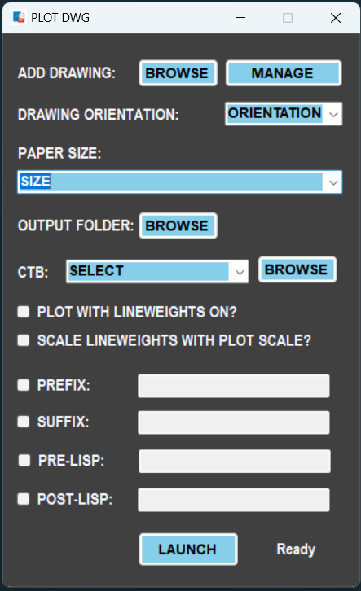
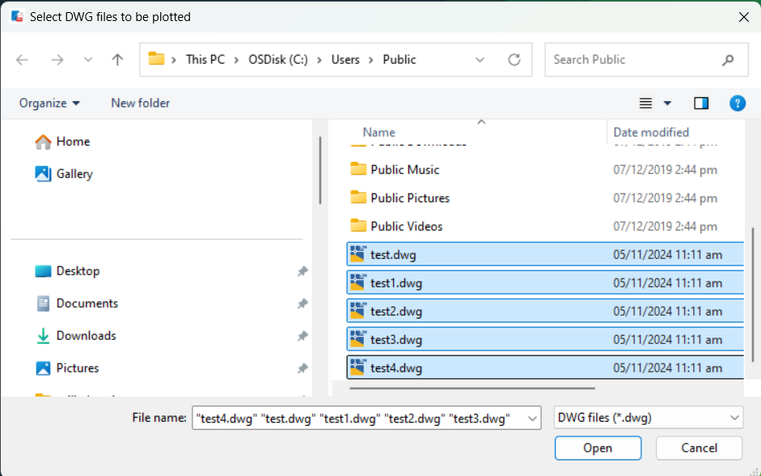
STEP: 1: SELECT DWG (AUTOCAD DRAWING) FILES TO BE PLOTTED.
STEP 1.1: CLICK ON THIS BROWSE BUTTON TO SELECT ALL THE DWG FILES THAT YOU WANT TO PLOT.
STEP 1.2: AFTER SELECTING ALL YOUR DWG FILES CLICK ON THIS “OPEN” BUTTON TO ADD INTO THE APPLICATION’S DATABASE.

Slide 3
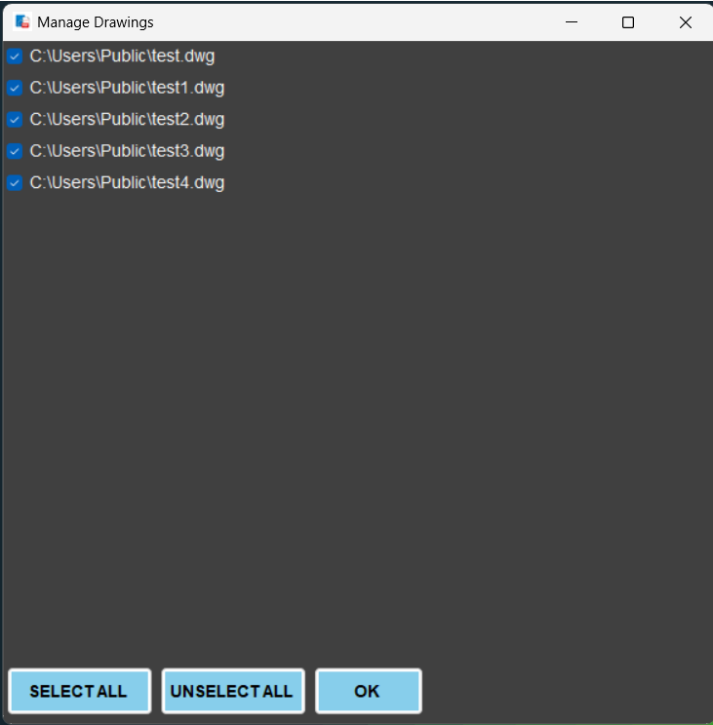
STEP: 2: MANAGE YOUR DRAWINGS TO BE PLOTTED. (OPTIONAL STEP)
STEP 2.1: CLICK ON THIS MANAGE BUTTON TO CHECK OR UNCHECK DWG FILES WHICH YOU WANT TO PLOT FOR SPECIFIC SETTING.
STEP 2.2: CHECK ONLY FILES WHICH YOU WANT TO PLOT USING CURRENT SPECIFIC SETTING.
STEP 2.3: AFTER CHECKING/UNCHECKNG FILES CLICK ON THIS “OK” BUTTON TO CONTINUE.

Slide 4
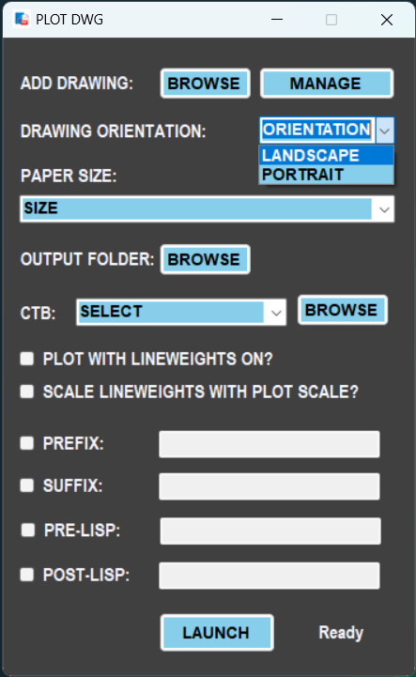
STEP: 3: SELECT THE ORIENTATION FOR THE PLOT SETTING.
STEP 3.1: CLICK ON THE DROP BUTTON AND SELECT THE REQUIRED PLOT ORIENTATION FOR YOUR SELECTED DWG FILES.

Slide 5
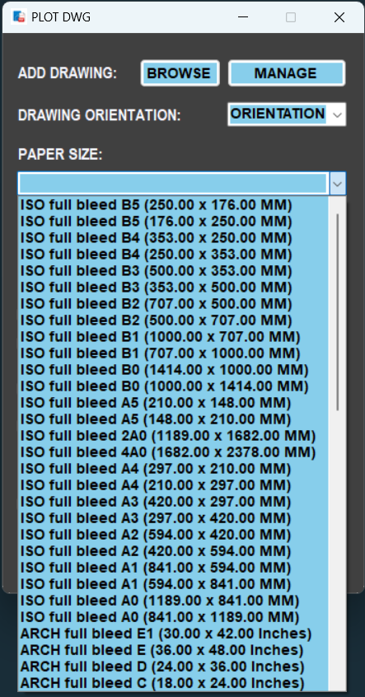
STEP: 4: SELECT THE PAPER SIZE FOR THE PLOT SETTING.
STEP 4.1: CLICK ON THE DROP BUTTON AND SELECT THE SPECIFIC PAPER SIZE AS PER YOUR REQUIREMENT.

Slide 6
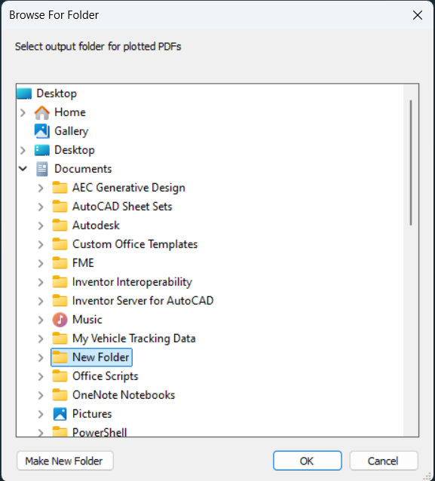
STEP: 5: SELECT OUTPUT FOLDER FOR THE OUTPUT PDFS TO BE
PLOTTED.
STEP 5.1: CLICK ON THIS BROWSE BUTTON TO SELECT THE OUTPUT FOLDER PATH.
STEP 5.2: CLICK ON THIS “OK” BUTTON AFTER SELECTING THE OUPUT FOLDER PATH FOR PDFS TO BE PLOTTED.

Slide 7
STEP: 6: SELECT THE CTB FILE THAT HAS COLOR PROPERTIES
FOR THE PLOT.
STEP 6.1: SELECT THE CTB FILE FROM THE DROPDOWN LIST OR BROWSE FROM YOUR FOLDER BY CLICKING ON THE “BROWSE” BUTTON.

Slide 8
STEP: 7: ENSURE WHETHER TO PLOT WITH LINEWIEGHT ON OR
NOT.
STEP 7.1: CHECK THIS CHECKBOX ONLY IF YOU WANT TO SHOW THE LINEWEIGHTS IN THE PLOTTED PDF.

Slide 9
STEP: 8: ENSURE WHETHER TO SCALE LINEWIEGHT AS PER
PAGESETUP SCALE OR NOT.
STEP 8.1: CHECK THIS CHECKBOX ONLY IF YOU WANT TO SCALE THE LINEWEIGHT AS PER THE PLOT SCALE YOU HAVE SET IN THE PAGESETUP.

Slide 10
STEP: 9: SET PREFIX FOR THE OUTPUT FILENAME
STEP 9.1: IF YOU WANT TO ADD PREFIX IN FOR THE OUTPUT FILE NAME, CHECK THE CHECKBOX AND WRITE THE REQUIRED PREFIX.
EXAMPLE:
LET SAY YOU HAVE ADDED PREFIX AS “SUMAN_”
THEN THE OUTPUT WILL BE “SUMAN_LAYOUTNAME.PDF”
NOTE: IF CHECKBOX IS CHECKED AND YOU HAVE NOT FILLED THE ENTRY BOX THEN IT WOULD POP AN ERROR MESSAGE AS INVALID INPUT.

Slide 11
STEP: 10: SET SUFFIX FOR THE OUTPUT FILENAME
STEP 10.1: IF YOU WANT TO ADD SUFFIX IN FOR THE OUTPUT FILE NAME, CHECK THE CHECKBOX AND WRITE THE REQUIRED SUFFIX.
EXAMPLE:
LET SAY YOU HAVE ADDED SUFFIX AS “_P01”
THEN THE OUTPUT WILL BE “LAYOUTNAME_P01.PDF”
NOTE: IF CHECKBOX IS CHECKED AND YOU HAVE NOT FILLED THE ENTRY BOX THEN IT WOULD POP AN ERROR MESSAGE AS INVALID INPUT.

Slide 12
STEP: 11: PRE-LISP EXRESSION
STEP 11.1: IF YOU WANT TO RUN ANY LISP EXPRESSION JUST BEFORE THE PLOT COMMAND, YOU CAN CHECK THE CHECKBOX AND WRITE THE EXPRESSION INTO THE ENTRY BOX.
EXAMPLE:
LET SAY YOU WANT TO RELOAD ALL THE EXTERNAL REFS BEFORE PLOTTING:
(COMMAND “-XREF” “R” “*”)
NOTE: IF CHECKBOX IS CHECKED AND YOU HAVE NOT FILLED THE ENTRY BOX THEN IT WOULD POP AN ERROR MESSAGE AS INVALID INPUT.

Slide 13
STEP: 12: POST-LISP EXRESSION
STEP 12.1: IF YOU WANT TO RUN ANY LISP EXPRESSION JUST AFTER THE PLOT COMMAND, YOU CAN CHECK THE CHECKBOX AND WRITE THE EXPRESSION INTO THE ENTRY BOX.
EXAMPLE:
LET SAY YOU WANT TO UNLOAD ALL THE EXTERNAL REFS AFTER PLOTTING:
(COMMAND “-XREF” “U” “*”)
NOTE: IF CHECKBOX IS CHECKED AND YOU HAVE NOT FILLED THE ENTRY BOX THEN IT WOULD POP AN ERROR MESSAGE AS INVALID INPUT.

Slide 14
STEP: 13: START PLOTTING PROCESS.
STEP 13.1: AFTER YOU ARE ALL SET WITH THE PLOT SETTINGS, JUST CLICK ON THIS “LAUNCH” BUTTON AND THE PLOTING PROCESS WILL BE STARED
STEP 13.2: THIS LABEL WILL SHOW THE NUMBER OF DRAWING FILES COMPLETED VERSUS TOTAL NUMBER OF DRAWINGS FOR WHICH YOU HAVE STARTE THE PLOTTING PROCESS.

