Slide 1
IMDB Movie Reviews -FANDANGO RATING DISCREPANCY
CAPSTONE PROJECT
Presented By:
KR.BHUVANESH
SHANMUGANATHAN ENGINEERING COLLEGE
MECHANICAL ENGINEERING

Slide 2
OUTLINE
Problem Statement
Proposed System/Solution
System Development Approach
Algorithm & Deployment
Result
Conclusion
Future Scope
References

Slide 3
Problem Statement
Back in 2015, FiveThirtyEight published an article entitled "Be Suspicious Of Online Movie Ratings, Especially Fandango’s". The article concluded that Fandango tends to overrate their movies. In other words, the number of stars that the website shows for a certain movie is often higher than the true rating for the same movie.

Slide 4
Proposed Solution
To end that, this Analysis consists of two main parts:
Exploring Fandango Displayed Scores versus True User Ratings.
Comparison of Fandango Ratings to Other Sites
To determine if fandango's ratings in 2015 had a bias towards rating movies better to sell more tickets.

Slide 5
System Approach
HARDWARE REQUIRED
ram- 4GB(minimum)
rom- 512GB SSD
Processor- clockspeed more than 2.0GHZ
Graphics card- minimum 4 GB of VRAM
SOFTWARE REQUIRED
Visual studio code
Browser that supports google collab
Anaconda or jupyter notebook
LIBRARIES NEEDED
FOR VISUALIZATION
matplotlib.pyplot
seaborn
FOR DATA PROCESSING AND ANALYSIS
pandas
numpy

Slide 6
Algorithm & Deployment
Data exploration
Exploring Fandango Displayed Scores versus True User Ratings
Explore the DataFrame Properties and Head
Create a count plot to display the number of times a certain difference occurs
Comparison of Fandango Ratings to Other Sites
Let's find out which movies are causing the largest differences. First, show the top 5 movies with the largest *negative* difference between Users and RT critics. Since we calculated the difference as Critics Rating - Users Rating, then large negative values imply the users rated the movie much higher on average than the critics did.
Fandago Scores vs. All Sites
Comparing Distribution of Scores Across Sites
Visualize the distribution of ratings across all sites for the top 10 worst movies
Clearly Fandango is rating movies much higher than other sites, especially considering that it is then displaying a rounded up version of the rating.

Slide 7
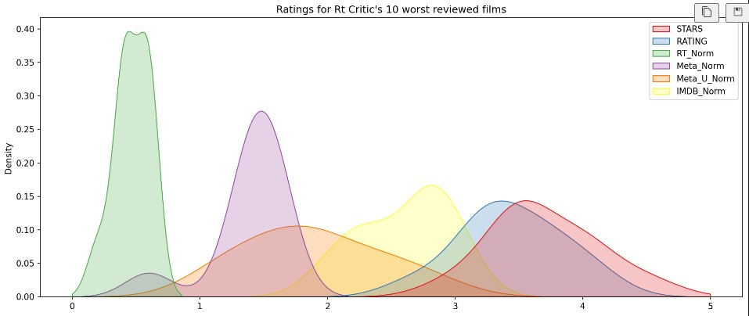
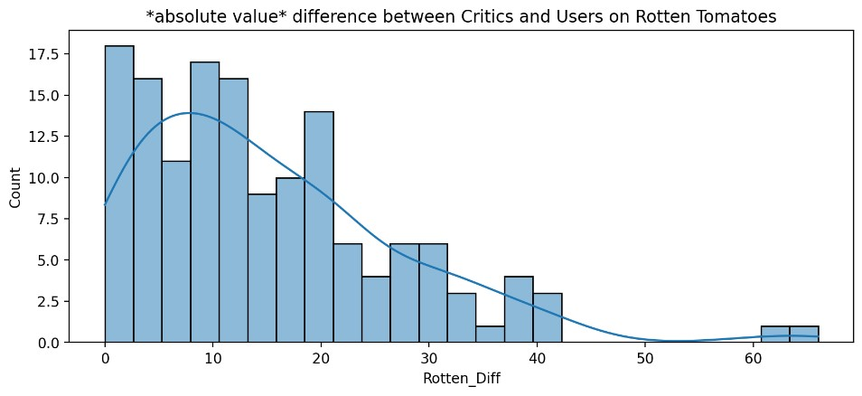
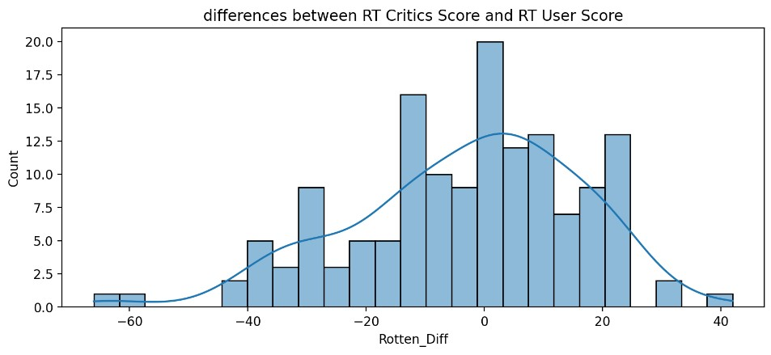
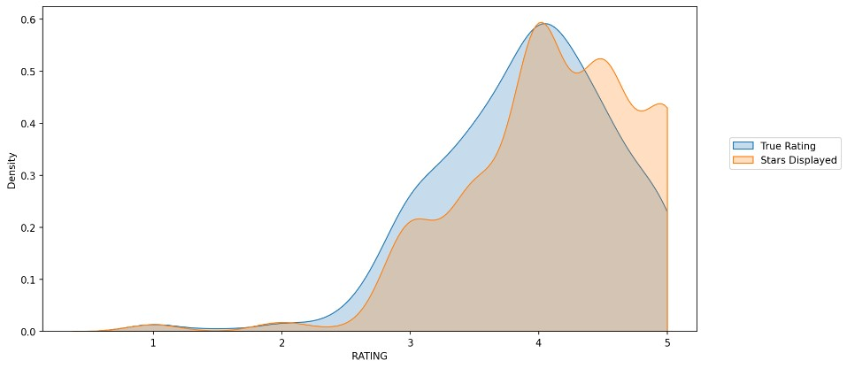
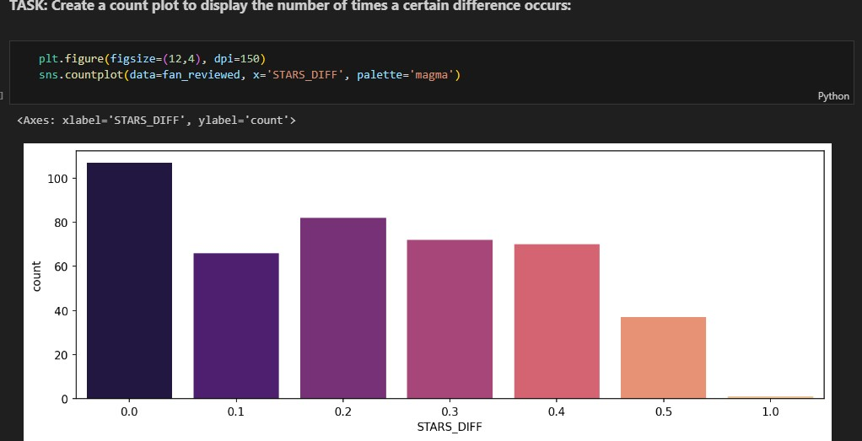
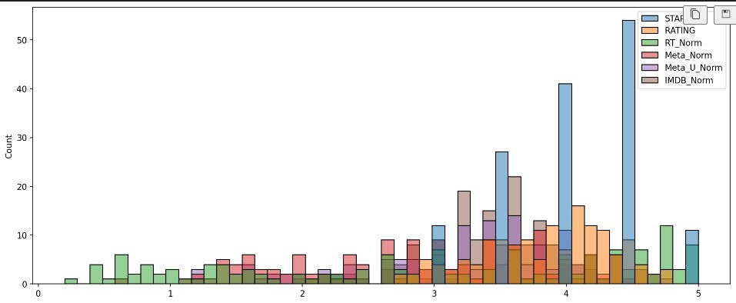
Result

Slide 8
Conclusion
In conclusion , Clearly Fandango is rating movies much higher than other sites, especially considering that it is then displaying a rounded up version of the rating. Our solution will help people to aware of trustworthiness of the movie review websites to prevent the misleading acts of such sites in future. It provides detailed and accurate data of the movie across varies sites with real user reviews and their ratings all over the sites.

Slide 9
Future scope
The proposed solution makes a foundation for the emerging advancements in the world of movies reviews, products review, and on.
FIELD EXPANSION:
This solution can be used even for the reviews on product’s price, quality, use case, availability, etc., across various shopping websites . This will create an revolution in market by providing the required data for picking up the correct and trustworthy products along with minimized time spent on search for the product. A review of certain movie or product can be picked up by our data set by collecting the real time reviews of users

Slide 10
References
https://pandas.pydata.org/pandas-docs/stable/user_guide/index.htm
https://www.kaggle.com/datasets
https://seaborn.pystata.org/
https://matplotlib.org/stable/contents.html

Slide 11
THANK YOU

