Slide 1
Pedometer demonstration
Group 2

Slide 2
How the code works
Acceleration vector
Measure the acceleration vector every 0.1 seconds
Compare it with the previous acceleration vector
If its is higher than the threshold – moving

Slide 3
If it accelerates and decelerates – count step – peak detection
Based on the frequency of steps – mode of activity – walking , jogging, running
The interval of measurement and threshold needs to be optimised to get it working well

Slide 4
Uploading data to cloud
We have used ThinkSpeak platform as our cloud companion.
But here data is uploaded once in 20 seconds due to the limitations
It is not getting uploaded real time
Look for alternative

Slide 5
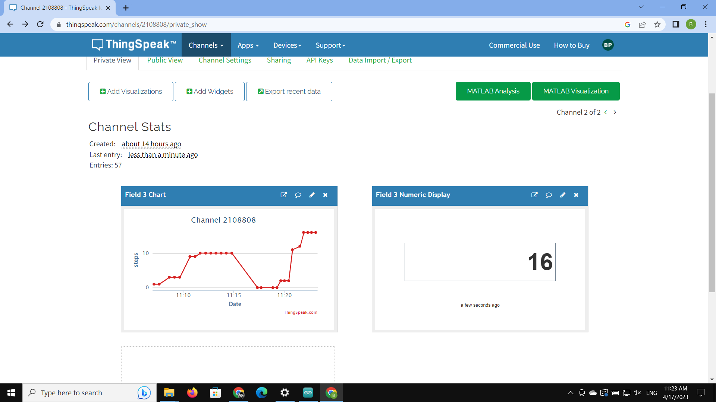

Slide 6
Local update
Send data to pc locally using python to receive data using the ip address of wifi
The update is faster very 3 seconds
Can we decreased further as well to 1 second
But both needs to be connected to the same network

Slide 7
Enclose model
We used Fusion 360 to design the enclosure model
It enclosure is such that it can be worn with belt using the slits provided
The measurements needs to be corrected

Slide 8
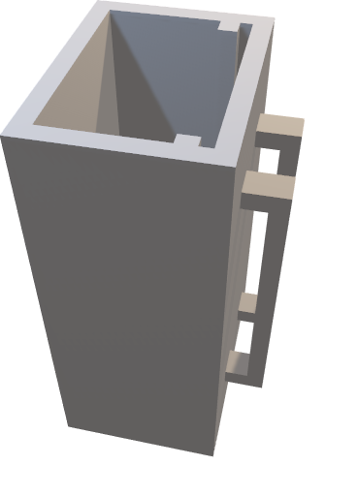
Model

Slide 9
Thank You

