Slide 1
INSUREBETA
-We care for your wheels

Slide 2
PROBLEM STATEMENT
The existing insurance systems require an agent to act as a mediator between the insurance company and the customer.
This leads to extra charges of payments in terms of brokerage and token money to the customer.
There is no existing provision for tracking the status of insurance application of the customer.

Slide 3
OBJECTIVES
The aim of the project is to develop a user friendly, secure and error free web application where the user can buy insurance policies, renew them and claim the insurance.
Module for admin to verify and approve or reject claims is to be developed.

Slide 4
Technologies Used
Front End
Angular 8
Bootstrap
Back End
Spring JPA with REST API
Database
Oracle
Rest API Testing Tool Used
Postman

Slide 5
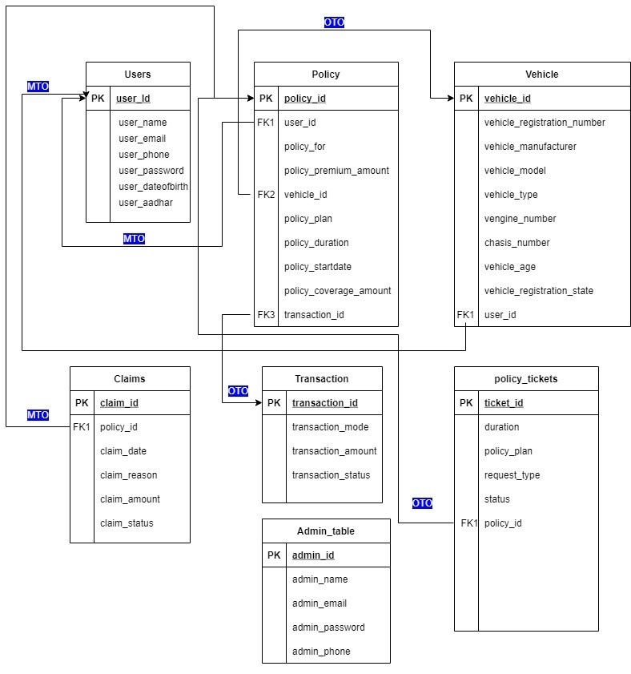
E-R Diagram

Slide 6
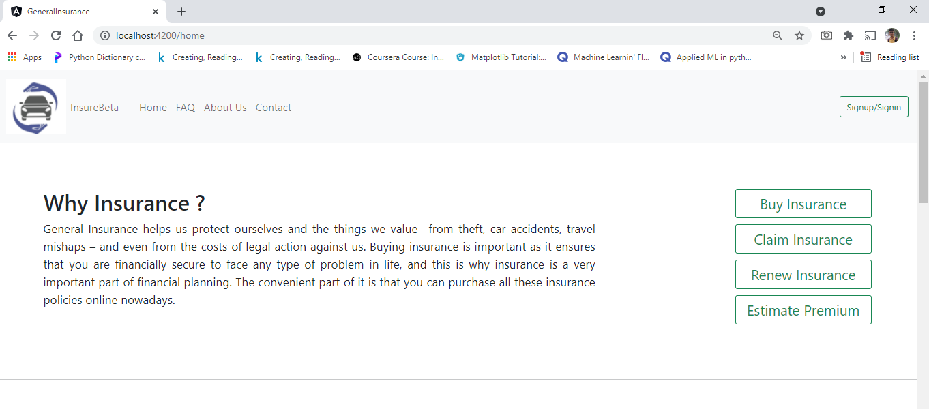
GLIMPSE OF THE PROJECT
HOME PAGE

Slide 7
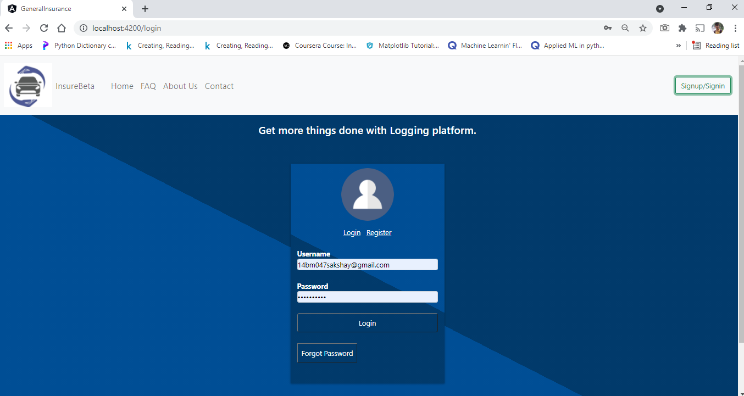
LOGIN

Slide 8
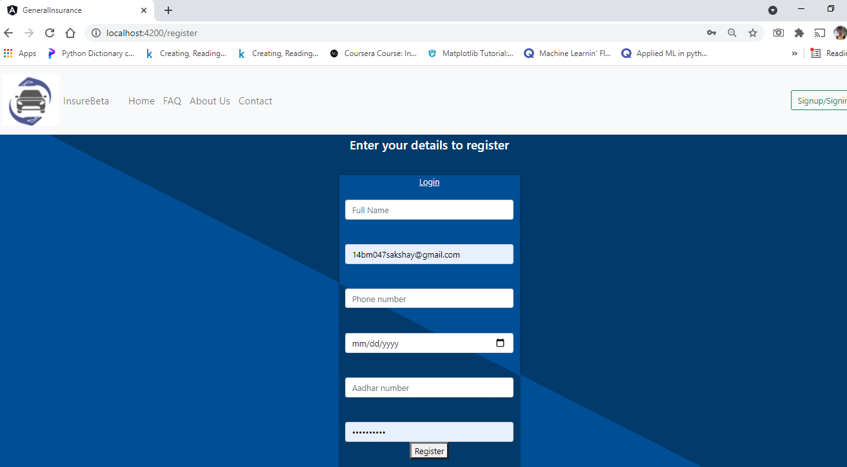
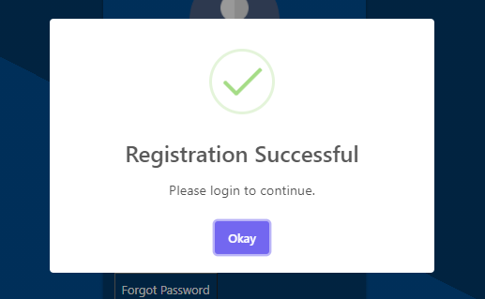
REGISTERATION

Slide 9
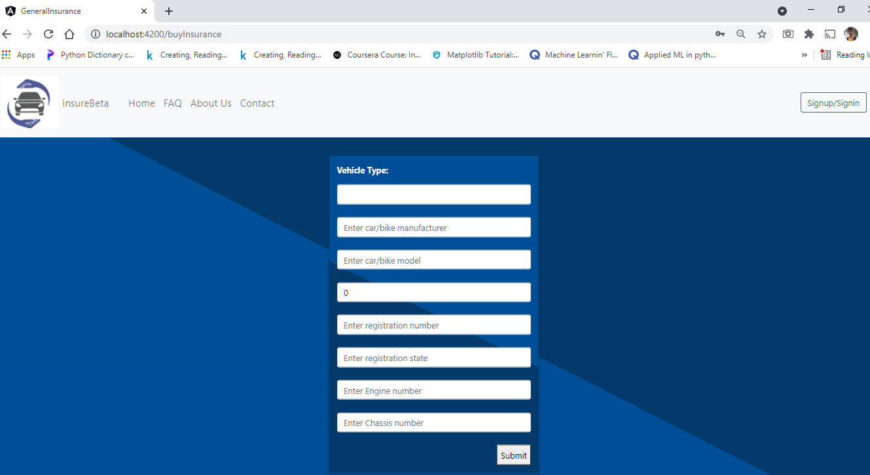
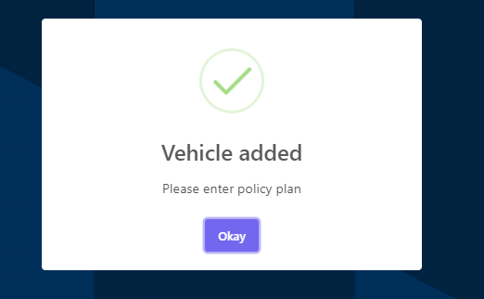
BUY INSURANCE

Slide 10
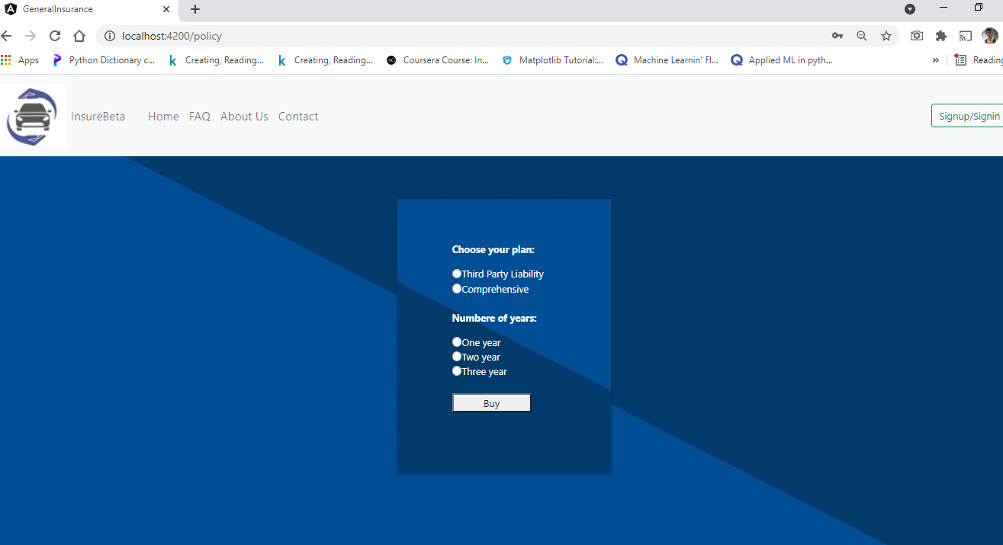
POLICY PLANS

Slide 11
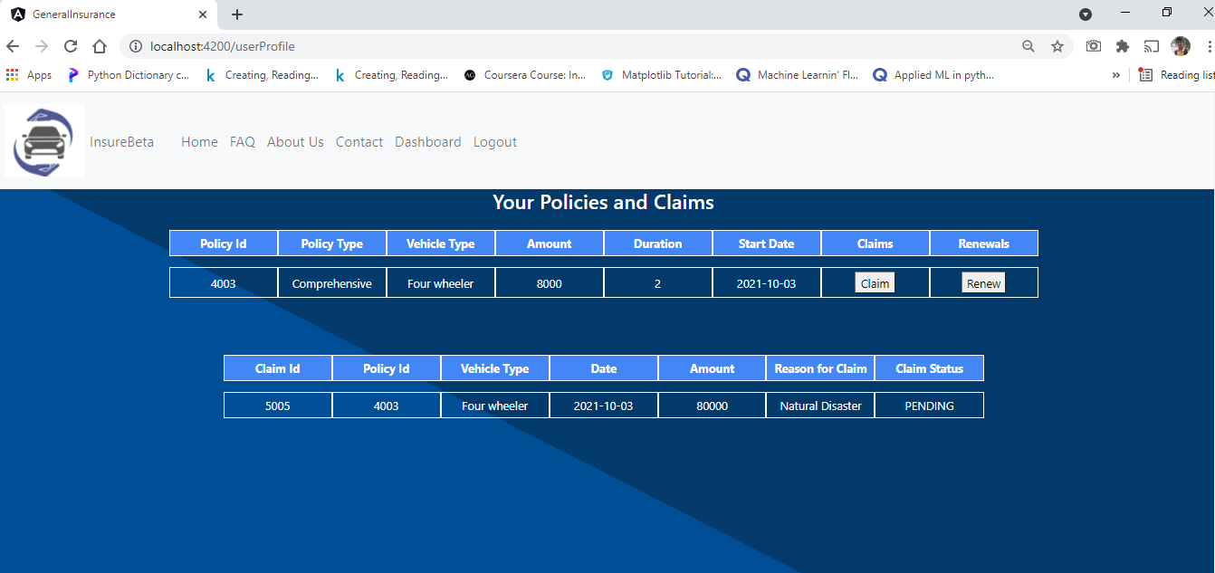
USER DASHBOARD

Slide 12
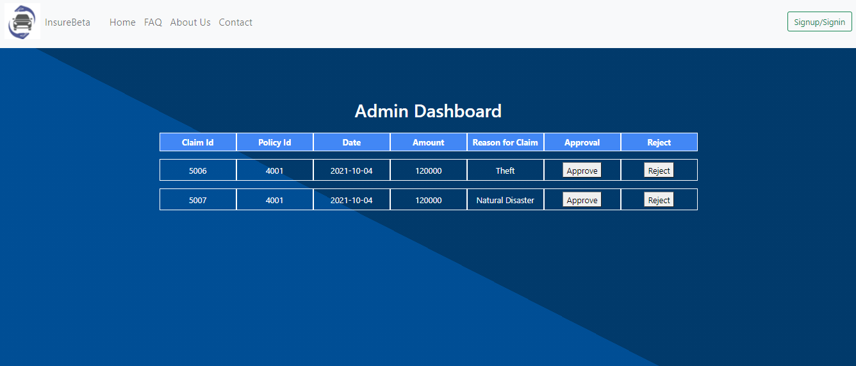
ADMIN DASHBOARD

Slide 13
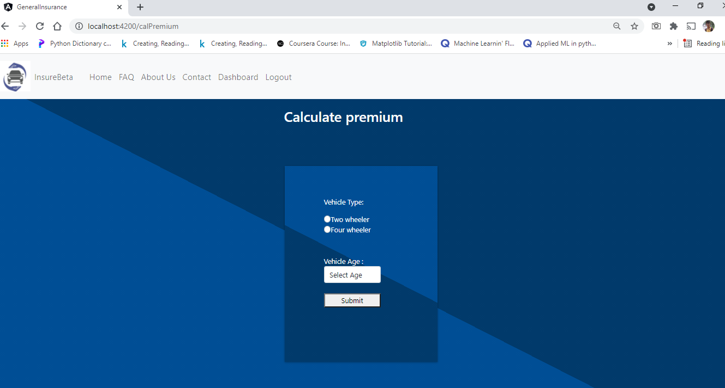
ESTIMATE PREMIUM

Slide 14
CONCLUSION
This project allows the user to buy insurance for their vehicles without the requirement of any third party agent.
Users can also claim and renew the insurance easily and can also track the status of their claims.
This application simplifies the tiresome manual process of buying an insurance.

