Slide 1
Most Popular Components in Syncfusion
Hemavathi

Slide 2
List of Popular Components
DataGrid
Charts
ListView
Scheduler
Diagram

Slide 3
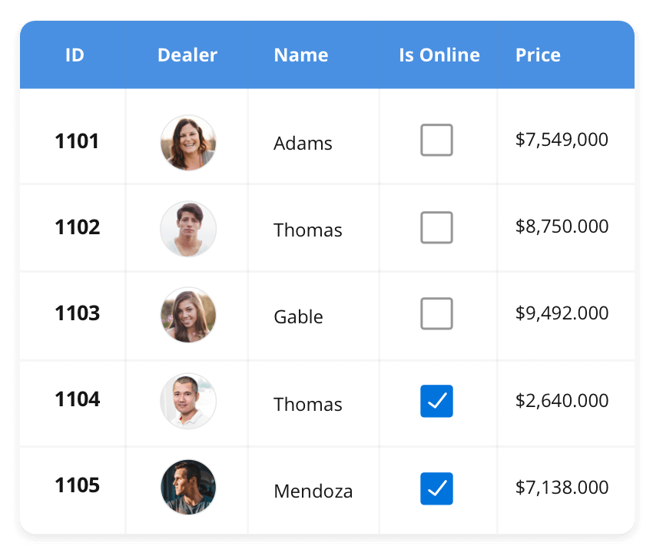
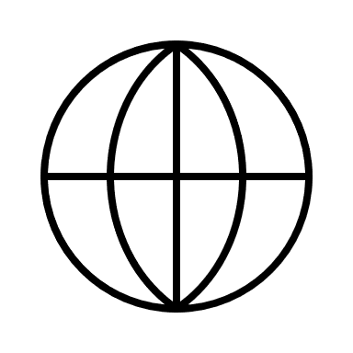


DataGrid
The DataGrid control is a high-performance grid component that helps display and manipulate large amounts of data in a tabular format. Its rich feature set includes functionalities like data binding, sorting, grouping, editing, filtering, swiping, dragging, resizing, loading more items, pull-to-refresh, and exporting to Excel and PDF file formats.
Supported Platforms
JavaScript
Angular
React
Vue
Blazor
Flutter
ASP.NET.MVC
ASP.NET core
Winforms
WPF
WinUI
Flutter
Xamarin
.NET MAUI
UWP
Xamarin
Flutter
UWP
JavaScript
.NET MAUI

Slide 4
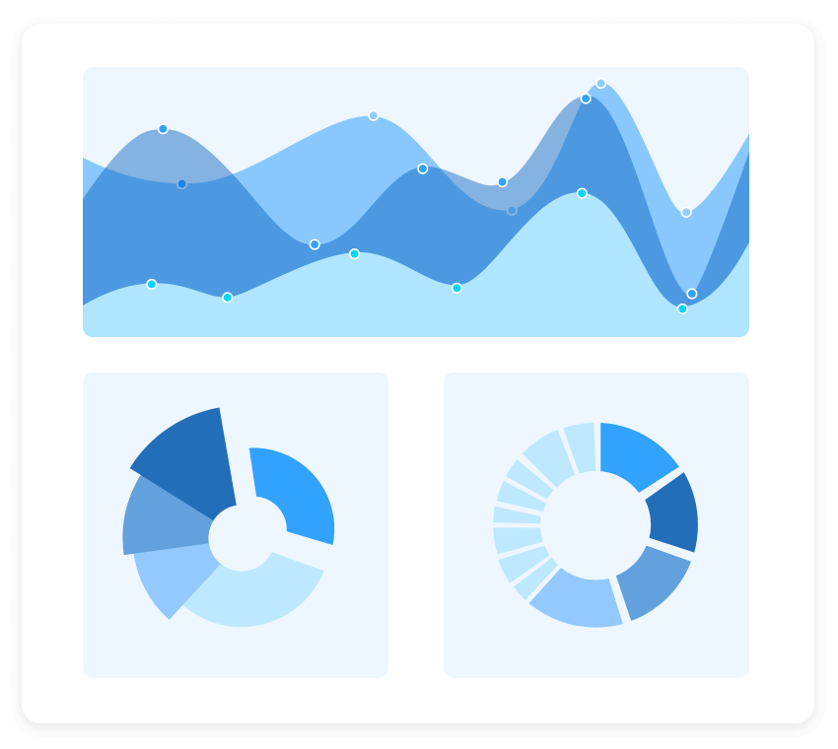
Charts
The Charts control can plot a wide range of chart types, ranging from line charts to specialized financial charts. Its rich feature set includes functionalities like data binding, multiple axes, legends, animation, data labels, annotations, trackballs, tooltips, and zooming.
Supported Platforms
JavaScript
Angular
React
Vue
Blazor
Flutter
ASP.NET.MVC
ASP.NET core
Winforms
WPF
WinUI
Flutter
Xamarin
.NET MAUI
UWP
Xamarin
Flutter
UWP
JavaScript
.NET MAUI

Slide 5
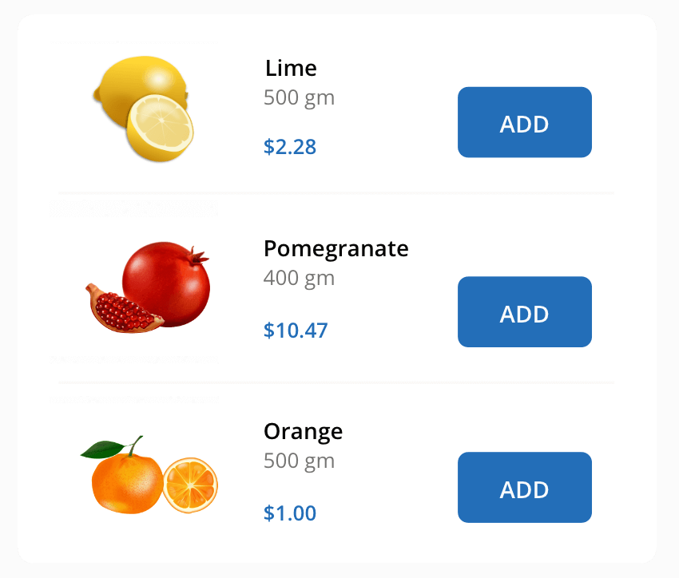
ListView
The ListView renders a set of data items with UI views or custom templates. It has many features like grouping, sorting, filtering, paging, swiping, multiple selection, drag and drop, and different layout types. The ListView control has been optimized to work with large amounts of data.
Supported Platforms
JavaScript
Angular
React
Vue
Blazor
Flutter
ASP.NET.MVC
ASP.NET core
Winforms
WPF
WinUI
Flutter
Xamarin
.NET MAUI
UWP
Xamarin
Flutter
UWP
JavaScript
.NET MAUI

