Slide 1
How to represent a document with a vector?
Liu Yu
June 8, 2018

Slide 2
Outline
Introduction
The vectorization of words
The vectorization of document
Liu Yu(BUAA)
Text Mining
June 8, 2018

Slide 3
1 Introduction
Why we eager to represent a document with a vector?
Many machine learning algorithms require the input to be represented as a fixed-length feature vector.
Liu Yu(BUAA)
Text Mining
June 8, 2018

Slide 4
2. The vectorization of words
2.1 One-hot representation
2.2 Distributed representation
2.3 Word2vec
Liu Yu(BUAA)
Text Mining
June 8, 2018

Slide 5
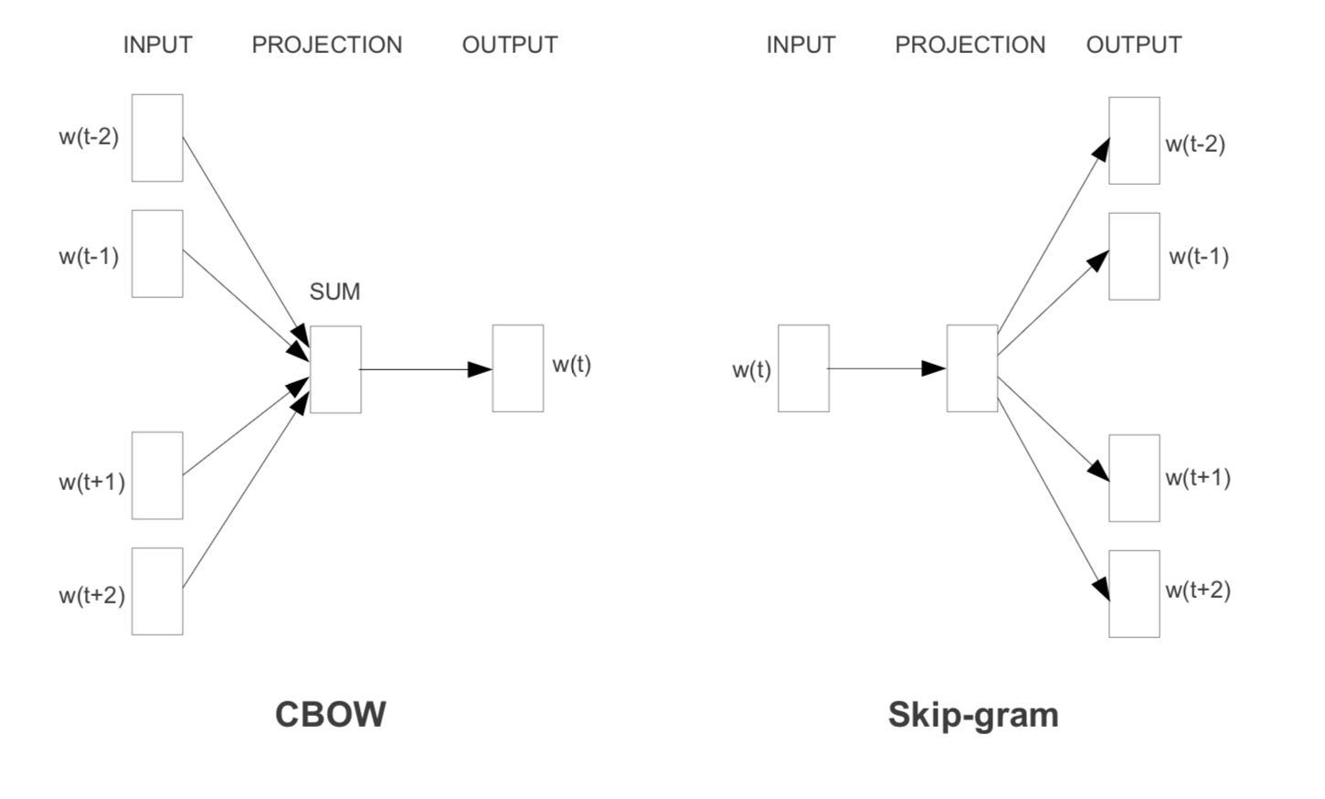
Word2vec
Liu Yu(BUAA)
Text Mining
June 8, 2018

Slide 6
3. The vectorization of document
2.1 Bag-of-words
2.2 Doc2vec
Liu Yu(BUAA)
Text Mining
June 8, 2018

Slide 7
3 . The vectorization of document
3.1 Bag-of-words
Bag-of-words features have two major weaknesses:
This method lose the ordering of the words and ignore semantics of the words
Curse of dimensionality
Liu Yu(BUAA)
Text Mining
June 8, 2018

Slide 8
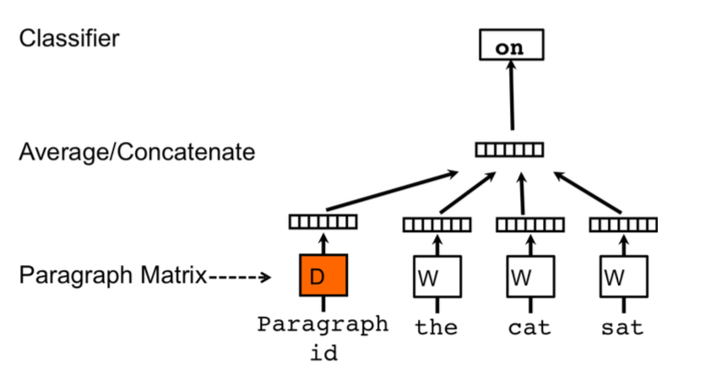
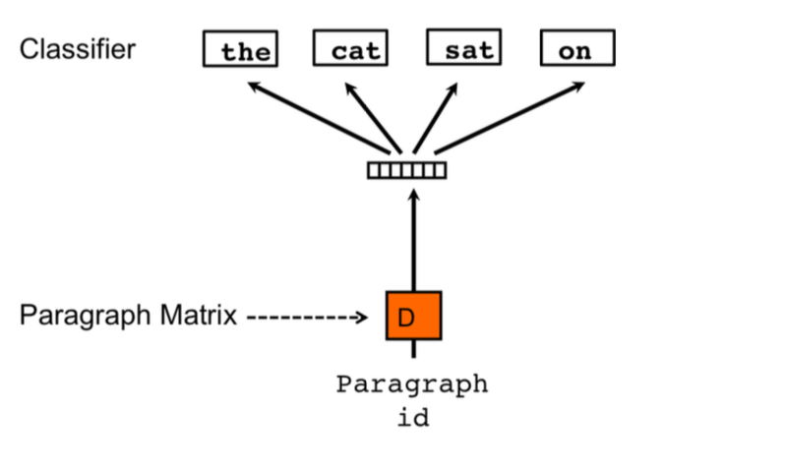
3 . The vectorization of document
3.2 Doc2vec
Liu Yu(BUAA)
Text Mining
June 8, 2018

