Slide 1
public class Point : IGeometry, IComparable<Point>, IElement0D
{
public virtual double X { get; set; } = 0;
public virtual double Y { get; set; } = 0;
public virtual double Z { get; set; } = 0;
}
double
13.5
hasX
hasX
point
hasY
double
point
hasY
5.5
hasZ
double
hasZ
9.0

Slide 2
double
13.5
hasX
hasX
point
hasY
double
point
hasY
5.5
hasZ
double
hasZ
9.0

Slide 3
BHoM NurbsCurve type, with the formalization of its “ControlPoints” Property
BHoM.
Points
double
hasX
point
hasY
double
RDF_1
hasZ
double
nurbsCurve
hasControlPoints
rdf:Seq
double
BHoM:Contains
RDF_2
hasX
rdf:type
point
hasY
double
public class NurbsCurve : ICurve
{
public virtual List<Point> ControlPoints { get; set; } = new List<Point>();
public virtual List<double> Weights { get; set; } = new List<double>();
public virtual List<double> Knots { get; set; } = new List<double>();
}
rdf:type
hasZ
double
BHoM.
IGeometry

Slide 4
double
hasX
point
hasY
double
RDF_1
hasZ
double
nurbsCurve
hasControlPoints
rdf:Seq
double
BHoM:Contains
RDF_2
hasX
rdf:type
point
hasY
double
BHoM.
Points
rdf:type
hasZ
double

Slide 5
HasSet
<string>
RDF_1
someTagXYZ
BHoM.Obejct
hasTags
RDF_2
someTag123
rdf:type
BHoM:Contains
rdf:Bag
public class BHoMObject : IBHoMObject
{
public virtual Guid BHoM_Guid { get; set; } = Guid.NewGuid();
public virtual string Name { get; set; } = "";
public virtual FragmentSet Fragments { get; set; } = new FragmentSet();
public virtual HashSet<string> Tags { get; set; } = new HashSet<string>();
public virtual Dictionary<string, object> CustomData { get; set; } = new Dictionary<string, object>();
}
xsd:string

Slide 6
HasSet
<string>
RDF_1
someTagXYZ
BHoM.Obejct
hasTags
RDF_2
someTag123
rdf:type
BHoM:Contains
rdf:Bag
xsd:string

Slide 7
data
Key
tuple
Value
data
RDF_1
BHoM.Object
hasCostumData
Dictionary
<string,Object>
Key
data
RDF_2
tuple
Value
data
rdf:type
rdf:type
rdf:type
BHoM:Contains
keyType
xsd:string
rdf:Bag
Tuple <string, object>
public class BHoMObject : IBHoMObject
{
public virtual Guid BHoM_Guid { get; set; } = Guid.NewGuid();
public virtual string Name { get; set; } = "";
public virtual FragmentSet Fragments { get; set; } = new FragmentSet();
public virtual HashSet<string> Tags { get; set; } = new HashSet<string>();
public virtual Dictionary<string, object> CustomData { get; set; } = new Dictionary<string, object>();
}
ValueType
systemObject

Slide 8
Key
data
tuple
Value
data
RDF_1
BHoM.Object
hasCostumData
Dictionary
<string,Object>
Key
data
RDF_2
tuple
Value
data
rdf:type
rdf:type
rdf:type
BHoM:Contains
keyType
xsd:string
rdf:Bag
Tuple <string, object>
ValueType
systemObject

Slide 9
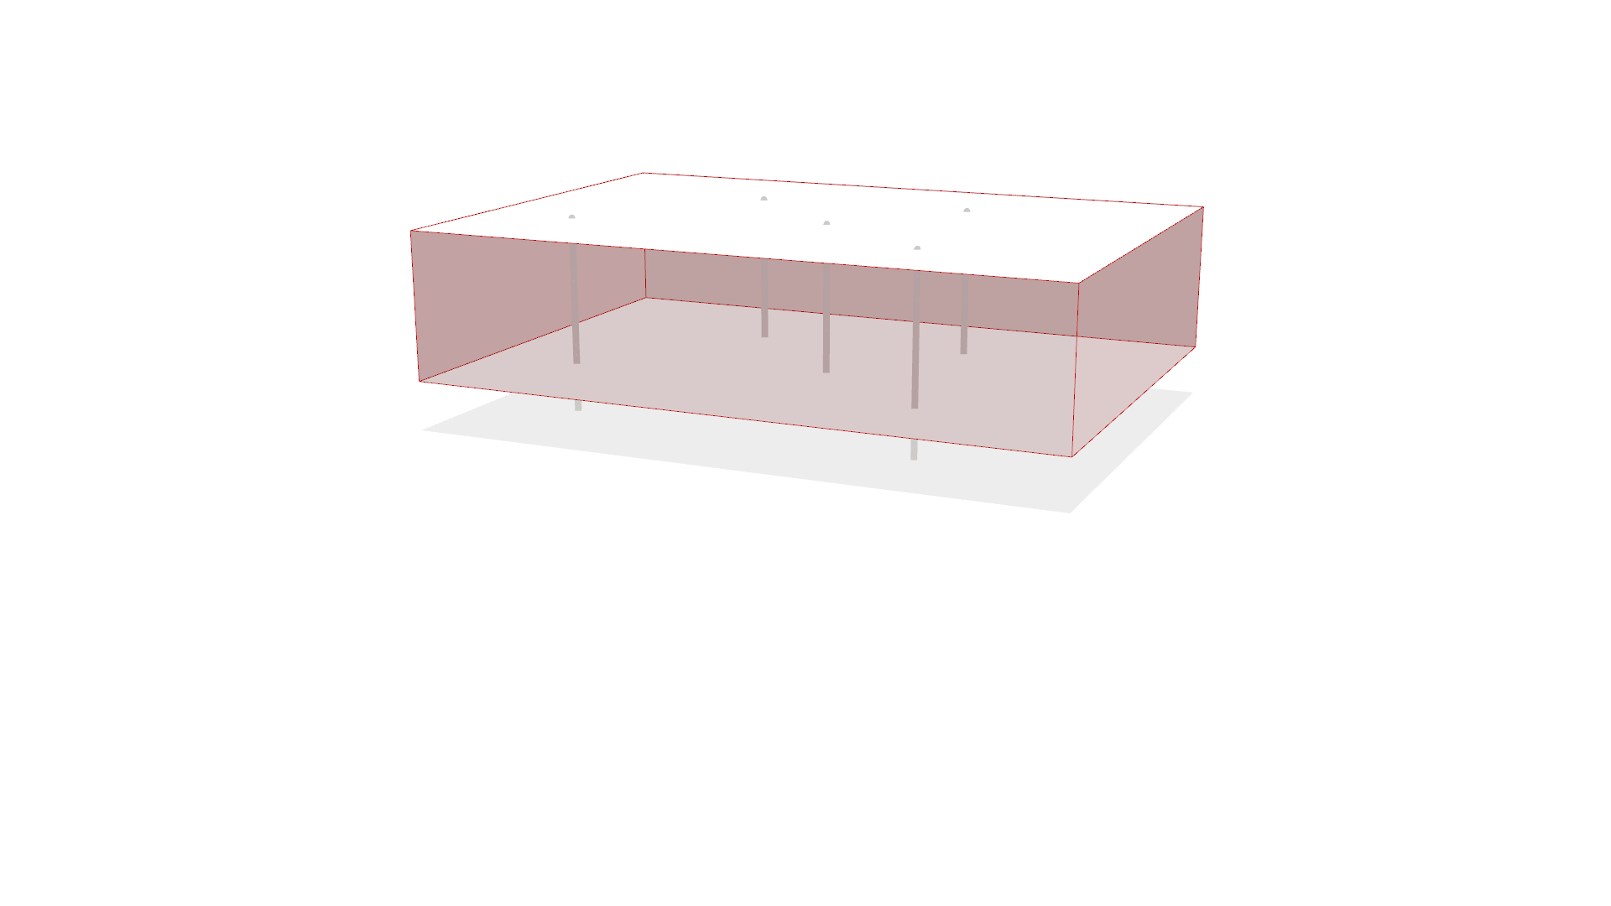

Slide 10
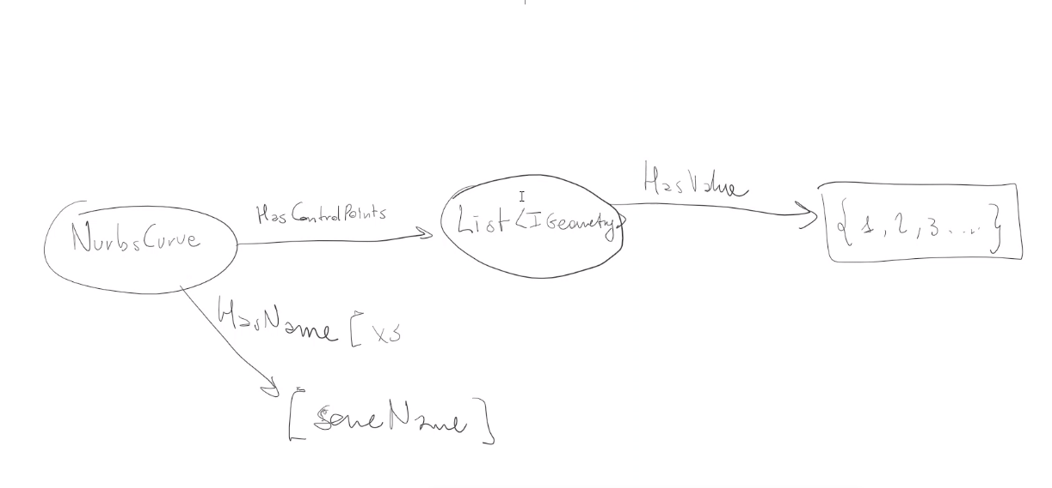
Xsd:string
name
Xsd:string

Slide 11
Xsd:string
name
mYcURBE

