Slide 1
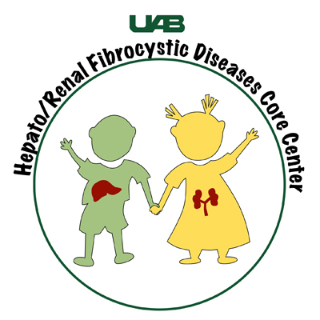
Do You Have a Child with Renal Cystic Disease?
(ARPKD, Nephronophthisis, Joubert, Meckel-Gruber, Bardet-Biedel, Oro-Facial-Digital-Syndrome Type 1 and more)
The University of Alabama at Birmingham Hepato/Renal Fibrocystic Disease Core Center (UAB HRFDCC) has developed a unique set of clinical, genetic and educational resources for ARPKD (autosomal recessive polycystic kidney disease) and other recessive forms of renal cystic disease.
It’s EASY to enroll your child. You only need to sign consent forms!
1.
Go to arpkdstudies.uab.edu and download the FAQs for you and your child’s doctor.
2.
Call Jasmine Jaber, the Research Coordinator (RC) for the study at 202-476-2838 for questions or to participate in one, two or three of these studies.
3.
Send forms by MAIL, FAX, or EMAIL for the following studies you want your child to participate:
Privacy concerns?
Not to worry, it’s completely anonymous.
Clinical Database – after consent, the coordinator will handle the rest with your child’s doctor.
Genetic Studies – after consent, the RC will send all the materials for blood collection to your doctor or lab (during regular labs so there is no extra lab draw). Blood samples will be returned to Children’s National and you will then be contacted for final permission for use of the DNA.
Tissue Repository – after consent, the RC will send out materials for tissue collection (primarily kidney and liver tissue, often stored at pathology labs). You will be contacted for final permission.
HELP future children impacted by rare cystic disease.
Thank you!

