Slide 1
Genome Graphs
Genome graphs and the evolution of genome inference - Genome Res. 2017 May; 27(5): 665–676.
doi: 10.1101/gr.214155.116

Slide 2
Human Reference Genome
The first draft genome was published in 2001
The ‘complete’ genome, meaning 99% of the euchromatic sequence with multiple gaps in the assembly, was announced in 2003
Currently, the human genome is at version 38 (GRCh38)
fewer than 1000 reported gaps (Genome Research Consortium [GRC])

Slide 3
Pitfalls:
Of the 20 donors the reference was meant to sample from, 70% of the sequence was obtained from a single sample, ‘RPC-11’, from an individual who had a high risk for diabetes
The remaining 30% is split 23% from 10 samples and 7% from over 50 sources
After the sequencing of the first personal genomes in 2007, the emerging differences between genomes suggested that the reference could not easily serve as a universal or ‘gold-standard’ genome
The HapMap project and the subsequent 1000 Genomes Project were a partial consequence of the need to sample broader population variability

Slide 4
In short, there is lack of diversity in reference genome

Slide 5
Thus there is Reference Bias
Variations that are not present in the current reference will not be detected anyways if just resequencing

Slide 6
Potential Solutions
Gold-standard reference cohorts each specific for a particular population
Development of pan-genomes, comprising a collection of multiple genomes from the same species
Pangenomes – these genomes could vary by insertions, deletions, structural rearrangements , large and small mutations
De novo assembly to make inferences on individual samples

Slide 7
How to encapsulate all that information ? Genome Graphs

Slide 8
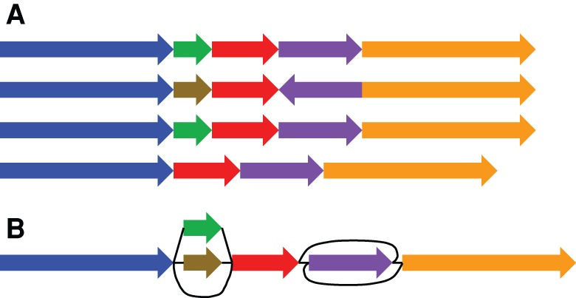
Existing Co-ordinate systems
Existing primary reference genome is a poor coordinate space
Doesn’t capture hundreds of alternative locus scaffolds overlapping each genomic location, across the entire primary reference genome
Much large structural variation is not adequately described by the coordinates provided by the primary reference.
(A) A reference cohort, in which there is no attempt to identify homologies between the genome sequences. (B) A genome graph, in which homologies are collapsed and included as alternate paths in the graph.

Slide 9
Existing Co-ordinate systems
Existing reference coordinate systems:
Variant databases use the reference coordinate systems
Gene and transcript annotations
Genome browsers use linear tracks of genomic data, and graph visualizations
Change can be tricky !

Slide 10
Sequence graphs
Sequences represented as walks in graph
De Bruijn graphs – directed graphs
Nodes are kmers
Edges are bases between “to” and “from” node
Alternative paths stand in for both structural and single variants
But just directed graphs are not enough, as they donot express strandness – forward or reverse
Hence bi-directed graphs or Sequence Graphs !
But again all inversions, reverse tandem duplications, and arbitrarily complex rearrangements cannot be represented in just bi-directed graph
Thus Bi-edged graphs !!
Edge labeled version of bidirected graphs

Slide 11
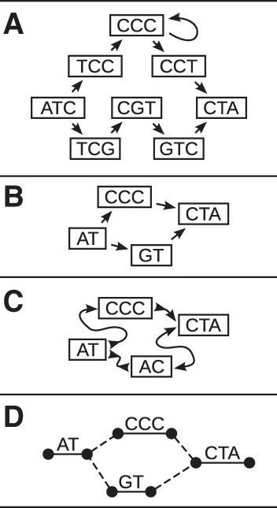
Sequence Graphs
Four types of genome graphs, all constructed from the pair of sequences ATCCCCTA and ATGTCTA. (A) De Bruijn graph. (B) Directed acyclic graph. (C) Bidirected graph (a.k.a., sequence graph). (D) Biedged graph (a.k.a., biedged sequence graph).

Slide 12
Things to consider:
The moment we move to sequence graphs defining a locus becomes a problem
Graphs have multiple paths, which have complex relationships
Allelism in graphs
Repeatome
Hierarchy
Pangenome ordering

Slide 13
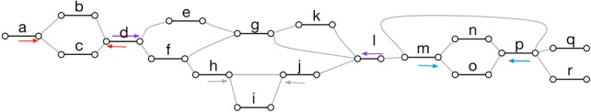
Allelism in graphs
Sites described as motifs called superbubble or ultrabubble
Directed acyclic subgraphs - connects through 1 source node and 1 sink node
New variants - add Motifs
Nested and overlapping subgraphs in structural variants
However - Not all variation nicely partitioned
Ultrabubble sites in a biedged sequence graph. Each arrow shows the terminal node of a site. The color of the arrows indicates the node pairing. Note that the ultrabubble denoted by the gray pair of arrows is nested within the ultrabubble denoted by the purple arrows.

Slide 14
Repeatome as Array Sequence Graphs
Highly repetitive satellite arrays
Centromeres
Ribosome
Subgraphs of instances of type of repeat
Similar instances of repeat were combined within graph node

Slide 15
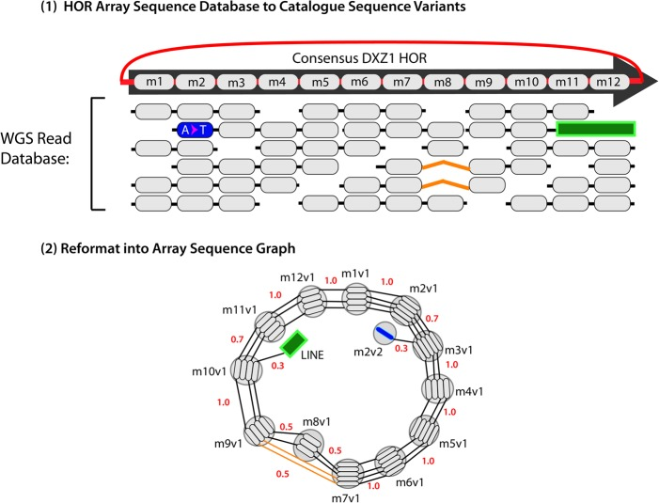
A schematic example of an “Array Sequence Graph” of the type used to construct a linearization of the DXZ1 repeat array in the X Chromosome centromere. A collection of reads (top) shown in the context of a consensus higher-order repeat are converted into a graph representation (bottom). A cycle around the graph represents a higher-order repeat, and the individual repeat units (oblongs) are represented within each node (circles). Edges between individual repeat units represent phasing information from input reads. Transitions between nodes are annotated with probabilities. (Adapted from Miga et al. 2014)

Slide 16
Hierarchy
Hierarchy of graphs
In most collapsed graphs
Repetitive elements are completely collapsed
Input sequences are least collapsed
Monoallelic representation of genome - Intermediates
Mapping a subsequence to an element in more collapsed graphs in hierarchy automatically implies the mapping of the subsequence to all the more collapsed version of the element.
Eg: mapping of repeat instance would imply mapping to the canonical copy, classifying it as an instance of the repeat type.

Slide 17
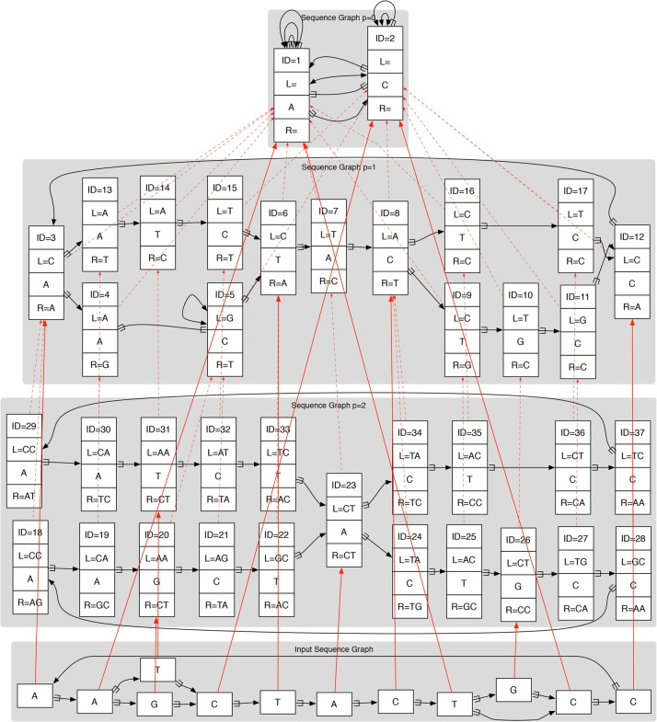

Slide 18

Pangenome ordering
Linear ordering of node
A pangenome ordering on a graph constructed from two genomes. The red edges indicate the path of the pangenome through the graph. The solid and dotted edges indicate the adjacencies between nodes in the two source genomes. (Adapted from Nguyen et al. 2015)

Slide 19
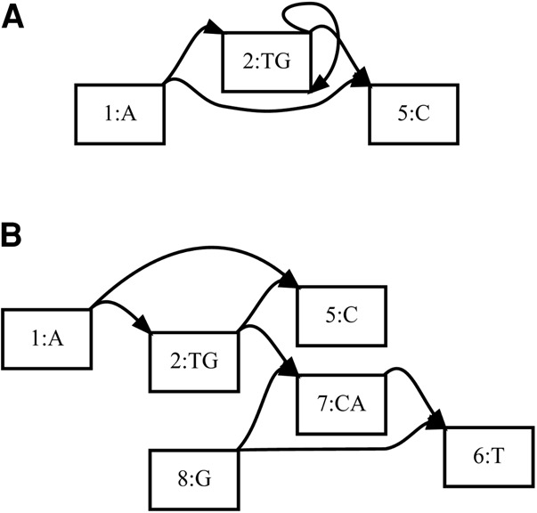
How to decipher Genome Graphs
”unrolls” and “unfolds”
bidirected cyclic graphs > directed acyclic graphs

Slide 20
Extending mapping to genome graphs
Indexing
Self-index
Graph Positional Burrows Wheeler Transform - Graph-PBWT(gPBWT) [vg]
K-mer lookup
Distance Measurement
To account for the distance between paired end reads
Its difficult to calculate distance between mappings and the relative orientations in graphs
Context mapping
Flanking sequences

Slide 21
Graphs should include
Population cohorts
Representation of :
Alternate allele
Repeats
Large structural variations
Potential to accommodate new novel variations

Slide 22
Challenges to graph genomes
Making the cohort information compact enough to store in memory is difficult
Compact data is hard to perform computation on
New tools to read and interpret graph based genomes
Indexing in graphs is complicated
New co-ordinate system
New data formats
Updating all databases, annotations and data formats
Basically reinventing the wheel !

Slide 23
Discussion

Slide 24
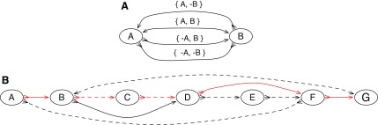
An illustration of a pan-genome reference on a sequence graph. (A) A bidirected graph representing the four ways two blocks can be connected. The arrowheads on the edges indicate their endpoints: the sides of the vertices. (B) An example pan-genome reference on a sequence graph. There are two sequences, indicated by the color of the edges. The red sequence, represented by the thread A, B, C, D, F, G, and the black sequence, represented by the thread A, −F, −E, −D, −B, G. The red thread visits the edges {−A, B}, {−B, C}, {−C, D}, {−D, F}, and {−F, G}, and the black thread visits the edges {−A, −F}, {F, −E}, {E, −D}, {D, −B}, and {B, G}. Neither thread includes all the blocks. A pan-genome reference, indicated by the dotted edges, is A, −F, −E, −D, −C, −B, G. The dotted edges and the edges {−B, D} and {−D, F} are the edges consistent with the given pan-genome reference.

