Slide 1
Monthly management pack
2026-06
Gross profit -73,405.91 KES against budget (-19.38%)
Synthetic ledger, fingerprint f8b8fa811c7ef11b | 120 lines, 3 branches, 18 months | 17 published checks

Slide 2
The headline
One month, two numbers, and the driver behind them
-73,405.91
-19.38%
-0.74%
gross profit variance (KES)
gross profit vs budget
revenue vs budget
Revenue is roughly on plan; gross profit is not. Price is the largest single driver of the gap, and every figure on the following slides reconciles to it.
All figures from outputs/answer_key.json; synthetic ledger, disclosed.

Slide 3
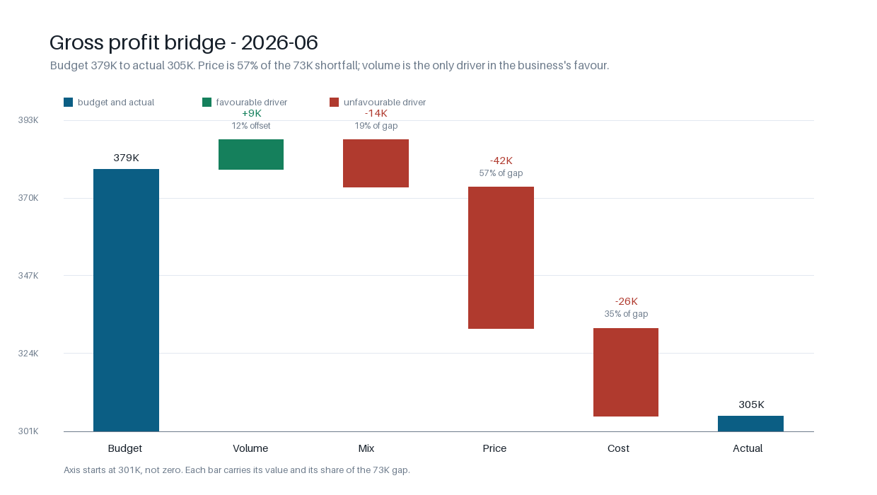
Where the profit went
Budget to actual, four drivers that sum to the gap
Each bar carries its value and its share of the gap; axis starts near the level, not at zero.

Slide 4
Price and cost did the damage
The bridge in numbers
Driver | KES | Share of budget GP
Volume - total units at budget margin | 8,755.42 | 2.31%
Mix - a different blend at budget margins | -14,164.16 | -3.74%
Price - actual units at the change in selling price | -41,943.76 | -11.07%
Cost - actual units at the change in unit cost | -26,053.41 | -6.88%
Total variance | -73,405.91 | -19.38%
The four rows add to the total to the cent.

Slide 5
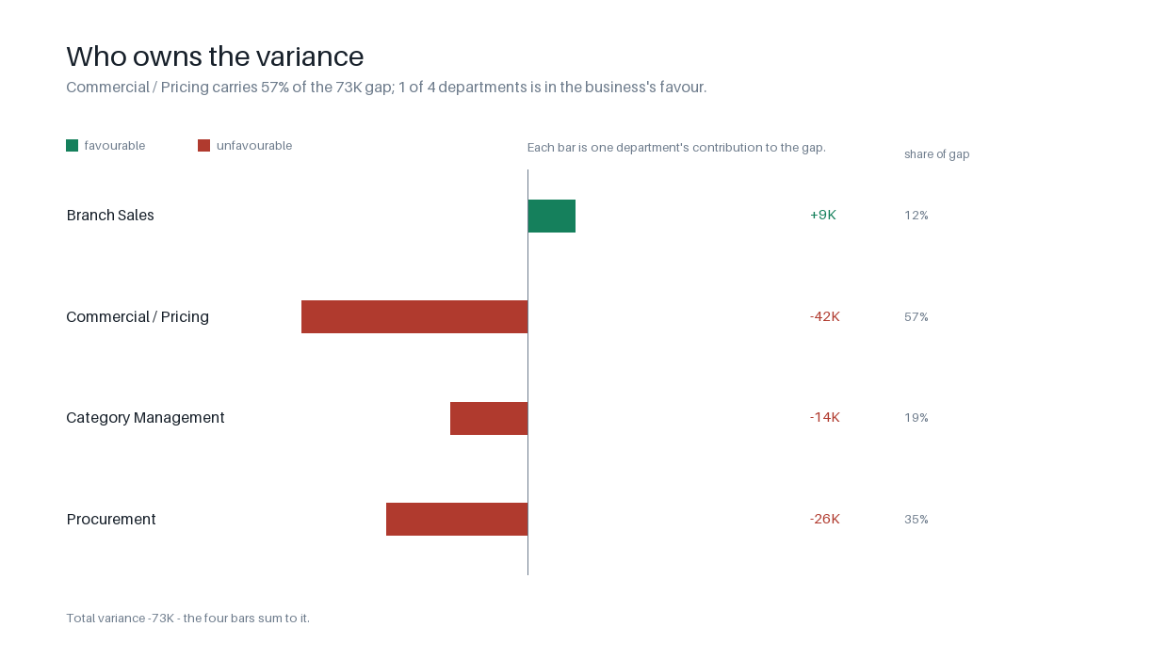
Who owns it
Each driver attributed to the department that can act on it
Department | KES | Share
Branch Sales | 8,755.42 | 12%
Commercial / Pricing | -41,943.76 | 57%
Category Management | -14,164.16 | 19%
Procurement | -26,053.41 | 35%
Ownership is arithmetic: the department that can move the largest component of each line.

Slide 6
Line level
The five worst lines, each with its owner
Branch | Product | Variance | Price | Unit cost | Owner
Nakuru | Fabric Softener 1L | -3,950.82 | -2,742.60 | -1,068.00 | Commercial / Pricing
Nakuru | Scouring Powder 500g | -3,527.86 | -2,428.80 | -970.75 | Commercial / Pricing
Mombasa Road | Fabric Softener 1L | -3,427.92 | 104.40 | -1,288.80 | Branch Sales
Mombasa Road | Scouring Powder 500g | -3,051.30 | -92.96 | -1,162.00 | Branch Sales
Nakuru | Air Freshener 300ml | -2,824.04 | -1,963.84 | -860.20 | Commercial / Pricing
All 120 lines are in outputs/tables/line_variance.csv.

Slide 7
What I would do first
Owner, action, value at stake
Branch Sales
Rebuild the Mombasa Road trading plan against the trend gap (Units below budget in 3 of the last 3 months, 10.86% down on a rolling basis: this is a branch drifting, not one bad month, and the unit gap is worth KES 41,382.41 of gross profit at budget margins.)
41,382.41
Commercial / Pricing
Reissue the Nakuru price file and cap discount authority at 7% (Prices realised 9.87% below the budgeted price for the volume actually sold, costing KES 40,901.06 of gross profit on KES 379,260.56 of budgeted branch revenue.)
40,901.06
Procurement
Renegotiate Home Care supply terms or reprice the range (Unit costs on Home Care are running 6.56% above budget on the volume bought, costing KES 25,934.14 of gross profit.)
25,934.14
Category Management
Review Staples ranging, promo depth and shelf allocation against the budgeted blend (The blend moved towards lower-margin lines: Staples went from 25.00% of budgeted units to 31.56% actual, costing KES 14,164.16 of gross profit at budget margins.)
14,164.16
Worth of gross profit, review date the last working day of next month.

Slide 8
Method, limits, and how to regenerate
What a reader should not have to take on trust
- Flexed budget: actual volume at budget price and cost. Volume, mix, price and cost reconcile to the cent.
- Mix is the residual of the volume movement, so it is a portfolio effect - no single product manager owns it.
- Gross profit only: no overhead allocation, no tax, no FX, no write-offs.
- 120 lines, 3 branches, 18 months, 17 published checks over 16 distinct identities.
- Synthetic seeded ledger; a hand-edited line fails its fingerprint check.
- Regenerate the pack with make run; rebuild this deck and the PDF with make docs.
How a pack like this runs month to month: docs/how-a-management-pack-is-produced.md

