Slide 1
MAVUNO HOME & CARE
Revenue Decline Diagnostic
Why group revenue fell 10.7% — and who owns each cause
Q3 2026 vs Q3 2025 · prepared 2026-10-05 · Senior Data Analyst · Internal — Commercial leadership
NET REVENUE
GROSS MARGIN
ORDERS PER CUSTOMER
AVERAGE ORDER VALUE
KSh 43.65M
18.57%
4.82
KSh 1,619
-10.7%
-1.38pp
-11.4%
-4.5%
Notes:
Bottom line: Group net revenue fell KSh 5.21M (10.7%). We did not lose customers — active customers rose +5.5%. We lost trips (-11.4% orders per customer) and basket (-4.5% average order value), and 71% of the damage sits in two of six stores.

Slide 2
FRAMING
The decision this analysis exists to support
Whose plan gets rewritten next quarter — retention, pricing, or merchandising?
Group net revenue fell KSh 5.21M (10.7%). We did not lose customers — active customers rose +5.5%. We lost trips (-11.4% orders per customer) and basket (-4.5% average order value), and 71% of the damage sits in two of six stores.
A revenue decline does not need attention. It needs a small number of named owners with quantified problems.
This deck converts one headline into four owned problems — with evidence, an expected recovery and a review date.
Notes:
Open with the decision, not the method. If nobody's plan changes, the analysis failed.

Slide 3
THE NUMBERS, EACH AGAINST A COMPARISON
Executive summary
NET REVENUE
GROSS MARGIN
ORDERS PER CUSTOMER
KSh 43.65M
18.57%
4.82
-10.7%
from KSh 48.86M in Q3 2025
-1.38pp
gross profit KSh 8.04M
-11.4%
the engine of the decline
AVERAGE ORDER VALUE
ACTIVE CUSTOMERS
REVENUE WITH NO CUSTOMER ID
KSh 1,619
5,555
0.76%
-4.5%
3.40 lines per order
+5.5%
acquisition is NOT the problem
KSh 0.70M
the declared coverage limit
Gross profit fell 16.9% against a 10.7% revenue fall — margin compressed 1.38pp. Revenue is not profit.
No naked numbers: every tile carries a year-on-year move or a target.
Notes:
Six tiles, six comparisons. The one to dwell on is orders per customer — it is the engine of the whole decline.

Slide 4
FINDINGS 1–2 OF 5
What the analysis found
1. We did not lose customers — we lost trips and basket size
Active customers rose +5.5%, so acquisition is working. But orders per customer fell -11.4% and average order value fell -4.5%. The engine failed, not the funnel — and that single distinction changes who is accountable and what the fix is.
So what: A funnel problem would be fixed in marketing. A frequency and basket problem is fixed in CRM, assortment and availability.
2. Two of six stores carry 71% of the decline
Mombasa Nyali (-27.0%) and Thika Road (-18.7%) are not a chain-wide trend. They are two local, separately-diagnosable events inside one quarter.
So what: Treating this as a chain-wide trend would spread a thin fix across six stores instead of a targeted fix on two.
Notes:
Each finding carries a so-what. A finding without a consequence is trivia.

Slide 5
FINDINGS 3–4 OF 5
What the analysis found
3. The largest single cost has a date, a store and an owner
Two hero Personal Care SKUs sat off the shelf at Mombasa Nyali for 76 days (9.5% shelf availability). It cost KSh 2.16M. Only KSh 0.45M of that is Personal Care revenue — KSh 1.71M is baskets that were never started.
So what: Measuring only the affected category understates the event by roughly 4.8x. Availability failures are basket failures, not category failures.
4. Discounting, not pricing, is the second lever
List price per unit rose +4.3% while discount depth went from 4.80% to 7.82% of gross — roughly an extra KSh 1.43M given away in the quarter, concentrated in Beverages (+13.05pp).
So what: Gross profit fell faster than revenue. Price rises are being handed straight back through promotions, so margin — not just revenue — is the thing at risk.
Notes:
Each finding carries a so-what. A finding without a consequence is trivia.

Slide 6
FINDINGS 5 OF 5
What the analysis found
5. Retention is healthy; the leak is trip frequency
4,410 of 5,265 Q3 2025 customers returned (83.8%), and 1,145 new customers arrived. Churn is not the problem — the people we keep are simply shopping less often.
So what: Win-back for the 855 lapsed customers is worth doing, but the money is in raising frequency among the customers who already come back.
Notes:
Each finding carries a so-what. A finding without a consequence is trivia.

Slide 7
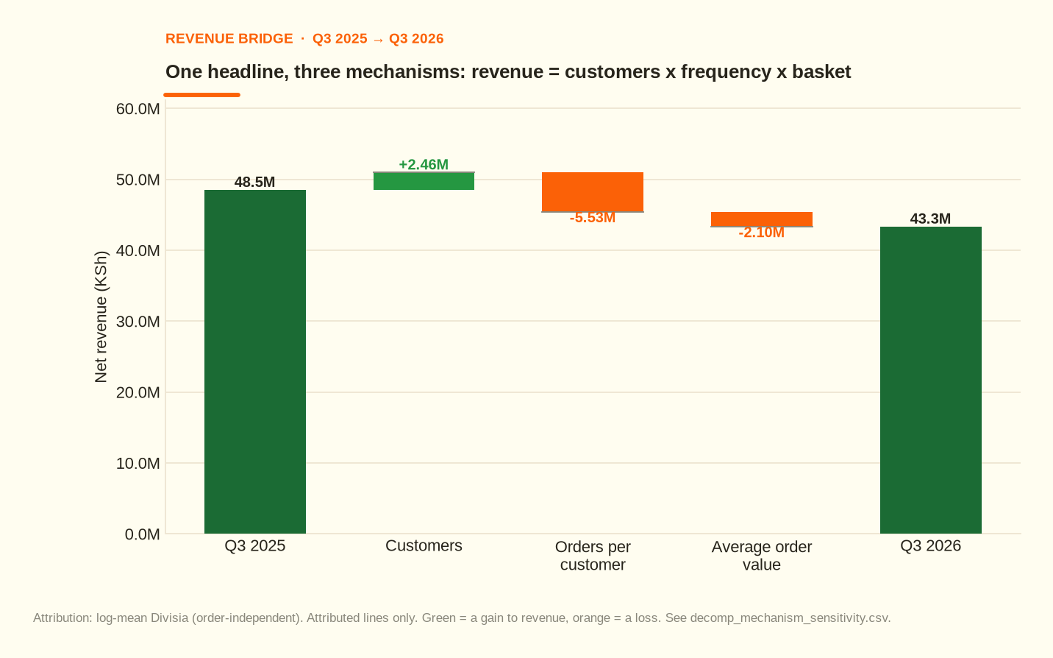
THE BRIDGE
One headline, three mechanisms
Customers contributed a gain of KSh +2.46M.
Orders per customer cost KSh -5.53M.
Average order value cost KSh -2.10M.
Frequency is the largest effect under every ordering — that is the robust result.
The 10.7% fall is one customer gain against two larger losses — it is not one event.
Notes:
The 10.7% fall is one customer gain against two larger losses — it is not one event.

Slide 8
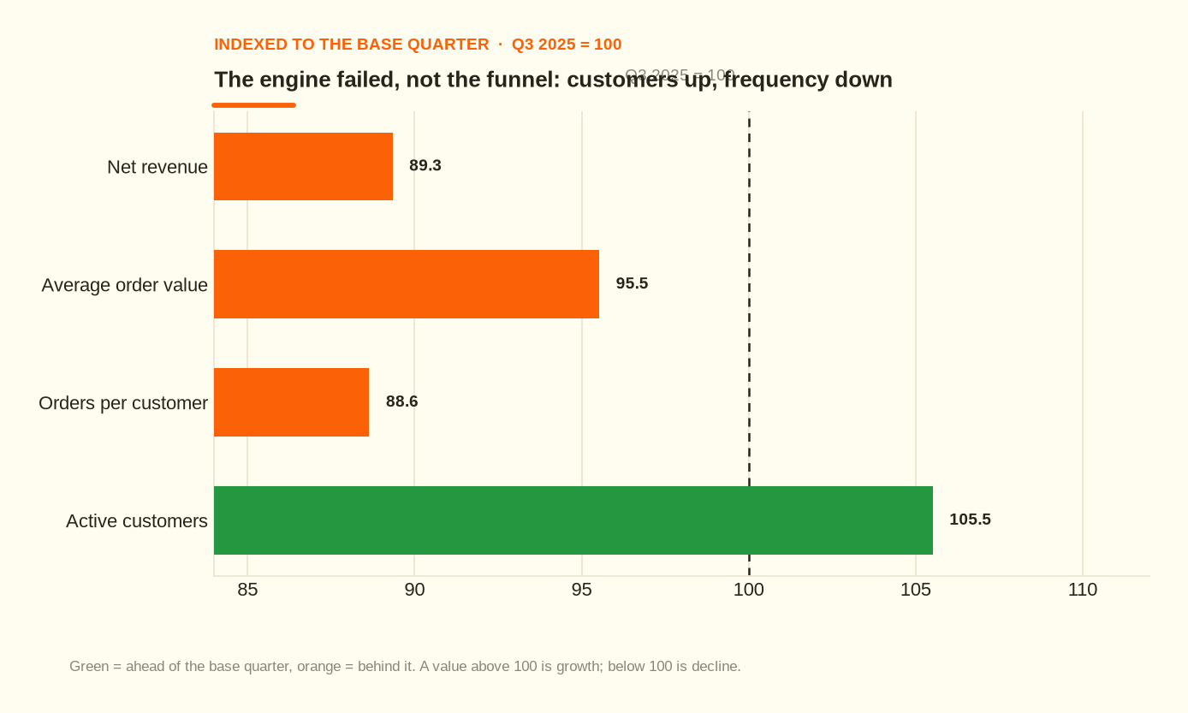
THE MECHANISM
Customers up, frequency down: the engine failed, not the funnel
Active customers +5.5%.
Orders per customer -11.4%.
Average order value -4.5%.
Acquisition is working. Repeat behaviour is not.
Acquisition is working; repeat behaviour is not. Different problem, different owner.
Notes:
Acquisition is working; repeat behaviour is not. Different problem, different owner.

Slide 9
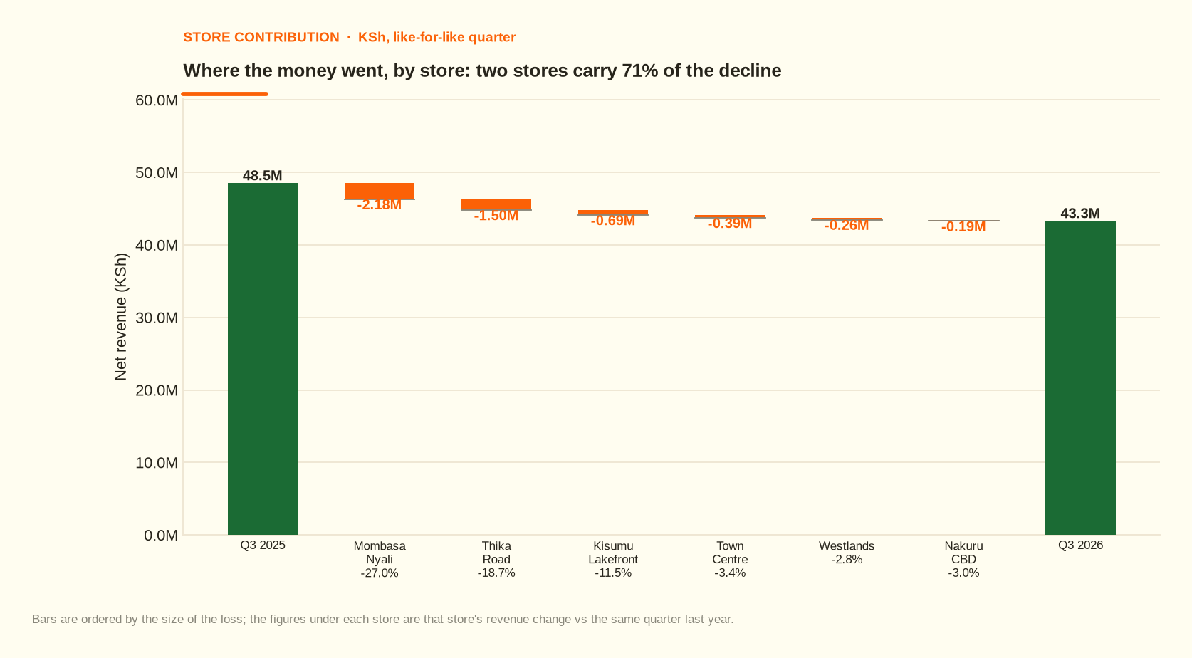
WHERE IT HAPPENED
Two of six stores carry the decline
Mombasa Nyali: KSh -2.18M (-27.0%).
Thika Road: KSh -1.50M (-18.7%).
Two local events, not a chain-wide trend.
The fix must therefore be targeted, not spread thin.
Two stores carry 71% of the decline.
Notes:
Two stores carry 71% of the decline.

Slide 10
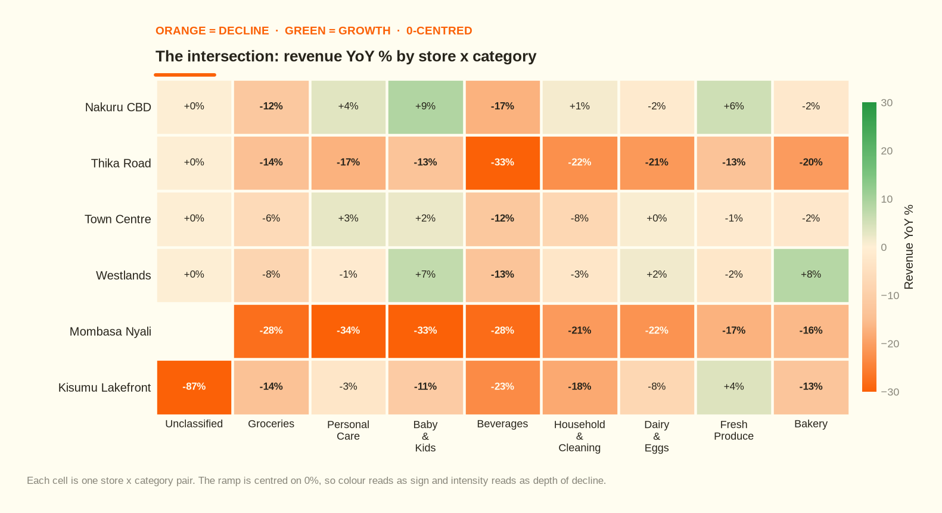
WHERE IT HAPPENED
The decline is concentrated in the intersection
Red-orange = decline; green = growth; the ramp is centred on 0%.
Mombasa Nyali and Thika Road light up across every category.
Concentration means the fix can be targeted too.
The decline is concentrated, not diffuse — so the fix can be too.
Notes:
The decline is concentrated, not diffuse — so the fix can be too.

Slide 11
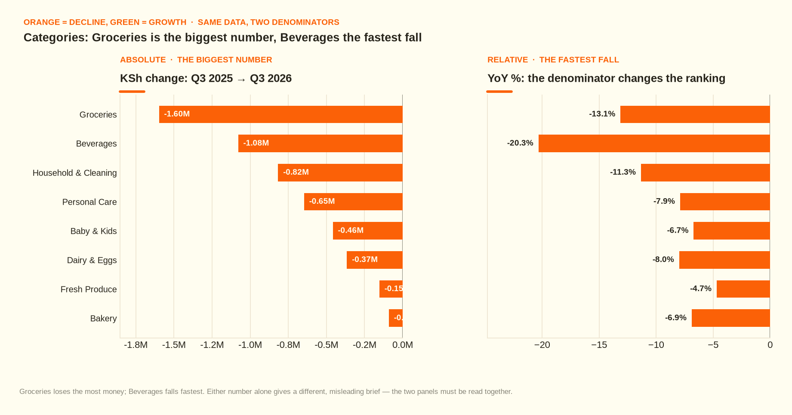
STRUCTURE
Groceries loses the most money; Beverages falls fastest
Two denominators, two different rankings.
Absolute loss points at Groceries.
Percentage fall points at Beverages.
Quoting either alone would mislead the room.
Groceries is the biggest absolute loss, Beverages the fastest fall. Either alone misleads.
Notes:
Groceries is the biggest absolute loss, Beverages the fastest fall. Either alone misleads.

Slide 12
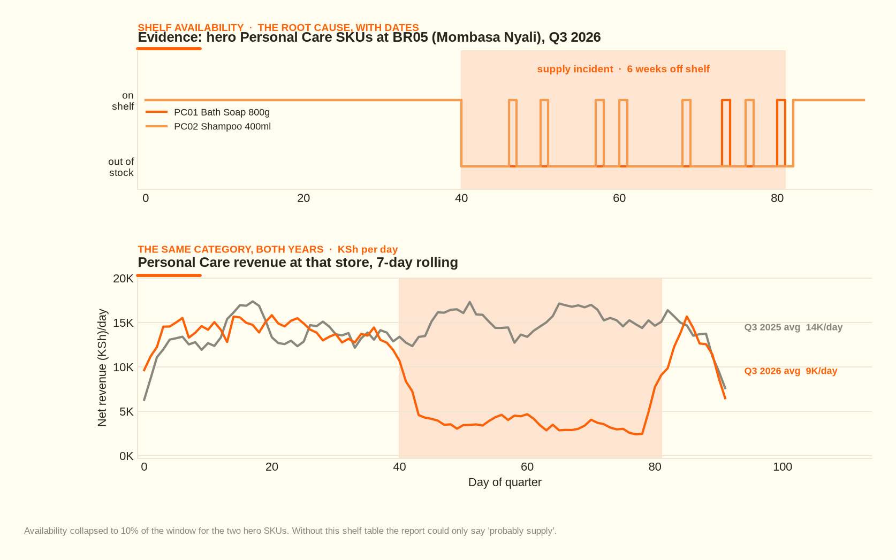
THE EVIDENCE
The biggest single cost has a date, a store and an owner
Bath Soap 800g at Mombasa Nyali.
9.5% shelf availability for 76 days.
Total cost KSh 2.16M — of which only KSh 0.45M is the affected category.
KSh 1.71M is baskets that were never started.
9.5% availability for 76 days at Mombasa Nyali.
Notes:
9.5% availability for 76 days at Mombasa Nyali.

Slide 13
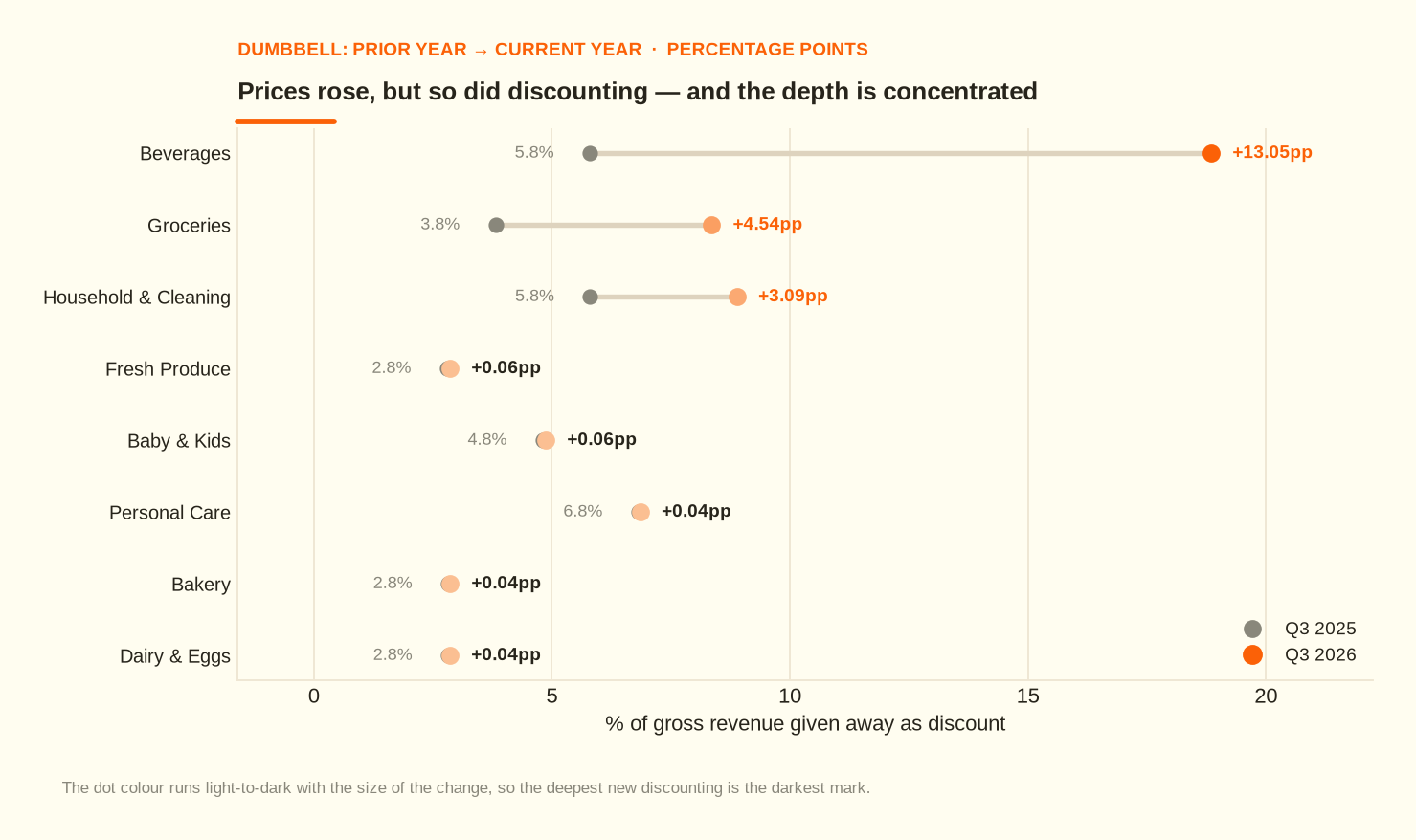
PRICING AND MARGIN
Prices rose, but discounting rose faster
Discount depth 4.80% → 7.82% of gross.
Beverages alone: +13.05pp.
About KSh 1.43M of extra discount in one quarter.
Gross profit fell faster than revenue.
KSh 1.43M of extra discount in one quarter.
Notes:
KSh 1.43M of extra discount in one quarter.

Slide 14
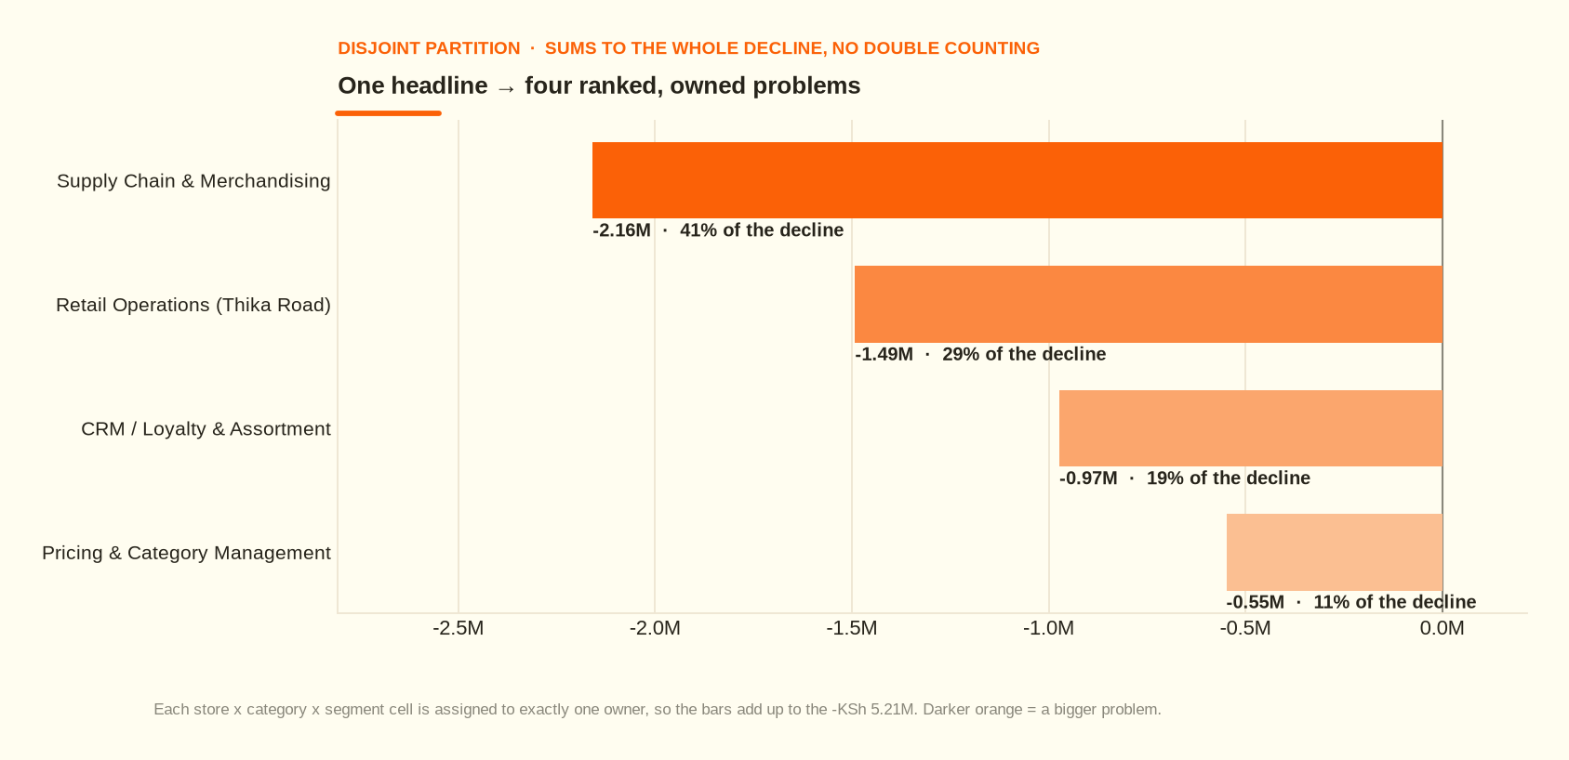
WHAT TO DO ABOUT IT
One headline → four ranked, owned problems
Supply Chain & Merchandising — KSh -2.16M (41%).
Retail Operations (Thika Road) — KSh -1.49M (29%).
CRM / Loyalty & Assortment — KSh -0.97M (19%).
Pricing & Category Management — KSh -0.55M (11%).
Disjoint and audited: the bars sum to the whole decline.
Disjoint and audited: the bars sum to the whole decline with no double counting.
Notes:
Disjoint and audited: the bars sum to the whole decline with no double counting.

Slide 15
THE ACTION REGISTER
Ranked problems, owners and expected recovery
# | Owner | The problem | Cost | Share of decline
1 | Supply Chain & Merchandising | Two hero Personal Care SKUs out of stock for six weeks at Mombasa Nyali; the damage spread to whole baskets | KSh -2.16M | 41%
2 | Retail Operations (Thika Road) | Thika Road footfall cut for the full quarter — visits per customer well below every other store | KSh -1.49M | 29%
3 | CRM / Loyalty & Assortment | Residual: fewer trips per customer and slimmer baskets right across the chain | KSh -0.97M | 19%
4 | Pricing & Category Management | Beverage promotional depth deepened sharply outside the two affected stores | KSh -0.55M | 11%
Days 0–30: rebuild safety stock on the hero SKUs; cap beverage discount depth with an approval gate.
Days 30–60: rebuild the Mombasa basket; Thika Road access recovery with the landlord and county.
Days 60–90: win-back and second-purchase nudges to fix the frequency leak.
Continuous: capture a customer ID on every transaction and log supplier lead times.
Notes:
Two cheap reversible actions first. The policy change and the purchase order can start this week.

Slide 16
INTELLECTUAL HONESTY
Facts, hypotheses, and the edge of what we know
Statement | Tier | Note
Revenue fell 10.7%; gross profit fell 16.9% | Fact | measured from the cleaned star schema
Two stores explain 71% of the decline | Fact | measured; contribution shares sum to the group change
Hero SKUs were 9.5% available for 76 days at Mombasa Nyali | Fact | from the branch x SKU x day availability table
Active customers rose +5.5% while frequency fell -11.4% | Fact | the mechanism identity, order-independent attribution
The stock-out *caused* the basket erosion at that store | Hypothesis | the two co-move exactly in time; no causal test was run
Single-sourcing or no safety stock caused the stock-out | Hypothesis | no procurement, supplier or lead-time data in this extract
Thika Road's decline is due to the road-works | Hypothesis | the frequency-only signature is consistent with an access problem; no other local factor is recorded
Kisumu Lakefront's -11.5% | Unexplained | flagged, deliberately not back-filled with a story
855 Q3 2025 customers did not return | Fact | but 83.8% did — churn is not the problem
Notes:
A senior analysis is judged as much by what it refuses to claim. The Kisumu figure is flagged and deliberately not back-filled with a story.

Slide 17
MONITORING
How we will know whether it worked
Metric | Baseline | Target by Q1 FY2027 | Watched by
Orders per customer | 5.44 | back above 5.44 | CRM
Hero SKU shelf availability (Mombasa) | 9.5% | >99% | Supply Chain
Thika Road visits per customer | -23.7% YoY | >0% YoY | Retail Ops
Beverage discount depth | 7.82% of gross | <= 4.80% | Pricing
Gross margin | 18.57% | back above 19.95% | Finance
The uncomfortable test: if the people who receive this deck make the same decisions they made last quarter, it was decoration.
Follow up in 90 days: did the decision change, and did the recommendation work?
Notes:
Name the follow-up date in the room. An analysis that never checks its own predictions never improves.

