Slide 1
MATPLOTLIB

Slide 2
matplotlib is probably the single most used Python package for 2D-graphics. It provides both a very quick way to visualize data from Python and publication-quality figures in many formats. We are going to explore matplotlib in interactive mode covering most common cases.

Slide 3
pyplot
pyplot provides a convenient interface to the matplotlib object-oriented plotting library. It is modeled closely after Matlab(TM). Therefore, the majority of plotting commands in pyplot have Matlab(TM) analogs with similar arguments.

Slide 4
Using defaults
Matplotlib comes with a set of default settings that allow customizing all kinds of properties. You can control the defaults of almost every property in matplotlib: figure size and dpi, line width, color and style, axes, axis and grid properties, text and font properties and so on. While matplotlib defaults are rather good in most cases, you may want to modify some properties for specific cases.

Slide 5
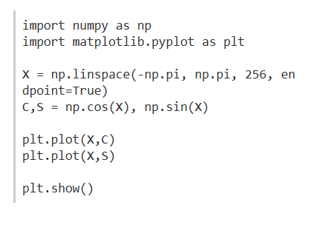

Slide 6
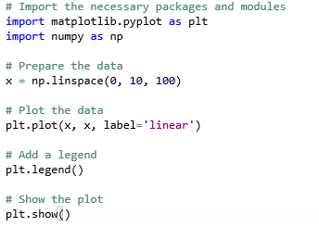
Example1 (ex1)

Slide 7
PYPLOT
matplotlib.pyplot is a collection of command style functions that make matplotlib work like MATLAB. Each pyplot function makes some change to a figure: e.g., creates a figure, creates a plotting area in a figure, plots some lines in a plotting area, decorates the plot with labels, etc.

Slide 8
PYPLOT
In matplotlib.pyplot various states are preserved across function calls, so that it keeps track of things like the current figure and plotting area, and the plotting functions are directed to the current axes.

Slide 9
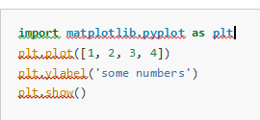
Generating visualizations with pyplot is very quick:

Slide 10
You may be wondering why the x-axis ranges from 0-3 and the y-axis from 1-4. If you provide a single list or array to the plot() command, matplotlib assumes it is a sequence of y values, and automatically generates the x values for you. Since python ranges start with 0, the default x vector has the same length as y but starts with 0. Hence the x data are [0,1,2,3].
plot() is a versatile command, and will take an arbitrary number of arguments. For example, to plot x versus y, you can issue the command:
plt.plot([1, 2, 3, 4], [1, 4, 9, 16])

Slide 11
For every x, y pair of arguments, there is an optional third argument which is the format string that indicates the color and line type of the plot. The letters and symbols of the format string are from MATLAB, and you concatenate a color string with a line style string. The default format string is ‘b-‘, which is a solid blue line. For example, to plot the above with red circles, you would issue

Slide 12


Slide 13
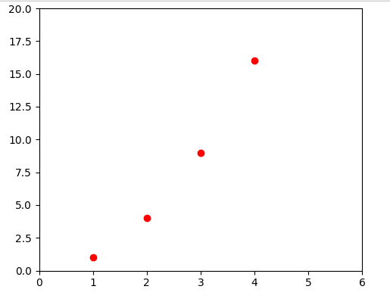

Slide 14
the plot() documentation for a complete list of line styles and format strings. The axis() command in the example above takes a list of [xmin, xmax, ymin, ymax] and specifies the viewport of the axes.
If matplotlib were limited to working with lists, it would be fairly useless for numeric processing. Generally, you will use numpy arrays. In fact, all sequences are converted to numpy arrays internally. The example below illustrates a plotting several lines with different format styles in one command using arrays.

Slide 15
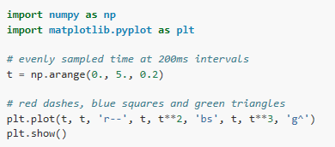

Slide 16
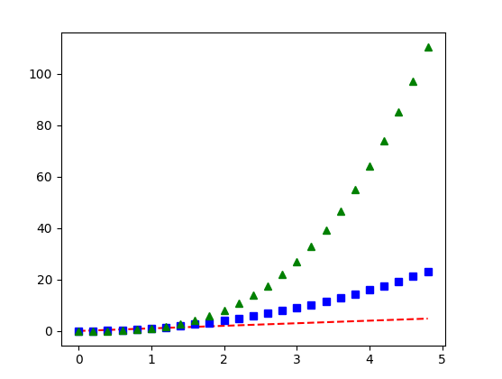

Slide 17
Plotting with keyword strings
There are some instances where you have data in a format that lets you access particular variables with strings. For example, with numpy.recarray or pandas.DataFrame.
Matplotlib allows you provide such an object with the data keyword argument. If provided, then you may generate plots with the strings corresponding to these variables.

Slide 18
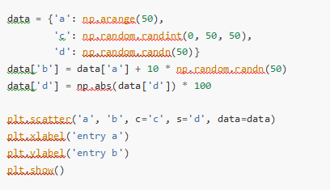
Notes:
plt2

Slide 19
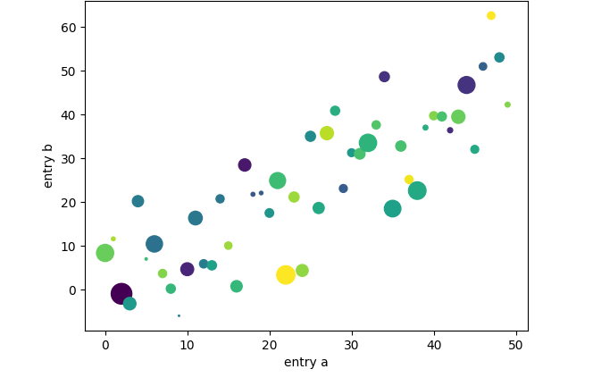

Slide 20
Plotting with categorical variables
It is also possible to create a plot using categorical variables. Matplotlib allows you to pass categorical variables directly to many plotting functions. For example:

Slide 21
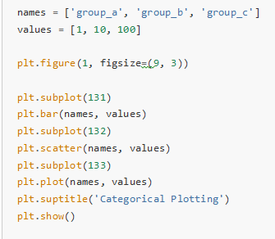
Notes:
plt4

Slide 22
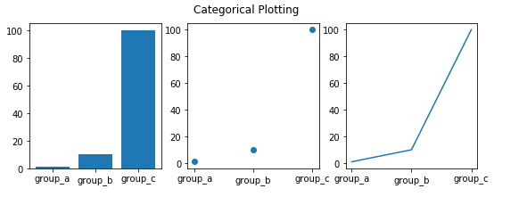

Slide 23
Controlling line properties
Lines have many attributes that you can set: linewidth, dash style, antialiased, etc; see matplotlib.lines.Line2D. There are several ways to set line properties
Use keyword args:
plt.plot(x, y, linewidth=2.0)

Slide 24

Use the setter methods of a Line2D instance. plot returns a list of Line2D objects; e.g., line1, line2 = plot(x1, y1, x2, y2). In the code below we will suppose that we have only one line so that the list returned is of length 1. We use tuple unpacking with line, to get the first element of that list:

Slide 25
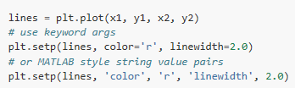
Use the setp() command. The example below uses a MATLAB-style command to set multiple properties on a list of lines. setp works transparently with a list of objects or a single object. You can either use python keyword arguments or MATLAB-style string/value pairs:

Slide 26
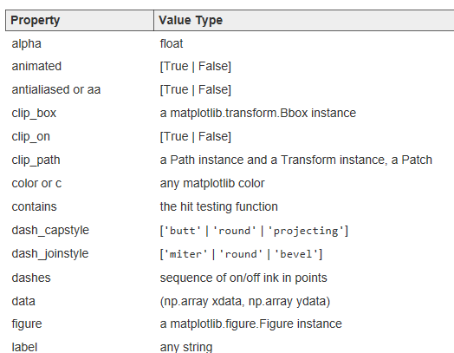

Slide 27
Working with multiple figures and axes
MATLAB, and pyplot, have the concept of the current figure and the current axes. All plotting commands apply to the current axes. The function gca() returns the current axes (a matplotlib.axes.Axes instance), and gcf() returns the current figure (matplotlib.figure.Figure instance). Normally, you don’t have to worry about this, because it is all taken care of behind the scenes. Below is a script to create two subplots.

Slide 28
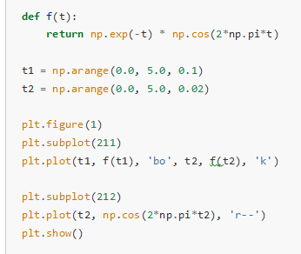

Slide 29
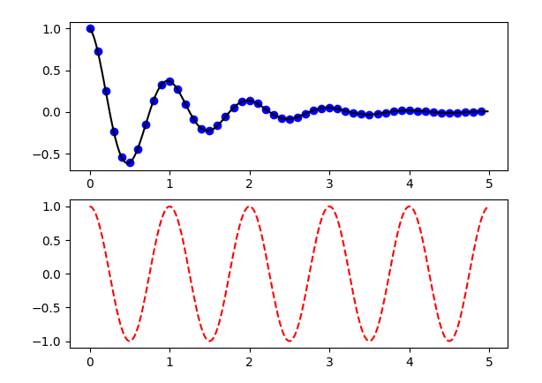

Slide 30
The figure() command here is optional because figure(1) will be created by default, just as a subplot(111) will be created by default if you don’t manually specify any axes. The subplot() command specifies numrows, numcols, plot_number where plot_number ranges from 1 to numrows*numcols. The commas in the subplot command are optional if numrows*numcols<10. So subplot(211) is identical to subplot(2, 1, 1).

Slide 31
You can create an arbitrary number of subplots and axes. If you want to place an axes manually, i.e., not on a rectangular grid, use the axes() command, which allows you to specify the location as axes([left, bottom, width, height]) where all values are in fractional (0 to 1) coordinates. See Axes Demo for an example of placing axes manually and Basic Subplot Demo for an example with lots of subplots.
You can create multiple figures by using multiple figure() calls with an increasing figure number. Of course, each figure can contain as many axes and subplots as your heart desires:

Slide 32
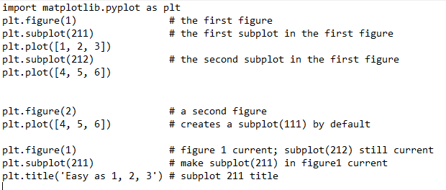

Slide 33
You can clear the current figure with clf() and the current axes with cla(). If you find it annoying that states (specifically the current image, figure and axes) are being maintained for you behind the scenes, don’t despair: this is just a thin stateful wrapper around an object oriented API.
If you are making lots of figures, you need to be aware of one more thing: the memory required for a figure is not completely released until the figure is explicitly closed with close(). Deleting all references to the figure, and/or using the window manager to kill the window in which the figure appears on the screen, is not enough, because pyplot maintains internal references until close() is called.

Slide 34
Working with text
The text() command can be used to add text in an arbitrary location, and the xlabel(), ylabel() and title() are used to add text in the indicated locations.

Slide 35
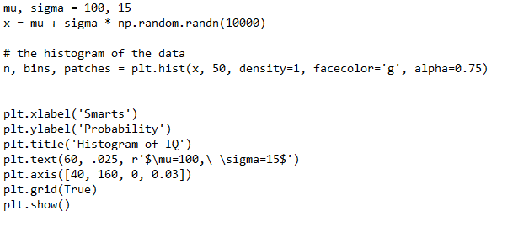

Slide 36
