Slide 1
NUMPY

Slide 2
Why NUMPY?
NumPy’s main object is the homogeneous multidimensional array. It is a table of elements (usually numbers), all of the same type, indexed by a tuple of positive integers. In NumPy dimensions are called axes.

Slide 3
For example, the coordinates of a point in 3D space [1, 2, 1] has one axis. That axis has 3 elements in it, so we say it has a length of 3. In the example pictured below, the array has 2 axis. The first axis has a length of 3, the second axis has a length of 3.
[ [ 1., 0., 0.],
[ 0., 1., 2.] ]

Slide 4
What is Numpy
All ndarrays are homogenous: every item takes up the same size block of memory, and all blocks are interpreted in exactly the same way. How each item in the array is to be interpreted is specified by a separate data-type object, one of which is associated with every array. In addition to basic types (integers, floats, etc.), the data type objects can also represent data structures.

Slide 5
NumPy’s array class is called ndarray. It is also known by the alias array. Note that numpy.array is not the same as the Standard Python Library class array.array(), which only handles one-dimensional arrays and offers less functionality.

Slide 6
Array attributes
Array attributes reflect information that is intrinsic to the array itself. Generally, accessing an array through its attributes allows you to get and sometimes set intrinsic properties of the array without creating a new array. The exposed attributes are the core parts of an array and only some of them can be reset meaningfully without creating a new array. Information on each attribute is given below.

Slide 7
Attribute: Memory layout
ndarray.flags | Information about the memory layout of the array.
ndarray.shape | Tuple of array dimensions.
ndarray.strides | Tuple of bytes to step in each dimension when traversing an array.
ndarray.ndim | Number of array dimensions.
ndarray.data | Python buffer object pointing to the start of the array’s data.
ndarray.size | Number of elements in the array.
ndarray.itemsize | Length of one array element in bytes.
ndarray.nbytes | Total bytes consumed by the elements of the array.
ndarray.base | Base object if memory is from some other object.

Slide 8
ndarray.ndim
the number of axes (dimensions) of the array.
ndarray.shape
the dimensions of the array. This is a tuple of integers indicating the size of the array in each dimension. For a matrix with n rows and m columns, shape will be (n,m). The length of the shape tuple is therefore the number of axes, ndim.

Slide 9
ndarray.size
the total number of elements of the array. This is equal to the product of the elements of shape.
ndarray.dtype
an object describing the type of the elements in the array. One can create or specify dtype’s using standard Python types. Additionally NumPy provides types of its own. numpy.int32, numpy.int16, and numpy.float64 are some examples.

Slide 10
ndarray.itemsize
the size in bytes of each element of the array. For example, an array of elements of type float64 has itemsize 8 (=64/8), while one of type complex32 has itemsize 4 (=32/8). It is equivalent to ndarray.dtype.itemsize.
ndarray.data
the buffer containing the actual elements of the array. Normally, we won’t need to use this attribute because we will access the elements in an array using indexing facilities.

Slide 11
Example
>>> import numpy as np
>>> a = np.arange(15).reshape(3, 5)
>>> a
array([[ 0, 1, 2, 3, 4], [ 5, 6, 7, 8, 9], [10, 11, 12, 13, 14]])

Slide 12
There are several ways to create arrays.
For example, you can create an array from a regular Python list or tuple using the array function. The type of the resulting array is deduced from the type of the elements in the sequences.

Slide 13
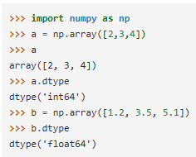

Slide 14

A frequent error consists in calling array with multiple numeric arguments, rather than providing a single list of numbers as an argument.

Slide 15

array transforms sequences of sequences into two-dimensional arrays, sequences of sequences of sequences into three-dimensional arrays, and so on.

Slide 16

The type of the array can also be explicitly specified at creation time:

Slide 17
Often, the elements of an array are originally unknown, but its size is known. Hence, NumPy offers several functions to create arrays with initial placeholder content. These minimize the necessity of growing arrays, an expensive operation.
The function zeros creates an array full of zeros, the function ones creates an array full of ones, and the function empty creates an array whose initial content is random and depends on the state of the memory. By default, the dtype of the created array is float64.

Slide 18
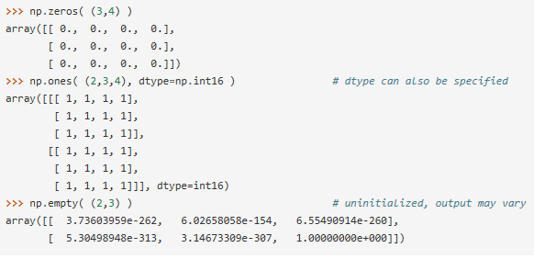

Slide 19

To create sequences of numbers, NumPy provides a function analogous to range that returns arrays instead of lists.

Slide 20
When arange is used with floating point arguments, it is generally not possible to predict the number of elements obtained, due to the finite floating point precision. For this reason, it is usually better to use the function linspace that receives as an argument the number of elements that we want, instead of the step:

Slide 21
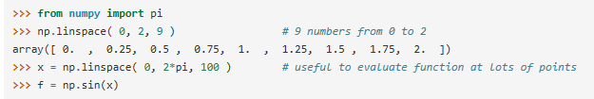

Slide 22
Printing Arrays
When you print an array, NumPy displays it in a similar way to nested lists, but with the following layout:
the last axis is printed from left to right,
the second-to-last is printed from top to bottom,
the rest are also printed from top to bottom, with each slice separated from the next by an empty line.
One-dimensional arrays are then printed as rows, bidimensionals as matrices and tridimensionals as lists of matrices.

Slide 23
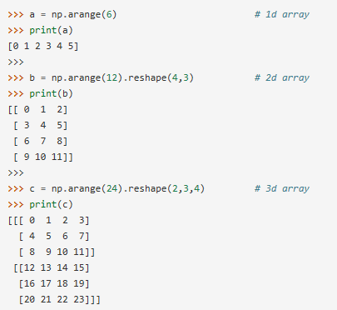

Slide 24
See next to get more details on reshape.
If an array is too large to be printed, NumPy automatically skips the central part of the array and only prints the corners:

Slide 25
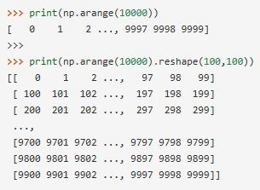

Slide 26
Basic Operations
Arithmetic operators on arrays apply elementwise. A new array is created and filled with the result.

Slide 27
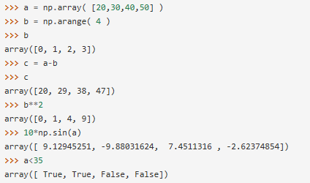

Slide 28
Unlike in many matrix languages, the product operator * operates elementwise in NumPy arrays. The matrix product can be performed using the dot function or method:

Slide 29
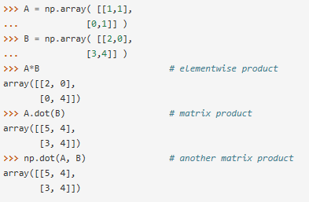

Slide 30
Some operations, such as += and *=, act in place to modify an existing array rather than create a new one.

Slide 31
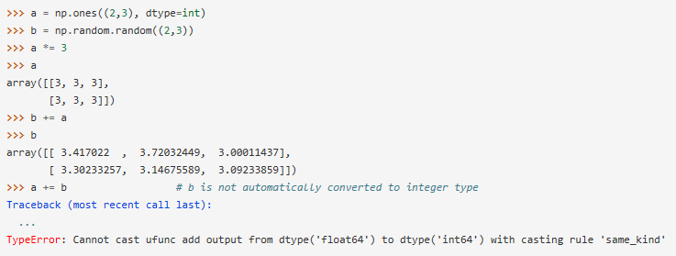

Slide 32
When operating with arrays of different types, the type of the resulting array corresponds to the more general or precise one (a behavior known as upcasting).

Slide 33
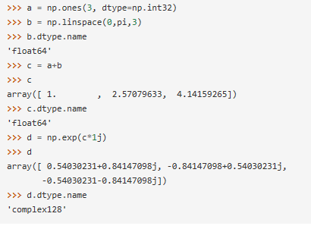

Slide 34
Many unary operations, such as computing the sum of all the elements in the array, are implemented as methods of the ndarray class.

Slide 35
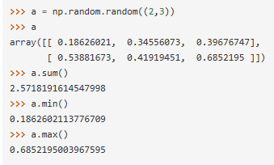

Slide 36
By default, these operations apply to the array as though it were a list of numbers, regardless of its shape. However, by specifying the axis parameter you can apply an operation along the specified axis of an array:

Slide 37
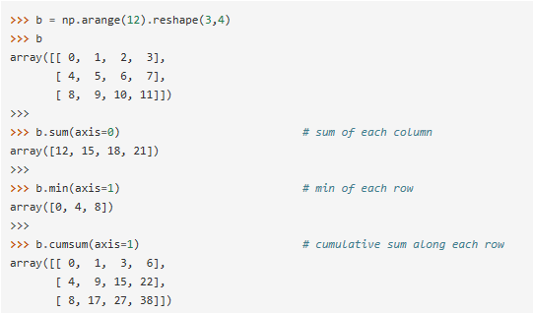

Slide 38
Universal Functions

