Slide 1
AI-POWERED PLATFORM
Sports Injury Risk
Detection from Video
An AI-powered platform that analyses athlete movement videos to detect biomechanical risk factors, predict injury probability, and deliver personalised corrective recommendations for athletes, coaches, physiotherapists, and sports scientists.
TEAM MEMBERS
Manjeera
Payal
Mithra
Bibek
Sumit
Sonika
Computer Vision
Pose Estimation
XGBoost
FastAPI
Next.js
Groq AI
01

Slide 2
PROBLEM STATEMENT & OBJECTIVES
The Challenge We Are Solving
THE PROBLEM
PROJECT OBJECTIVES
Sports injuries cost athletes seasons and entire careers. Across professional sport, injury-related absences account for significant financial loss and performance decline — yet most are preventable if caught early.
01
Detect Biomechanical Risk Before Injury Occurs
Design and deploy a complete video analysis pipeline that extracts pose landmarks, calculates clinical biomechanical metrics (knee angle, trunk lean, movement symmetry, knee valgus), and flags patterns associated with common sports injuries such as ACL tears, hamstring strains, and lower-back overload — before any injury has taken place.
Manual Assessment is Subjective
Coaches and physios rely on visual observation. There is no standardised, data-driven method to flag risky movement patterns in real training environments before they cause an injury.
02
Deliver Role-Specific Insights to Every Stakeholder
Diagnosis Happens After the Injury
Build a multi-role platform with dedicated dashboards for Athletes, Coaches, Physiotherapists, Sports Scientists, and Administrators. Each user sees data relevant to their responsibilities — an athlete sees their corrective plan, a coach sees team risk overview, a physio sees rehabilitation tracking.
Current clinical tools measure damage after it has occurred. Athletes lack any systematic early-warning system that identifies biomechanical deterioration during training sessions.
No Personalised Continuous Monitoring
Generic advice does not account for sport type, position, individual injury history, or bilateral movement asymmetry — all of which significantly affect risk levels.
03
Generate Actionable, Personalised Recommendations
Use a Groq-hosted large language model (Llama 3.3-70B) to convert the raw risk data into a clear, personalised corrective exercise plan covering targeted exercises, mobility drills, and recovery scheduling — adapted to the athlete's sport type and specific biomechanical flags detected.
02

Slide 3
OUR SOLUTION
What the Platform Delivers
SportGuard is a full-stack web application that ingests sports training videos and produces structured, data-driven injury risk assessments. Every uploaded video is processed through a five-stage AI pipeline that extracts pose landmarks, calculates biomechanical metrics, predicts risk level using a trained XGBoost classifier, and generates a personalised corrective plan via a large language model.
1
Video Ingestion & Processing
2
MediaPipe Pose Estimation
3
Biomechanical Analysis Engine
Athletes upload videos in any common format (MP4, MOV, AVI). FFmpeg normalises the footage and OpenCV samples every third frame. A skeleton-annotated MP4 is returned at the end of analysis.
Google MediaPipe Pose Landmarker detects 33 body landmarks per frame. Landmarks are filtered by visibility (≥0.75) and a 4 % inset margin to reject hallucinated off-screen joints.
Calculates knee flexion, hip angle, trunk lean, elbow angle, knee valgus (FPPA), bilateral symmetry, and balance offset. Risk flags activate when thresholds are breached in ≥10–25 % of frames.
4
XGBoost Risk Prediction
5
Groq AI Recommendations
6
Role-Based Dashboards & Reports
A trained XGBoost classifier receives 12 aggregated features and outputs one of four risk classes: Low, Moderate, High, or Critical. Feature importance is led by symmetry score and valgus angle — not raw knee bend.
The Llama 3.3-70B model (via Groq API) generates a structured corrective plan: targeted exercises, mobility drills, and recovery scheduling — adapted to the user's role and the specific flags detected in their session.
Five dedicated dashboards (Athlete, Coach, Physiotherapist, Sports Scientist, Admin). Each view surfaces the information most relevant to that role. Sessions can be deleted by the athlete; all deletions are logged for the admin.
03

Slide 4
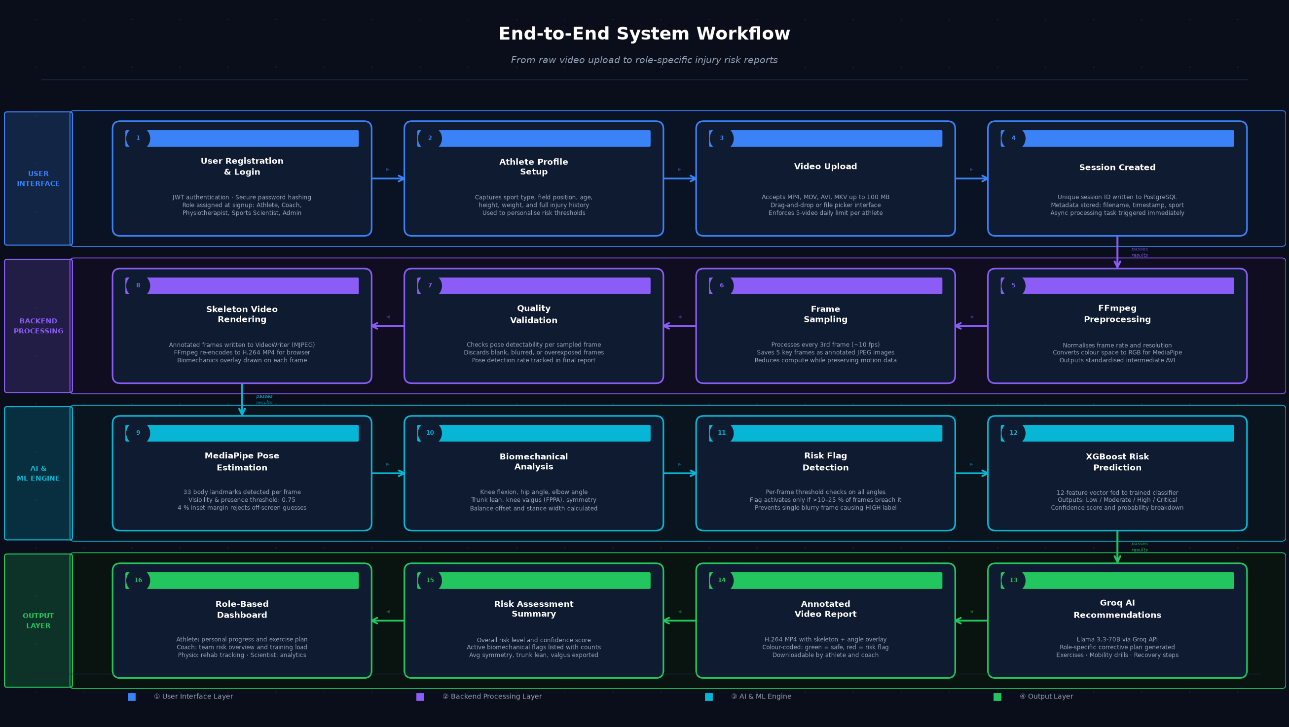
SYSTEM WORKFLOW
04

