Slide 1
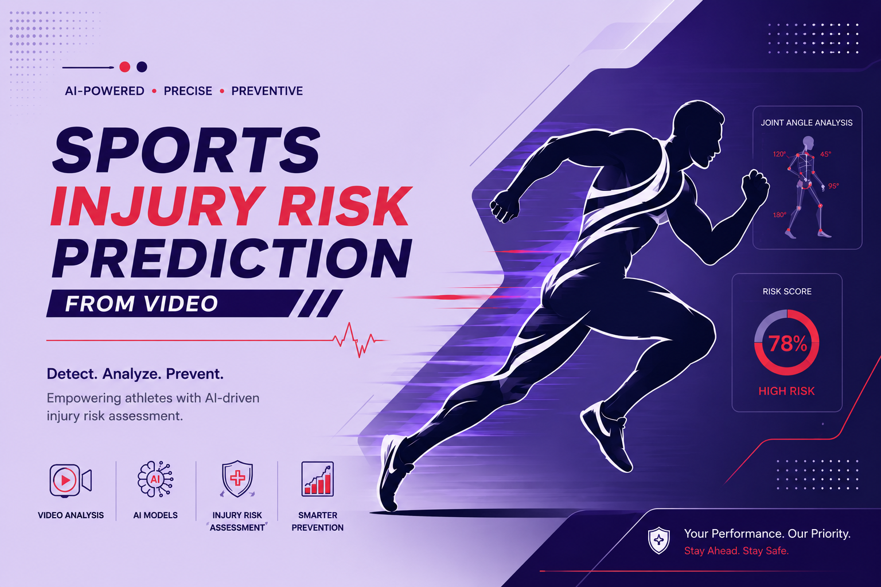
Notes:
Title slide for the project: Sports Injury Risk Prediction from Video.

Slide 2
Sports Injury Risk Detection from Video
PROBLEM STATEMENT
PROJECT OBJECTIVE
Athletes can develop injuries due to abnormal movement patterns, poor posture, biomechanical issues, and training-related factors.
Manual movement analysis can be difficult and time-consuming
01
Analyze athlete movement videos using computer vision and pose estimation.
02
Identify biomechanical issues and abnormal movement patterns that may indicate injury risk.
03
Generate injury-risk insights and corrective recommendations to support injury prevention.
Team Members
Manjeera • Payal • Mithra • Bibek • Sonika • Sumit
Mentor: Springboard Mentor
Notes:
Our project is AI Sports Injury Risk Detection from Video. The main problem is that abnormal movement and biomechanical issues can increase injury risk, and manual movement analysis can be difficult and time-consuming. Our objective is to analyze athlete videos, identify movement-related risk factors, and provide injury-risk insights and corrective recommendations.

Slide 3
Key Features
01
02
03
04
Ai Video Analysis
Biomechanical Assessment
Injury Risk Scoring
Recommendations and Reports

Slide 4
Workflow
End-to-end athlete video analysis pipeline
REGISTER / LOGIN
ATHLETE PROFILE
VIDEO UPLOAD
POSE ANALYSIS
BIOMECHANICALANALYSIS
→
→
→
→
Role-Based Account & Sign In
Sport • training • Injury history
Movement Video
MediaPipe Landmarks
Angles • ROM • Trunk Lean • Valgus
↓
RISK SCORE
→
RECOMMENDATIONS
→
REPORTS
0–100 risk assessment
Posture • exercise • Recory
• History • PDF • CSV Export
TECHNOLOGY / PROCESS FLOW
React + TypeScript
→
FastAPI
MediaPipe Pose
→
XGBoost ML Risk Engine
→
→
Reports
Video → Pose & Biomechanics → XGBoost ML Risk Model → Recommendations → Reports
Notes:
This is our end-to-end workflow. The athlete first registers and logs in, then maintains the athlete profile. Next, the athlete uploads a movement video. MediaPipe Pose detects body landmarks, and we perform biomechanical analysis such as joint angles, ROM difference, knee valgus proxy and trunk lean. These factors are used by the risk engine to generate a 0–100 risk score. The system then provides posture, exercise and recovery recommendations, and the results can be viewed and exported through Reports History.

Slide 5
Backend & API
FastAPI-based backend for authentication, video processing and risk analysis
SYSTEM ARCHITECTURE
BACKEND STACK
FastAPI
REST API framework
React + TypeScript
Frontend
↓
PostgreSQL
Stores users, athlete profiles, videos and analysis results
FastAPI
Backend API layer
Authentication
Registration, login & Role-Based Access Control (RBAC)
↓
Auth
Video Upload
Risk APIs
Register / Login
Async processing
Assessment & history
Async Processing
Video analysis runs in the background
↙
↘
↓
PostgreSQL
REST APIs
Frontend communicates with backend through APIs
Application database
KEY API FLOW
POST /register
→
POST /login
→
POST /videos/upload
→
GET /videos/{id}
→
GET /athletes/me/risk-history
Frontend → REST API → FastAPI → Auth / Video Processing / Risk APIs → PostgreSQL
Notes:
This slide shows our backend architecture. We use FastAPI for the REST APIs and PostgreSQL for storing application data. Authentication handles registration and login. When a user uploads a video, the processing runs asynchronously in the background, so the frontend does not remain blocked. The backend provides APIs for video processing, risk assessment and risk history, and the React frontend communicates with these APIs.

Slide 6
Frontend & User Interface
Technology
Main User Features
React + TypeScript frontend connected to the FastAPI backend
React
Builds the interactive user interface and application pages.
01 . Registration & Login
Role-based secure account creation (Athlete/Coach/Staff).
02 . Athlete Profile
Sport, position, training load and injury history.
TypeScript
Adds structure and type safety to the frontend code.
03 . Dashboard
Latest analysis, risk score and activity information..
04 . Video Upload & Analysis
Uploads movement videos for pose and biomechanical analysis.
Register
Login
Athlete Profile
Upload
Analysis
Risk Result
Reports
API Integration
Frontend communicates with FastAPI through APIs..
05 . Reports History
Previous analyses, risk results, recommendations and reports.
User Workflow

Slide 7
Registration Page

Slide 8
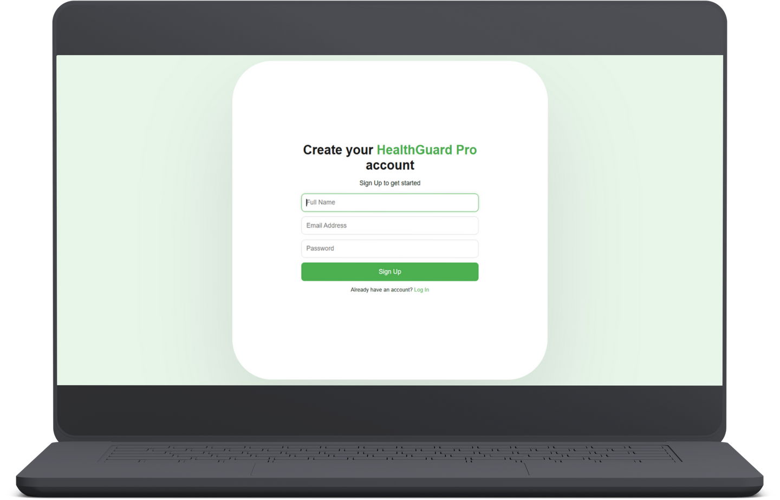
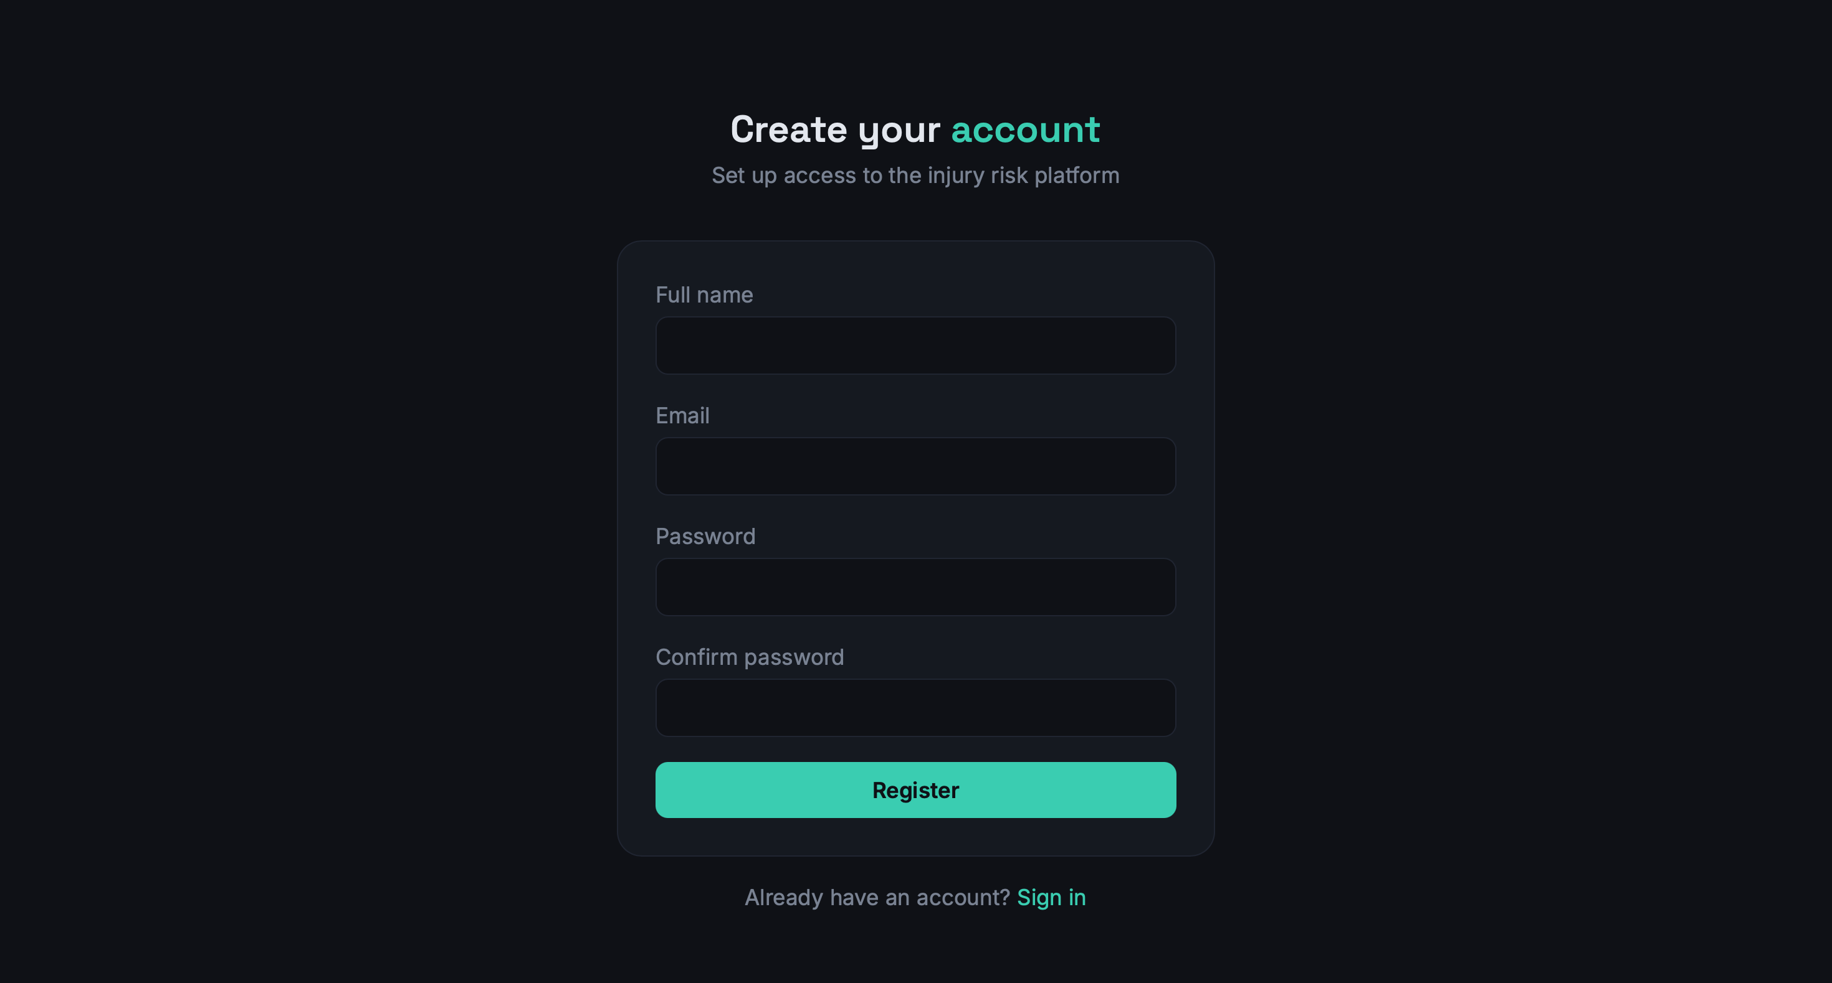
Features
Role-Based User Registration
Athlete & Coach Profiles
Responsive Design

Slide 9

Login Page

Slide 10
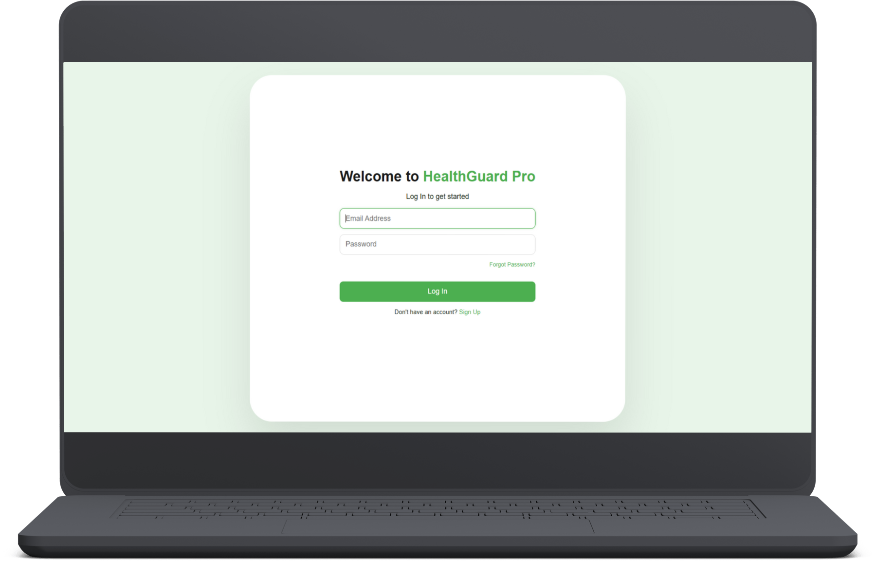
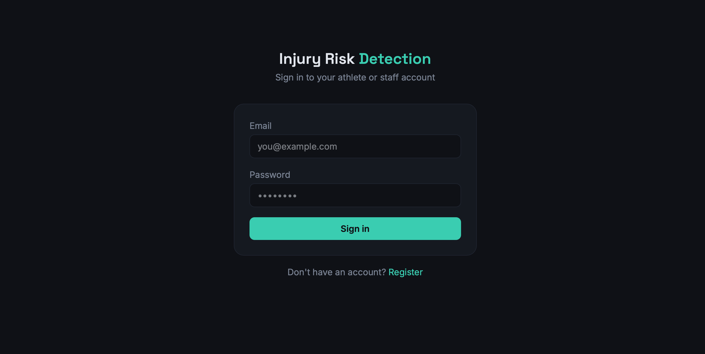
Features
Role-based authentication & login.
User-Friendly Input Fields

Slide 11

Let’s Explore
Dashboard

Slide 12
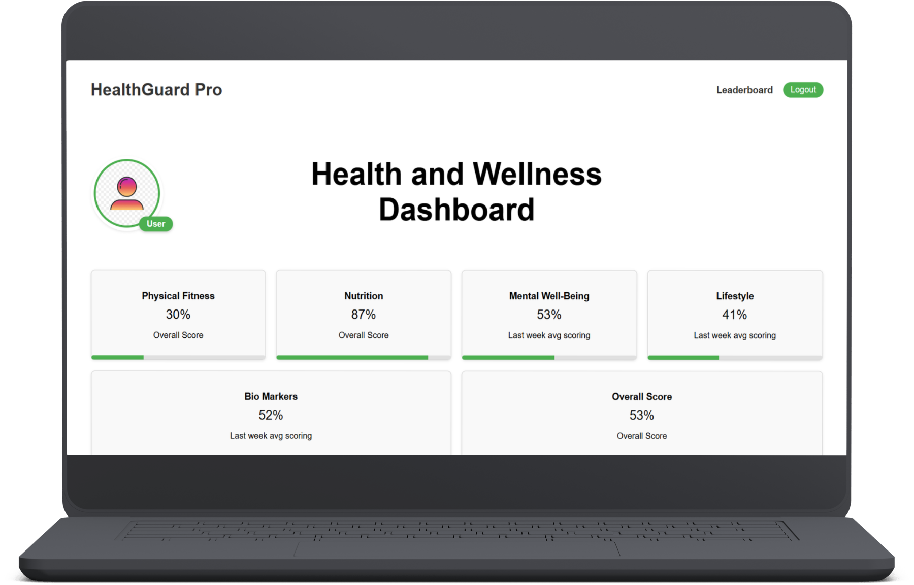
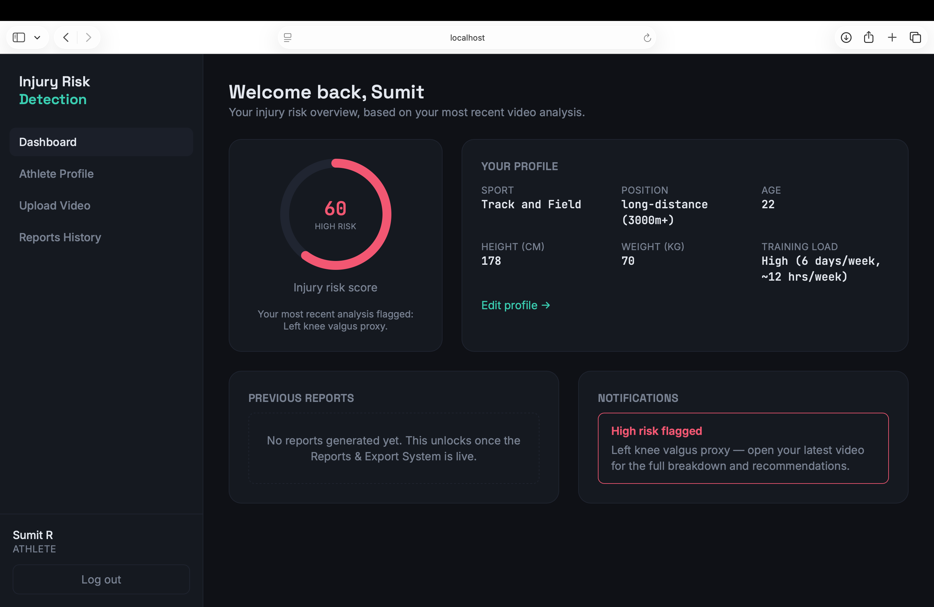

Slide 13
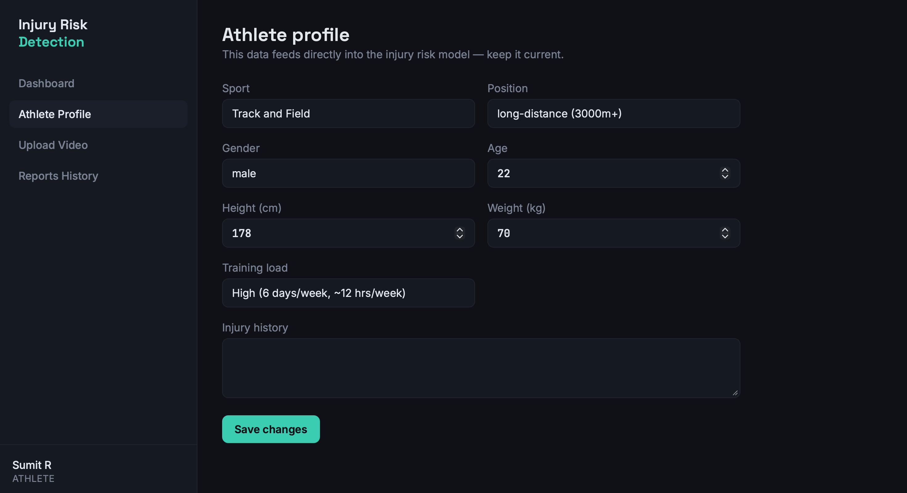

Slide 14
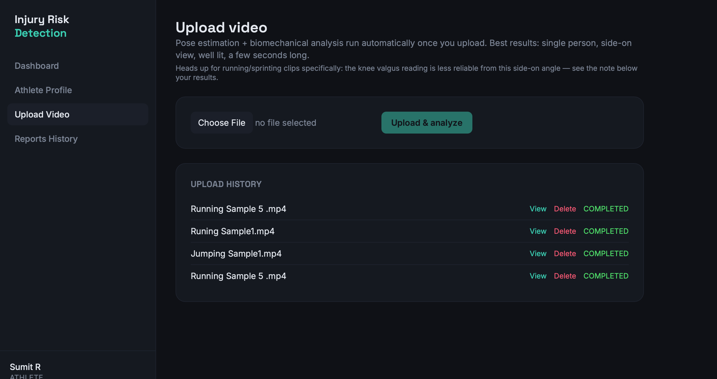

Slide 15
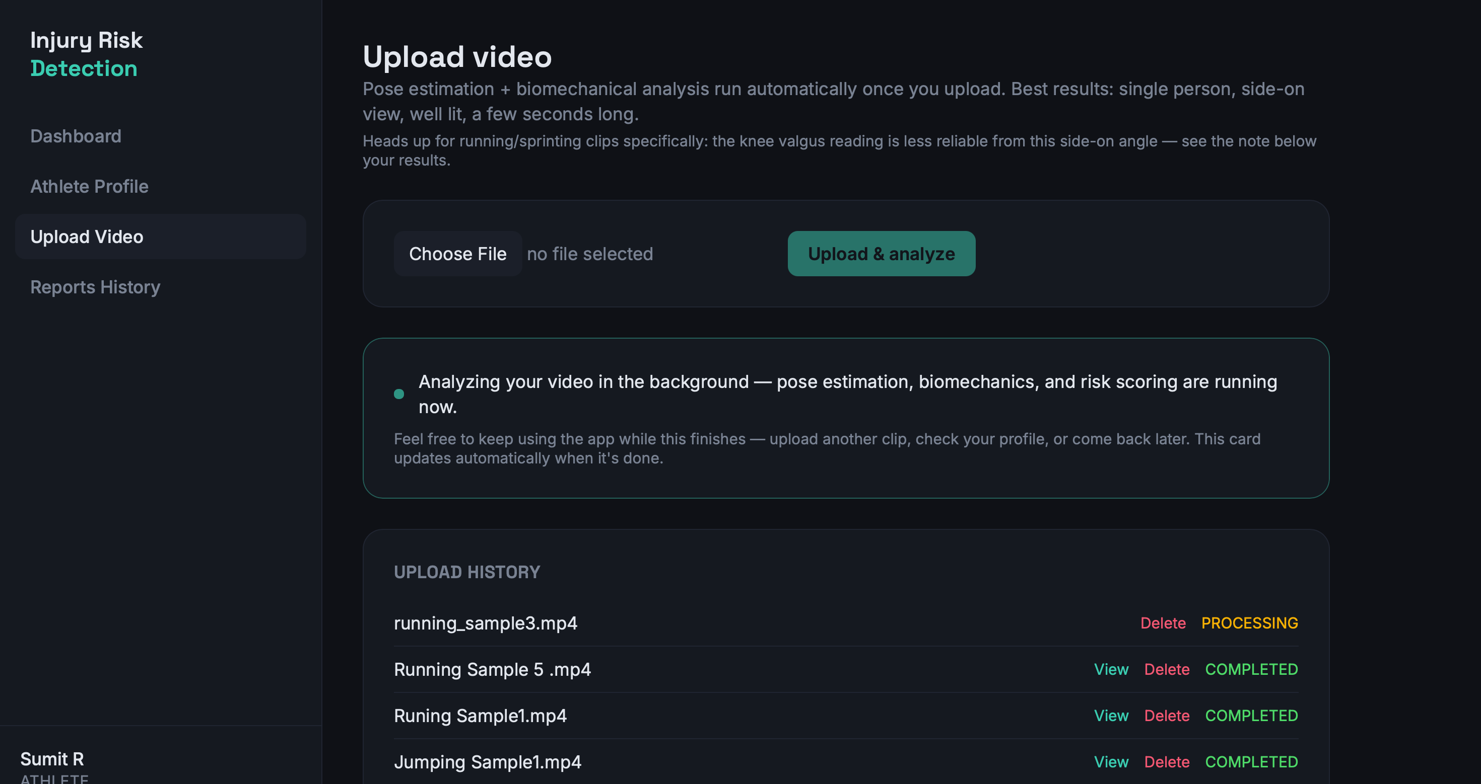

Slide 16
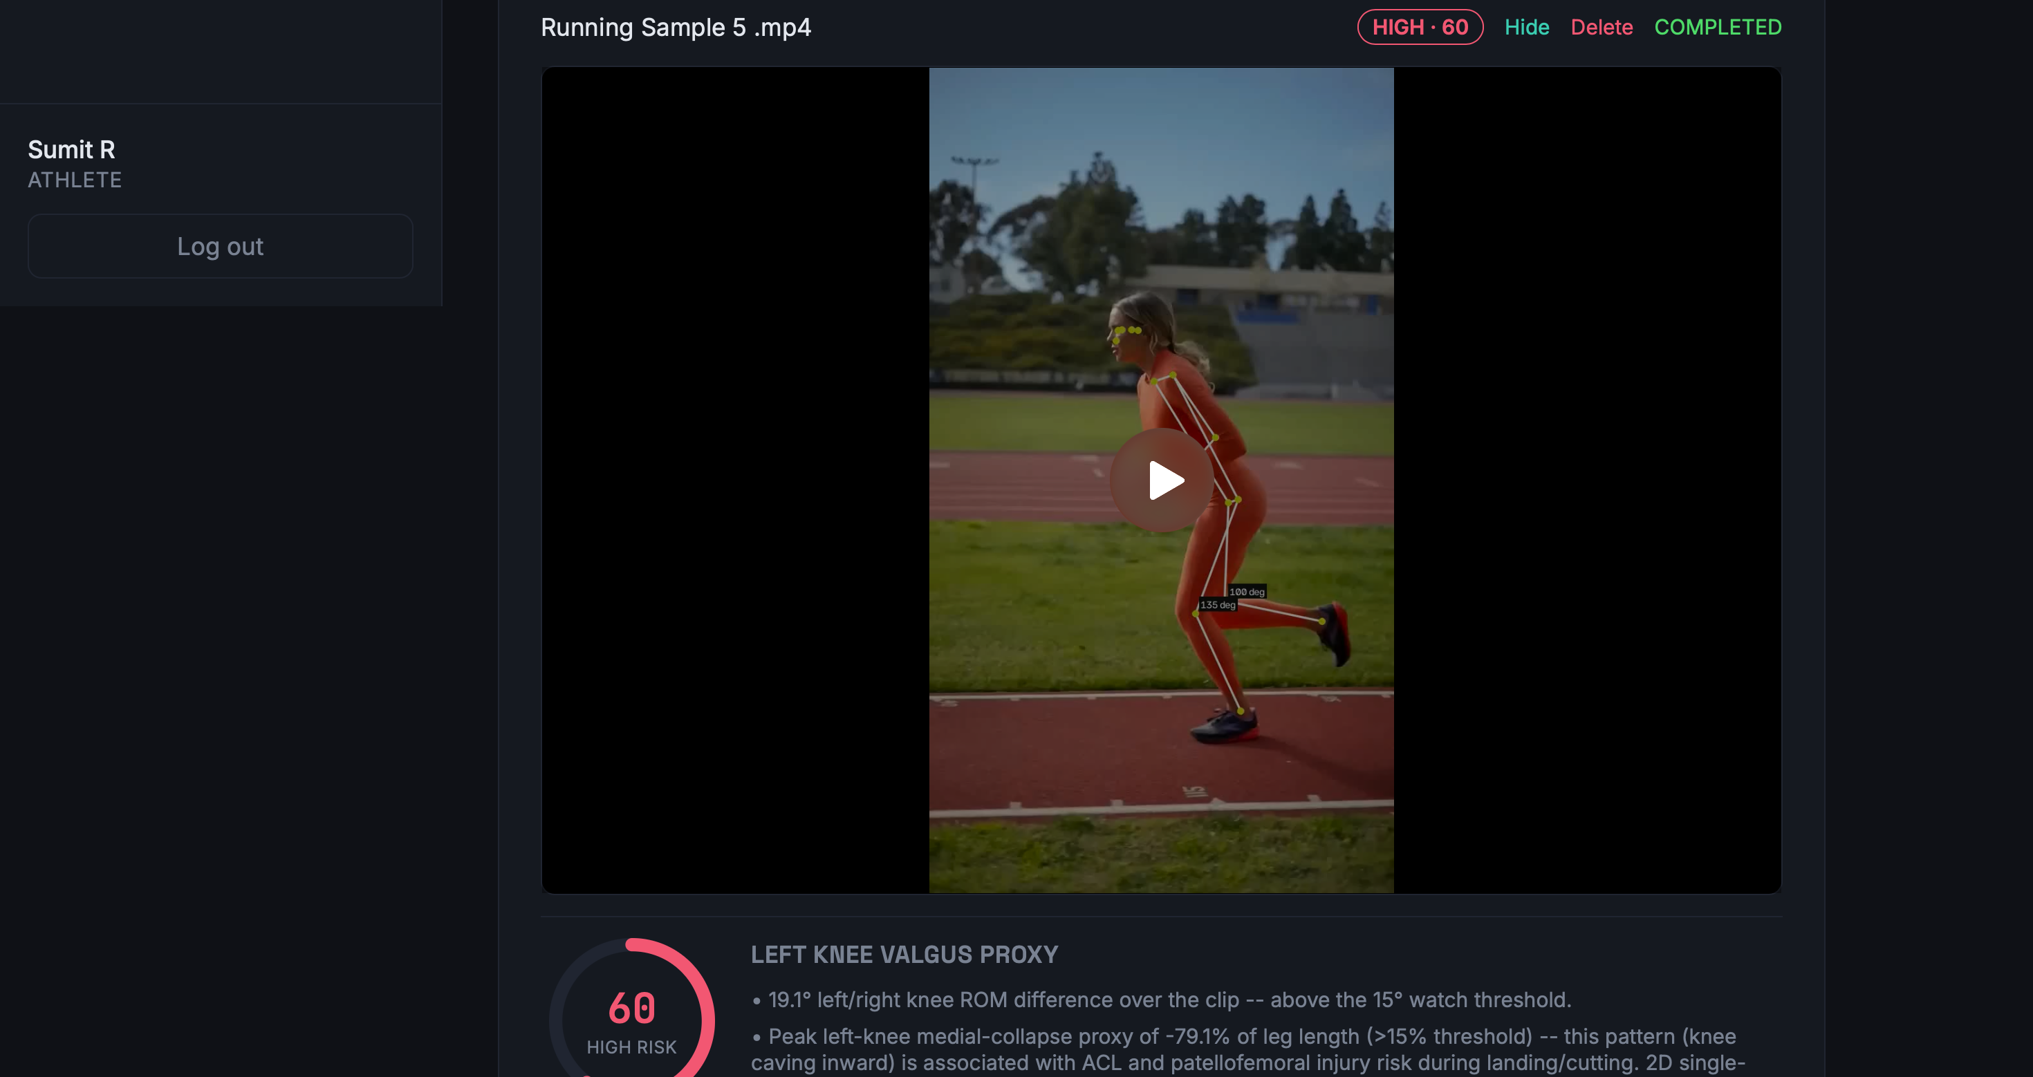

Slide 17
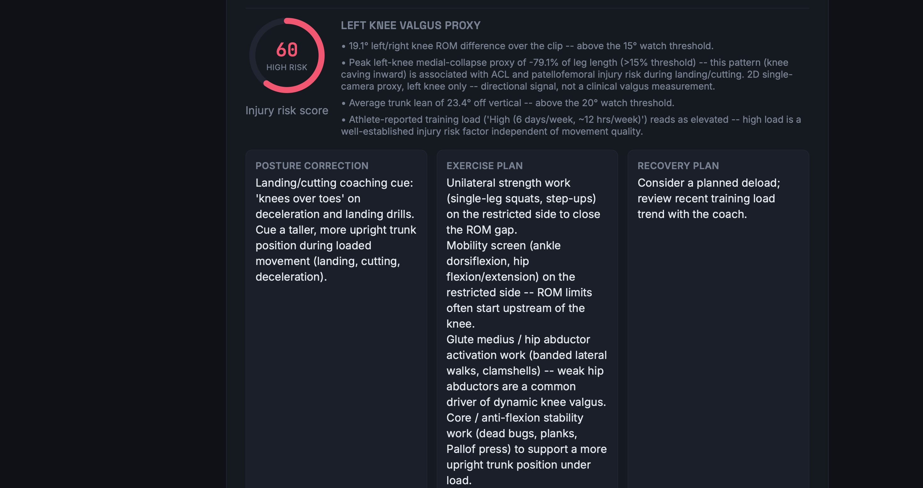

Slide 18
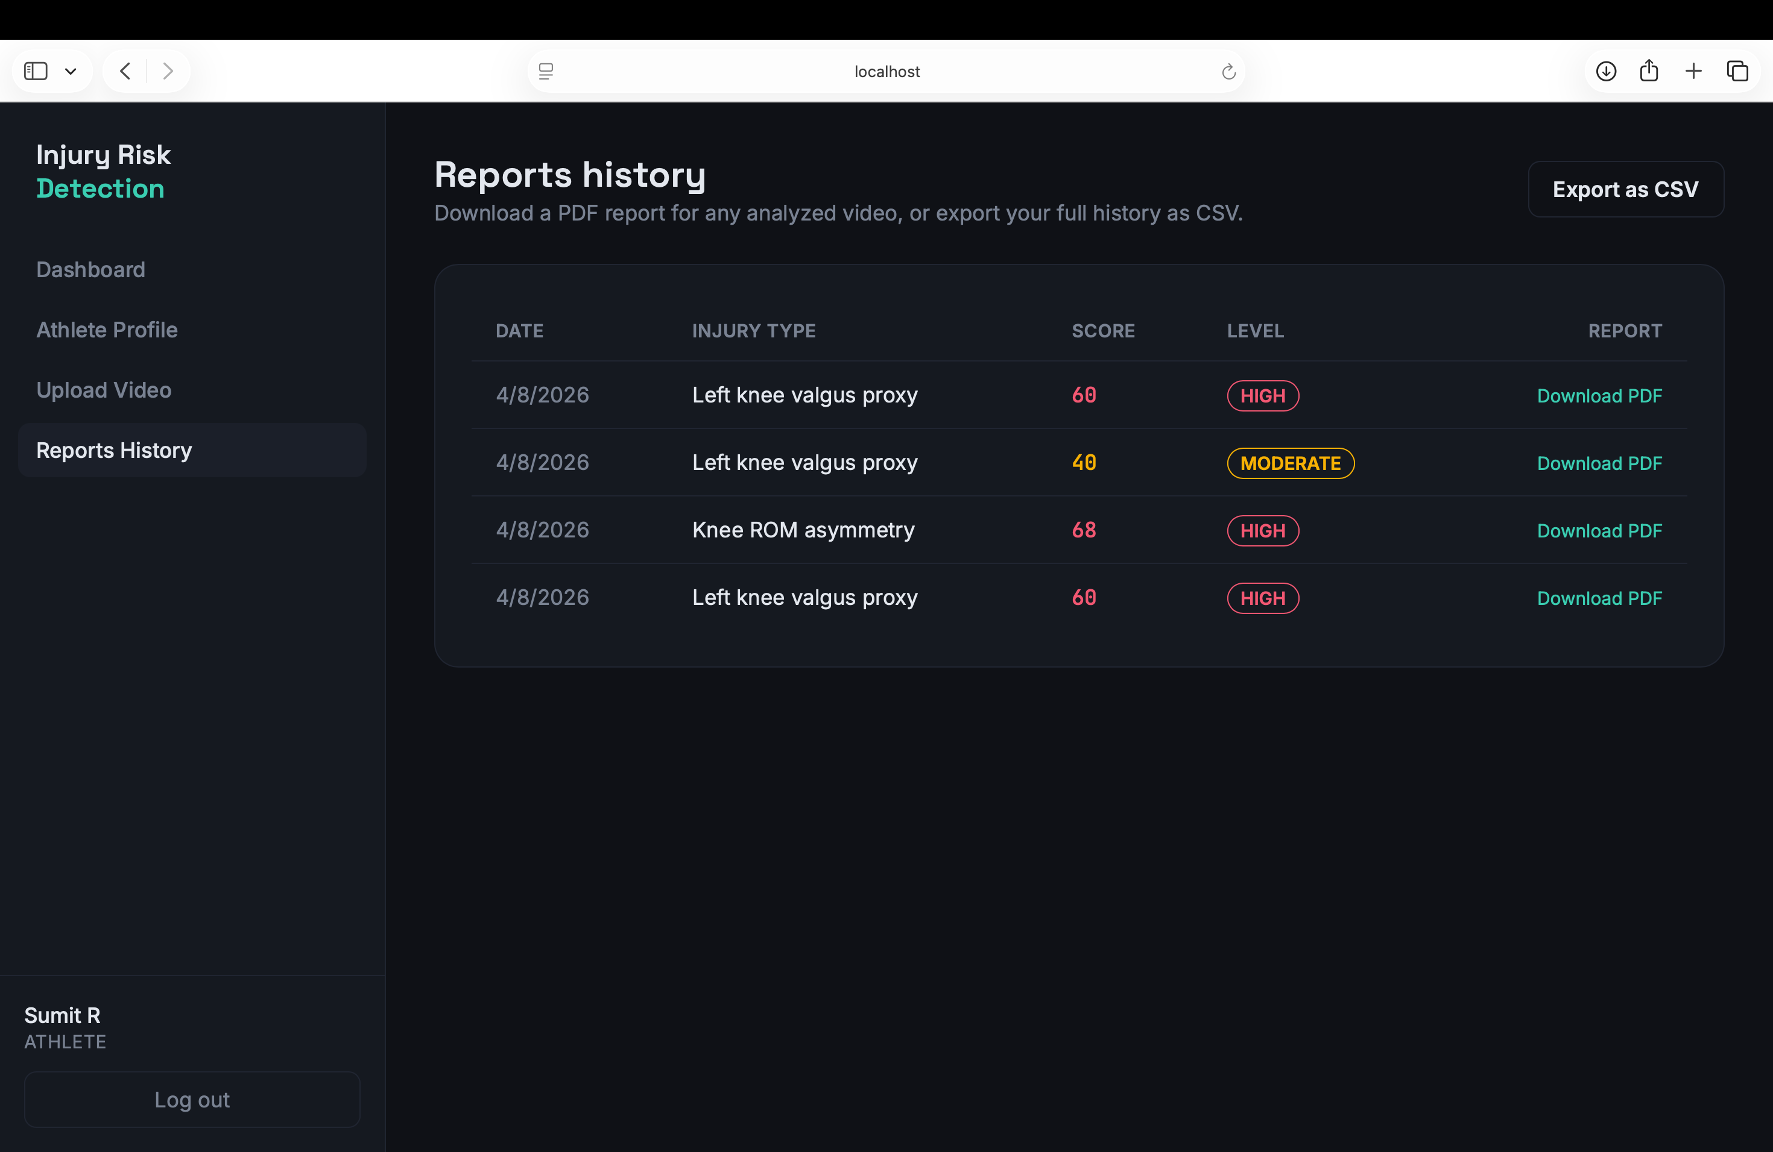

Slide 19
Pose Estimation & Biomechanical Analysis
POSE ESTIMATION
BIOMECHANICAL ANALYSIS
MediaPipe Pose
01 · Joint Angles
02 · Knee Valgus Proxy
• Detects athlete body landmarks from video frames.
Measures angles at joints such as the knee and elbow.
2D estimate of inward/outward knee alignment; directional, not clinical.
• Provides 33 pose landmarks.
• Maps required points to a 17-point COCO-style representation.
03 · ROM Difference
04 · Trunk Lean
Compares left and right knee range of motion across the clip.
Measures upper-body lean during movement.
• Tracks shoulder, elbow, hip, knee, ankle and other body points.
Key tracked points
Shoulder
Elbow
Hip
Knee
Ankle
Foot
ANALYSIS FLOW
Video
→
Frames
→
MediaPipe Pose
→
Body Landmarks
→
Joint & Movement Metrics
→
Biomechanical Analysis
Note: knee valgus is a 2D single-camera proxy and is less reiable for side-on running footage.

Slide 20
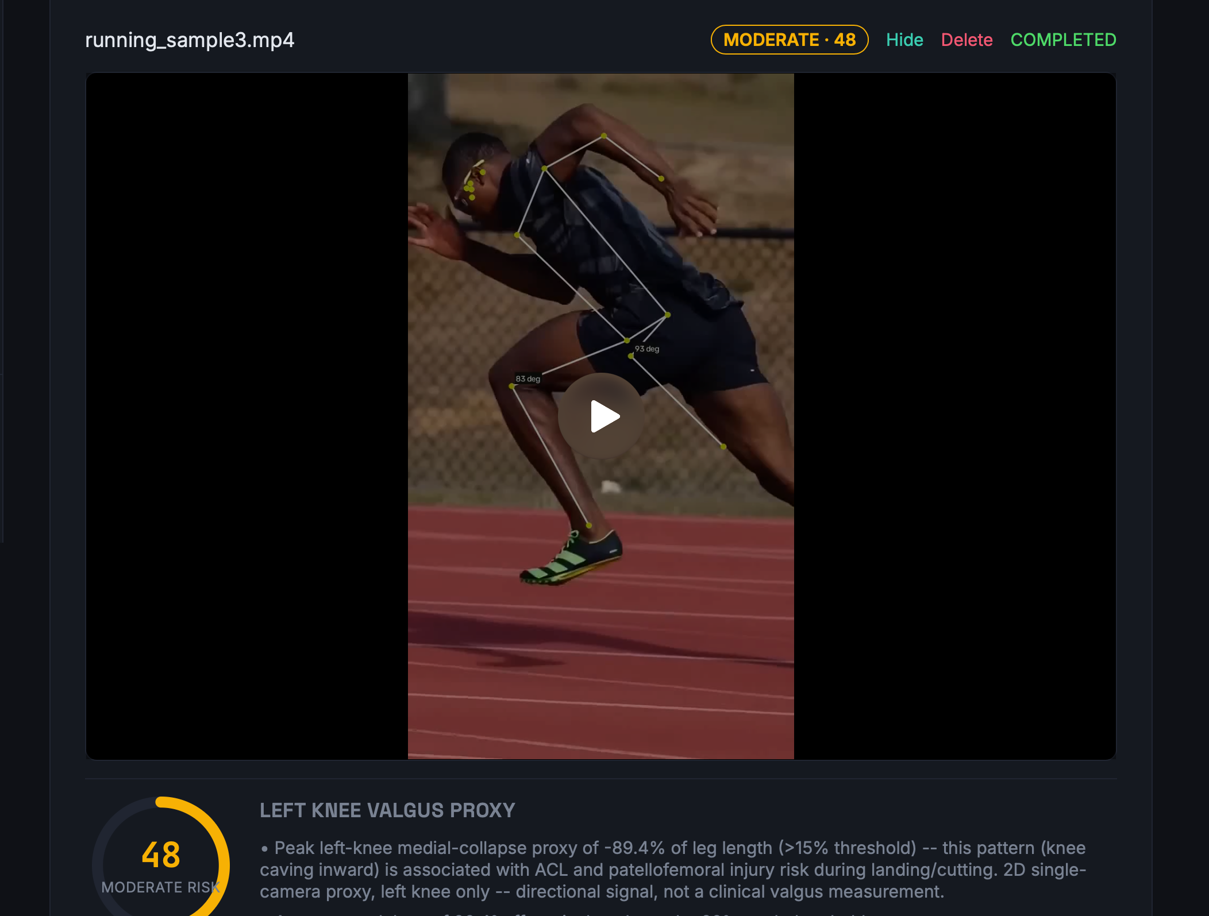
Annotated athlete video / skeleton overlay

Slide 21
Risk Scoring + Recommendations + Testing
RISK SCORING
RECOMMENDATIONS
TESTING
XGBoost ML Risk Engine
Posture Correction
Injury-Risk Engine Tests
Movement cues based on identified biomechanical factors.
Score, thresholds, factors and recommendations.
Trained XGBoost machine learning model evaluates extracted biomechanical features to predict a 0–100 injury risk score with high explainability.
Upload-Flow Tests
Exercise Plan
End-to-end video upload and analysis flow.
Targeted exercise suggestions related to movement limitations.
Score Range
Output
Biomechanics Regression
0–100
Risk Level
Checks biomechanical calculations remain stable.
Recovery Plan
RISK LEVELS
Recovery and training-load guidance based on risk factors.
Risk-History Tests
Validates risk history aggregation across videos.
Low
Moderate
High
Critical
SCORING FACTORS
Biomechanics → Risk Factors → Score → Recommendations
WHY XGBOOST & SYNTHETIC DATA?
Knee valgus proxy
Knee ROM asymmetry
Addresses clinical data scarcity by training on validated synthetic biomechanical distributions, providing high accuracy, fast inference, and feature importance.
Trunk lean
Training load
Injury history
Notes:
The current system uses an explainable rule-based scoring engine rather than a newly trained injury classifier. It combines biomechanical factors and athlete profile information to produce a 0–100 score and a risk level. The system also provides posture correction, exercise and recovery recommendations. We validate the system using injury-risk engine tests, upload-flow tests, biomechanics regression tests and risk-history tests.

Slide 22
Reports & Deployment
01 · REPORTS & HISTORY
02 · REPORT GENERATION
03 · DEPLOYMENT PLAN
Reports History
Generated Report Includes
Docker
Containerize the application.
• Stores previous video analysis results.
Athlete information
Video name & assessment date
Cloud Platform
• Displays injury type, risk score and risk level.
Deploy frontend and backend using a platform such as Render.
• Downloads an individual PDF report.
Risk score & risk level
Contributing biomechanical factors
• Exports complete history as CSV.
Configuration
Recommendations
Safety disclaimer
Set environment variables and database connection.
Post-Deployment Testing
PDF
CSV
Validate the complete application after deployment.
Individual assessment report
Complete report history export
Analysis → Risk Result → Report
END-TO-END DELIVERY FLOW
Analysis
→
Risk Result
→
Reports
→
PDF / CSV
→
Docker
→
Cloud Deployment
Notes:
This slide shows our reporting system and the next deployment phase. Users can view previous analysis in Reports History, download PDF reports, and export the history as CSV. Currently, the application is running locally and cloud deployment is not completed. In Milestone 4, we plan to containerize the application using Docker, deploy the frontend and backend on a cloud platform such as Render, configure environment variables and the database, and test the complete application.

Slide 23
Results, Limitations & Future Scope
CURRENT RESULTS
LIMITATIONS
FUTURE SCOPE
✓
Role-Based Access Control (RBAC)
Single-athlete scope
→
Real-world clinical dataset validation
Current workflow is designed around one athlete per analysis.
✓
Athlete profile management
Deep Learning & Real-time Edge Processing
→
Video upload & async processing
2D knee-valgus proxy
✓
Accuracy depends on camera angle and is less reliable for side-on running footage.
→
Support more sports & movements
✓
Pose & biomechanical analysis
Synthetic training baseline
Better camera-angle handling
XGBoost ML injury risk prediction (0–100)
Trained on synthetic biomechanical data; real-world clinical validation is ongoing.
→
✓
✓
Personalized recommendations
Not a clinical diagnosis
→
Docker + cloud production deployment
Results are intended as automated screening and risk indication.
✓
Reports & export
PROJECT TAKEAWAY
From athlete video to actionable injury-risk insights
Video → Analysis → XGBoost ML Risk (0–100) → Recommendations → Reports
Notes:
These are our current results, limitations and future scope. The user can register and log in, maintain an athlete profile, upload a video, run pose and biomechanical analysis, receive a risk score and recommendations, and view or export reports. Current limitations include the single-athlete scope, camera-angle dependence of the 2D knee-valgus proxy, rule-based risk scoring, and the fact that the system is not a clinical diagnosis. Future work includes a real labeled injury dataset, a trained ML risk model, support for more sports and movements, better camera-angle handling, and Docker plus cloud deployment.

Slide 24
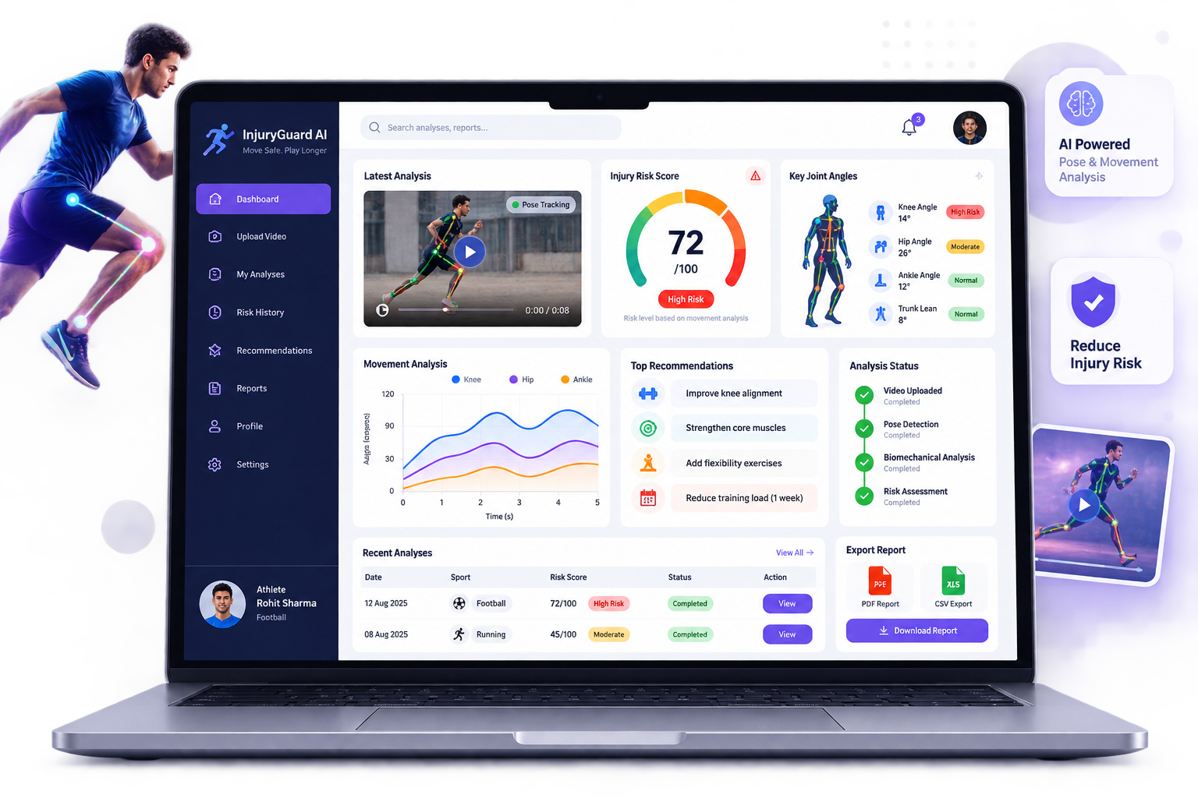
Why You’ll Love Using
Our Website!
🏃 Role-Based Athlete & Coach Profiling
🎥 Video-Based Movement Analysis
🤖 XGBoost ML-Powered Injury Risk Scoring (0–100)
💡 Personalized Corrective Recommendations
📄 Interactive Reports & History Tracking

Slide 25


Conclusion
Our project provides an AI-powered platform for analyzing athlete movement from video. The system features role-based access for athletes and coaches, performs pose estimation and biomechanical analysis, and predicts injury risk (0–100) using a trained XGBoost machine learning model. It also provides personalized recommendations to help improve movement and reduce potential injury risks. In the future, we plan to validate the model against large-scale clinical cohorts and support multi-camera tracking. Overall, the project demonstrates a complete, reliable end-to-end AI pipeline for video-based sports injury assessment.

Slide 26
Thank you very much!

