Slide 1






Exploring Programmatic Access to Protein Sequence, Function and Structure Information
Mihaly Varadi & Andrew Nightingale
ECCB 2018
Athens, 8th Sep
pdbhelp@ebi.ac.uk
proteindatabank
@PDBeurope
pdbeurope
pdbart

Slide 2
Welcome to the workshop
Who are we?
What is the plan for today?
Where to find materials?

Slide 3
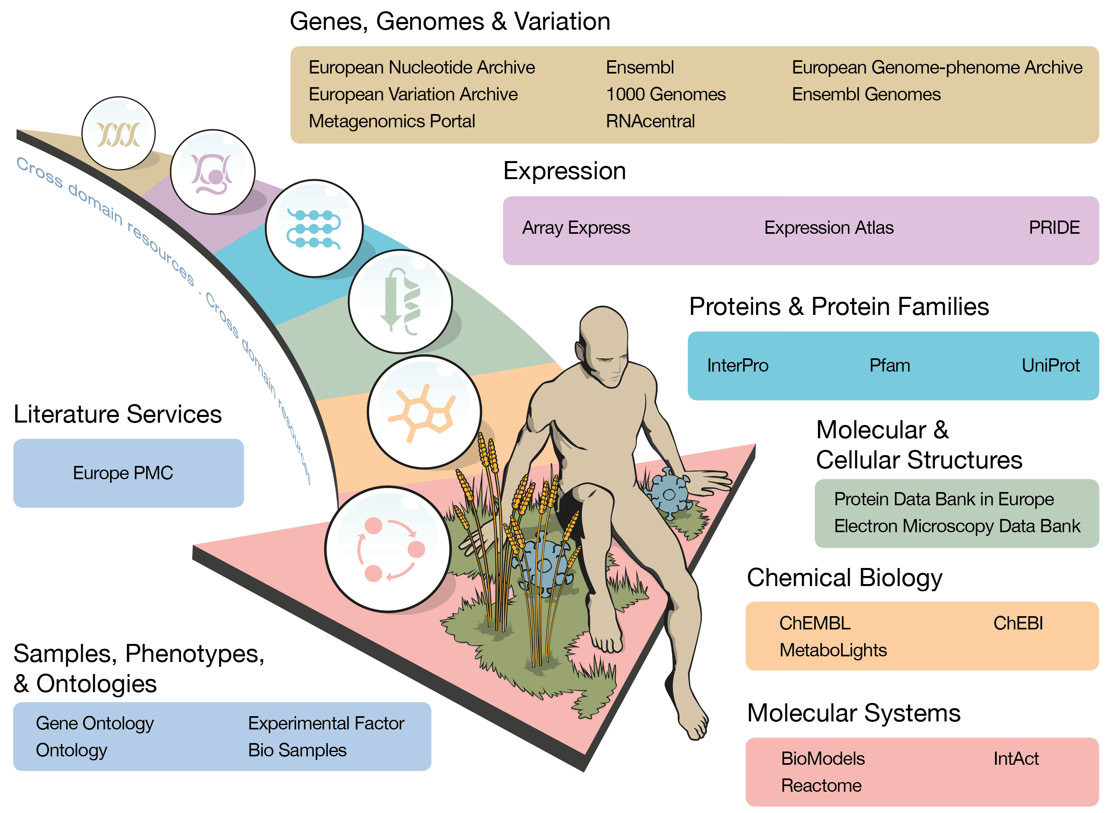
EMBL-EBI resources

Slide 4
Workshop schedule (morning)
Session 1 - Introductions
09:00 – 09:10 Welcome (this is what happens now)
09:10 – 09:50 Introduction to UniProt
09:50 – 10:30 Introduction to PDBe
Coffee break 30min
Session 2 – API
11:00 – 11:45 PDBe API
11:45 – 12:30 UniProt API
Lunch break 60min

Slide 5
Workshop schedule (afternoon)
Session 3 – Web components
13:30 – 14:15 UniProt web components
14:15 – 15:00 PDBe web components
Coffee break 30min
Session 4 – Bringing it all together
15:30 – 17:00 Case study (or own ideas)

Slide 6
Where to find materials?
All the materials of this workshop can be found in this GitHub repository:
https://github.com/uniprot-pdbe/eccb2018

