Slide 1






Protein Data Bank in Europe
PDBe.org
Mihaly Varadi
ECCB 2018
Athens, 8th Sep
pdbhelp@ebi.ac.uk
proteindatabank
@PDBeurope
pdbeurope
pdbart

Slide 2
Programmatic access to PDBe (API)

Slide 3
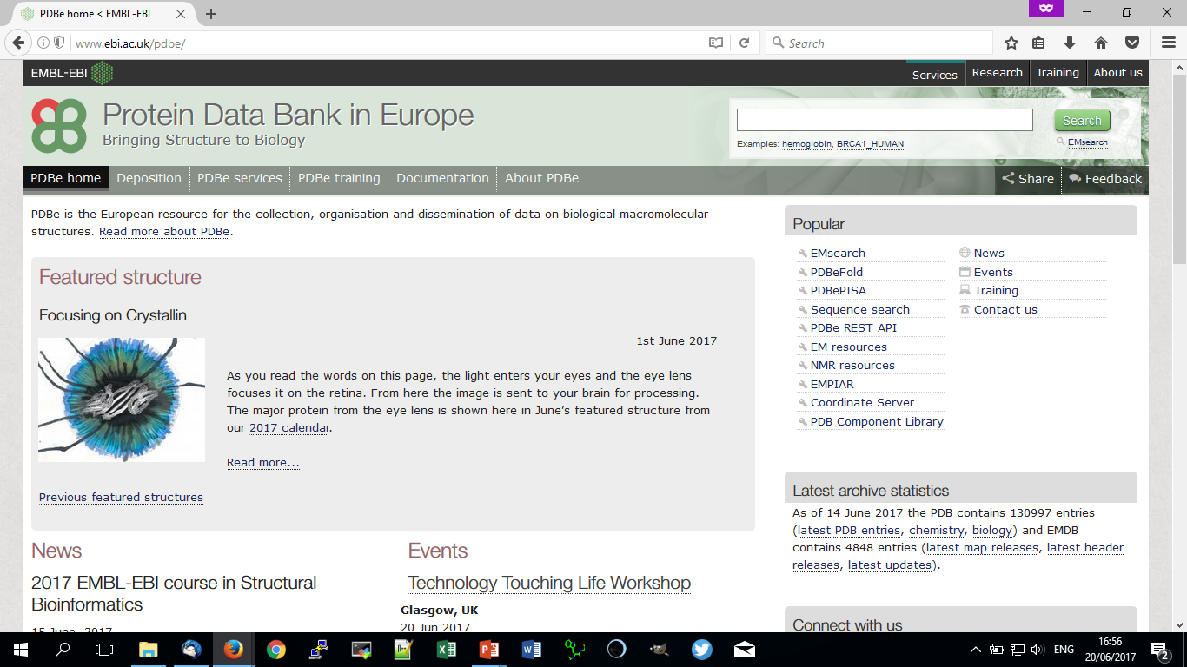
RESTful API for PDBe data
Allows access to vast amounts of PDBe data
Powers the PDBe search and web pages
= It will always be well maintained!
PDBe.org/API
Notes:
Link expand on next slide

Slide 4
RESTful API for PDBe data
Allows access to vast amounts of PDBe data
Powers the PDBe search and web pages
= It will always be well maintained!
PDBe.org/API
Notes:
Can access API from homepage, or directly ay PDBe.org/API

Slide 5
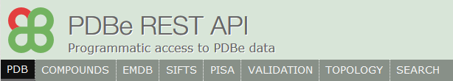
What can the REST API give you?
Split into 8 groups
These REST calls are based on different subsets of data
These are grouped for ease of use
These are available on the documentation page
Thorough set of example calls
Give URL and output JSON on the page
Notes:
The data from the API split into 8 groups – for ease of use
Find these on the API documentation page
Each group has interactive example calls on the documentation pages… (feed into next slide)

Slide 6
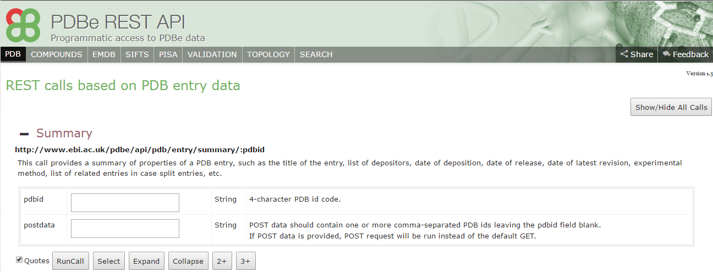
Documentation example
Each of the tabs gives list of example calls for that group
Short description of the results given under API URL
PDBe.org/API
Notes:
Here’s an example call in the ‘PDB’ group
Can see the URL for the call and a short description

Slide 7
Documentation example
‘Summary’ example for PDB entry information
A box is available to run call for a specific PDB entry
PDBe.org/API
Notes:
Can insert specific PDB ID for the example call

Slide 8
Documentation example
Can also give list of multiple PDB entry IDs
Gives results for all entry codes provided
PDBe.org/API
Notes:
Also possible with multiple PDB IDs

Slide 9
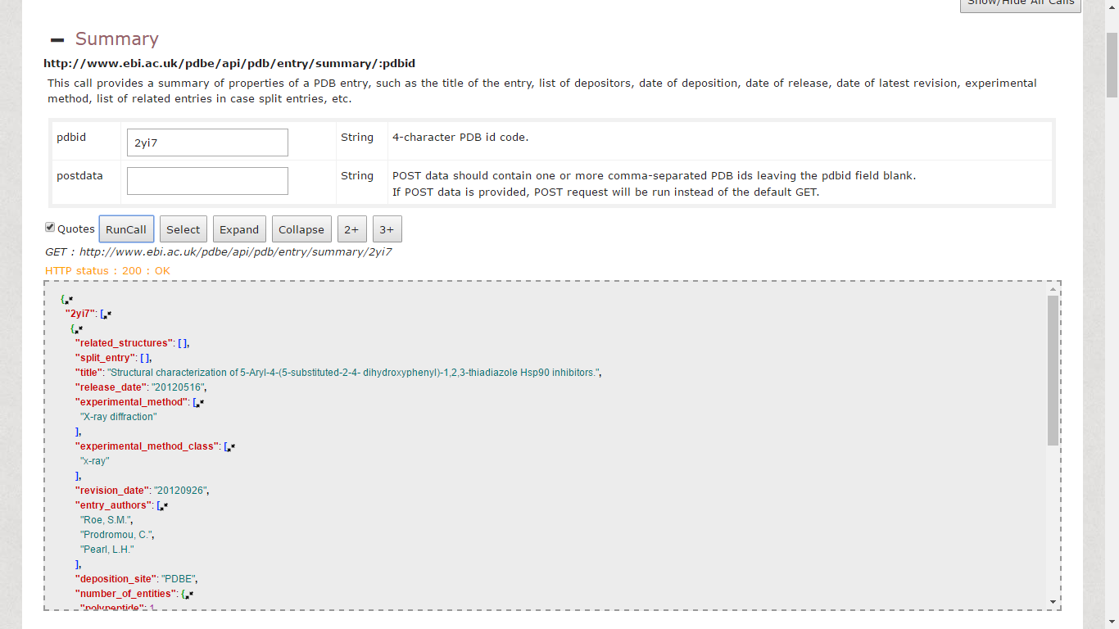
Documentation example
Enter PDB ID
Click ‘Run call’
PDBe.org/API

Slide 10
Documentation example
Returns you the URL for that API call
PDBe.org/API

Slide 11
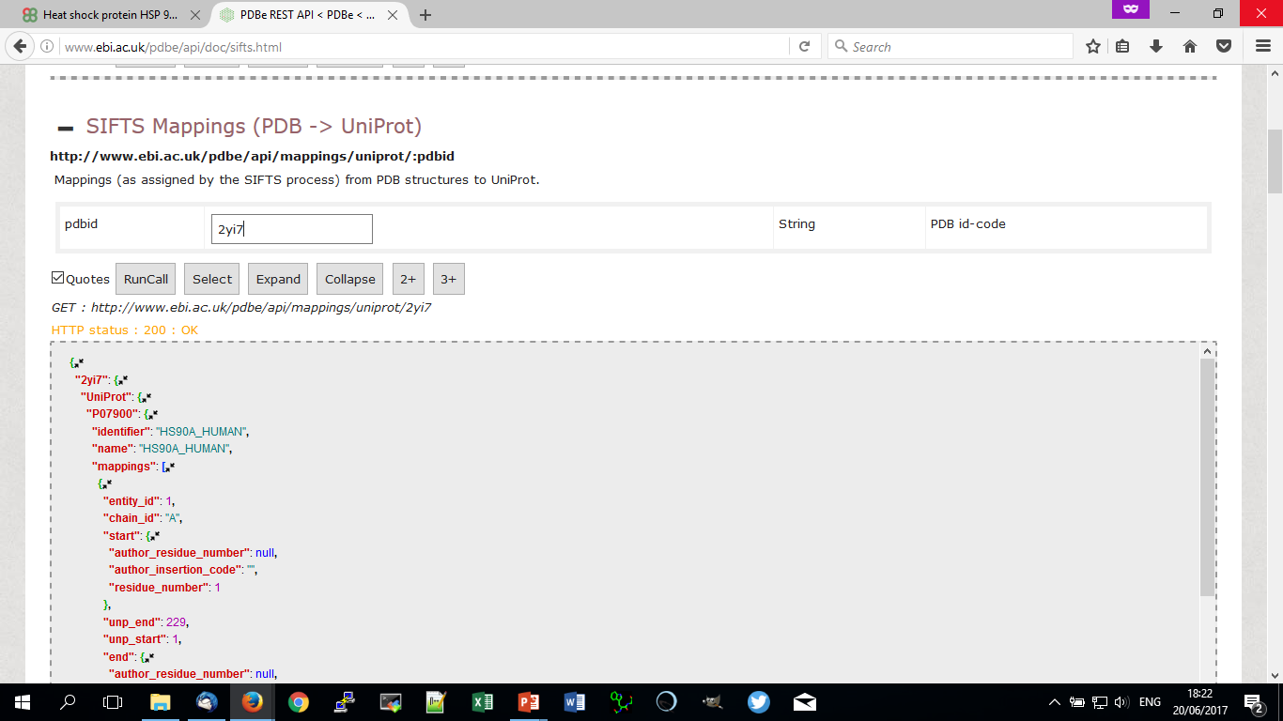
Website example – UniProt mappings
PDBe.org/API

Slide 12
Website example – UniProt mappings
PDBe.org/API

Slide 13
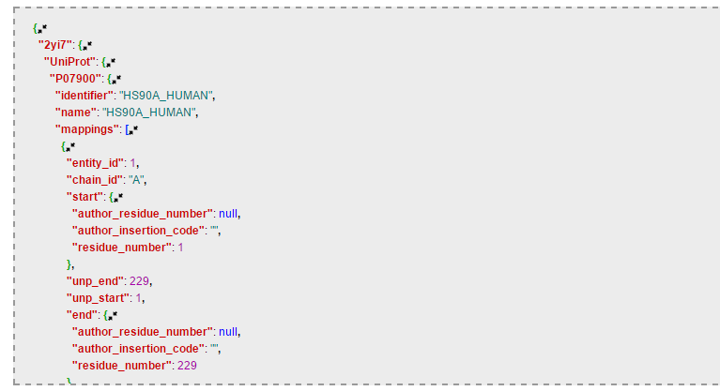
Website example – UniProt mappings
Results given as JSON
PDB ID top level
Mapping type
Mapping ID
Further description
Range covered by mapping
PDBe.org/API
Notes:
Further description includes mapping section. Within this…
Range covered by the mapping – from the PDB sequence range to Uniprot range

Slide 14
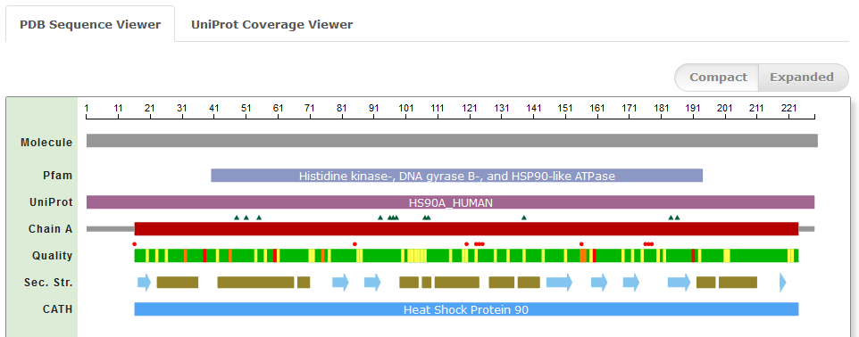
Showing sequence annotations
Component for displaying sequence annotation
Uses API to get this information
PDBe.org/API

Slide 15
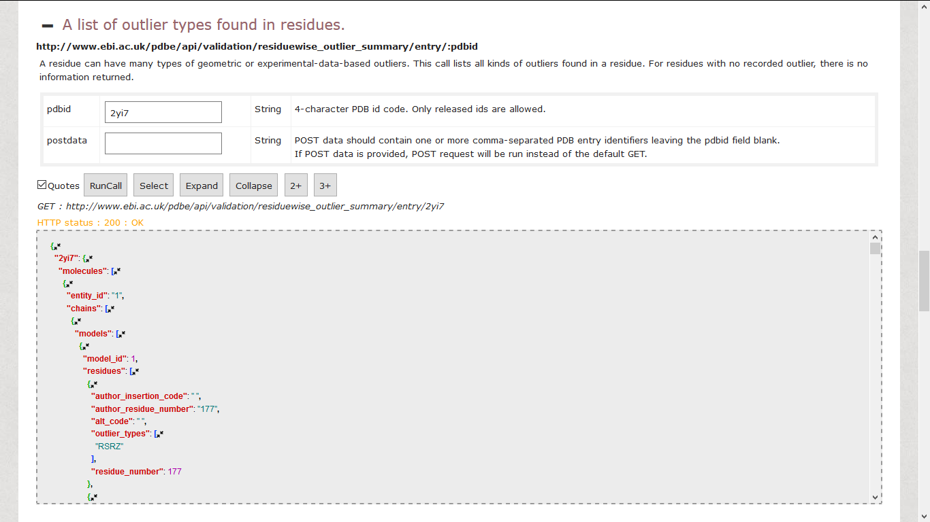
Finding validation information for PDB entry
PDBe.org/API
Notes:
Another example…
Can use the API to get validation metrics for an entry
This example describes outliers for specific residues in entry
*Click for URL expand*

Slide 16
Finding validation information for PDB entry
PDBe.org/API
Notes:
Again, URL contains info about the call – part of the validation grouping

Slide 17
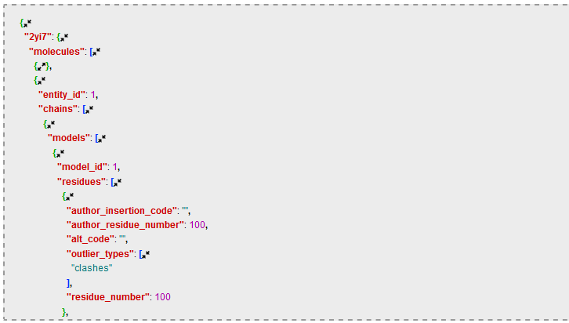
Finding validation information for PDB entry
Results given as JSON
PDB ID top level
Results listed by entity
Further listed by individual chain
Models required for NMR entries
Each residue with outliers
The list of outliers
PDBe.org/API
Notes:
Results for that specific call.
Entity, i.e. distinct macromolecules in entry
Chain – because may be multiple copies of each macromolecule
Models need to be accounted for
List of each residue containing an outlier
List of outliers for that specific residue

Slide 18
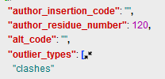
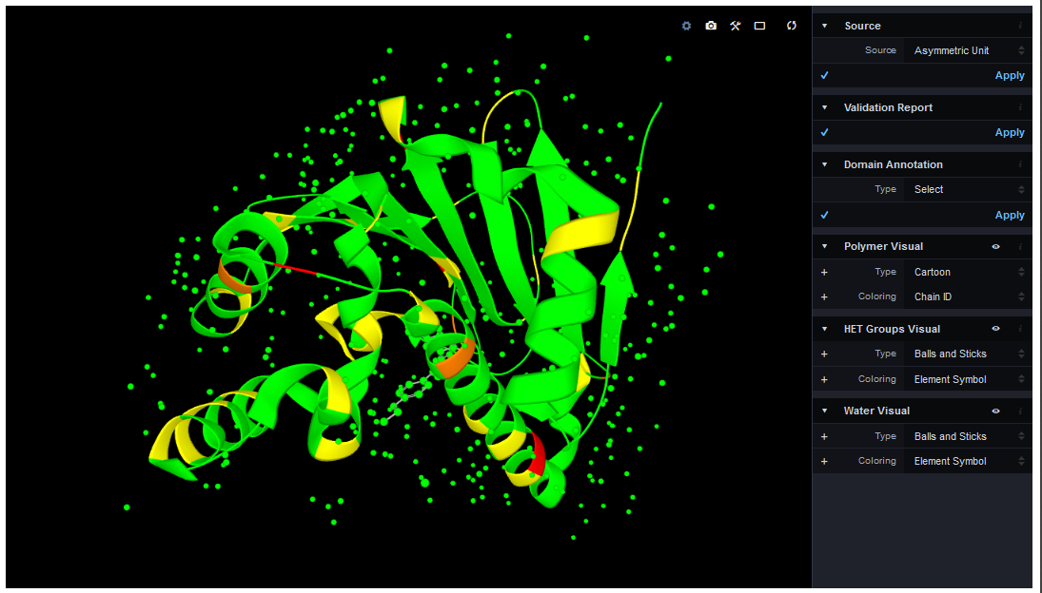
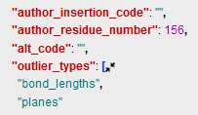
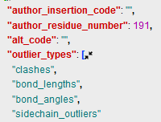
LiteMol – Powered by PDBe API
Uses API to get structure and annotation data
Including residue-level validation information
PDBe.org/API
Notes:
An example of how we use this validation information is LiteMol…
API results on the right show how we get the colours
Yellow has single outlier type
Orange has two outlier types
Red has 3 or more
This is then displayed on the structure to indicate validation issues

Slide 19
Hands-on part!
https://github.com/uniprot-pdbe/eccb2018/

