Slide 2
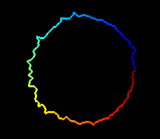
Definition of coordinate system
90
360
180
0
0
270

Slide 3
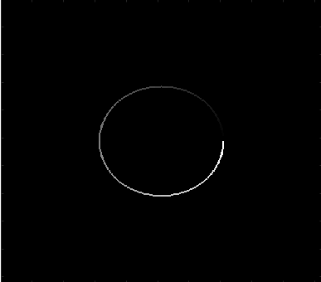
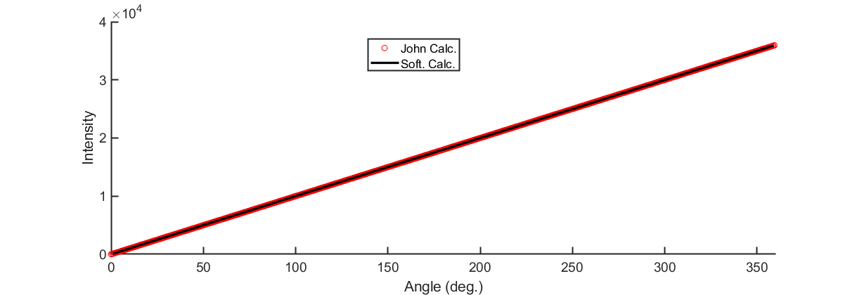

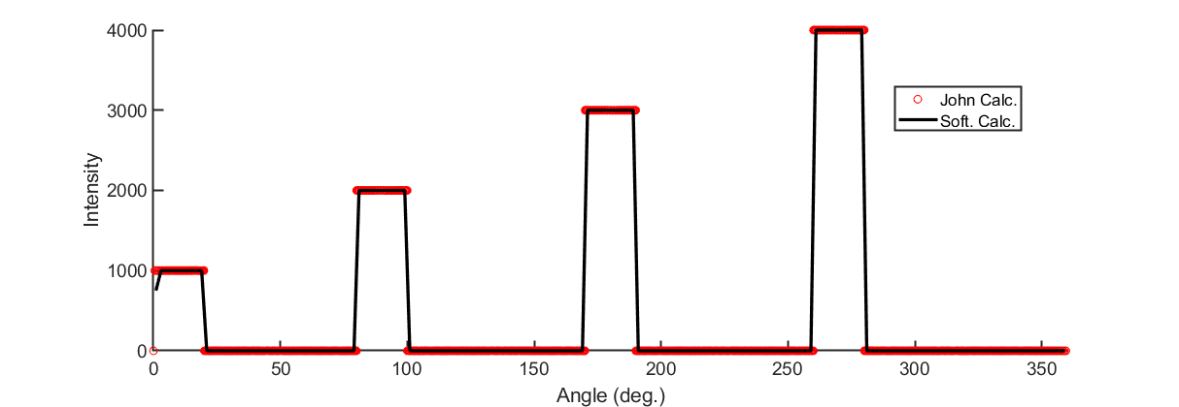
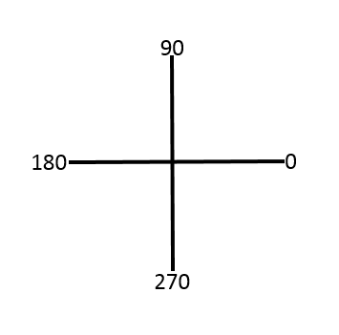
Some simulations to make sure program worked:
35942
0
4000
0

Slide 4
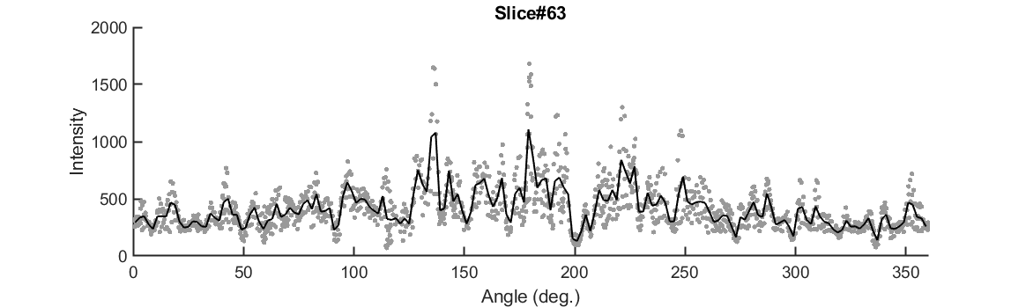
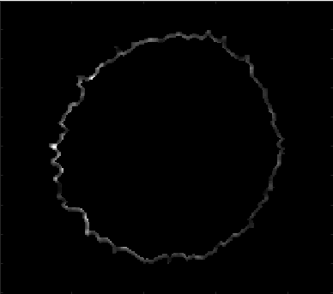
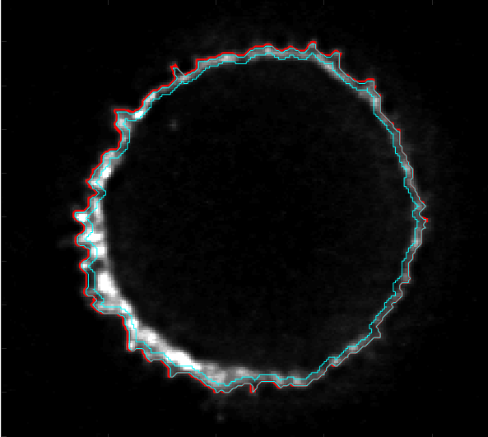
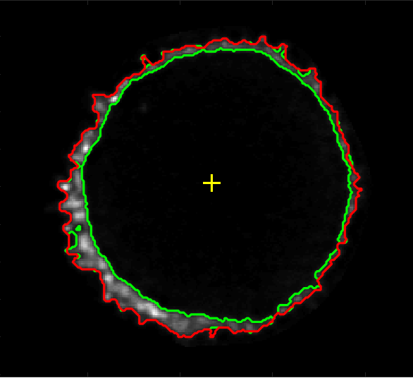
I looked at slices in the middle of the cell from “1005_high_MYC_A488_CD45_A594_OKT3_A647_21_ch0_stack0000_642nm”.
Raw Data
Average
Edge of cell used in calc.
Erosion of Segm. Boundary
Segmentation
1681
0

Slide 5
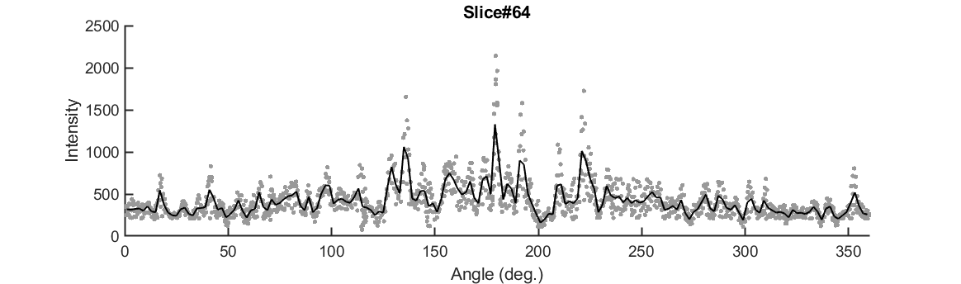
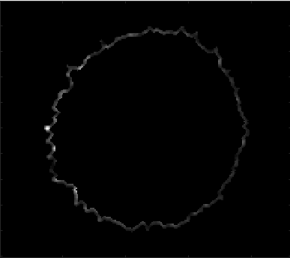
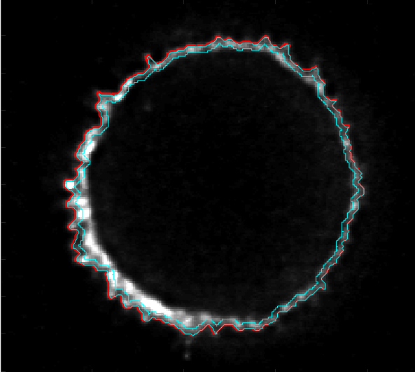
I looked at slices in the middle of the cell from “1005_high_MYC_A488_CD45_A594_OKT3_A647_21_ch0_stack0000_642nm”.
Raw Data
Average
2140
0

Slide 6
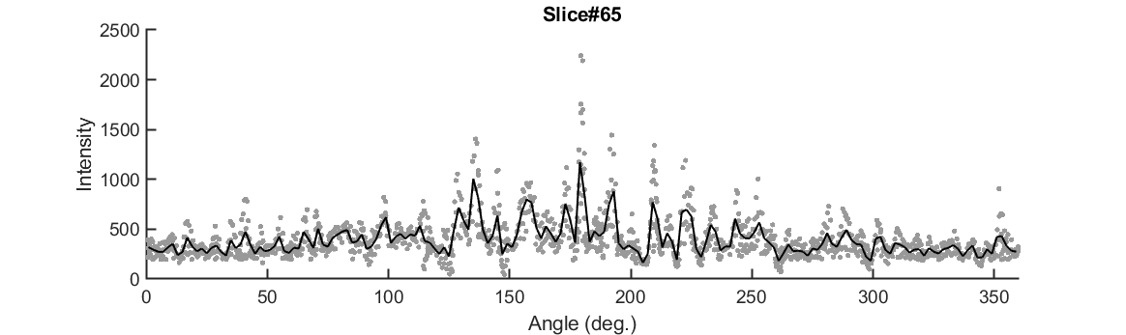
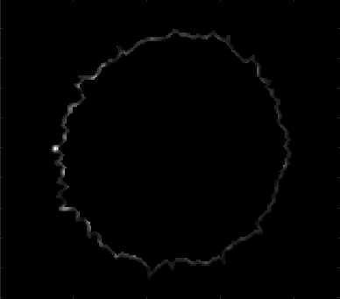
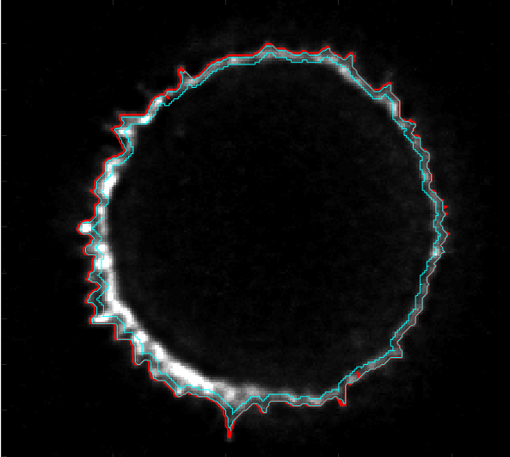
I looked at slices in the middle of the cell from “1005_high_MYC_A488_CD45_A594_OKT3_A647_21_ch0_stack0000_642nm”.
Raw Data
Average
2241
0

Slide 7
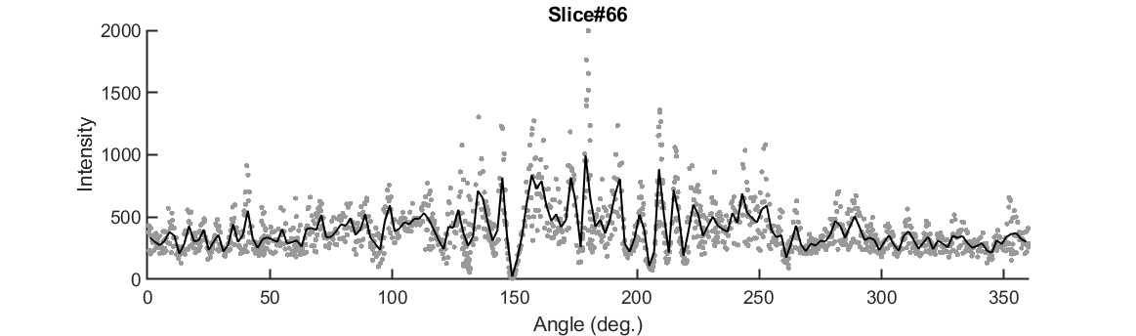
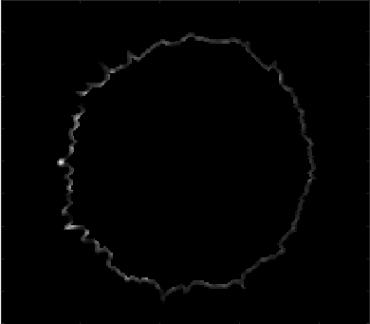
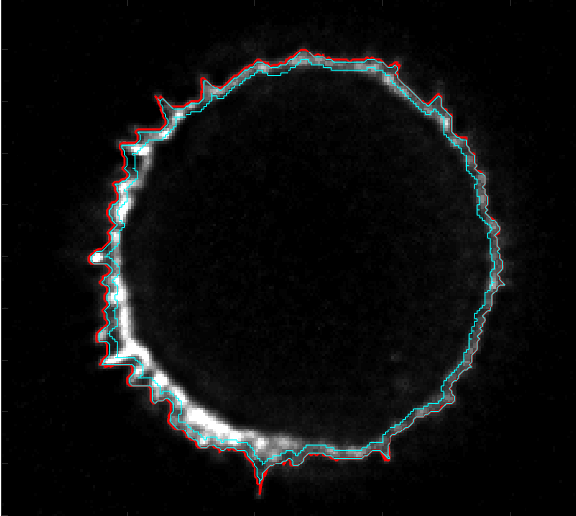
I looked at slices in the middle of the cell from “1005_high_MYC_A488_CD45_A594_OKT3_A647_21_ch0_stack0000_642nm”.
Raw Data
Average
1996
0

Slide 8
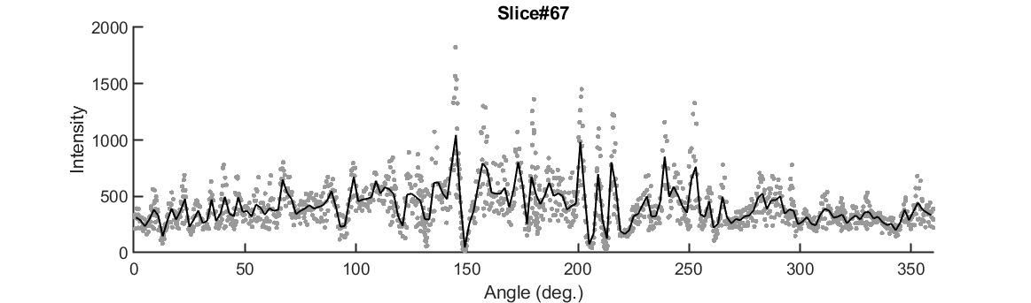
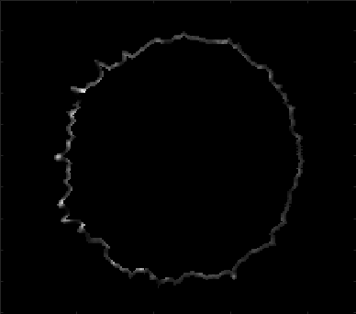
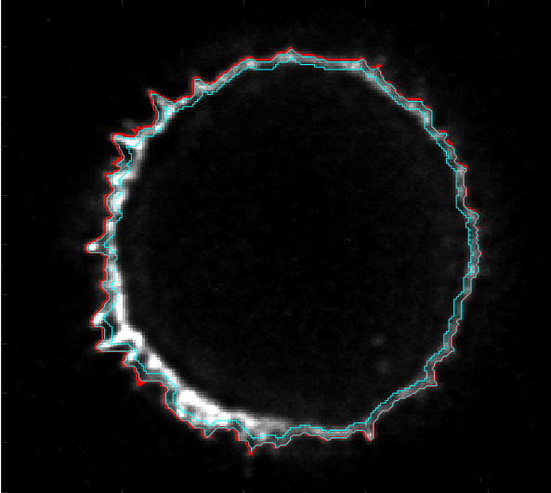
I looked at slices in the middle of the cell from “1005_high_MYC_A488_CD45_A594_OKT3_A647_21_ch0_stack0000_642nm”.
Raw Data
Average
1824
0

Slide 9
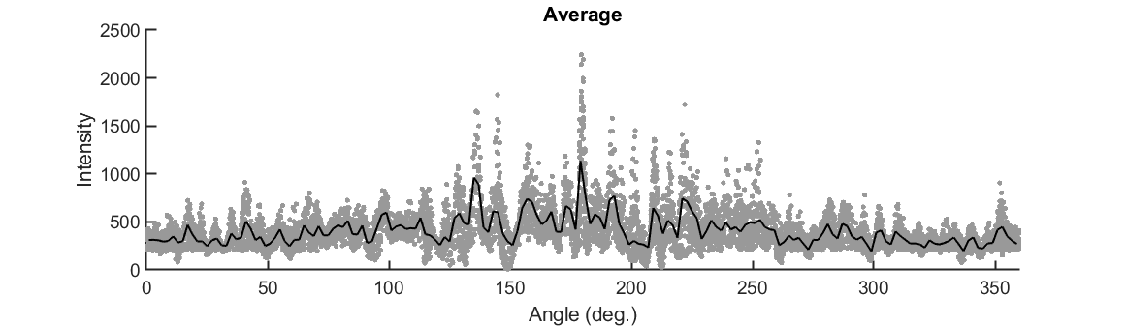
I looked at slices in the middle of the cell from “1005_high_MYC_A488_CD45_A594_OKT3_A647_21_ch0_stack0000_642nm”.
This is the average of slices 63-67.
Raw Data
Average

Slide 11
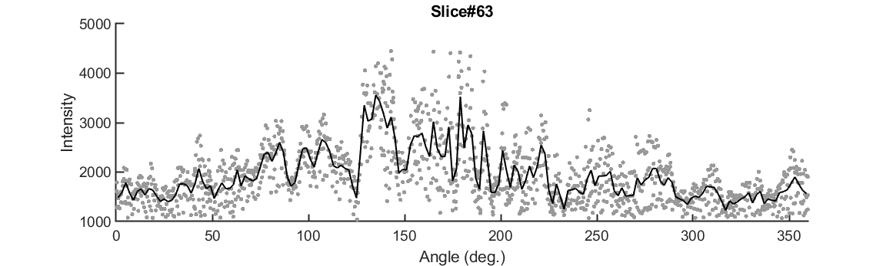
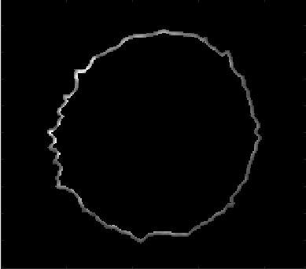
I looked at slices in the middle of the cell from “1005_high_MYC_A488_CD45_A594_OKT3_A647_21_ch1_stack0000_560nm”.
Raw Data
Average
4446
0

Slide 12
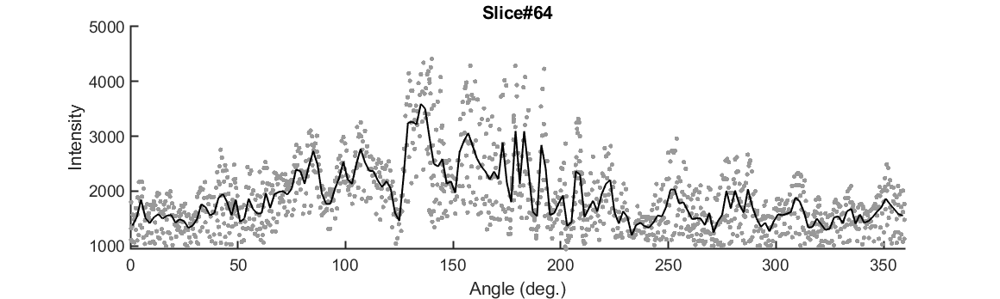
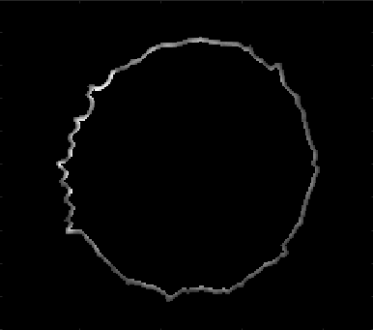
I looked at slices in the middle of the cell from “1005_high_MYC_A488_CD45_A594_OKT3_A647_21_ch1_stack0000_560nm”.
Raw Data
Average
4414
0

Slide 13
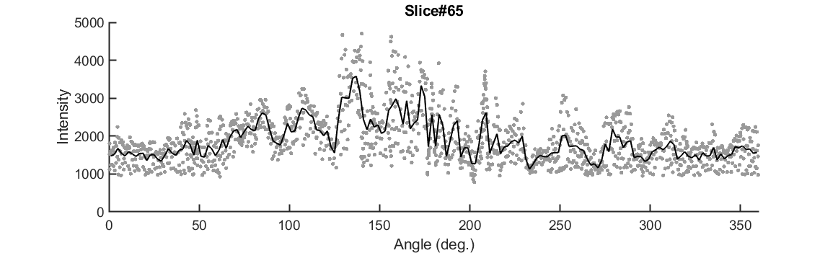
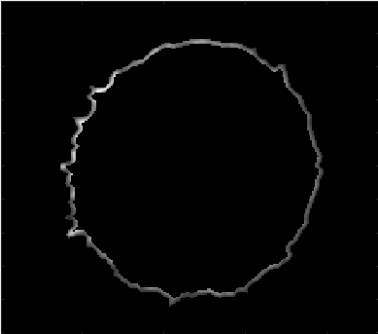
I looked at slices in the middle of the cell from “1005_high_MYC_A488_CD45_A594_OKT3_A647_21_ch1_stack0000_560nm”.
Raw Data
Average
4702
0

Slide 14
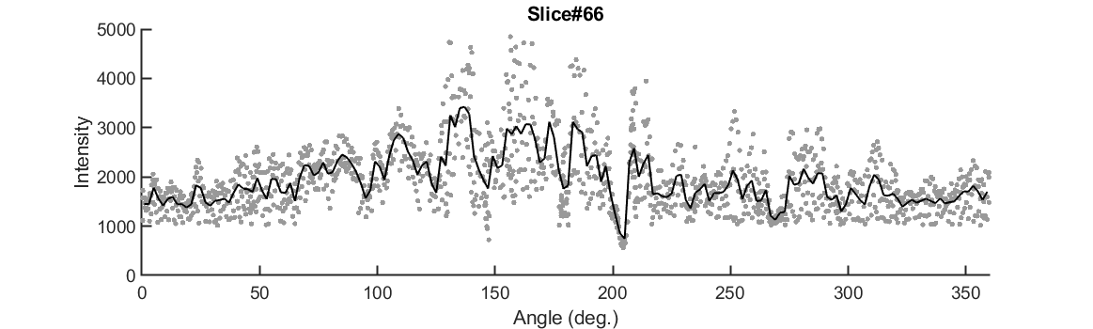

I looked at slices in the middle of the cell from “1005_high_MYC_A488_CD45_A594_OKT3_A647_21_ch1_stack0000_560nm”.
Raw Data
Average
4846
0

Slide 15
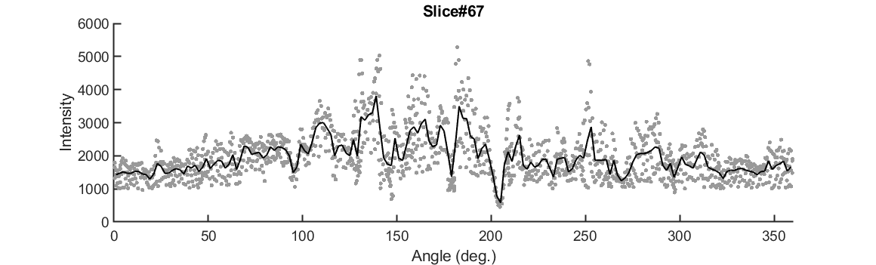

I looked at slices in the middle of the cell from “1005_high_MYC_A488_CD45_A594_OKT3_A647_21_ch1_stack0000_560nm”.
Raw Data
Average
5280
0

Slide 16
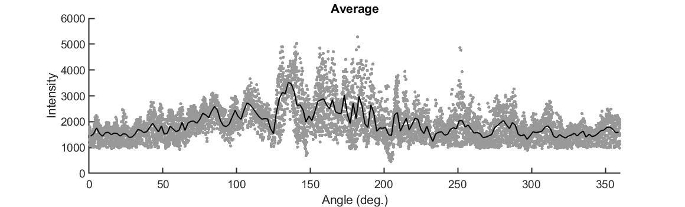
I looked at slices in the middle of the cell from “1005_high_MYC_A488_CD45_A594_OKT3_A647_21_ch1_stack0000_560nm”.
This is the average of slices 63-67.
Raw Data
Average

