Slide 1



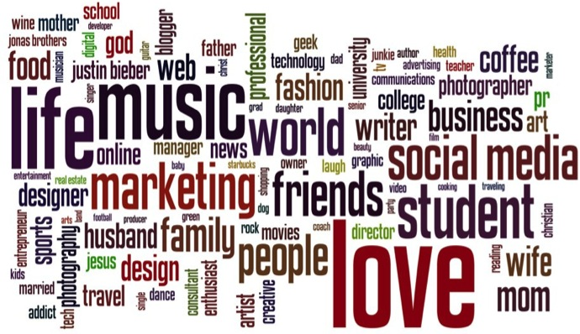
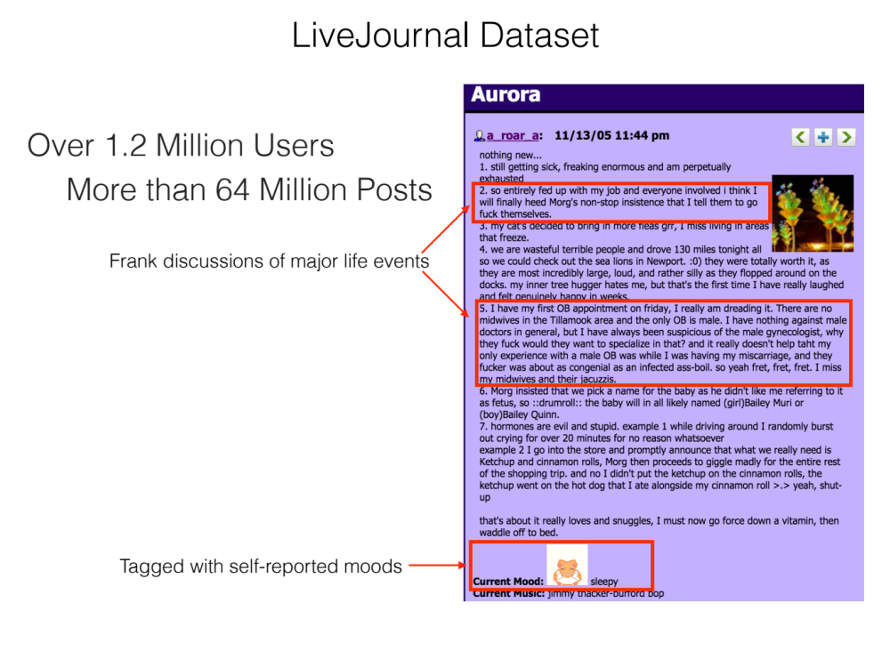
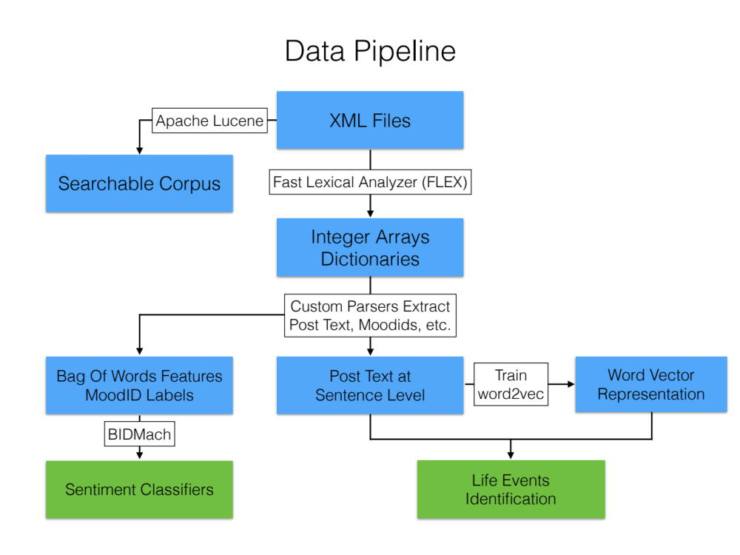

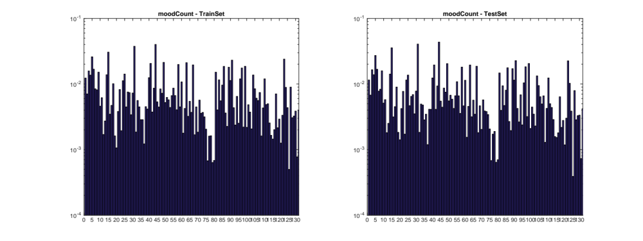
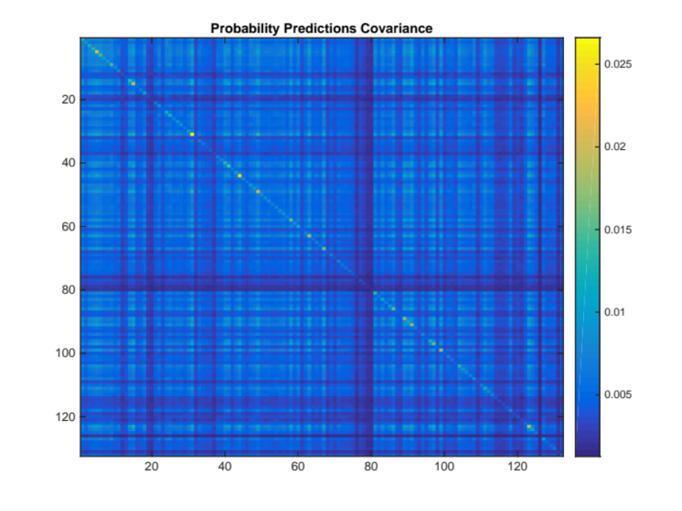
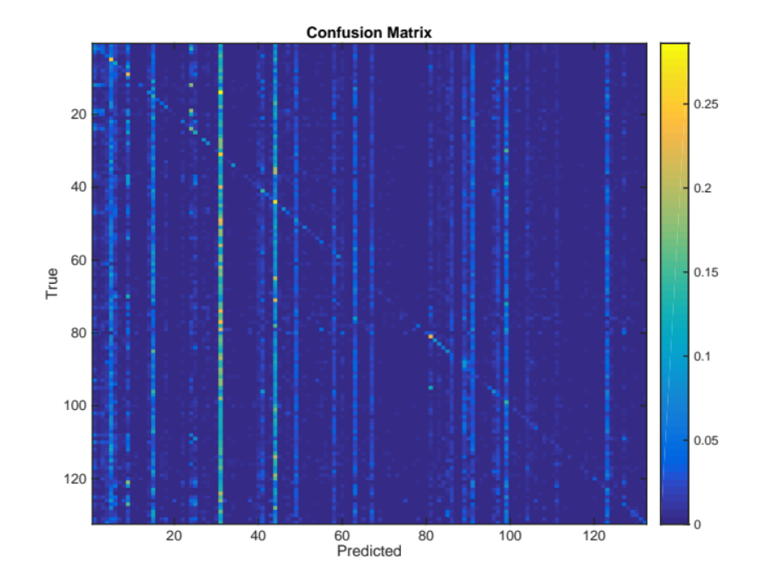
Berkeley Institute of Design
DeStress Mining Stress Meaning from Social Media
Main Objective
Identify causes, interventions and archetypes for stress and well being
Work in Progress
Succesful word2vec semantic querying for advanced featurization
Re-training classifiers with post-level randomization
Future Work
PCA reduction to 6 universal emotions (discrete emotion classification) → ICA reduction to 2 fundamental dimensions (dimensional emotion classification)
Mechanical Turk automated query result selection for LiveJournal word2vec
Causal inference between Life Events Questionnaire (LEQ) features and stress/mood labels
Data Wrangling
Post data:
Colloquial, incomplete, cryptic, misspelled, personal/anonymous
Labeling
50% of posts tagged by users with a mood tag
Labels: 132 moodID number representing emotions such as: “happy, “cranky”, “frustrated”, etc.
Features: Bag of words of each post
Classifier: Logistic Regression with L1 regularization
BIDMach: CPU and GPU-accelerated Machine Learning Library
Results: 60% mean Area Under the Curve
Conclusion: Hard task:
i) Too many moodIDs (several are synonyms – not orthogonal);
ii) Post content is very noisy (html, misspellings, slang, etc.)
Potential Solution: Dimensionality reduction (PCA/ICA) & better features (word2vec)
Advanced Featurization
Theory: Life Events Questionnaire (LEQ): Clinical tool with 79 questions about chronic and acute (positive and negative) stress events.
Challenge: Discover LEQ content within post data (colloquial).
Learning Model: Word2Vec - Semantic word representation into vectors vec(“king”) – vec(“man”) + vec(“woman”) = “Queen”
Model 1: Google News corpus - 300 dimensional
- Reordered vector to match our dictionary → word2vec * dictionary
- Two iterations: 1) Single Word/Phrase → 2) Handpicked Phrases
Model 2: Custom model trained on LiveJournal dataset + user IDs
- Gensim / 300-dimensional / typos, colloquialisms, etc.
- Add user IDs every 3 words → different semantics per user
1st Iteration – Single word/phrase
scala> query("illness", 5)
0.705 -- and attempting to sleep of illness .
0.683 -- did you suffer illness or injury ?
0.680 -- sickness !
0.670 -- they may fake terminal illness , pregnancy , or disease .
0.652 -- my mother who fell ill to a mental illness twice .
2nd Iteration – Handpicked Phrases
scala> multi_query(illness_queries, 7, true, 2)
0.632 -- my father was diagnosed with cancer in early june lung cancer that has spread to the bones .
0.628 -- my mom is in the hospital with a kidney infection .
0.628 -- my brother is sick with bronchitis .
0.625 -- i went to the doctors , and i ended up having double ear infections and really bad strep throat .
0.623 -- he passed away last thursday due to complications with bronchitis in connection to a rare lung disease .
Team: Pablo Paredes, Cory Schilaci, Ana Ferreira, Gene Yoo, Pierre Karaschuk, Dennis Xing, In collaboration with: Daniel Seita, Prof. John Canny BIDS Facilitators: Dav Clark, Anthony Wai

