Slide 1

SAVE SIESTOOL

Slide 2
Team Members & Skill Sets
Proxima DasMohapatra: Data analysis and visualization with Python

Slide 3
Real World Challenge
Berkeley Seismology Lab uses seistool to visualize and analyse earthquake data measured by seismometers.
Seistool was developed in early 90’s using languages like C and FORTRAN.
This tool currently can work only on selected workstations, mostly Solaris.
Seistool is indispensable to BSL for data analysis and seismometer re-calibration.
In the near future, this tool might not work on any system.

Slide 4
Challenge Restatement
Re-build seistool as a web based application to enable visualization and analysis of earthquake data.
Use bokeh to provide interactive visualization for large data sets without significant delay in rendering graphs.

Slide 5
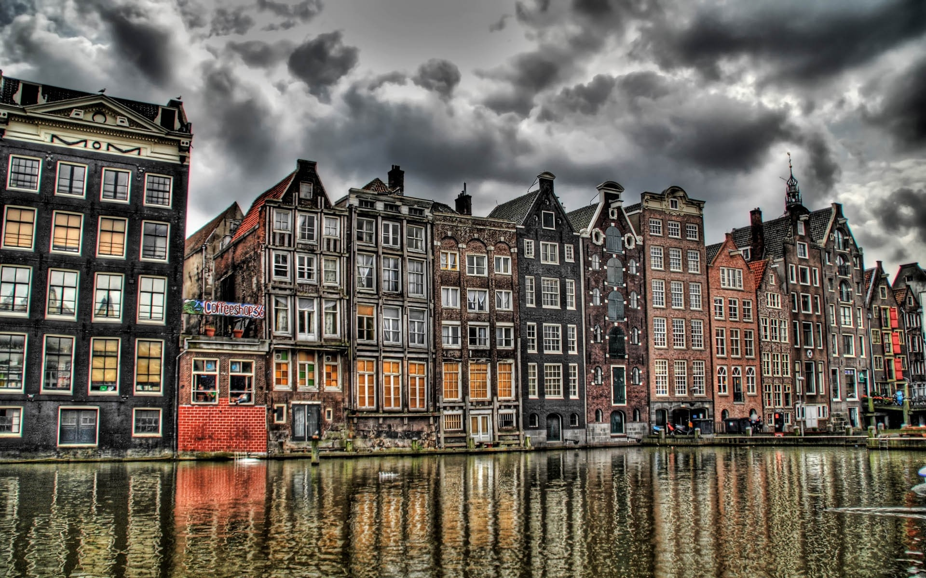
Data / Materials
Standard for Exchange of Earthquake Data (SEED) is a data format intended primarily for the archival and exchange of seismological time series data and related metadata.
MiniSEED is the subset of SEED standard that is used for time series data.
Format specific to the seismic community.

Slide 6
Tools Used
ObsPy: An open-source project dedicated to provide a Python framework for processing seismological data.
Bokeh: A Python interactive visualization library that targets modern web browsers for presentation.
Ipython notebook: An interactive computational environment used as a platform for reproducible research.

Slide 7
Web tool demonstration

Slide 8
Challenges
Bokeh framework has limited documentation.
Custom JavaScript callbacks for interactive visualization can be challenging.
Using JavaScript to process large time series data isn’t efficient.

Slide 9
Lessons Learnt
Porting scientific applications to web platforms is challenging – yet necessary.
There is a need for high level libraries for visualization of scientific data.
The tool is far from complete but serves as a proof of concept.

Slide 10
Future Research
Deploying the application to bokeh server
Add advanced functionality for time series analysis

Slide 11

♉♉♉
THANK YOU

