Slide 1
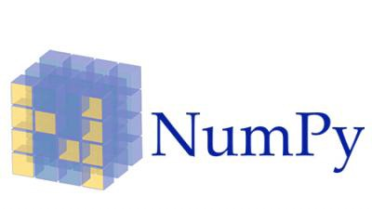

Inside NumPy: preparing for the next decade
Matti Picus, Ralf Gommers, Sebastian Berg, Tyler Reddy, Stéfan van der Walt, Charles Harris
Adapted from a talk at SciPyUSA 2019 https://www.youtube.com/watch?v=dBTJD_FDVjU
Notes:
Abstract:
Over the past year, and for the first time since its creation, NumPy has been operating with dedicated funding. NumPy developers think it has invigorated the project and its community. But is that true, and how can we know?
We will give an overview of the actions we've taken, both successful and unsuccessful, to improve sustainability of the NumPy project and its community. We will draw some lessons from a first year of grant-funded activity, discuss key obstacles faced, attempt to quantify what we need to operate sustainably, and present a vision for the project and how we plan to realize it.

Slide 2
A very brief history of NumPy: an incredibly mature codebase!
1994: Early Matrix object (Jim Fulton)
1995: Numeric (James Huginin, …)
2003: NumArray split off (team at STScl)
2005: NumPy created from Numeric and Numarray (Travis Oliphant)
2006: NumPy 1.0
…….: 1-2 releases every year, gradual progress, transition from SVN to git and GitHub
2015: governance and NumFOCUS relationship formalized
2018: first-ever directly paid developers hired
Notes:
Many people may not know NumPy was volunteer-only till a year ago. Give the 1 min history.

Slide 3



The Sloan & Moore grants to BIDS for NumPy
Two grants for in total $1.3M, Apr 2018 — Oct 2020
Current co-PIs: Stéfan van der Walt and Fernando Perez
Social aims: Improve community engagement Grow core team, Diversify contributors
Technical aims: More flexible & sustainable code, Frequent & consistent releases, Improve data type system, New array protocol

Slide 4
So who did we hire?
Two-three full-time engineers, ongoing (till Oct 2020 at least):
Mar 2018 - ? : Matti Picus (PyPy team member)
Jun 2018 - Jun 2019: Tyler Reddy (SciPy team member)
May 2019 - ? : Sebastian Berg (NumPy Steering Council member)
August 2019 - ? : Warren Weckesser (SciPy team member)
Additionally:
Supporting Kriti Singh through Outreachy (docs work)
Participating in GSOD and growing a web/doc team
Notes:
Matti already had quite a bit of knowledge of NumPy internals.
It was hard at the beginning getting enough input, with two people new to the project. Can still be a challenge. Calls helped a little, but few people showed up.

Slide 5
An organizational view of the project
Fiscal sponsor
Institutional Partners
NumFOCUS
BIDS
people
Quansight
people
Steering Council
Core developers
Contributors
Websites
Repositories
Code
Documentation
people
The NumPy project
your org?
Notes:
The interesting bit about the grant is that there’s no direct/formal link with NumPy itself. The grant was for BIDS; BIDS hires people; those individuals contribute to NumPy. Even Stefan, who is now PI, has the relationship with the funder as a Berkeley employee, not as a NumPy Steering Council member. Does it matter? (so far it didn’t, probably)

Slide 6
Key questions we’ll try to answer in this talk
Has grant funding over the last year invigorated the NumPy project?
How healthy/sustainable is NumPy today?
What does NumPy need in order to thrive?
What’s our vision for NumPy, and what is our plan to achieve that vision?
Notes:
To be answered later, not here:
invigorated: yes (we believe)
healthy: better than a year ago, still not great. bus factor 4 or so.
what does NumPy need to thrive: it does need funding, ~10 FTE or so. And a vision. And diversify project roles (e.g. docs, website, packaging/build, someone to build connections and improve interoperability with other projects and downstream).
our vision: see final slides

Slide 7
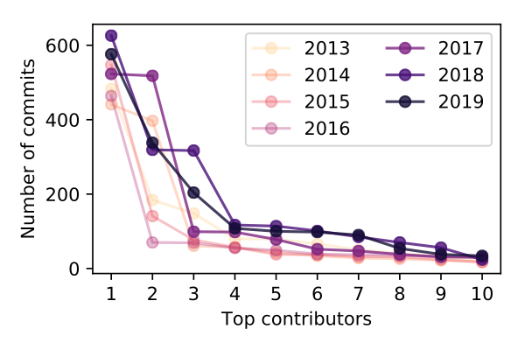
Impact of grant funding — an attempt to quantify
Heavier-tailed distributions in 2018-19: bus factor increased.
Fernando Perez, Ten years of (interactive) scientific computing
Notes:
This is a method that has been used before. A heavier-tailed distribution is considered healthier; bus factor is lower. 2018-19 are indeed heavier-tailed (see also next slide). makes sense, because we added two new devs that became productive. but that wasn’t a given beforehand; it could have reduced activity from volunteers.

Slide 8
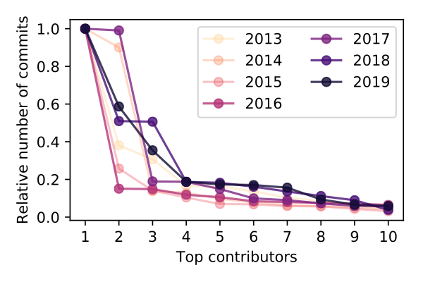
Impact of grant funding — an attempt to quantify
Heavier-tailed distributions in 2018-19: bus factor increased.
Fernando Perez, Ten years of (interactive) scientific computing
Notes:
This is a method that has been used before. A heavier-tailed distribution is considered healthier; bus factor is lower. 2018-19 are indeed heavier-tailed (see also next slide). makes sense, because we added two new devs that became productive. but that wasn’t a given beforehand; it could have reduced activity from volunteers.

Slide 9
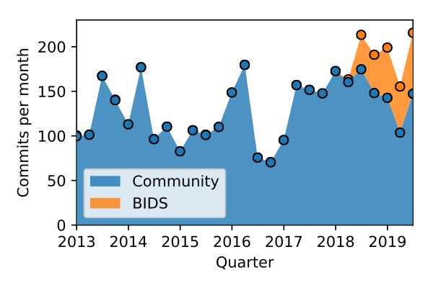
Impact of grant funding — an attempt to quantify
Volunteer contributions relatively stable; total activity up.
Notes:
Relative impact of 2 full-time people compared to volunteer base: ~25%, and fairly stable. This figure may underestimate the impact:
That extra bandwidth did give us the ability to integrate some larger contributions, e.g. numpy.random, that otherwise may not have to be possible.

Slide 10
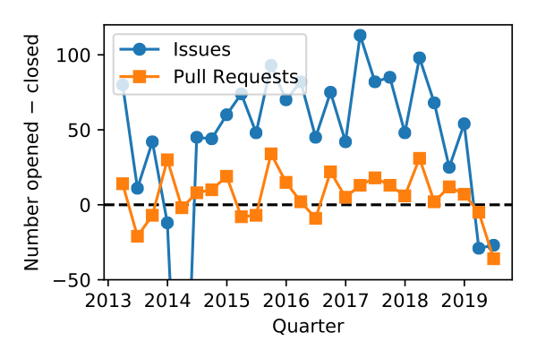
Impact of grant funding — an attempt to quantify
Issue/PR count rate of change is key indicator of project health.
Nadia Eghbal, Methodologies for measuring project health

Slide 11
Impact of grant funding — qualitative
We now have a roadmap
We’ve been able to organize core team sprints about every two months with around 5-10 participants
NumPy Enhancement Proposal process revived:matmul, random, __array_function__ protocol, and more
We paid down a decent amount of technical debt around CI, esoteric platforms, open issues and Prs
The 1.17.0 release is the largest release since 1.7.0 in 2013.
Planning the Array Developer Summit for next March for all tensor/array-like projects
Notes:
The roadmap is super valuable. Face-to-face meetings help a lot.
Giving new hires commit rights was the right choice.
Fft, random and __array_function__ (the 3 main features) came from non-paid people. What did help was the extra bandwidth of Matti to help integrate and review.

Slide 12
Has grant funding over the last year invigorated the NumPy project?
Yes, we think so.
Faster progress and more hands for maintenance also makes it more fun, more bandwidth for outreach and education.
The package’s popularity enables it to engage with top-of-the field domain experts
Notes:
Yes, we do think so.
For me personally, I used to spend much more time on SciPy, now I probably spend more time on NumPy. That’s partly because it’s necessary, but also because it is a bit more fun - not _only_ working on technical debt and urgent issues.

Slide 13
How healthy/sustainable is NumPy today?
More healthy than a year ago.
Still a worry though. Bus factor estimate: 5-7
Parts of the code base still lag: financial, polynomial, ... After the dtype system is revamped we should revisit the handling of not-available values and MaskedArrays
Successfully straddling the worlds of academia and industry with sponsors/contributors from both.
Notes:
Yes, we do think so.
For me personally, I used to spend much more time on SciPy, now I probably spend more time on NumPy. That’s partly because it’s necessary, but also because it is a bit more fun - not _only_ working on technical debt and urgent issues.

Slide 14

Funding
Notes:
Funding is a very complicated subject. Most projects mainly think about obtaining funding, but how to use funding as well as planning for when the funding stream ends (i.e. planning for sustainability) are equally important. Plus there are social issues to think about - what is the effect on your project culture and volunteer contributors?

Slide 15
Funding — what to pay for?
Pay for things that are important and otherwise won't get done.
Think broadly. There's more to a project than code!
Balance maintenance & innovation: keep people motivated!
Plan for sustainability. Don't start depending on funding unless you’re fairly certain it’s stable.
Make the life of volunteer maintainers easier, not harder!
Notes:
Pay for things …: this often means doing the boring tasks.
Think broadly: websites, docs, community building, governance - it's all important.
Plan for sustainability: NumPy did not quite get this right yet. Nor did most other projects.
Life of volunteer maintainers: in your plan, include paid time for others to review your work, or create bandwidth for others to do that by taking over some of their tasks. Do not just increase the load on volunteer maintainers.

Slide 16
Funding — who to pay?
All else being equal, give preference to existing maintainers.
Pay attention to communication and self-management skills, in addition to technical skills and motivation.
Consider this an opportunity to make your project more diverse.
Notes:
Existing maintainers: should be obvious
Communication and self-management: more important than in a regular job. You’re dealing with a complex community and set of stakeholders.
Diversity: both the demographics of your project, and the roles in your project. NumPy tried Outreachy once, not much else - this is not a success yet. Aiming to improve this the coming months.

Slide 17
Challenges

Slide 18
Sustainability — maintainer bandwidth
Of the 11 Steering Council members:
3 are very active (Chuck, Eric, Stephan)
3 are paid to work on NumPy (Sebastian full-time, Stéfan & Ralf a small part of their time (~1 day/wk))
5 are in low-activity mode (infrequent emails/commits)
This is still a major challenge! NumPy depends both on a handful of people, and probably on continued funding.
Notes:
What if there are major changes needed, e.g. due to a change to the CPython C API? We can’t always rely on volunteers digging really deep …

Slide 19
The project beyond code
It’s still hard getting work done on:
High-level documentation
Website
Community building
Governance and project management
Long-term planning (both technical and organizational)
Notes:
Working on this for GSoD

Slide 20
Improving NumPy’s culture
We still struggle with a lack of diversity: all maintainers are white and male.
Our GitHub and mailing list culture is infrequently not as friendly and welcoming as we’d all like it to be.
Notes:
Often due to either time constraints (maintainers have lots to do in little time), or due to conflicting needs (NumPy is pretty fundamental).

Slide 21
Vision

Slide 22
Scope & Vision
The key thing NumPy offers is:
an array object (N-dimensional, in-memory, on CPUs)
and array computing APIs
and some utility routines like random numbers
NumPy lives at the heart of the numerical Python ecosystem. We want to:
evolve while remaining a stable base,
address bottlenecks that limit how the wider ecosystem can grow,
and grow and diversify our team and community.

Slide 23
What does NumPy need in order to thrive?
Sustained funding at a higher level than today.
More bandwidth from key people for long-term planning, managing the project
Attracting people in roles that primarily focus on activities other than coding
Also fund other key components in OSS data science: SciPy, Matplotlib, pandas, Scikit-learn, ...
Notes:
Now: 2.5 FTE. We made a dent, but there’s so much more to do. Need a full-time manager, a tech writer, half a web developer. What about missing data support, fuller-featured abstraction layers?
Diversify project roles: docs, website, packaging/build, building better connections and improve interoperability with other projects and downstream.

Slide 24

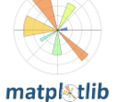



Parts of a plan to get there
In the next year, work with tech writers and web developers to start building a docs/web team. Efforts already ongoing.
Build a diverse and robust funding quilt: Express our needs as a community (not just NumPy), and ask funders and major users for contributions: Recently started (e.g. pitched to NASA), want to make this much more concrete.
Maintenance
Key Improvements
Notes:
GSoD, some BIDS funds, CZI, etc.
Mention funding BoF, and come talk to me.

Slide 25
How can you help?
Become a contributor to your favorite project (most of you already are)
Re-negotiate with your employer for time to work on your project
Encourage your employer or clients to engage with NumFocus or any of the other intiatives to fund Open Source

Slide 26
Thanks for listening.
Questions?

