Slide 1
/*
* DynamicProgrammingQ2_1.c
*
* MATLAB MEX interface for dynamic-programming alignment of two
* SRVF-represented functions or curves. Given Q1, T1, Q2, T2 and
* dynamic-programming grids tv1 and tv2, the routine computes an
* optimal monotone piecewise-linear reparameterization gamma that
* minimizes the integrated squared SRVF mismatch between Q1(t) and
* sqrt(gamma'(t)) Q2(gamma(t)), with an optional identity-deviation
* penalty controlled by lambda.
*
* Q1 is the normalized derivative-based representation of the atlas mean
* curve/profile at one fiber/voxel location; Q2 is the SRVF-like transformed subject
* profile
* MATLAB usage:
* [G, T, dist] = DynamicProgrammingQ2_1(Q1, T1, Q2, T2, tv1, tv2, lambda);
*
* Outputs:
* G the estimated warped coordinate
* T warping path grid points
* dist final dynamic-programming alignment cost
*/

Slide 2
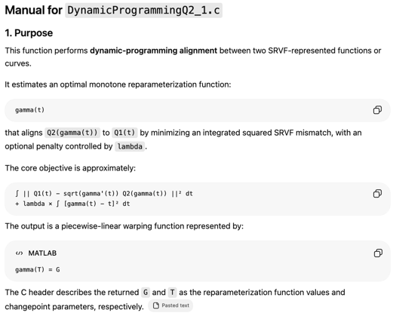

Slide 3
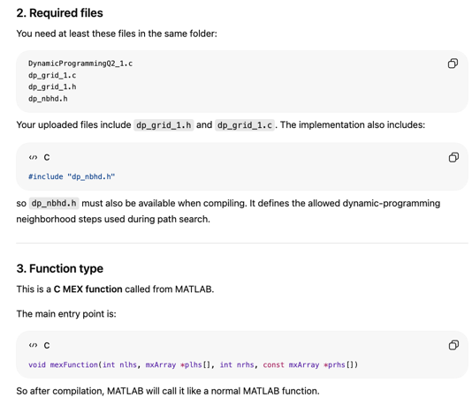

Slide 4
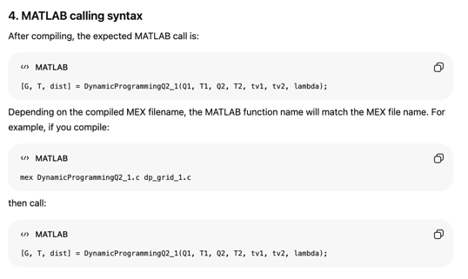

Slide 5
MATLAB example
%% Example: SRVF-based dynamic-programming alignment
clear; close all;
% Add folder containing DynamicProgrammingQ2_1 MEX file
addpath(genpath('../elastic'));
%% 1. Generate example raw profiles
TT = 101;
t = (1:TT) / TT; % same style as your production code
% Reference profile, for example atlas mean profile
f_mean = sin(2*pi*t)';
% Subject profile with nonlinear phase distortion
f_subject = 0.5*sin(2*pi*(t.^1.25))';
% Combine reference and subject profiles
% Column 1 = reference; column 2 = subject
f0 = [f_mean, f_subject];
%% 2. Compute SRVF-like representation
binsize = mean(diff(t));
% fy is the derivative along the profile/time direction
[~, fy] = gradient(f0, binsize, binsize);
% Square-root-slope / SRVF-like transform
q = fy ./ sqrt(abs(fy) + eps);
% Extract reference and subject q-functions
q1 = q(:,1)';
q2 = q(:,2)';
% Normalize q-functions as in your pipeline
q1 = q1 / norm(q1);
q2 = q2 / norm(q2);
%% 3. Set dynamic-programming grid and penalty
tv1 = t;
tv2 = t;
lambda = 0.01;
%% 4. Run dynamic-programming alignment
[G, T, dist] = DynamicProgrammingQ2_1(q1, t, q2, t, tv1, tv2, lambda);
%% 5. Interpolate and normalize gamma
gam0 = interp1(T, G, t, 'linear', 'extrap');
% Normalize gamma to [0, 1], following your production code
gam_f = (gam0 - gam0(1)) / (gam0(end) - gam0(1));
% Map normalized gamma back to the t range
t_warp = (t(end) - t(1)) .* gam_f + t(1);
%% 6. Apply gamma to the original subject profile
f_subject_aligned = interp1(t, f_subject, t_warp, 'linear', 'extrap')';
%% 7. Plot results
figure;
plot(t, f_mean, 'k-', 'LineWidth', 2); hold on;
plot(t, f_subject, 'b--', 'LineWidth', 1.5);
plot(t, f_subject_aligned, 'r-', 'LineWidth', 1.5);
xlabel('Profile coordinate');
ylabel('Signal');
legend('Reference profile', 'Original subject profile', 'Aligned subject profile');
title(sprintf('SRVF dynamic-programming alignment, cost = %.4f', dist));
figure;
plot(t, gam_f, 'r-', 'LineWidth', 1.5); hold on;
plot([0 1], [0 1], 'k--');
xlabel('t');
ylabel('\gamma(t)');
legend('Estimated gamma', 'Identity');
title('Estimated warping function');

