Slide 1
WORKFIT
01
WORKFIT
Work that fits around long-term care
A personal planning workspace
Healthcare Challenge 2
Tencent Cloud Hackathon Singapore 2026
WorkFit / Healthcare Challenge 2

Slide 2
WORKFIT
02
THE EVERYDAY CONFLICT
Care takes time. Work pays the bills.
A person managing long-term care may also need flexible paid work.
Appointments, travel and recovery compete with changing shift offers.
WorkFit checks which combination fits the time and income constraints the person confirms.
WorkFit / Healthcare Challenge 2

Slide 3
WORKFIT
03
A CONCRETE WEEK
SGD 270 within a 20-hour limit
Synthetic demonstration, not a patient record
Three six-hour shifts at SGD 90 each meet the target.
A reserved care window excludes conflicting offers.
If one chosen offer disappears, the remaining SGD 180 leaves a SGD 90 gap.
WorkFit / Healthcare Challenge 2

Slide 4
WORKFIT
04
THE PRODUCT WORKFLOW
A plan that responds to change
Review shift details and their source text.
Reserve time, including travel and personal buffer.
Confirm income, hours and rest limits.
Compare feasible schedules and select a proposal.
Record the response. Recheck when circumstances change.
WorkFit / Healthcare Challenge 2

Slide 5
WORKFIT
05
ARCHITECTURE
Local data with a checked planning core
Cloudflare hosting
Browser workspace
Files →
Serves the browser application
Profiles, offers and reserved time
Inputs ↓
Checked planning core
Local saved state
Validated plan →
Overlap, hours, rest and income
Proposals, responses and backups
WorkFit / Healthcare Challenge 2

Slide 6
WORKFIT
06
AGENT BOUNDARY
Language helps with input. Rules check the plan.
Earlier local prototype: model-assisted draft extraction with source quotes and user review.
Public build: explicit-format import and deterministic schedule search.
Proposed cloud extension: structured extraction, validation and user confirmation before changing a saved week.
No automatic medical advice, employer agreement or patient contact.
WorkFit / Healthcare Challenge 2

Slide 7
WORKFIT
07
EVIDENCE AND VALUE
Less recomputation when the week changes
Implemented: feasible combinations, income shortfalls and invalidation of outdated proposals.
Verified: profile separation, stale edit rejection, backup validation and the browser workflow.
ChatGPT with equivalent tools can reproduce these calculations. The product packages them into a persistent workflow.
Patient time savings and clinical benefit still need user testing.
WorkFit / Healthcare Challenge 2

Slide 8
WORKFIT
08
BUILD REFLECTION
WorkBuddy experts and cloud connections
Experts provide a starting point for frontend, website and deployment work.
The built-in CloudBase connector can connect Tencent Cloud services and assist deployment after authorization.
The supplied conversation shows project inspection and hosting guidance. It does not establish a completed Tencent Cloud deployment.
Current WorkFit hosting: Cloudflare.
WorkFit / Healthcare Challenge 2

Slide 9
WORKFIT
09
TRY WORKFIT
A week with room for care
Live app
https://workfit.jp2019213506.workers.dev/
Source code
https://github.com/BIGBEN171/workfit
Plans stay in this browser. Export a backup to keep a copy.
WorkFit / Healthcare Challenge 2

Slide 10
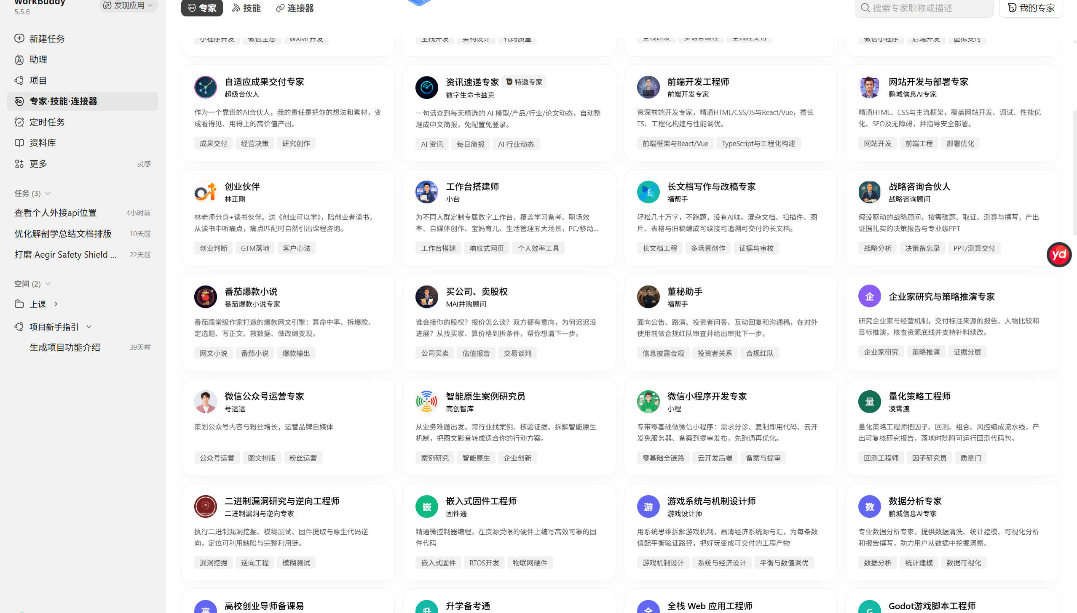
WorkBuddy experts
User-supplied screenshot. Guidance shown; deployment completion not established.

Slide 11
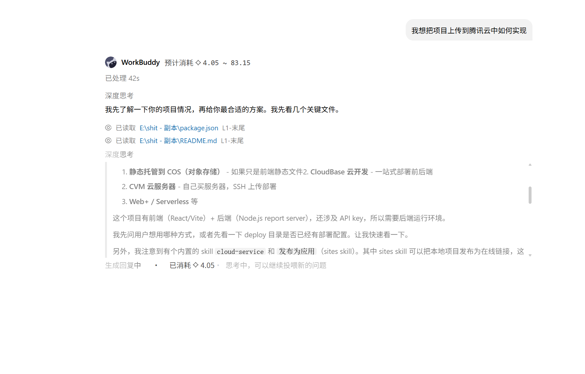
Deployment guidance in WorkBuddy
User-supplied screenshot. Guidance shown; deployment completion not established.

