Slide 1
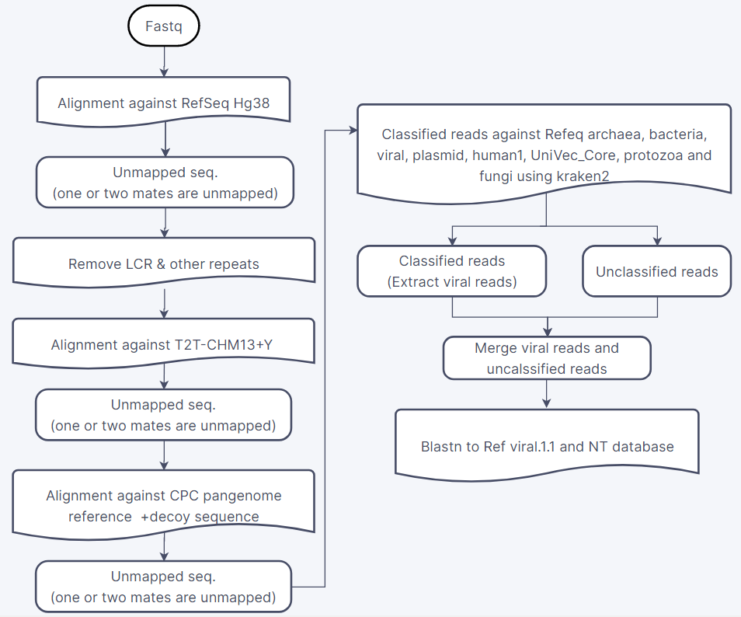
为了了解我们母婴间血液中病毒组的情况，我们试图用20个母子对（40个样本）的血液WGS数据来进行病毒组图谱和病毒整合分析。
鉴于以往的相关研究方法，我们的研究方法是：
病毒组分析：剔除掉人基因组序列，以及剔除注释在细菌、古细菌、真菌和质粒相关序列，用剩下的序列进一步比对注释到病毒基因组中。
病毒整合分析：提取hg38.bam中的unmapped和softclip reads，在比对到病毒基因组上，通过比对上的相同reads ID来定位整合位点。
后面分析发现，在直接通过比对pangenome基因组去除后，人基因组相关的序列已经很少了，便省略了去除重复序列和T2T比对的步骤

Slide 2
通过分析，主要有以下几点分析结果：
病毒组分析：
去除掉非病毒序列后，kraken2注释和blastn比对结果发现这些序列主要注释在噬菌体上；存在极少的具有研究价值的TTV，HHV，HPV和HERV病毒，但覆盖度很低（<10%），而EBV和Dengue几乎不存在（40个样本数据中仅有一条序列blastn到EBV）
病毒在hg38上的整合分析：
整合分析发现，40个样本每个样本可能存在1000个左右的病毒在hg38中发生整合
在可能发生整合的病毒中，覆盖度超过50%的仅有10个左右，甚至在大部分样本中，只有人内源性逆转录病毒K113覆盖度达到50%
从hg38整合位点注释结果发现，这些可能的整合区域主要位于基因间区和内含子区域，且这些区域与Repeats区域高度重叠（~90%）

Slide 3
未比上人基因组的序列在两个病毒中的比对情况：20个母子对，40个样本有25个样本有序列比上了EBV；但40个样本没有一个样本的序列比对上了Dengue virus。
母子对 | MotherID |  |  |  | ChildID |  |  |  | City /Project
 | Sample | num_seqs | sum_len | len: min /avg /max | Sample | num_seqs | sum_len | len: min /avg /max
1 | 00115071023M16BFF2 Total | 227,124,280 | 22,696,411,992 | 50 /99.9 /100 | 15103690BFF2 Total | 189,017,512 | 18,893,208,318 | 50 /100 /100 | Guang zhou
 | 00115071023M16BFF2 Unmapped against Human | 434,772 | 42,643,098 | 50 /98.1 /100 | 15103690BFF2 Unmapped against Human | 417,106 | 40,388,622 | 50 /96.8 /100
 | 00115071023M16BFF2 mapped against EBV | 3 | 121 |  | 15103690BFF2 mapped against EBV | 5 | 287
2 | 00115091030M19BFF2 Total | 201,896,088 | 20,180,207,868 | 50 /100 /100 | 16200323BFF2 Total | 164,521,926 | 16,430,952,272 | 50 /99.9 /100
 | 00115091030M19BFF2 Unmapped against Human | 935,386 | 91,967,638 | 50 /98.3 /100 | 16200323BFF2 Unmapped against Human | 306,718 | 30,025,760 | 50 /97.9 /100
 | 00115091030M19BFF2 mapped against EBV | 3 | 175 |  |  | 1 | 58
3 | 00116081415M13BFF2 Total | 215,815,756 | 21,570,952,804 | 50 /100 /100 | 17200418BFF2 Total | 206,436,544 | 20,634,605,470 | 50 /100 /100
 | 00116081415M13BFF2 Unmapped against Human | 286,330 | 25,370,402 | 50 /88.6 /100 | 17200418BFF2 Unmapped against Human | 390,922 | 38,673,124 | 50 /98.9 /100
 |  |  |  |  |  | 1 | 65
4 | 00114031182M22BFF2 Total | 186,797,844 | 18,672,560,510 | 50 /100 /100 | 14201404BFF2 Total | 217,558,420 | 21,739,914,856 | 50 /99.9 /100
 | 00114031182M22BFF2 Unmapped against Human | 405,270 | 39,537,124 | 50 /97.6 /100 | 14201404BFF2 Unmapped against Human | 253,508 | 23,450,684 | 50 /92.5 /100
5 | 00114071065M17BFF2 Total | 196,211,224 | 19,605,303,662 | 50 /99.9 /100 | 14202093BFF2 Total | 188,123,464 | 18,801,688,412 | 50 /99.9 /100
 | 00114071065M17BFF2 Unmapped against Human | 1,150,220 | 111,587,054 | 50 /97 /100 | 14202093BFF2 Unmapped against Human | 219,164 | 20,269,904 | 50 /92.5 /100
 |  | 2 | 102 |  |  | 2 | 112
6 | 00114121376M16BFF2 Total | 220,341,784 | 22,023,054,240 | 50 /99.9 /100 | 15101696BFF2 Total | 201,819,680 | 20,168,346,208 | 50 /99.9 /100
 | 00114121376M16BFF2 Unmapped against Human | 360,716 | 32,967,872 | 50 /91.4 /100 | 15101696BFF2 Unmapped against Human | 649,920 | 62,900,294 | 50 /96.8 /100
 |  |  |  |  |  | 1 | 53
7 | 00115031271M16BFF2 Total | 203,943,562 | 20,387,359,172 | 50 /100 /100 | 15102929BFF2 Total | 206,353,994 | 20,602,223,884 | 50 /99.8 /100 | Shijiazhuang
 | 00115031271M16BFF2 Unmapped against Human | 452,320 | 44,298,308 | 50 /97.9 /100 | 15102929BFF2 Unmapped against Human | 286,520 | 25,746,812 | 50 /89.9 /100
 |  | 4 | 179
8 | 00115061198M19BFF2 Total | 179,068,316 | 17,898,652,822 | 50 /100 /100 | 15103432BFF2 Total | 213,140,102 | 21,289,124,050 | 50 /99.9 /100
 | 00115061198M19BFF2 Unmapped against Human | 264,546 | 24,812,260 | 50 /93.8 /100 | 15103432BFF2 Unmapped against Human | 500,452 | 47,094,348 | 50 /94.1 /100
 |  | 1 | 36 |  |  | 2 | 100
9 | 00115021004M24BFF2 Total | 231,336,672 | 23,114,727,358 | 50 /99.9 /100 | 15102304BFF2 Total | 158,196,204 | 15,791,817,524 | 50 /99.8 /100
 | 00115021004M24BFF2 Unmapped against Human | 993,044 | 97,499,422 | 50 /98.2 /100 | 15102304BFF2 Unmapped against Human | 307,042 | 26,710,368 | 50 /87 /100
 |  |  |  |  |  | 1 | 53
10 | 00115061183M24BFF2 Total | 180,297,380 | 18,022,520,686 | 50 /100 /100 | 15103341BFF2 Total | 191,843,314 | 19,162,858,974 | 50 /99.9 /100 | Beijing
 | 00115061183M24BFF2 Unmapped against Human | 292,636 | 28,080,922 | 50 /96 /100 | 15103341BFF2 Unmapped against Human | 269,994 | 25,428,940 | 50 /94.2 /100
 |  |  |  |  | 15103341BFF2 mapped against EBV | 2 | 70
11 | 00116021188M27BFF2A Total | 666,933,018 | 100,039,952,700 | 150 /150 /150 | 16201278BFF2A Total | 600,271,552 | 90,040,732,800 | 150 /150 /150 | 早期早产
 | 00116021188M27BFF2A Unmapped against Human | 269,866 | 40,479,900 | 150 /150 /150 | 16201278BFF2A Unmapped against Human | 707,538 | 106,130,700 | 150 /150 /150
 |  | 2 | 76 |  |  | 5 | 217
12 | 00116021276M31BFF2A Total | 667,295,648 | 100,094,347,200 | 150 /150 /150 | 16201470BFF2A Total | 600,036,472 | 90,005,470,800 | 150 /150 /150
 | 00116021276M31BFF2A Unmapped against Human | 307,394 | 46,109,100 | 150 /150 /150 | 16201470BFF2A Unmapped against Human | 238,206 | 35,730,900 | 150 /150 /150
 |  | 2 | 80
13 | 00116031021M18BFF2A Total | 668,366,320 | 100,254,948,000 | 150 /150 /150 | 16100898BFF2A Total | 600,140,984 | 90,021,147,600 | 150 /150 /150
 | 00116031021M18BFF2A Unmapped against Human | 273,530 | 41,029,500 | 150 /150 /150 | 16100898BFF2A Unmapped against Human | 617,476 | 92,621,400 | 150 /150 /150
 |  | 2 | 108 |  | 16100898BFF2A Mapped against EBV | 1 | 32
14 | 00116049027M18BFF2A Total | 667,070,722 | 100,060,608,300 | 150 /150 /150 | 16201785BFF2B Total | 668,109,364 | 100,216,404,600 | 150 /150 /150
 | 00116049027M18BFF2A Unmapped against Human | 315,272 | 47,290,800 | 150 /150 /150 | 16201785BFF2B Unmapped against Human | 451,948 | 67,792,200 | 150 /150 /150
 |  | 2 | 78 |  |  | 6 | 680
15 | 00116059209M31BFF2A Total | 667,015,118 | 100,052,267,700 | 150 /150 /150 | 16202500BFF2A Total | 601,187,288 | 90,178,093,200 | 150 /150 /150
 | 00116059209M31BFF2A Unmapped against Human | 298,524 | 44,778,600 | 150 /150 /150 | 16202500BFF2A Unmapped against Human | 573,710 | 86,056,500 | 150 /150 /150
 |  |  |  |  |  | 10 | 410
16 | 00116091015M29BFF2B Total | 668,169,834 | 100,225,475,100 | 150 /150 /150 | 16103197BFF2A Total | 601,218,516 | 90,182,777,400 | 150 /150 /150
 | 00116091015M29BFF2B Unmapped against Human | 344,266 | 51,639,900 | 150 /150 /150 | 16103197BFF2A Unmapped against Human | 1,147,966 | 172,194,900 | 150 /150 /150
 | 00116091015M29BFF2B mapped against EBV | 2 | 65 |  | 16103197BFF2A mapped against EBV | 4 | 239
17 | 00116101167M31BFF2A Total | 667,044,200 | 100,056,630,000 | 150 /150 /150 | 17200395BFF2A Total | 601,076,450 | 90,161,467,500 | 150 /150 /150
 | 00116101167M31BFF2A Unmapped against Human | 278,778 | 41,816,700 | 150 /150 /150 | 17200395BFF2A Unmapped against Human | 359,936 | 53,990,400 | 150 /150 /150
18 | 00118081286M17BFF2A Total | 668,003,294 | 100,200,494,100 | 150 /150 /150 | 18104501BFF2A Total | 667,395,394 | 100,109,309,100 | 150 /150 /150
 | 00118081286M17BFF2A Unmapped against Human | 261,912 | 39,286,800 | 150 /150 /150 | 18104501BFF2A Unmapped against Human | 271,478 | 40,721,700 | 150 /150 /150
 |  | 2 | 67 |  |  | 3 | 133
19 | 00118121343M28BFF2A Total | 668,103,964 | 100,215,594,600 | 150 /150 /150 | 19105545BFF2B Total | 666,736,096 | 100,010,414,400 | 150 /150 /150
 | 00118121343M28BFF2A Unmapped against Human | 279,094 | 41,864,100 | 150 /150 /150 | 19105545BFF2B Unmapped against Human | 364,174 | 54,626,100 | 150 /150 /150
20 | 00119051646M32BFF2A Total | 666,955,196 | 100,043,279,400 | 150 /150 /150 | 19201150BFF2A Total | 667,205,400 | 100,080,810,000 | 150 /150 /150
 | 00119051646M32BFF2A Unmapped against Human | 260,998 | 39,149,700 | 150 /150 /150 | 19201150BFF2A Unmapped against Human | 362,972 | 54,445,800 | 150 /150 /150
EBV 和 Dengue的病毒分析：
为了探究我们WGS数据中是否存在明显的EBD和Dengue 病毒序列，选取了20个母子对进行分析统计；通过提取未必对上hg38的序列，进一步使用bwa mem比对到EBV和Dengue病毒序列上，发现：
1.未比上人基因组的序列在两个病毒中的比对情况：20个母子对，40个样本有25个样本有1-10条序列比上了EBV(高亮的行表示注释在EBV上的信息)；但40个样本没有一个样本的序列比对上了Dengue virus。

Slide 4
40个样本逐步剔除病毒外序列后的数量：unmapped:未比上HG38的序列； rm pg：除去比上pangenome后的序列；remanent：除去细菌、古细菌、真菌和质粒后的剩余序列。
6x |  |  |  |  |  |  | 30x
file | type | num_seqs （paired） | sum_len | min_len | avg_len | max_len | file | type | num_seqs（paired） | sum_len | min_len | avg_len | max_len
00114031182M22BFF2 | unmapped | 202,642 | 19,769,262 | 50 | 97.6 | 100 | 00116021188M27BFF2A | unmapped | 134,935 | 20,240,250 | 150 | 150 | 150
 | rm pg | 165,854 | 16,090,930 | 50 | 97 | 100 |  | rm pg | 37,550 | 5,632,500 | 150 | 150 | 150
 | remanent | 122,674 | 11,776,287 | 50 | 96 | 100 |  | remanent | 36,524 | 5,478,600 | 150 | 150 | 150
00114071065M17BFF2 | unmapped | 575,112 | 55,793,727 | 50 | 97 | 100 | 00116021276M31BFF2A | unmapped | 153,699 | 23,054,850 | 150 | 150 | 150
 | rm pg | 486,649 | 47,675,863 | 50 | 98 | 100 |  | rm pg | 51,081 | 7,662,150 | 150 | 150 | 150
 | remanent | 274,040 | 26,460,065 | 50 | 96.6 | 100 |  | remanent | 49,352 | 7,402,800 | 150 | 150 | 150
00114121376M16BFF2 | unmapped | 180,358 | 16,483,936 | 50 | 91.4 | 100 | 00116031021M18BFF2A | unmapped | 136,768 | 20,515,200 | 150 | 150 | 150
 | rm pg | 108,601 | 10,419,839 | 50 | 95.9 | 100 |  | rm pg | 31,910 | 4,786,500 | 150 | 150 | 150
 | remanent | 103,702 | 9,930,722 | 50 | 95.8 | 100 |  | remanent | 28,077 | 4,211,550 | 150 | 150 | 150
00115021004M24BFF2 | unmapped | 496,523 | 48,749,811 | 50 | 98.2 | 100 | 00116049027M18BFF2A | unmapped | 157,639 | 23,645,850 | 150 | 150 | 150
 | rm pg | 408,813 | 40,535,480 | 50 | 99.2 | 100 |  | rm pg | 51,563 | 7,734,450 | 150 | 150 | 150
 | remanent | 224,055 | 22,098,761 | 50 | 98.6 | 100 |  | remanent | 41,321 | 6,198,150 | 150 | 150 | 150
00115031271M16BFF2 | unmapped | 226,164 | 22,149,554 | 50 | 97.9 | 100 | 00116059209M31BFF2A | unmapped | 149,263 | 22,389,450 | 150 | 150 | 150
 | rm pg | 167,971 | 16,557,586 | 50 | 98.6 | 100 |  | rm pg | 47,852 | 7,177,800 | 150 | 150 | 150
 | remanent | 106,989 | 10,465,822 | 50 | 97.8 | 100 |  | remanent | 46,150 | 6,922,500 | 150 | 150 | 150
00115061183M24BFF2 | unmapped | 146,319 | 14,040,561 | 50 | 96 | 100 | 00116091015M29BFF2B | unmapped | 172,135 | 25,820,250 | 150 | 150 | 150
 | rm pg | 96,752 | 9,525,361 | 50 | 98.5 | 100 |  | rm pg | 72,073 | 10,810,950 | 150 | 150 | 150
 | remanent | 90,691 | 8,920,246 | 50 | 98.4 | 100 |  | remanent | 68,180 | 10,227,000 | 150 | 150 | 150
00115061198M19BFF2 | unmapped | 132,274 | 12,406,230 | 50 | 93.8 | 100 | 00116101167M31BFF2A | unmapped | 139,390 | 20,908,500 | 150 | 150 | 150
 | rm pg | 75,726 | 7,494,611 | 50 | 99 | 100 |  | rm pg | 30,169 | 4,525,350 | 150 | 150 | 150
 | remanent | 71,703 | 7,092,713 | 50 | 98.9 | 100 |  | remanent | 28,394 | 4,259,100 | 150 | 150 | 150
00115071023M16BFF2 | unmapped | 217,388 | 21,321,749 | 50 | 98.1 | 100 | 00118081286M17BFF2A | unmapped | 130,960 | 19,644,000 | 150 | 150 | 150
 | rm pg | 153,697 | 15,211,569 | 50 | 99 | 100 |  | rm pg | 31,439 | 4,715,850 | 150 | 150 | 150
 | remanent | 94,655 | 9,318,295 | 50 | 98.4 | 100 |  | remanent | 29,342 | 4,401,300 | 150 | 150 | 150
00115091030M19BFF2 | unmapped | 467,695 | 45,984,019 | 50 | 98.3 | 100 | 00118121343M28BFF2A | unmapped | 139,549 | 20,932,350 | 150 | 150 | 150
 | rm pg | 396,779 | 39,264,701 | 50 | 99 | 100 |  | rm pg | 32,581 | 4,887,150 | 150 | 150 | 150
 | remanent | 221,095 | 21,712,960 | 50 | 98.2 | 100 |  | remanent | 31,152 | 4,672,800 | 150 | 150 | 150
00116081415M13BFF2 | unmapped | 143,165 | 12,685,201 | 50 | 88.6 | 100 | 00119051646M32BFF2A | unmapped | 130,500 | 19,575,000 | 150 | 150 | 150
 | rm pg | 92,326 | 7,817,640 | 50 | 84.7 | 100 |  | rm pg | 25,808 | 3,871,200 | 150 | 150 | 150
 | remanent | 88,793 | 7,465,049 | 50 | 84.1 | 100 |  | remanent | 24,873 | 3,730,950 | 150 | 150 | 150
14201404BFF2 | unmapped | 126,754 | 11,725,342 | 50 | 92.5 | 100 | 16100898BFF2A | unmapped | 308,738 | 46,310,700 | 150 | 150 | 150
 | rm pg | 72,145 | 6,637,494 | 50 | 92 | 100 |  | rm pg | 133,010 | 19,951,500 | 150 | 150 | 150
 | remanent | 66,769 | 6,102,612 | 50 | 91.4 | 100 |  | remanent | 35,582 | 5,337,300 | 150 | 150 | 150
14202093BFF2 | unmapped | 109,584 | 10,135,152 | 50 | 92.5 | 100 | 16103197BFF2A | unmapped | 573,986 | 86,097,900 | 150 | 150 | 150
 | rm pg | 51,750 | 5,007,576 | 50 | 96.8 | 100 |  | rm pg | 369,389 | 55,408,350 | 150 | 150 | 150
 | remanent | 48,630 | 4,696,599 | 50 | 96.6 | 100 |  | remanent | 81,611 | 12,241,650 | 150 | 150 | 150
15101696BFF2 | unmapped | 324,961 | 31,450,247 | 50 | 96.8 | 100 | 16201278BFF2A | unmapped | 353,775 | 53,066,250 | 150 | 150 | 150
 | rm pg | 198,444 | 19,258,472 | 50 | 97 | 100 |  | rm pg | 202,897 | 30,434,550 | 150 | 150 | 150
 | remanent | 113,978 | 10,819,423 | 50 | 94.9 | 100 |  | remanent | 49,864 | 7,479,600 | 150 | 150 | 150
15102304BFF2 | unmapped | 153,522 | 13,355,284 | 50 | 87 | 100 | 16201470BFF2A | unmapped | 119,103 | 17,865,450 | 150 | 150 | 150
 | rm pg | 98,429 | 8,742,102 | 50 | 88.8 | 100 |  | rm pg | 32,305 | 4,845,750 | 150 | 150 | 150
 | remanent | 72,534 | 6,155,738 | 50 | 84.9 | 100 |  | remanent | 24,404 | 3,660,600 | 150 | 150 | 150
15102929BFF2 | unmapped | 143,260 | 12,873,406 | 50 | 89.9 | 100 | 16201785BFF2B | unmapped | 225,981 | 33,897,150 | 150 | 150 | 150
 | rm pg | 71,878 | 6,955,960 | 50 | 96.8 | 100 |  | rm pg | 78,604 | 11,790,600 | 150 | 150 | 150
 | remanent | 58,686 | 5,641,591 | 50 | 96.1 | 100 |  | remanent | 67,679 | 10,151,850 | 150 | 150 | 150
15103341BFF2 | unmapped | 134,997 | 12,714,470 | 50 | 94.2 | 100 | 16202500BFF2A | unmapped | 286,867 | 43,030,050 | 150 | 150 | 150
 | rm pg | 74,463 | 7,026,571 | 50 | 94.4 | 100 |  | rm pg | 151,078 | 22,661,700 | 150 | 150 | 150
 | remanent | 67,006 | 6,282,559 | 50 | 93.8 | 100 |  | remanent | 44,019 | 6,602,850 | 150 | 150 | 150
15103432BFF2 | unmapped | 250,229 | 23,547,474 | 50 | 94.1 | 100 | 17200395BFF2A | unmapped | 179,969 | 26,995,350 | 150 | 150 | 150
 | rm pg | 162,320 | 15,369,475 | 50 | 94.7 | 100 |  | rm pg | 40,633 | 6,094,950 | 150 | 150 | 150
 | remanent | 98,522 | 9,001,293 | 50 | 91.4 | 100 |  | remanent | 37,694 | 5,654,100 | 150 | 150 | 150
15103690BFF2 | unmapped | 208,558 | 20,194,811 | 50 | 96.8 | 100 | 18104501BFF2A | unmapped | 135,742 | 20,361,300 | 150 | 150 | 150
 | rm pg | 153,360 | 15,027,071 | 50 | 98 | 100 |  | rm pg | 28,551 | 4,282,650 | 150 | 150 | 150
 | remanent | 111,471 | 10,840,746 | 50 | 97.3 | 100 |  | remanent | 27,399 | 4,109,850 | 150 | 150 | 150
16200323BFF2 | unmapped | 153,367 | 15,013,680 | 50 | 97.9 | 100 | 19105545BFF2B | unmapped | 182,089 | 27,313,350 | 150 | 150 | 150
 | rm pg | 78,595 | 7,537,582 | 50 | 95.9 | 100 |  | rm pg | 76,714 | 11,507,100 | 150 | 150 | 150
 | remanent | 63,519 | 6,034,707 | 50 | 95 | 100 |  | remanent | 54,879 | 8,231,850 | 150 | 150 | 150
17200418BFF2 | unmapped | 195,463 | 19,336,762 | 50 | 98.9 | 100 | 19201150BFF2A | unmapped | 181,487 | 27,223,050 | 150 | 150 | 150
 | rm pg | 101,193 | 9,910,249 | 50 | 97.9 | 100 |  | rm pg | 43,042 | 6,456,300 | 150 | 150 | 150
 | remanent | 73,201 | 7,113,062 | 50 | 97.2 | 100 |  | remanent | 41,619 | 6,242,850 | 150 | 150 | 150
为了全面了解我们WGS数据中的病毒组情况，我们剔除人、细菌、古细菌、真菌和质粒相关序列，留下可能为病毒相关的序列。左边表格展示这些序列在每个样本中的具体信息。
40个样本逐步剔除病毒外序列后的数量：unmapped:未比上HG38的序列； rm pg：除去比上pangenome后的序列；remanent：除去细菌、古细菌、真菌和质粒后的剩余序列。

Slide 5
通过Kraken2和Blastn对剩下的序列进一步分析，统计每个样本中病毒物种的数量和相关的序列数量
每个样本注释到病毒物种的数量（total virus count）以及序列总数（total seq. count)
Depth | 6x |  |  | 30x
sample |  | total virus count | total seq. count | sample | total virus count | total seq. count
Mother | 00114031182M22BFF2 | 158 | 54632 | 00116021188M27BFF2A | 7 | 24
 | 00114071065M17BFF2 | 244 | 327038 | 00116021276M31BFF2A | 9 | 30
 | 00114121376M16BFF2 | 8 | 132 | 00116031021M18BFF2A | 44 | 117
 | 00115021004M24BFF2 | 223 | 296101 | 00116049027M18BFF2A | 13 | 31
 | 00115031271M16BFF2 | 166 | 90709 | 00116059209M31BFF2A | 12 | 36
 | 00115061183M24BFF2 | 21 | 131 | 00116091015M29BFF2B | 11 | 39
 | 00115061198M19BFF2 | 6 | 92 | 00116101167M31BFF2A | 6 | 20
 | 00115071023M16BFF2 | 161 | 85368 | 00118081286M17BFF2A | 6 | 23
 | 00115091030M19BFF2 | 235 | 270895 | 00118121343M28BFF2A | 11 | 19
 | 00116081415M13BFF2 | 5 | 62 | 00119051646M32BFF2A | 3 | 14
Child | 14201404BFF2 | 93 | 8299 | 16100898BFF2A | 13 | 41
 | 14202093BFF2 | 7 | 72 | 16103197BFF2A | 21 | 120
 | 15101696BFF2 | 182 | 58293 | 16201278BFF2A | 15 | 56
 | 15102304BFF2 | 89 | 9082 | 16201470BFF2A | 6 | 24
 | 15102929BFF2 | 76 | 4636 | 16201785BFF2B | 21 | 238
 | 15103341BFF2 | 66 | 1923 | 16202500BFF2A | 12 | 38
 | 15103432BFF2 | 109 | 36419 | 17200395BFF2A | 14 | 42
 | 15103690BFF2 | 90 | 17596 | 18104501BFF2A | 2 | 8
 | 16200323BFF2 | 119 | 16925 | 19105545BFF2B | 37 | 955
 | 17200418BFF2 | 133 | 34068 | 19201150BFF2A | 8 | 35

Slide 6
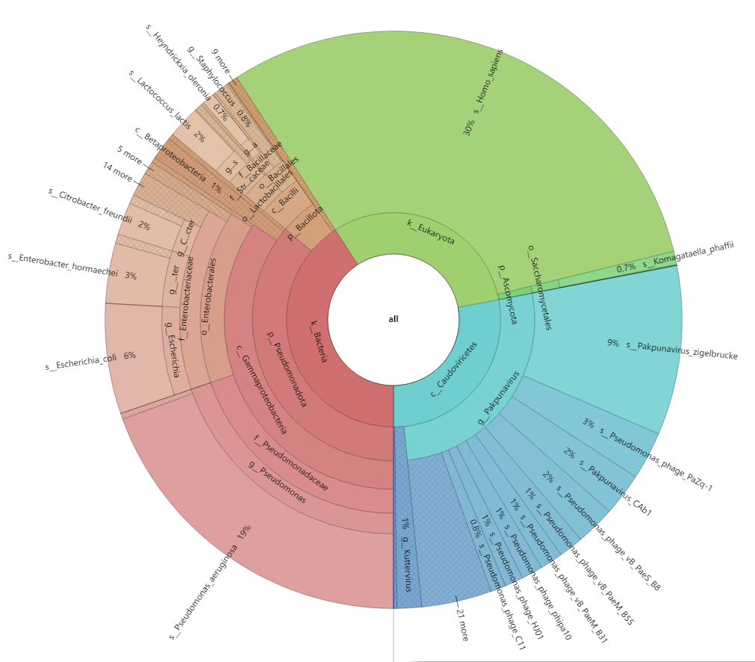
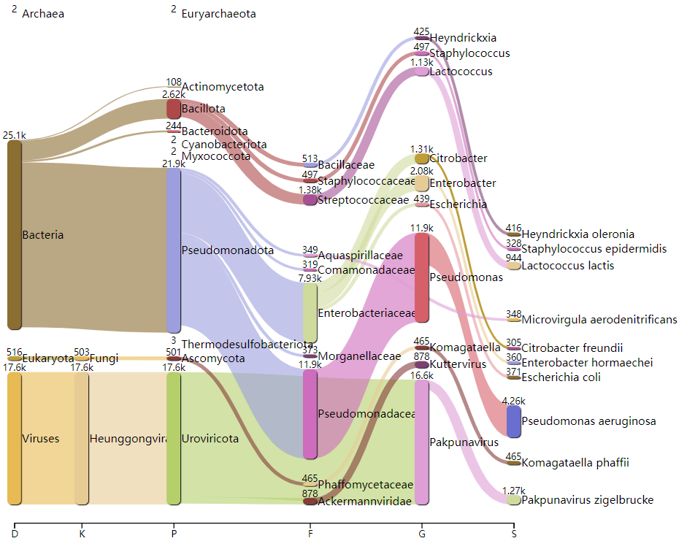
截取一个样本的病毒组情况（由kraken2分析得来），注释到的病毒主要是噬菌体门

Slide 7
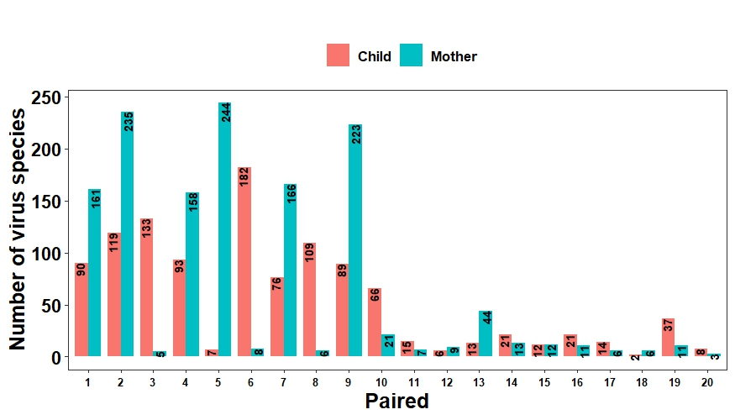
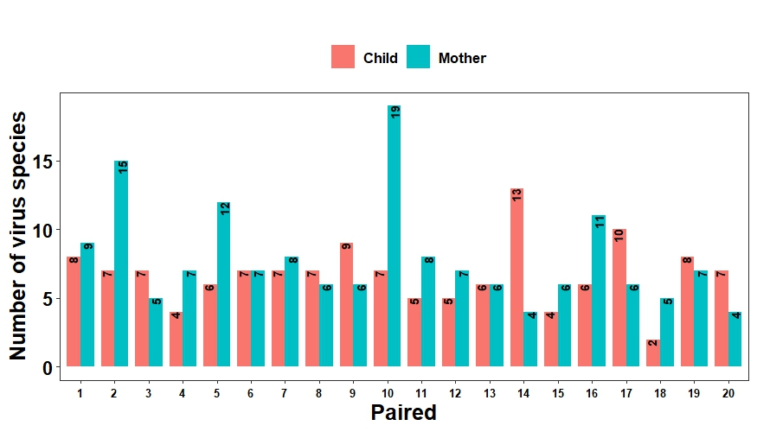
通过剔除掉大部分噬菌体，
观看剩下的病毒物种数量。
20个母子对，注释到的病毒物种的数量
剔除绝大部分噬菌体后，注释到的病毒物种的数量

Slide 8
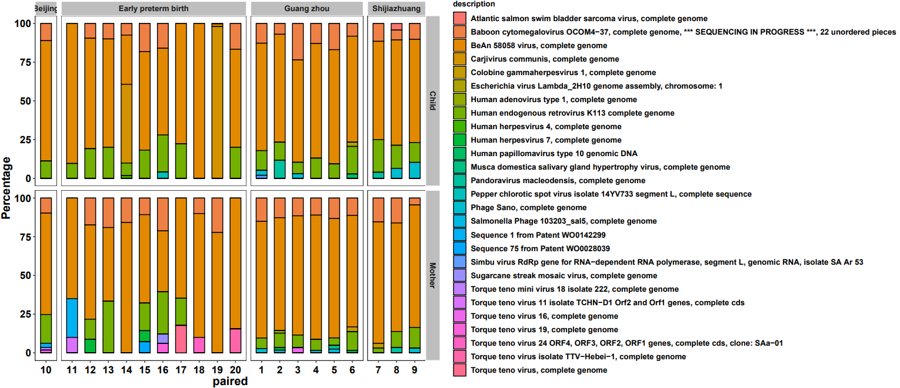
通过剔除掉大部分噬菌体，观看剩下的病毒物种。分析结果中存在的较少的TTV，HHV，HPV和HERV。

Slide 9
description | mother | child
Atlantic salmon swim bladder sarcoma virus, complete genome | 0 | 2
Baboon cytomegalovirus OCOM4-37 | 135 | 118
BeAn 58058 virus, complete genome | 810 | 658
Carjivirus communis, complete genome | 0 | 777
Colobine gammaherpesvirus 1, complete genome | 6 | 0
Escherichia virus Lambda_2H10 genome assembly, chromosome: 1 | 0 | 2
Human adenovirus type 1, complete genome | 2 | 0
Human endogenous retrovirus K113 complete genome | 117 | 137
Human herpesvirus 4, complete genome | 0 | 3
Human herpesvirus 7, complete genome | 8 | 0
Human papillomavirus type 10 genomic DNA | 0 | 2
Musca domestica salivary gland hypertrophy virus | 2 | 0
Pandoravirus macleodensis, complete genome | 3 | 7
Pepper chlorotic spot virus isolate 14YV733 segment L | 0 | 2
Phage Sano, complete genome | 8 | 14
Salmonella Phage 103203_sal5, complete genome | 2 | 0
Sequence 1 from Patent WO0142299 | 8 | 0
Sequence 75 from Patent WO0028039 | 2 | 0
Simbu virus RdRp gene for RNA-dependent RNA polymerase | 0 | 3
Sugarcane streak mosaic virus, complete genome | 2 | 0
Torque teno mini virus 18 isolate 222, complete genome | 2 | 0
Torque teno virus 11 isolate TCHN-D1 Orf2 and Orf1 genes | 2 | 0
Torque teno virus 16, complete genome | 4 | 0
Torque teno virus 19, complete genome | 2 | 0
Torque teno virus 24 ORF4, ORF3, ORF2, ORF1 genes | 2 | 0
Torque teno virus isolate TTV-Hebei-1, complete genome | 2 | 0
Torque teno virus, complete genome | 3 | 0
剔除绝大部分噬菌体后，对20个母亲和20个孩子注释到的病毒物种的reads统计，观察病毒在母亲和孩子中的一个有无情况

Slide 10
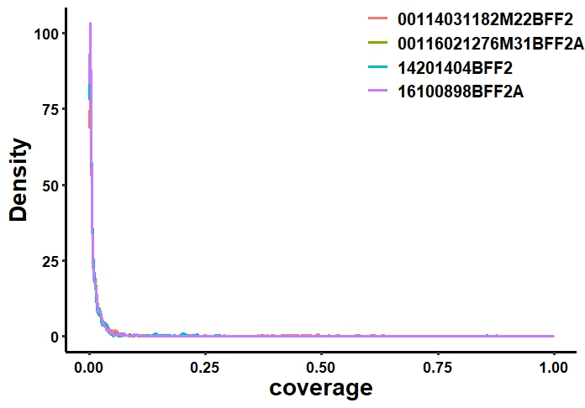
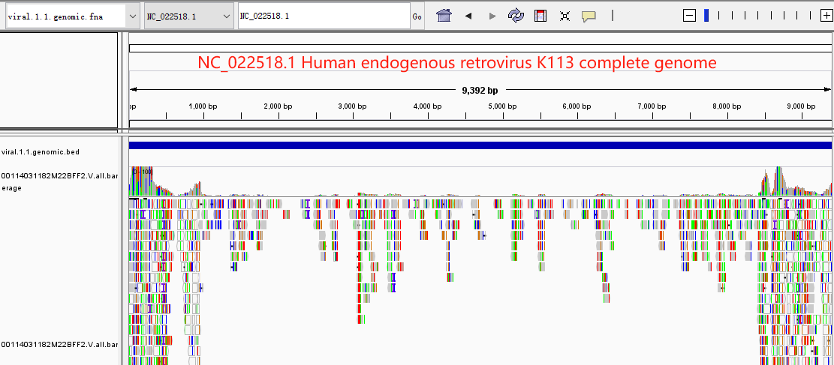
病毒整合在hg38的分析（用了4个样本）
1.提取hg38.bam中的unmapped和softclip reads，将这些reads比对到病毒基因组中（bwa -mem）
2.提取1.中比对到病毒的reads name，看这些reads在hg38中的比对情况
3.统计在病毒和hg38中都有比对的reads；病毒的覆盖情况；整合在hg38的位点注释和总长度
每个样本中可能发生整合的病毒，其覆盖度很低
sample | reads count (unmapped + softclip) | reads count (virus) | virus species count (Cov. > 0.5) / total | length integrated into Human | viurs integrated into Human (Cov. > 0.5) / total
00114031182M22BFF2 | 3,717,986 | 333,350 | 12 / 1317 | 36,315,754 | 12 / 1094
00116021276M31BFF2A | 17,666,384 | 1,499,712 | 1 / 1303 | 232,375,509 | 1 / 1293
14201404BFF2 | 3,392,510 | 260,831 | 1 / 1073 | 31,266,365 | 1 / 946
16100898BFF2A | 17,341,347 | 1,206,096 | 1 / 1350 | 186,592,294 | 1 /1275
12个覆盖度超过一半的病毒物种
>NC_022518.1 Human endogenous retrovirus K113 complete genome
>NC_042113.1 Pseudomonas phage vB_PaeM_C2-10_Ab02, complete genome
>NC_073617.1 Pseudomonas phage YS35, complete genome
>NC_073608.1 Pseudomonas phage Henu5, complete genome
>NC_073609.1 Pseudomonas phage vB_PaM_EPA1, complete genome
>NC_073619.1 Pseudomonas phage vB_PA45_GUMS, complete genome
>NC_073620.1 Pseudomonas phage phipa10, complete genome
>NC_073621.1 Pseudomonas phage vB_Paer_Ps12, complete genome
>NC_073615.1 Pseudomonas phage HJ01, complete genome
>NC_073614.1 Pseudomonas phage vB_PaeM_B31, complete genome
>NC_073616.1 Pseudomonas phage vB_PaeS_B8, complete genome
>NC_073618.1 Pseudomonas phage vB_PaeM_B55, complete genome

Slide 11
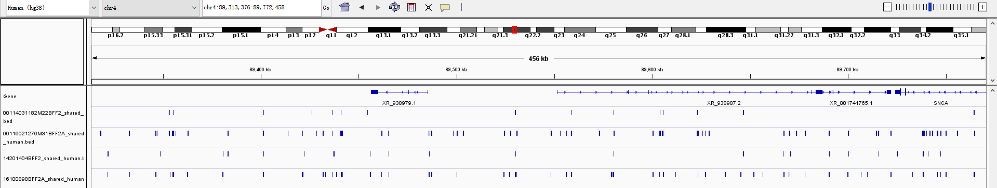
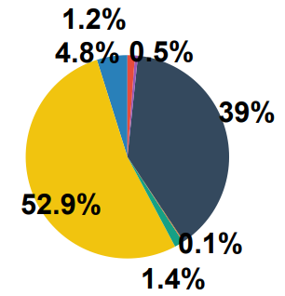
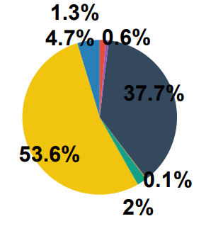
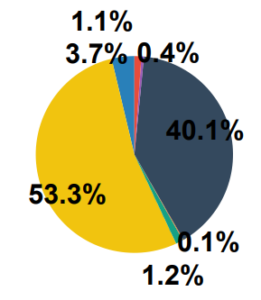
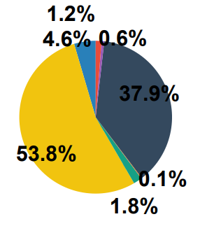
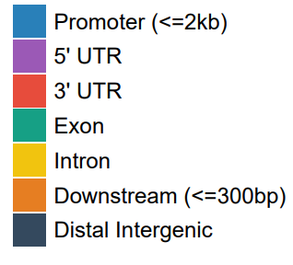
整合在hg38的位点注释
00114031182M22BFF2
00116021276M31BFF2A
14201404BFF2
16100898BFF2A
整合在hg38的位点与Repeats的overlap情况
Sample | 00114031182M22BFF2 | 00116021276M31BFF2A | 14201404BFF2 | 16100898BFF2A
Total region count | 328,789 | 1,140,397 | 277,068 | 929,881
Overlapped with Repeats | 294,308 | 1,004,499 | 253,175 | 838,762
Ratio | 89.51% | 88.08% | 91.38% | 90.20%

