Slide 1
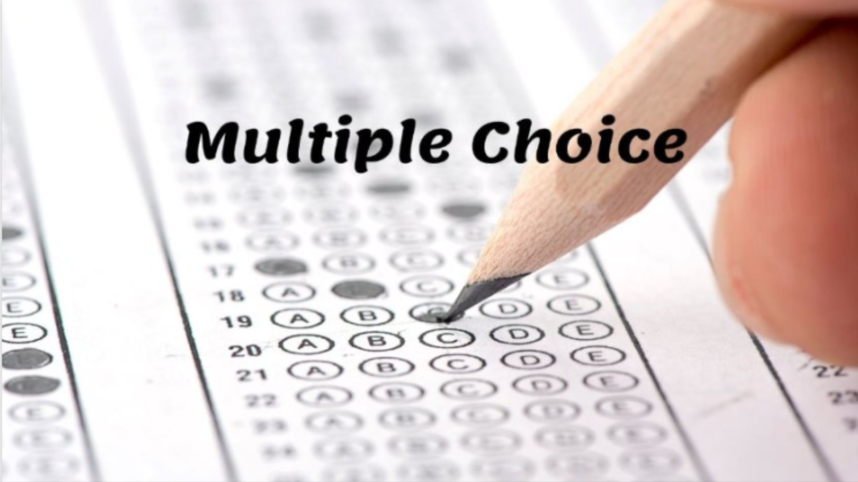

Slide 2
What is the capital of France?
A) London
B) Paris
C) Berlin
D) Madrid

Slide 3
Which planet is closest to the Sun?
A) Mercury
B) Venus
C) Earth
D) Mars

Slide 4
What year did WW2 end?
A) 1940
B) 1943
C) 1945
D) 1950

Slide 5
Who painted the Mona Lisa?
A) Picasso
B) Monet
C) Van Gogh
D) Da Vinci

Slide 6
What is H2O?
A) Water
B) Oxygen
C) Hydrogen
D) Helium

Slide 7
How many continents are there?
A) 5
B) 7
C) 6
D) 8

Slide 8
Which animal is known as mans best friend?
A) Cat
B) Horse
C) Dog
D) Fish

Slide 9
What is the largest ocean?
A) Pacific
B) Atlantic
C) Indian
D) Arctic

Slide 10
Who wrote Romeo and Juliet?
A) Dickens
B) Shakespeare
C) Austen
D) Twain

Slide 11
What color is a ruby?
A) Blue
B) Green
C) Yellow
D) Red

Slide 12
Multiple Choice
1. What is the capital of France?
2. Which planet is closest to the Sun?
3. What year did WW2 end?
4. Who painted the Mona Lisa?
5. What is H2O?
6. How many continents are there?
7. Which animal is known as mans best friend?
8. What is the largest ocean?
9. Who wrote Romeo and Juliet?
10. What color is a ruby?

Slide 14
1. B) Paris
2. A) Mercury
3. C) 1945
4. D) Da Vinci
5. A) Water
6. B) 7
7. C) Dog
8. A) Pacific
9. B) Shakespeare
10. D) Red

