Slide 1
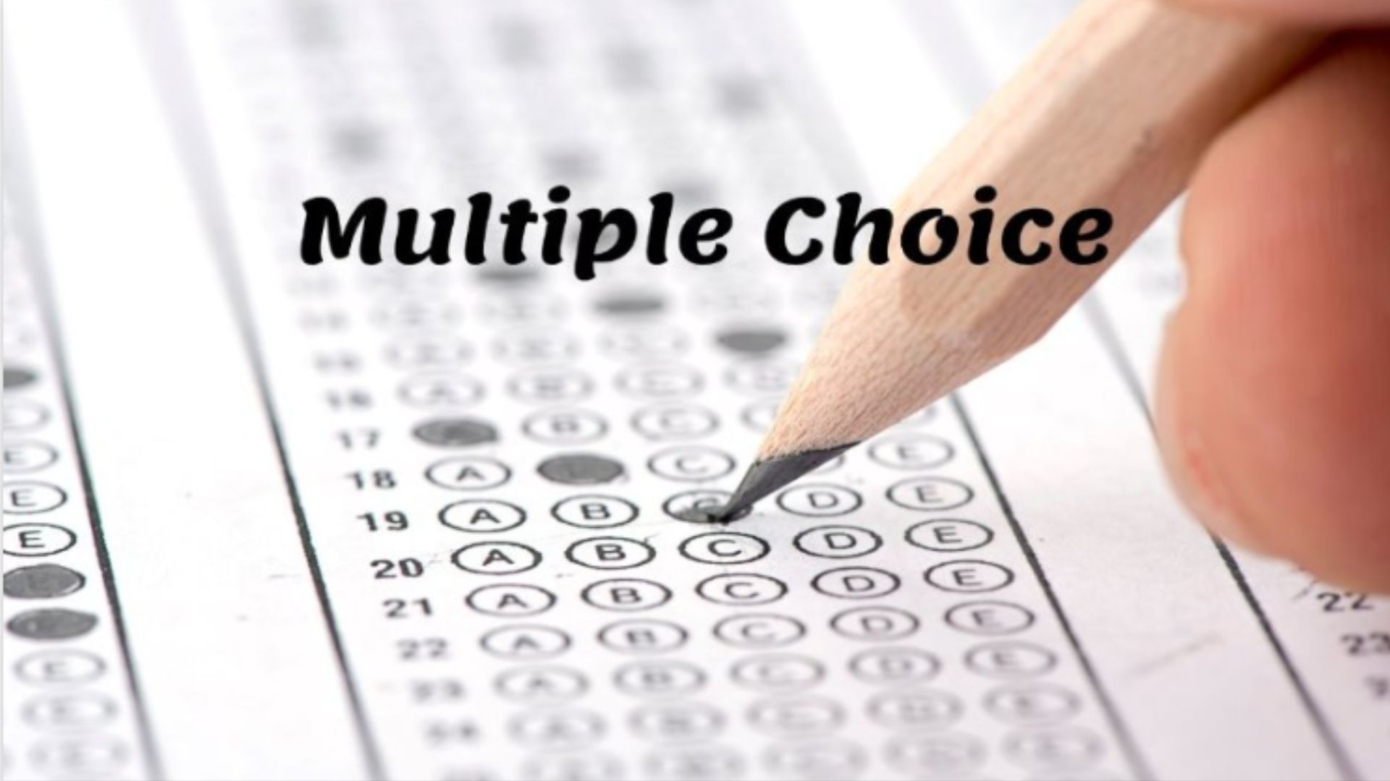

Slide 2
MC Question 1?
A) Answer 1
B) Wrong 1A
C) Wrong 1B
D) Wrong 1C

Slide 3
MC Question 2?
A) Answer 2
B) Wrong 2A
C) Wrong 2B
D) Wrong 2C

Slide 4
MC Question 3?
A) Answer 3
B) Wrong 3A
C) Wrong 3B
D) Wrong 3C

Slide 5
MC Question 4?
A) Answer 4
B) Wrong 4A
C) Wrong 4B
D) Wrong 4C

Slide 6
MC Question 5?
A) Answer 5
B) Wrong 5A
C) Wrong 5B
D) Wrong 5C

Slide 7
MC Question 6?
A) Answer 6
B) Wrong 6A
C) Wrong 6B
D) Wrong 6C

Slide 8
MC Question 7?
A) Answer 7
B) Wrong 7A
C) Wrong 7B
D) Wrong 7C

Slide 9
MC Question 8?
A) Answer 8
B) Wrong 8A
C) Wrong 8B
D) Wrong 8C

Slide 10
MC Question 9?
A) Answer 9
B) Wrong 9A
C) Wrong 9B
D) Wrong 9C

Slide 11
MC Question 10?
A) Answer 10
B) Wrong 10A
C) Wrong 10B
D) Wrong 10C

Slide 12
Multiple Choice
1. MC Question 1?
2. MC Question 2?
3. MC Question 3?
4. MC Question 4?
5. MC Question 5?
6. MC Question 6?
7. MC Question 7?
8. MC Question 8?
9. MC Question 9?
10. MC Question 10?

Slide 14
1. A) Answer 1
2. A) Answer 2
3. A) Answer 3
4. A) Answer 4
5. A) Answer 5
6. A) Answer 6
7. A) Answer 7
8. A) Answer 8
9. A) Answer 9
10. A) Answer 10

